Slide 1
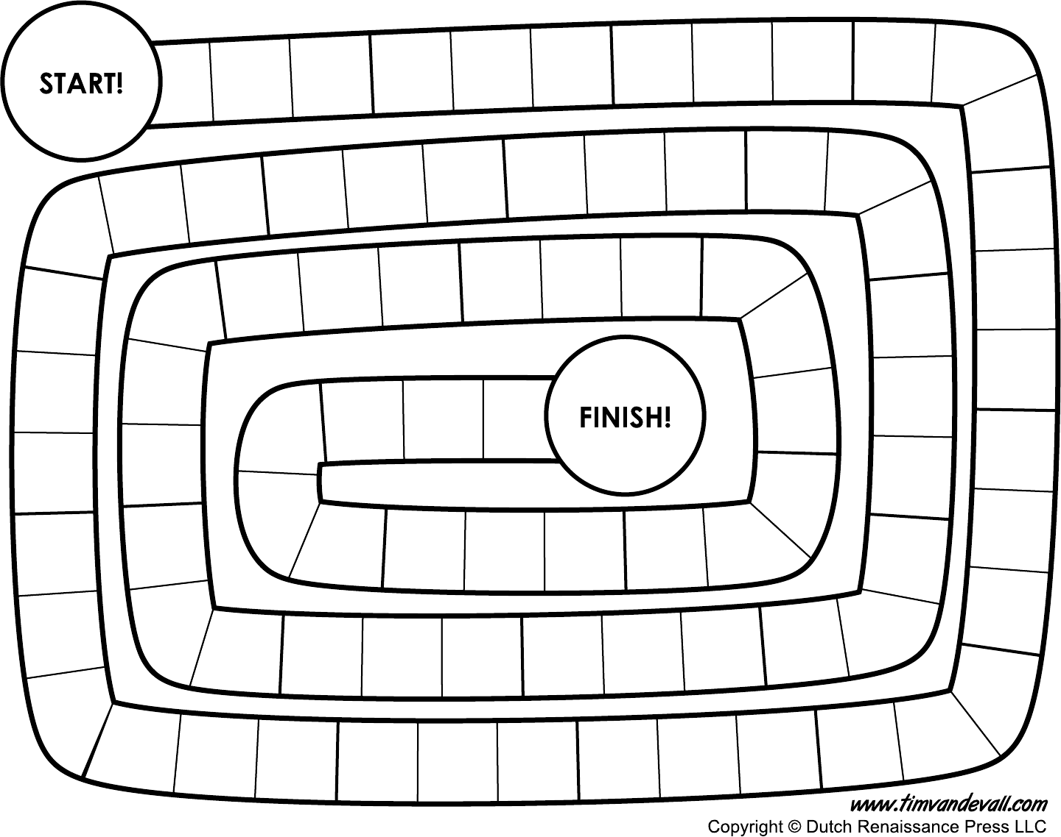

Slide 2
Draw a board like the one above and fill in the spaces with rules like: Go forward three spaces, move back two spaces, take a shortcut to square 17 and miss a go.
Decorate it with your own theme: space travel, superheroes, food, pets etc.
Make your own dice or spinner and write a rule on each part of the spinner or dice.

