Slide 1
WELCOME
to the
Preschool Playgroup
Run by Holy Trinity Church
Find us on Facebook
playgroup@htcchicago.org

Slide 2
K
N
G
the
I
is here!

Slide 3
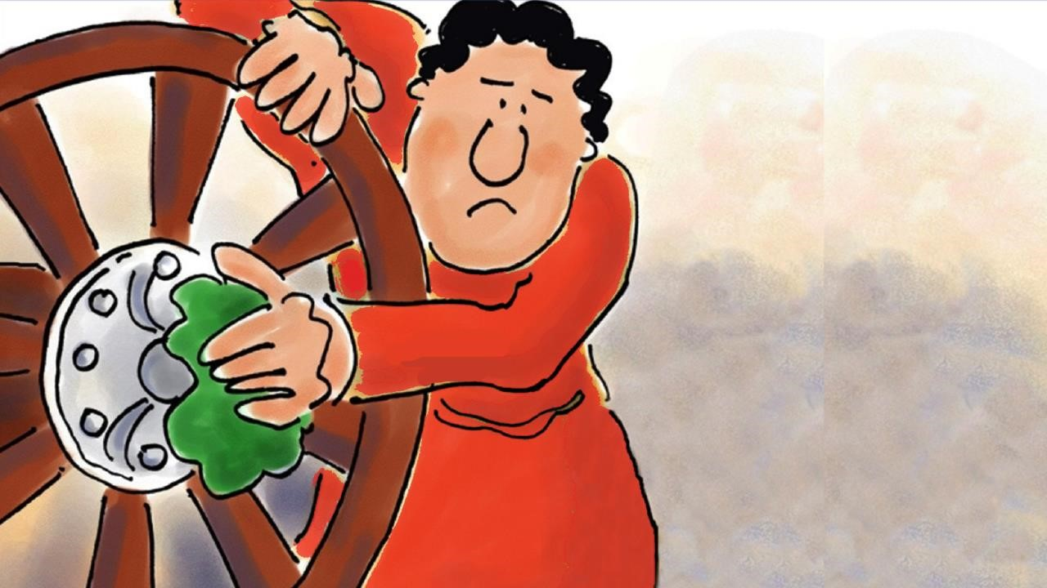

Slide 4
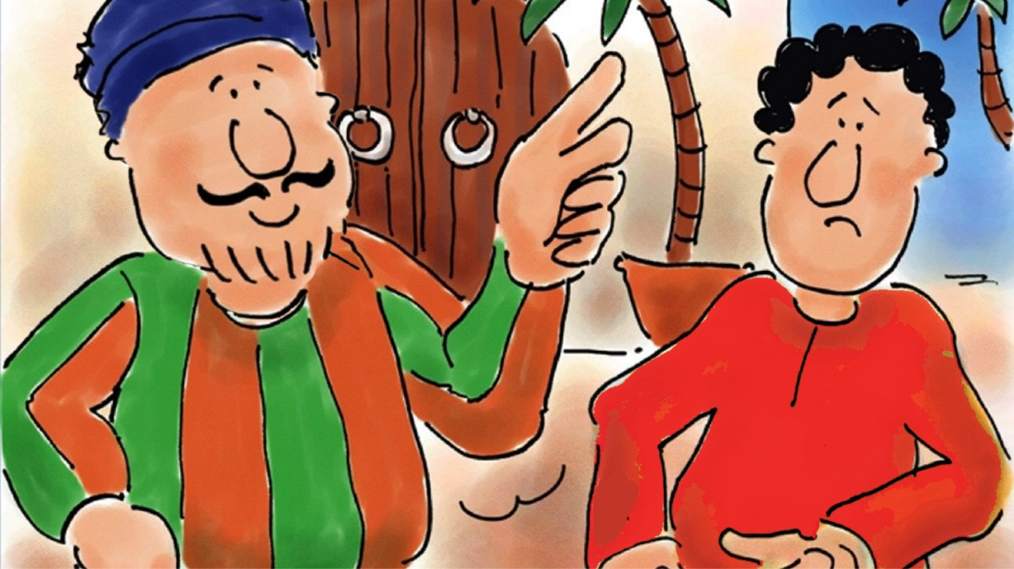

Slide 5
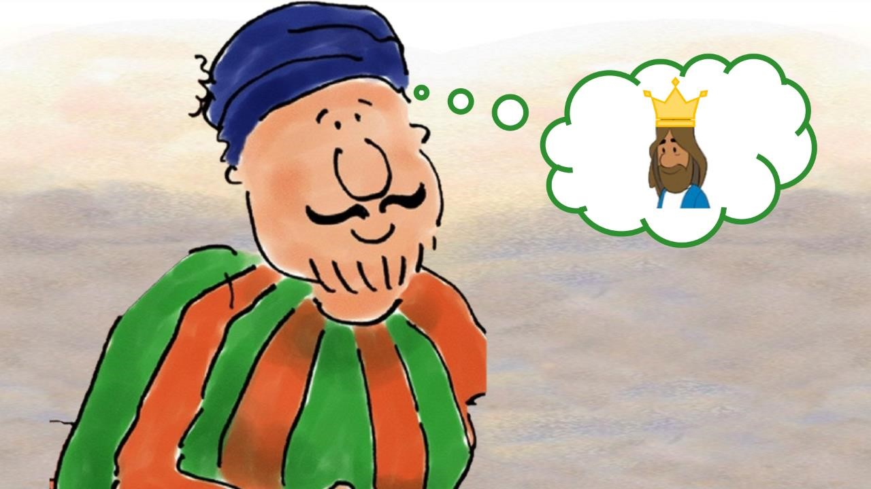

Slide 6
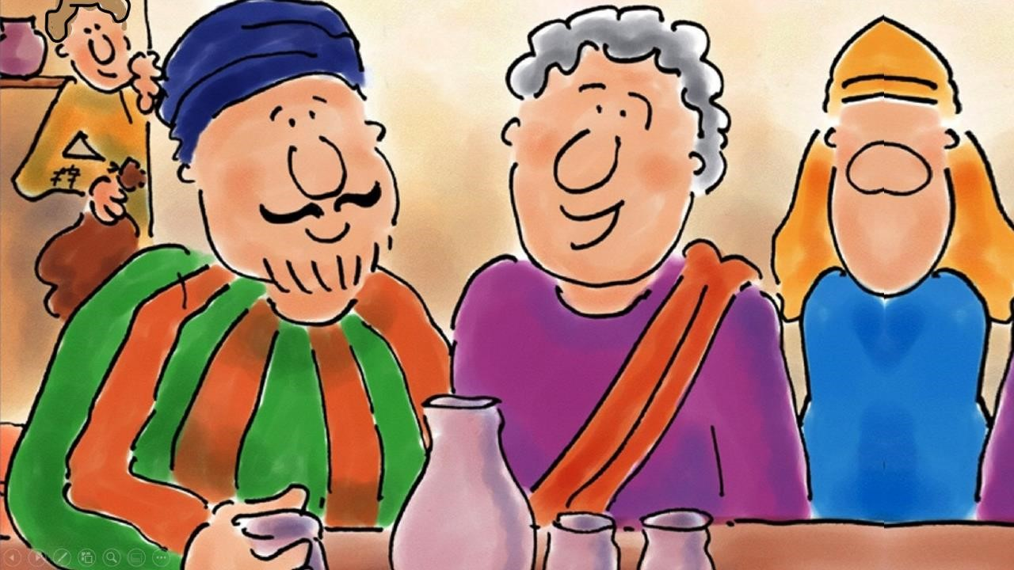

Slide 7
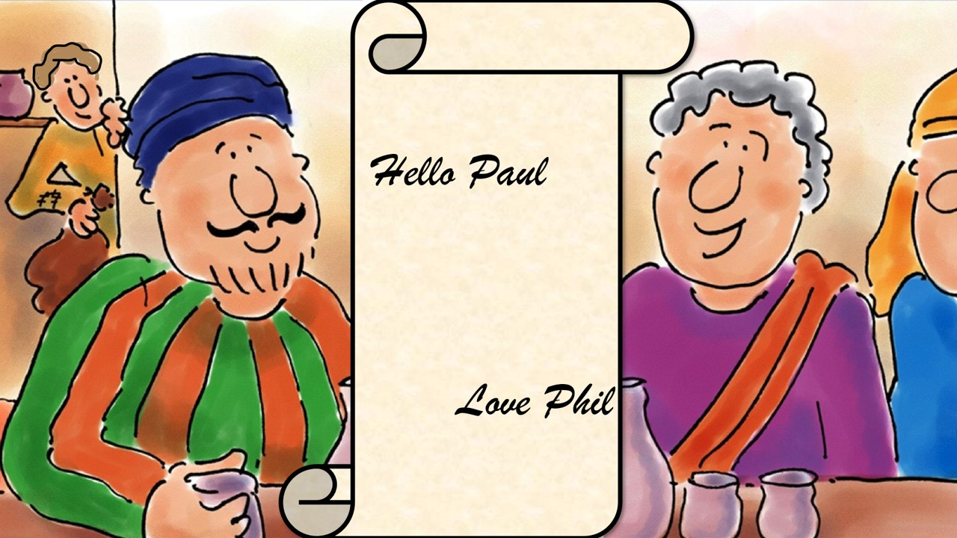

Slide 8
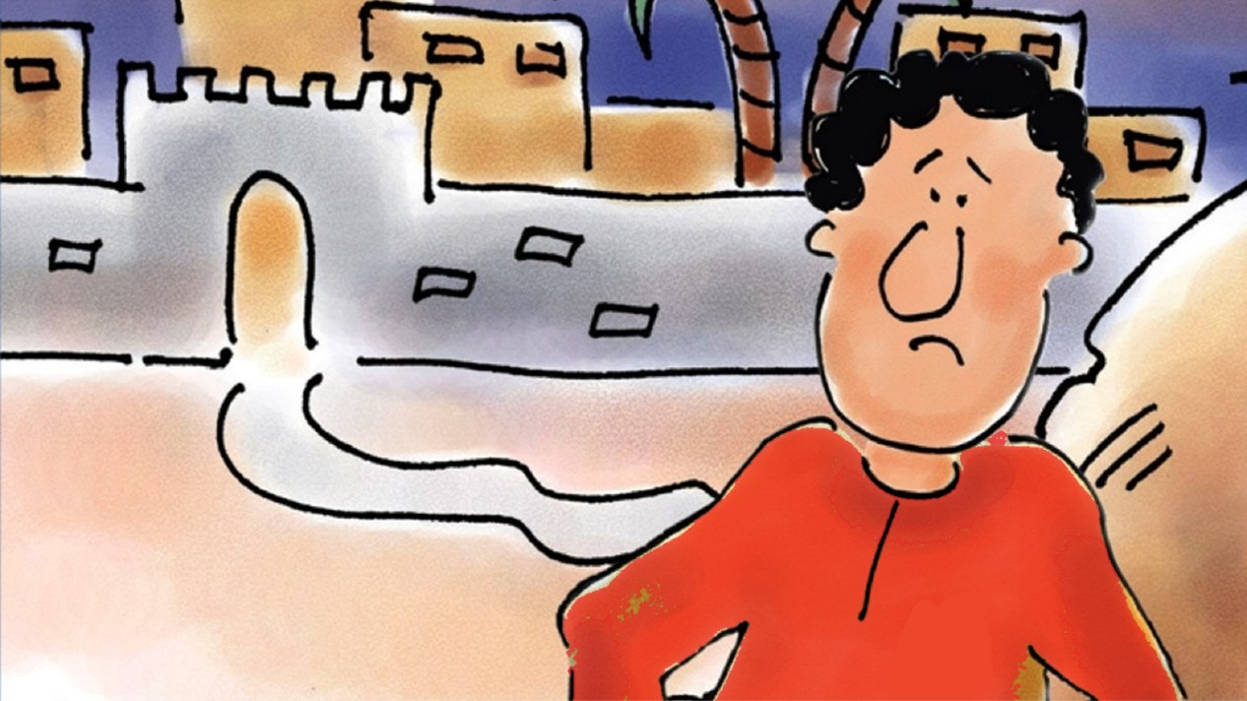

Slide 9
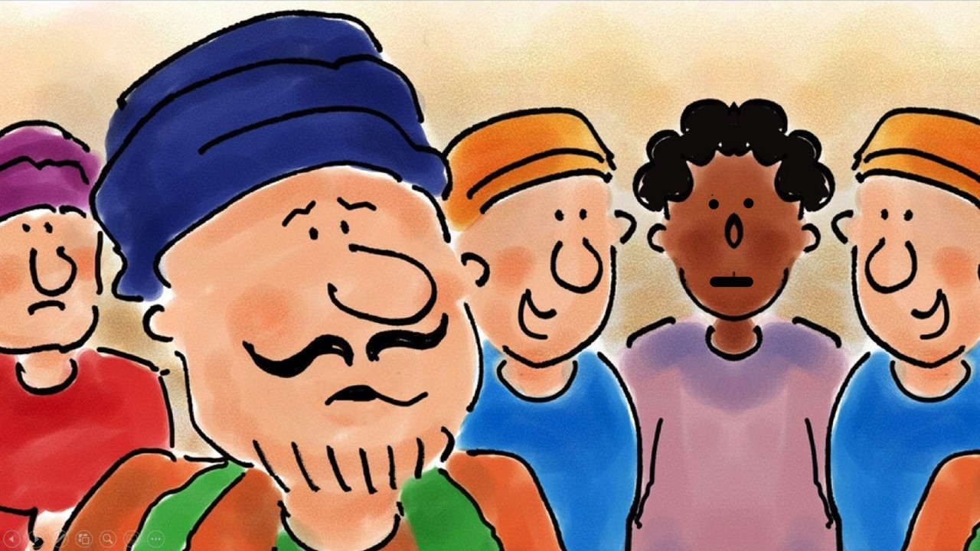

Slide 10
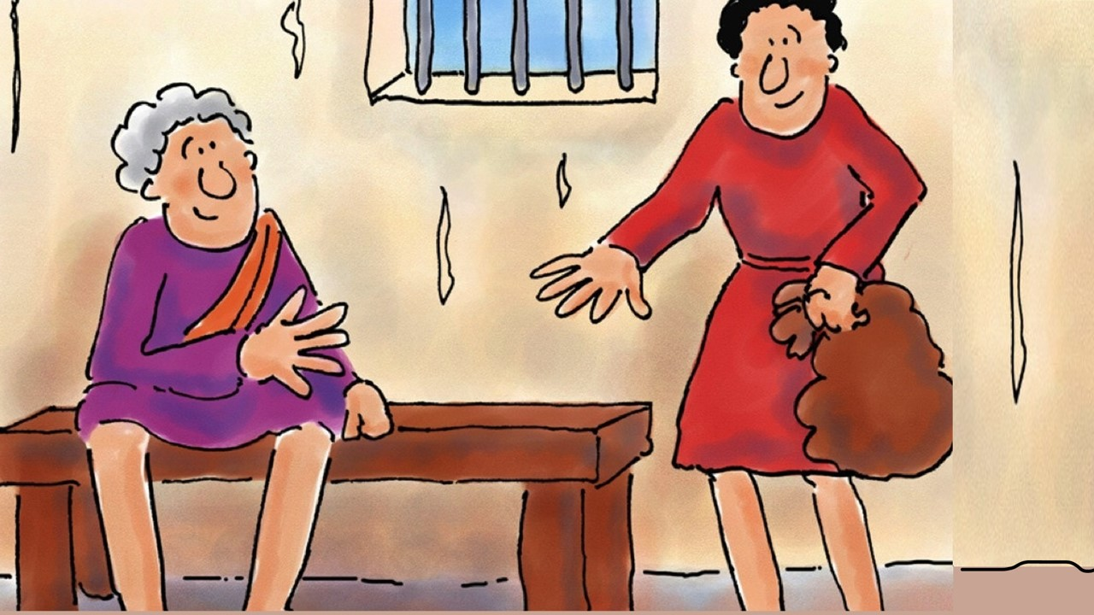

Slide 11
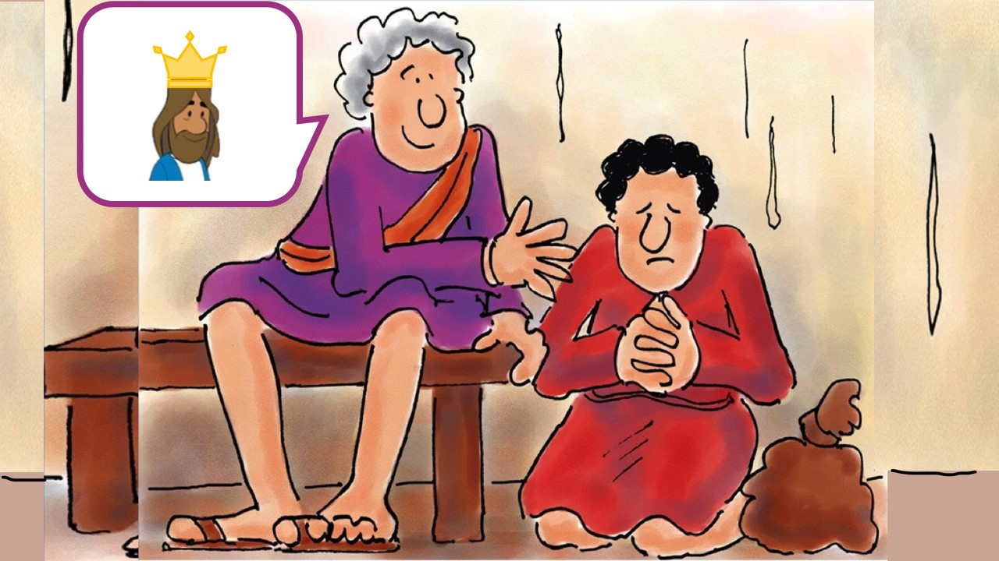

Slide 12
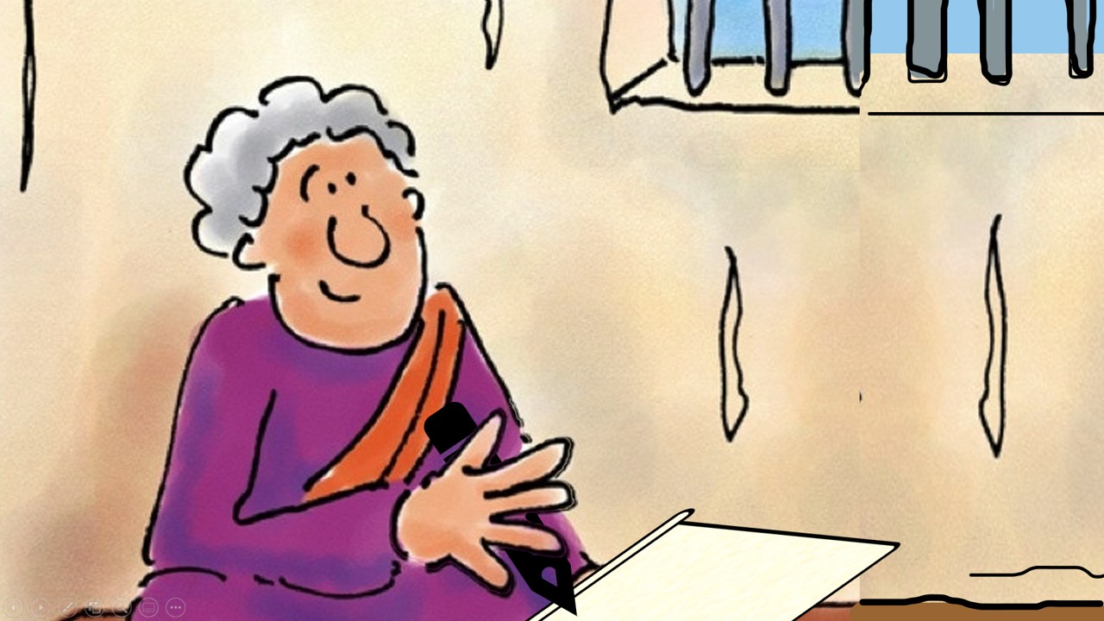

Slide 14
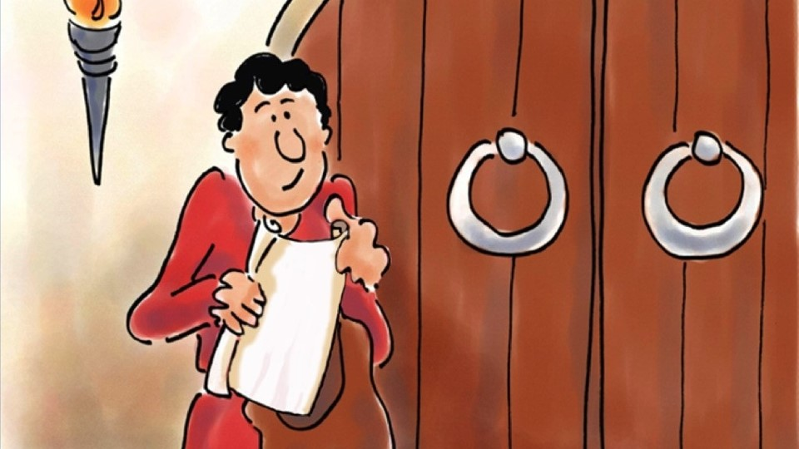

Slide 15
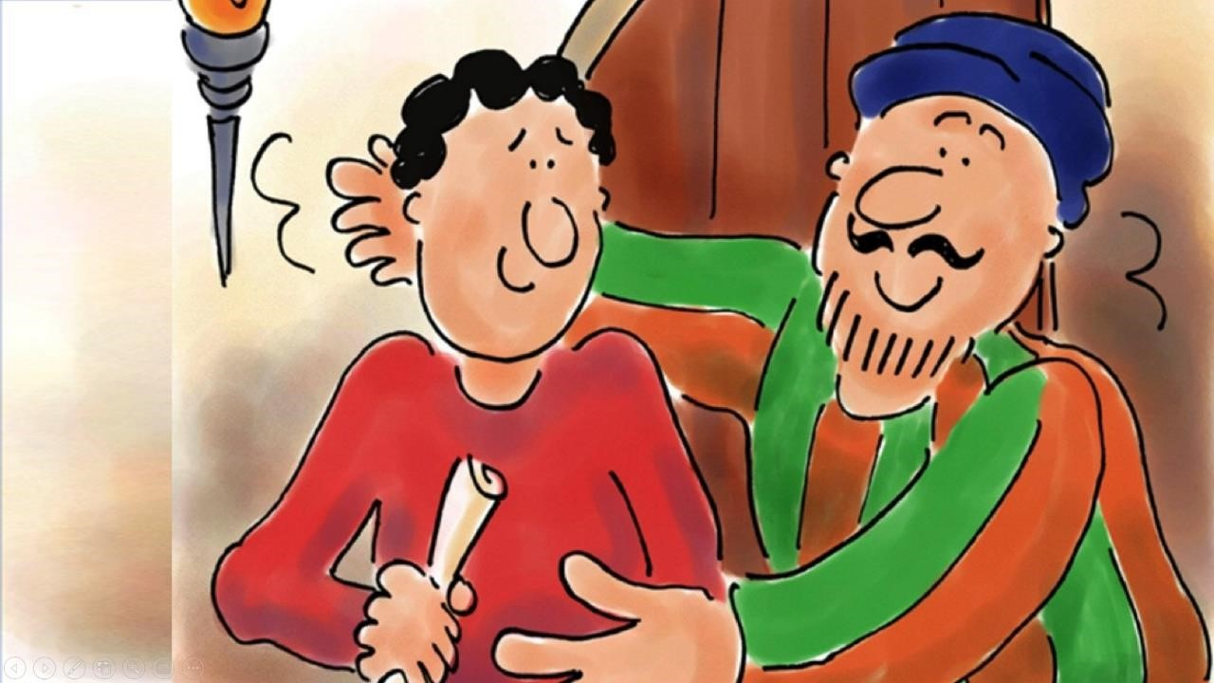

Slide 16
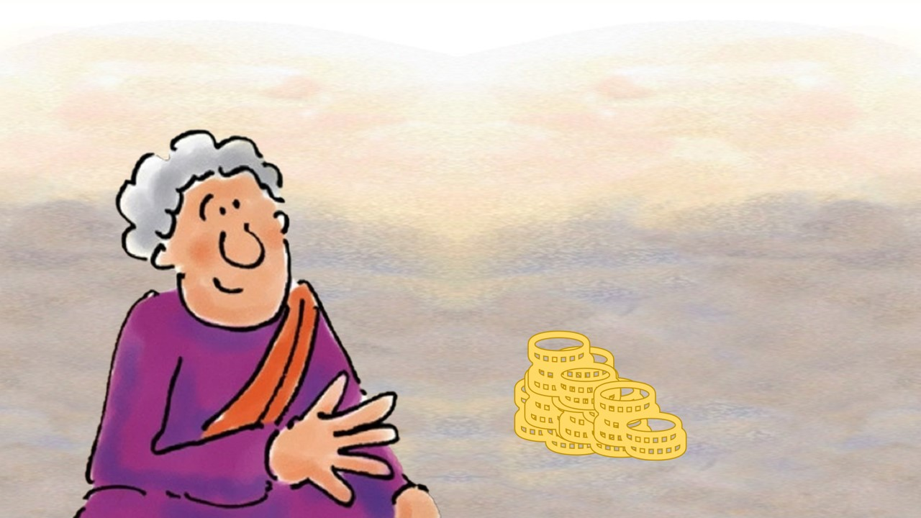

Slide 17
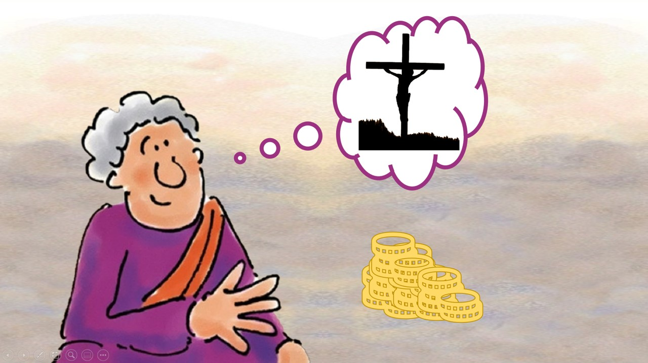

Slide 18
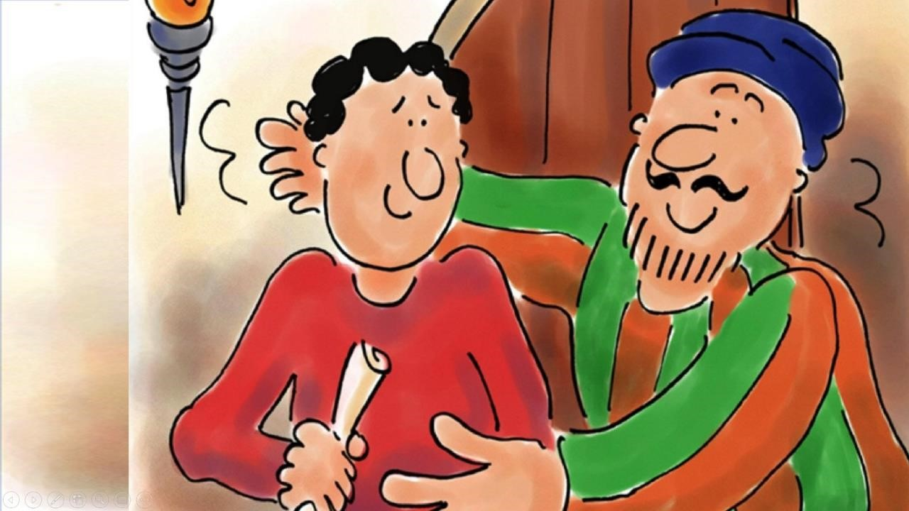

Slide 19
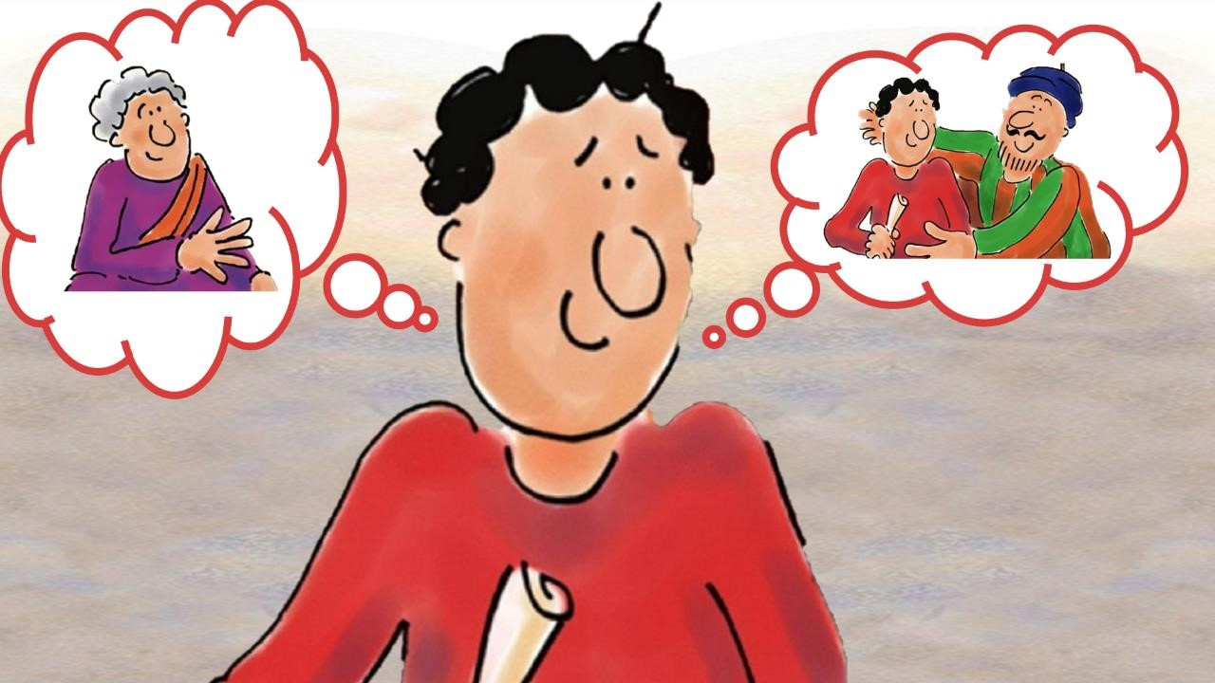

Slide 20
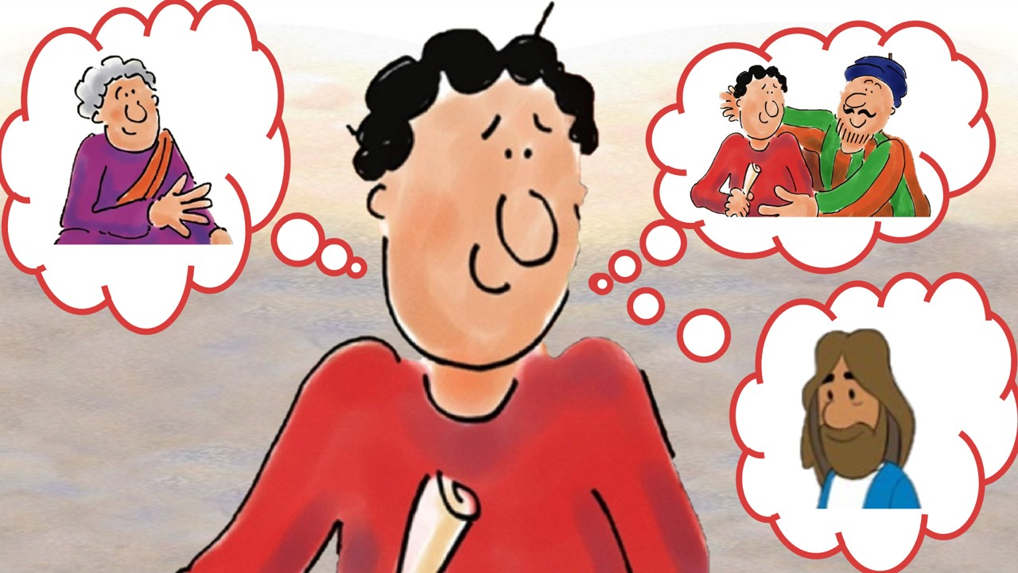

Slide 21
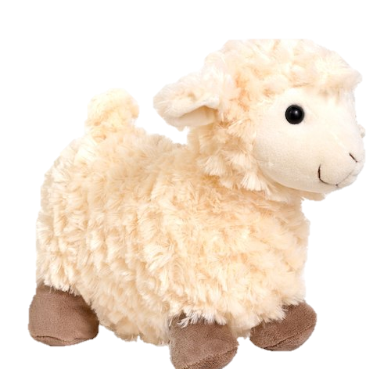
Mary had a little lamb,
Little lamb, little lamb
Mary had a little lamb;
it’s fleece was white as snow
And everywhere that Mary went,
Mary went, Mary went
Everywhere that Mary went
The lamb was sure to go

Slide 22
If you’re happy and you know it clap your hands
If you’re happy and you know it clap your hands
If you’re happy and you know it
And you really want to show it
If you’re happy and you know it clap your hands

Slide 23
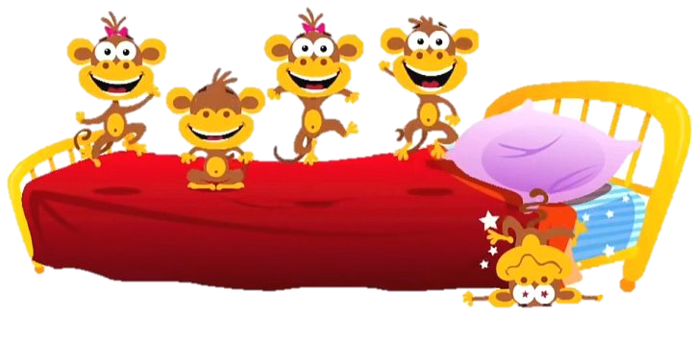
5 little monkeys jumping on the bed
One fell off and bumped his head
Mummy called the doctor and the doctor said
“No more monkeys jumping on the bed”
4 little monkeys…

Slide 24
Skidamarink a dink a dink
Skidamarink a doo
I love you
I love you in the morning
And in the afternoon
I love you in the evening
And underneath the moon

