Slide 1
WELCOME
to the
Preschool Playgroup
Run by Holy Trinity Church
Find us on Facebook
playgroup@htcchicago.org

Slide 2
K
N
G
the
I
is here!

Slide 3
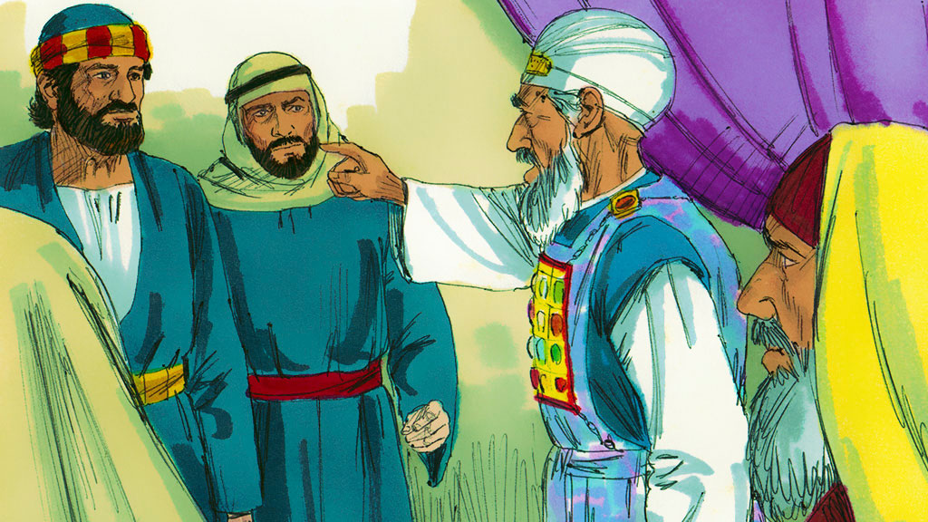

Slide 4
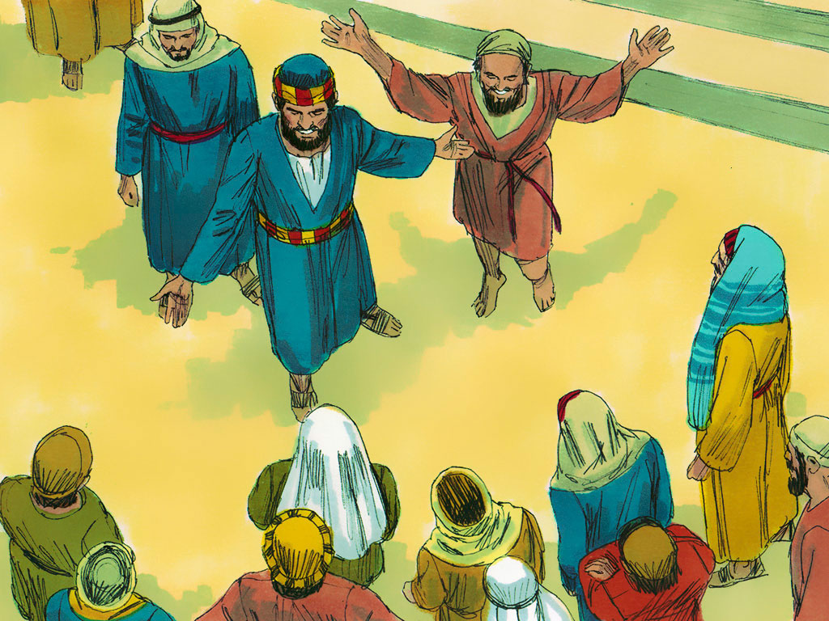

Slide 5
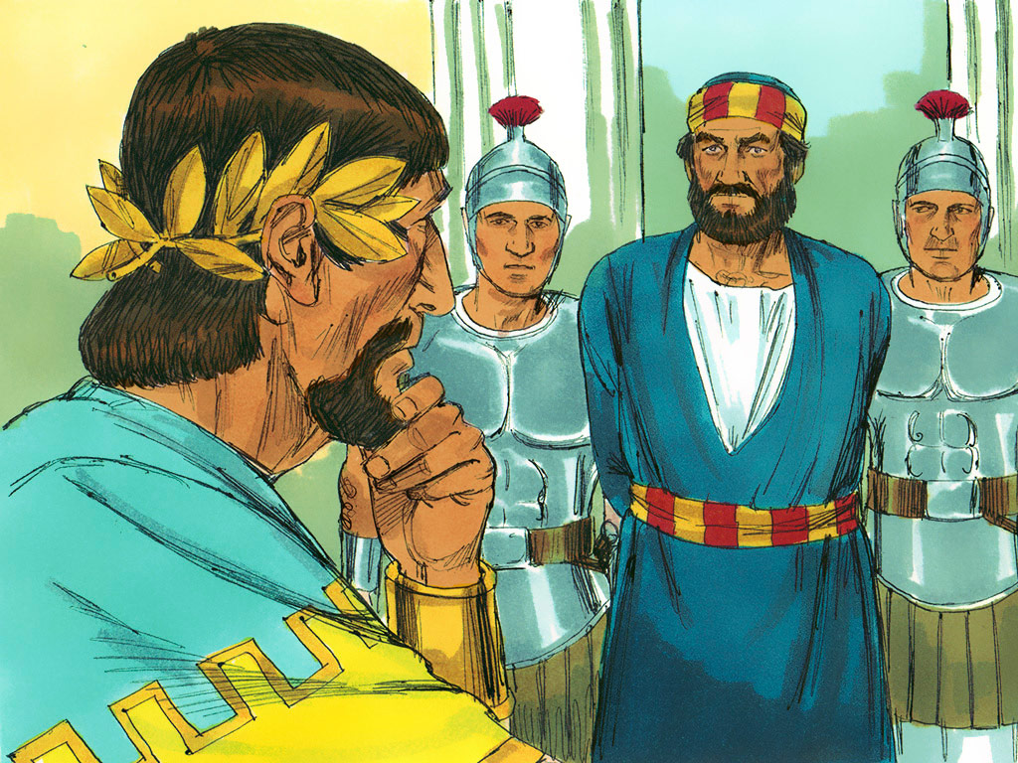

Slide 6
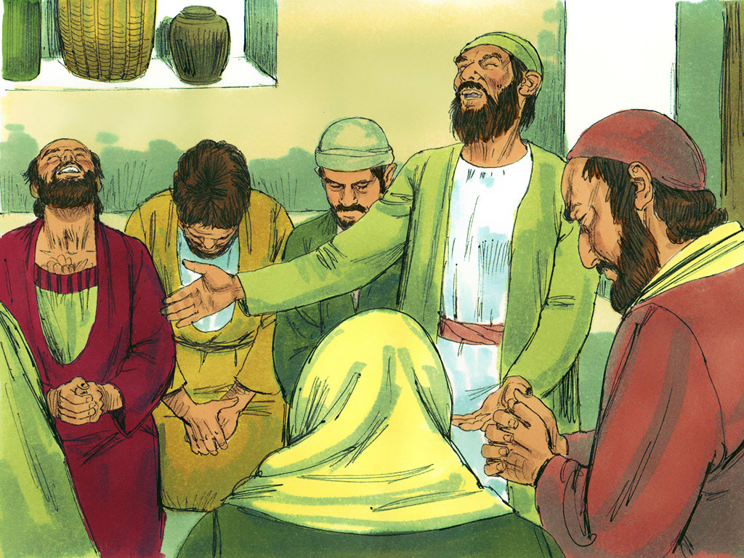

Slide 7
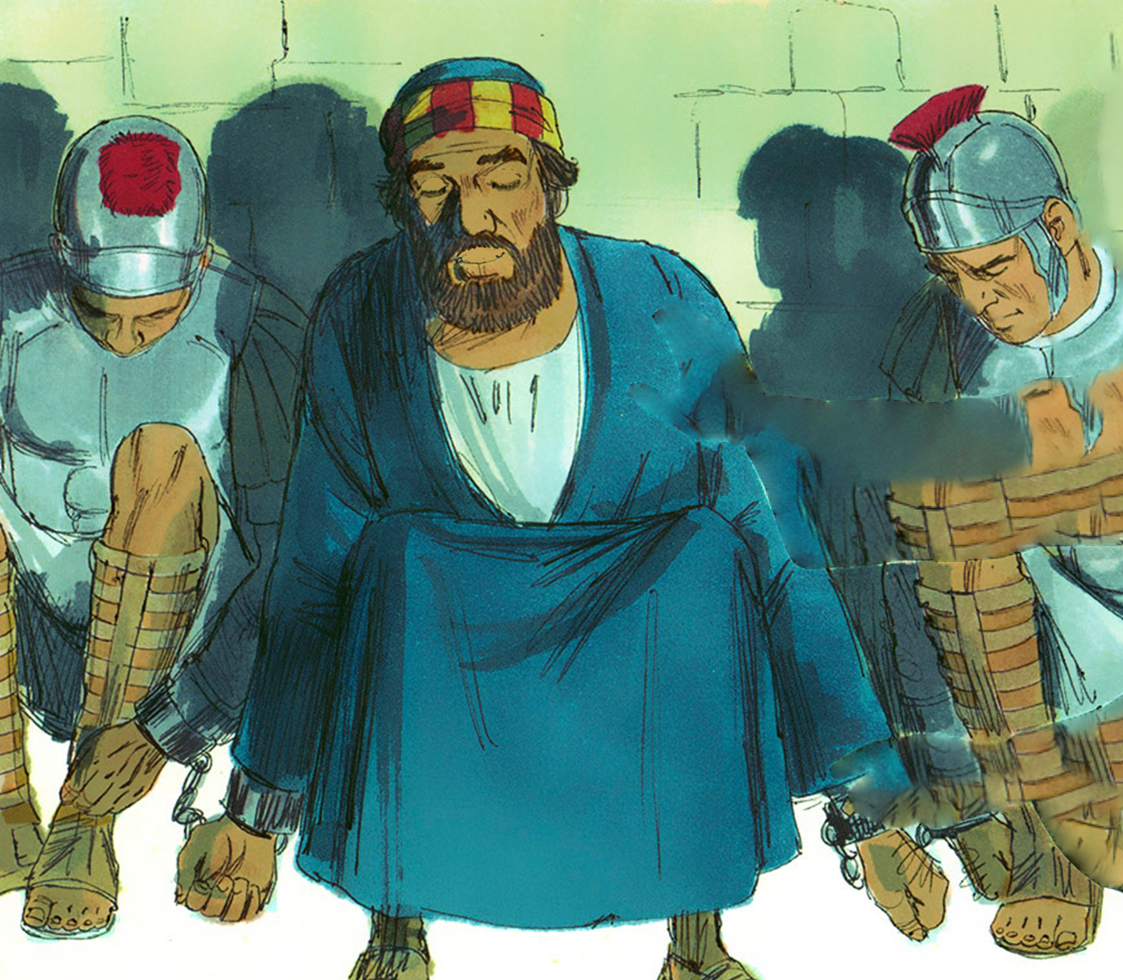
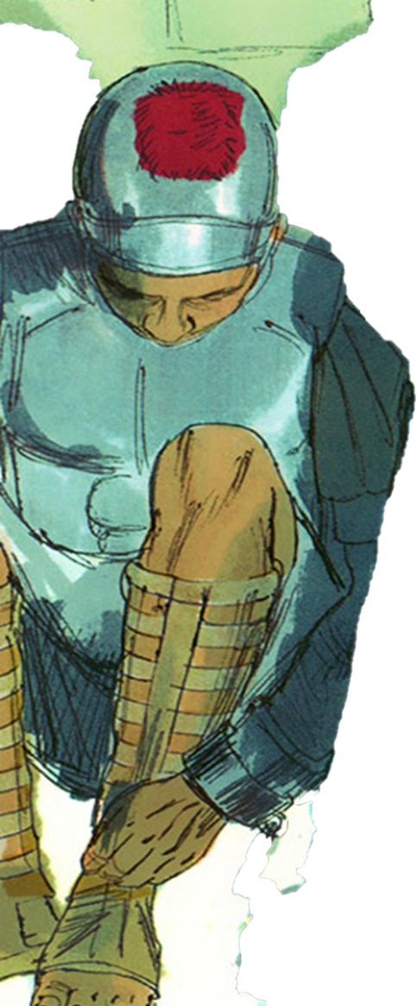

Slide 8
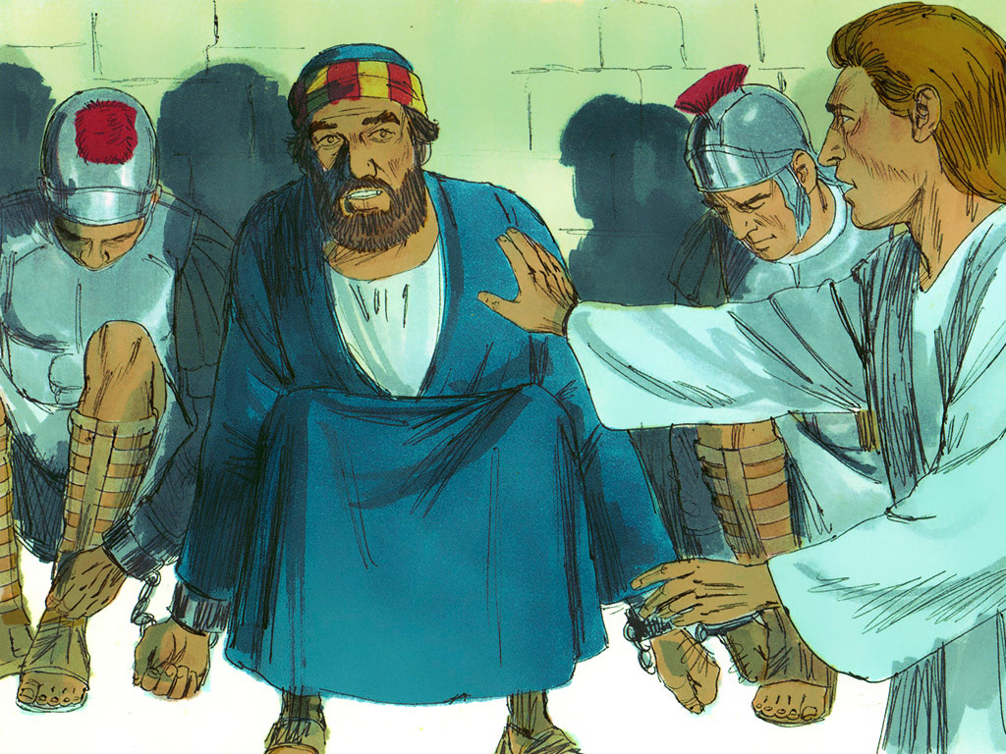
Get Up

Slide 9
Get dressed, put your shoes on and come with me

Slide 10
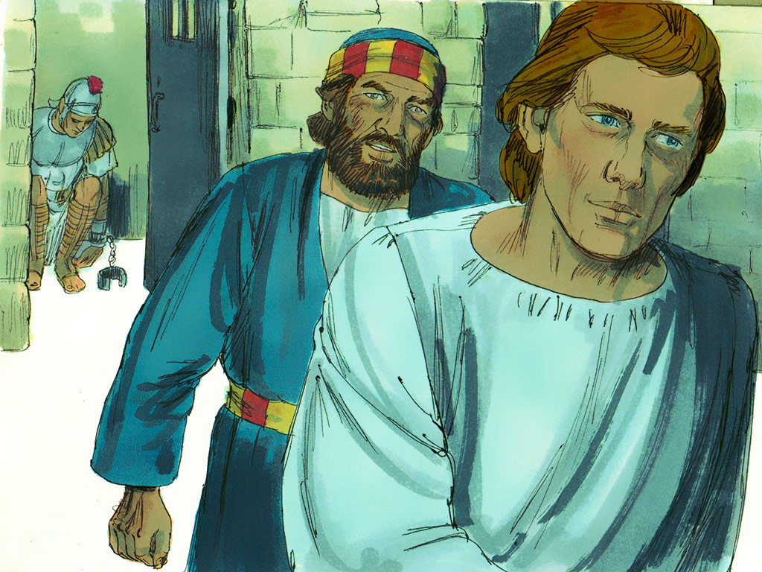

Slide 11
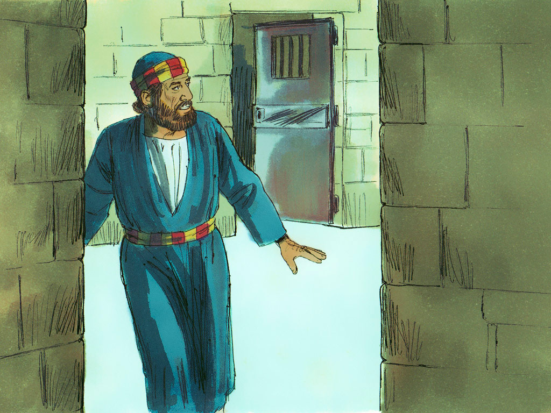

Slide 12
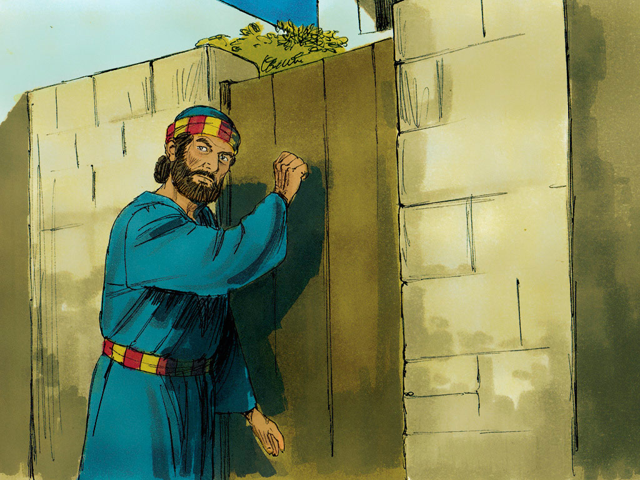

Slide 13
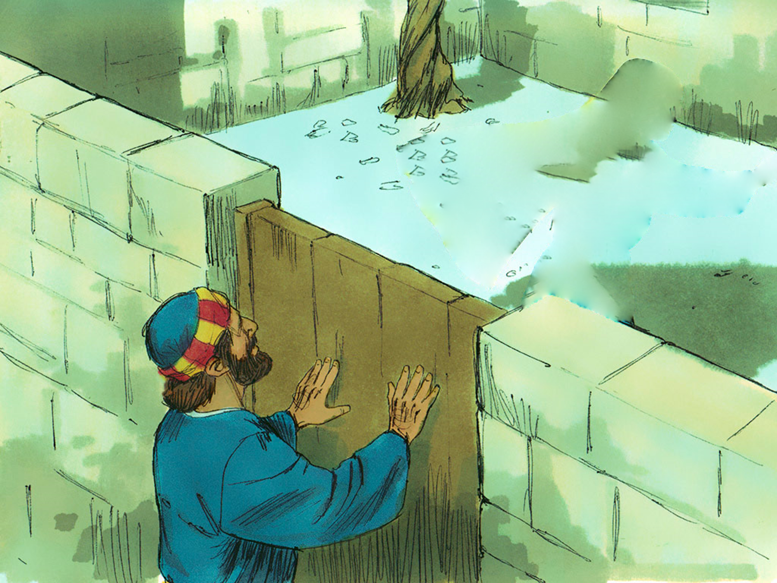
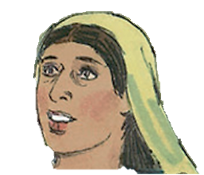
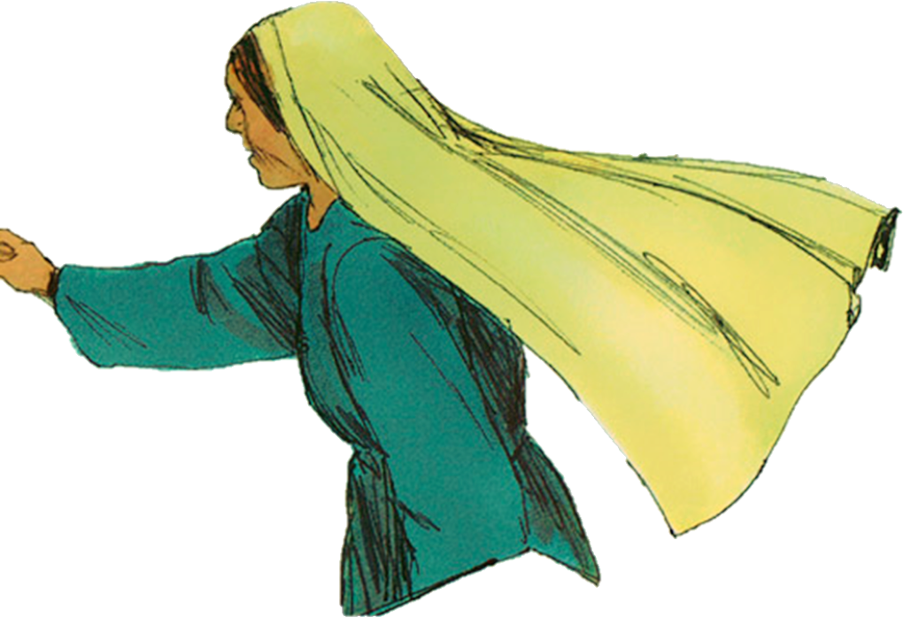
Can you let me in?

Slide 14
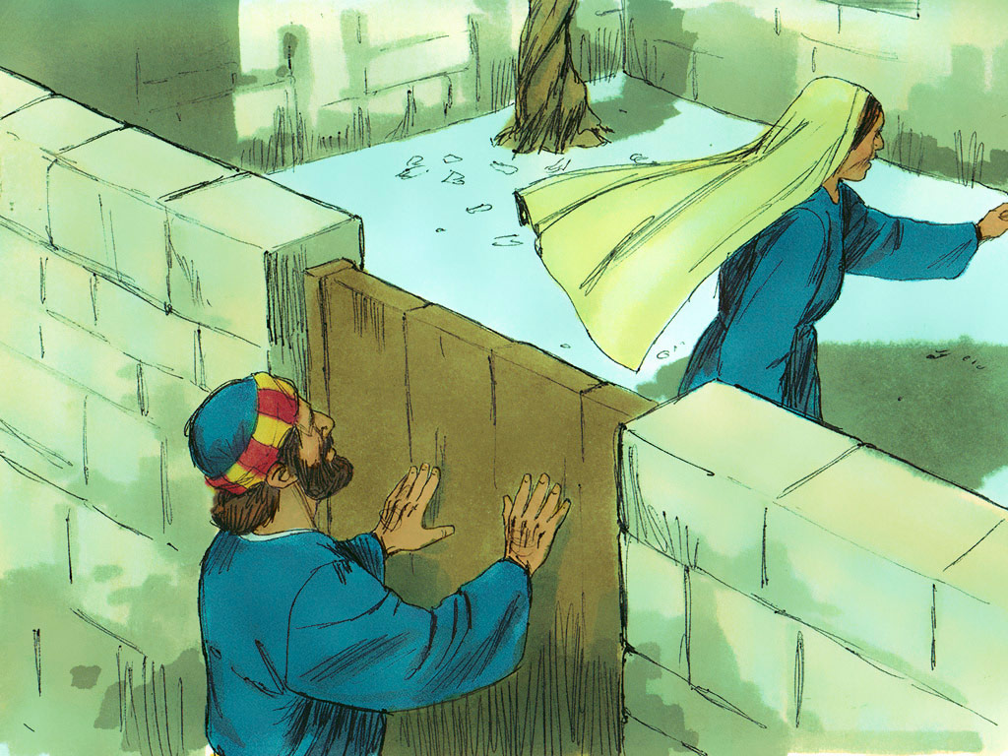

Slide 15
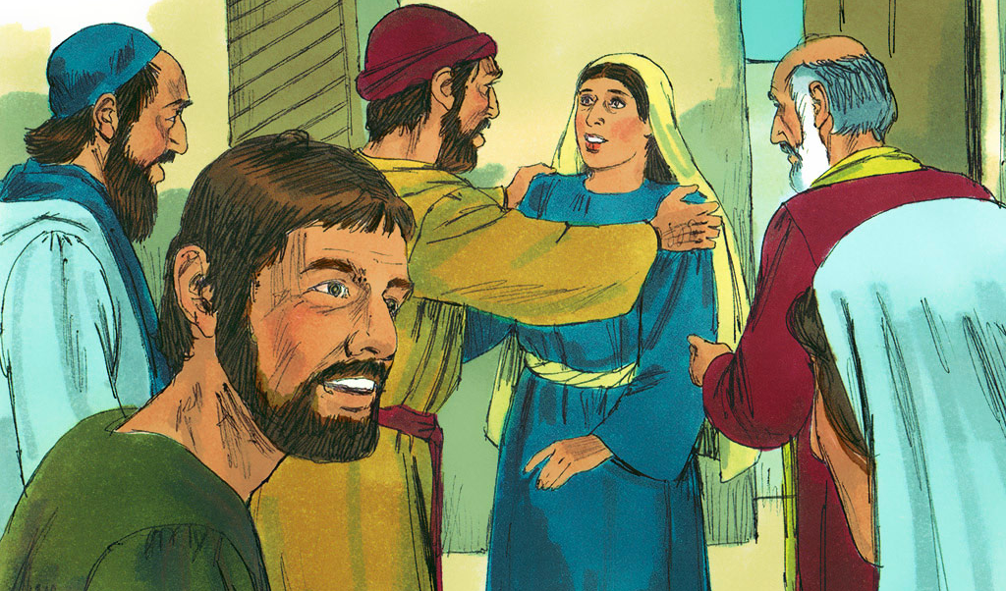
Peter is here!
Peter is free!

Slide 16
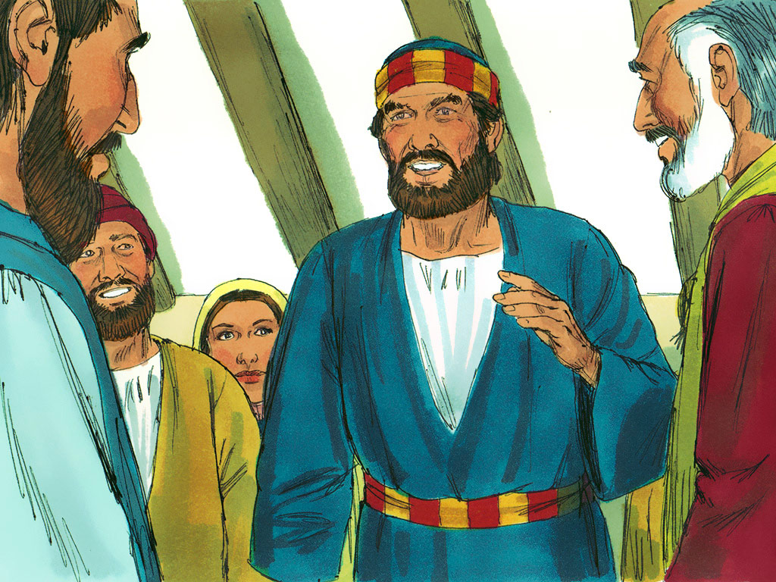

Slide 17
See the little bunnies sleeping ‘til noon
Shall we try and wake them with a merry tune?
They’re so still, are they ill?
Wake up soon!
Hop little bunnies, hop, hop, hop x3
Hop and Stop!

Slide 18
Twinkle twinkle little star
How I wonder what you are
Up above the world so high
Like a diamond in the sky
Twinkle twinkle little star
How I wonder what you are

Slide 19
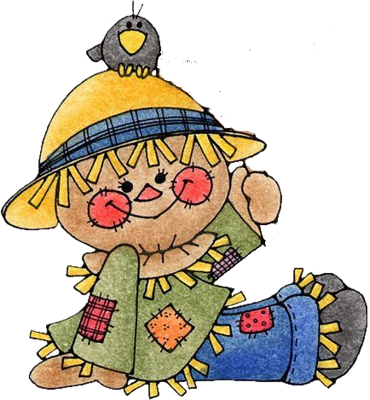
When all the cows are sleeping
And the sun has gone to bed
Up jumps the scarecrow and this is what he said
I’m a dingle dangle scarecrow With a flippy floppy hat
I can shake my arms like this I can shake my legs like that.
When all the hens are roosting and the sun’s behind a cloud
Up jumps the scarecrow and shouted very loud… The dogs are in the kennel
and the doves are in the loft
Up jumps the scarecrow and whispers very soft…

Slide 20
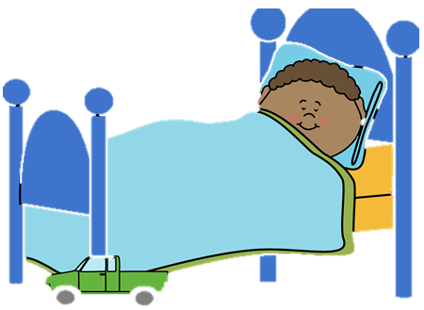
If I go climbing, climbing, climbing
If I go climbing; God is there
If I go climbing on the highest mountain
God is there ‘cos he is everywhere.
If I go flying in the biggest aeroplane
If I go driving far away
If I go swimming in the deepest ocean
If I go sleeping on the darkest night

Slide 21
Last playgroup will be:
June 19
Bring a picnic
and if it’s sunny
we’ll go to the park after
Summer!

