Slide 1
WELCOME
to the
Preschool Playgroup
Run by Holy Trinity Church
Find us on Facebook
playgroup@htcchicago.org

Slide 2
K
N
G
the
I
is here!

Slide 4
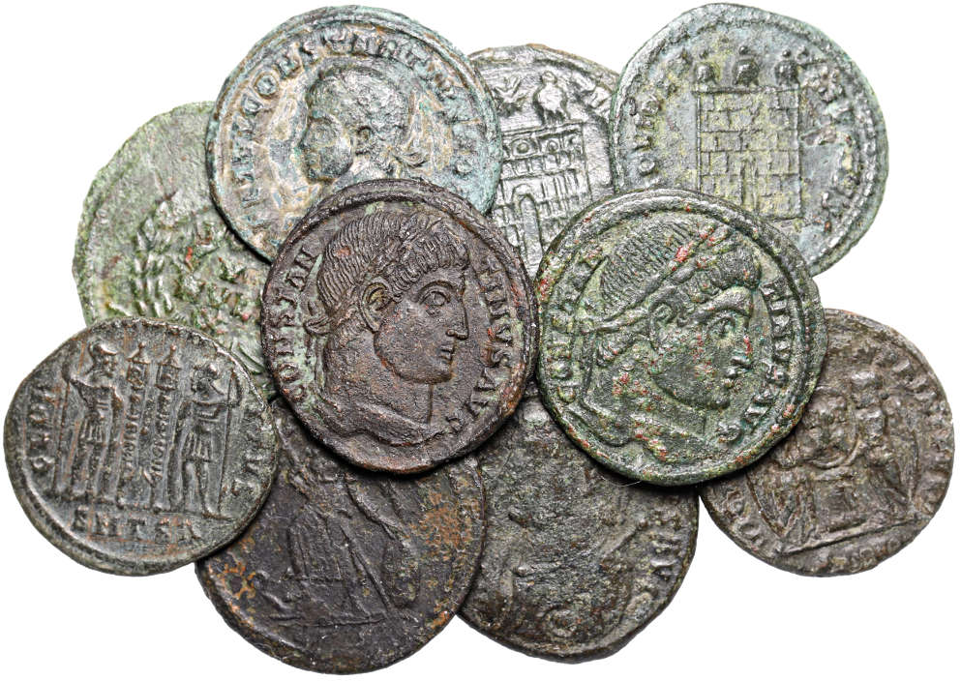

Slide 7
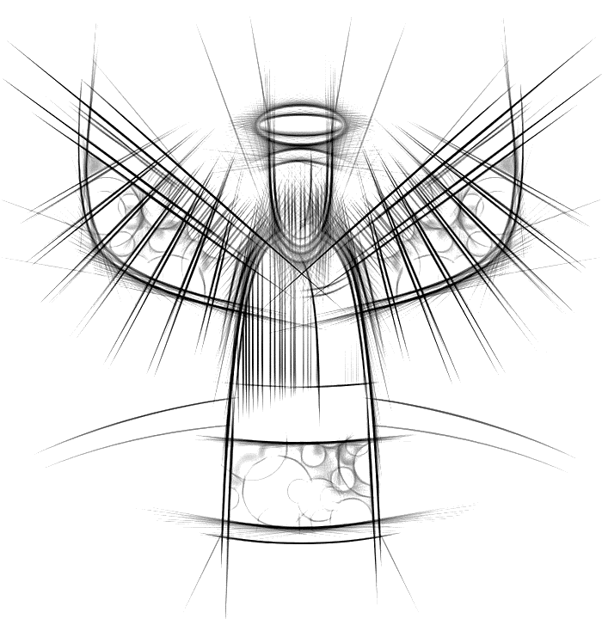

Slide 9
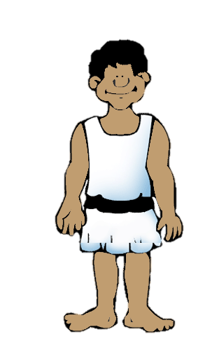
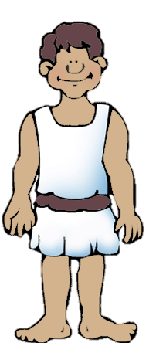

Slide 12
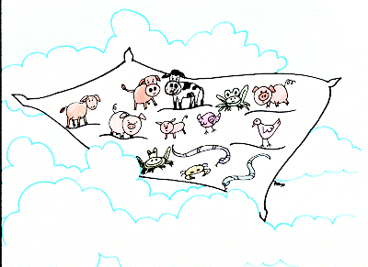

Slide 13
Get up Peter, kill these animals and eat them

Slide 14
No Way

Slide 15
If I say something is clean; it IS clean.
Don’t call it dirty

Slide 16
1 2 3
If I say something is clean; it IS clean.
Don’t call it dirty

Slide 18
Get up, Peter and go with them

Slide 22
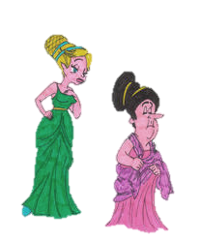
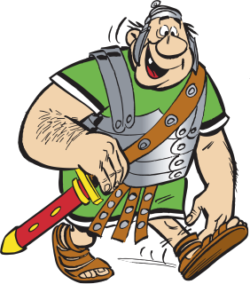
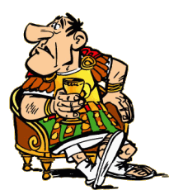
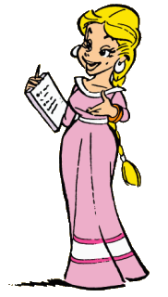
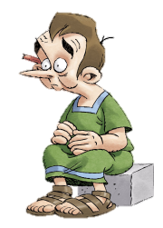

Slide 27
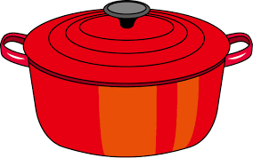
Pease porridge hot, Pease porridge cold
Pease porridge in the pot; 9 days old.
Some like it hot, Some like it cold
Some like it in the pot; 9 days old.

Slide 28
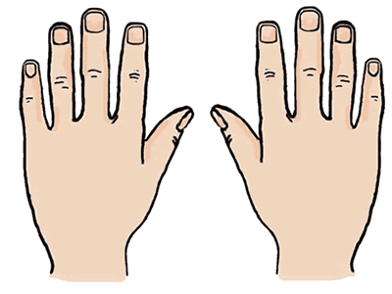
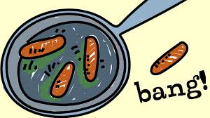
10 fat sausages sizzling in a pan
1 went POP and the other went BANG
8 fat sausages…
3
8
2
4
7
9
1
10
5
6

Slide 29
A Pizza Hut, a Pizza Hut
Kentucky Fried Chicken and a Pizza Hut
A Pizza Hut, a Pizza Hut
Kentucky Fried Chicken and a Pizza Hut
McDonalds, McDonalds
Kentucky Fried Chicken and a Pizza Hut
McDonalds, McDonalds
Kentucky Fried Chicken and a Pizza Hut

Slide 30
5 little peas
In a pea-pod pressed
1 grew, 2 grew
And so did all the rest
They grew and they grew
And they did not stop
Until one day the pod went
POP!
5 little peas
In a pea-pod pressed
1 grew, 2 grew
And so did all the rest
They grew and they grew
So fat and round
Then all the peas
Fell to the ground

