Slide 1
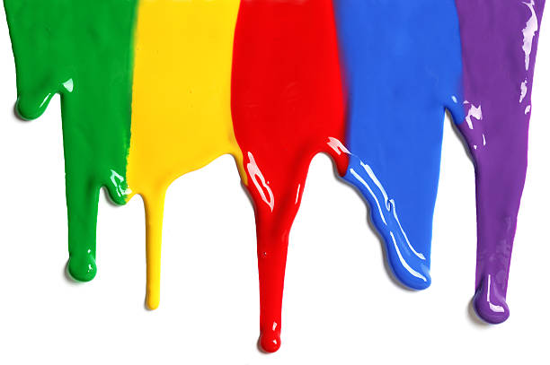
WELCOME
to the
Preschool Playgroup
Run by Holy Trinity Church
Find us on Facebook
playgroup@htcchicago.org

Slide 2
K
N
G
the
I
is here!

Slide 3
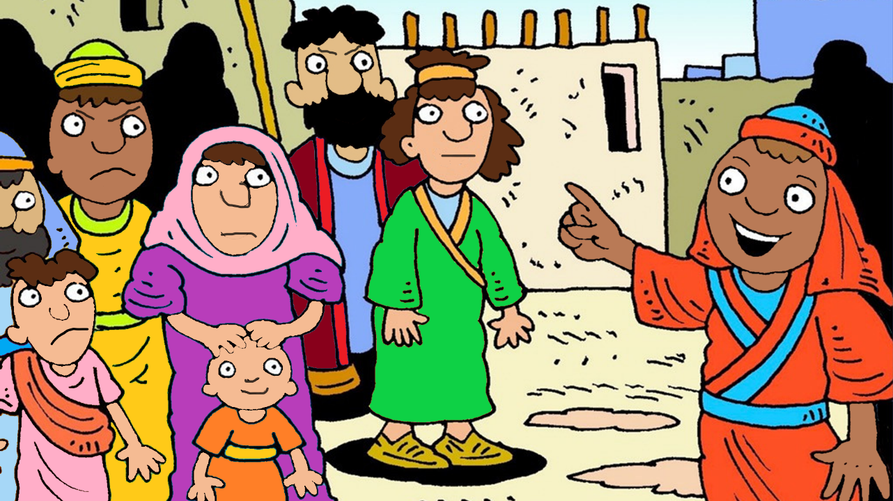

Slide 4
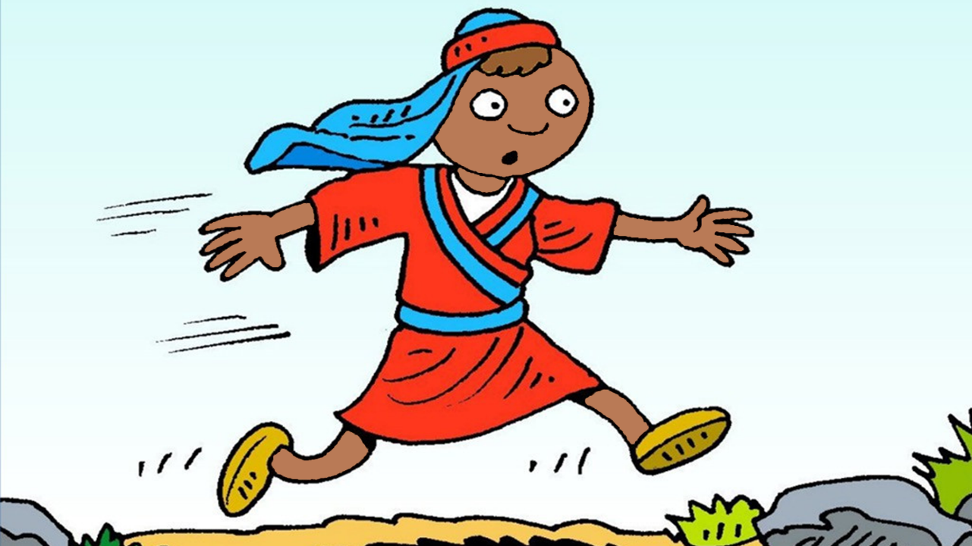

Slide 5
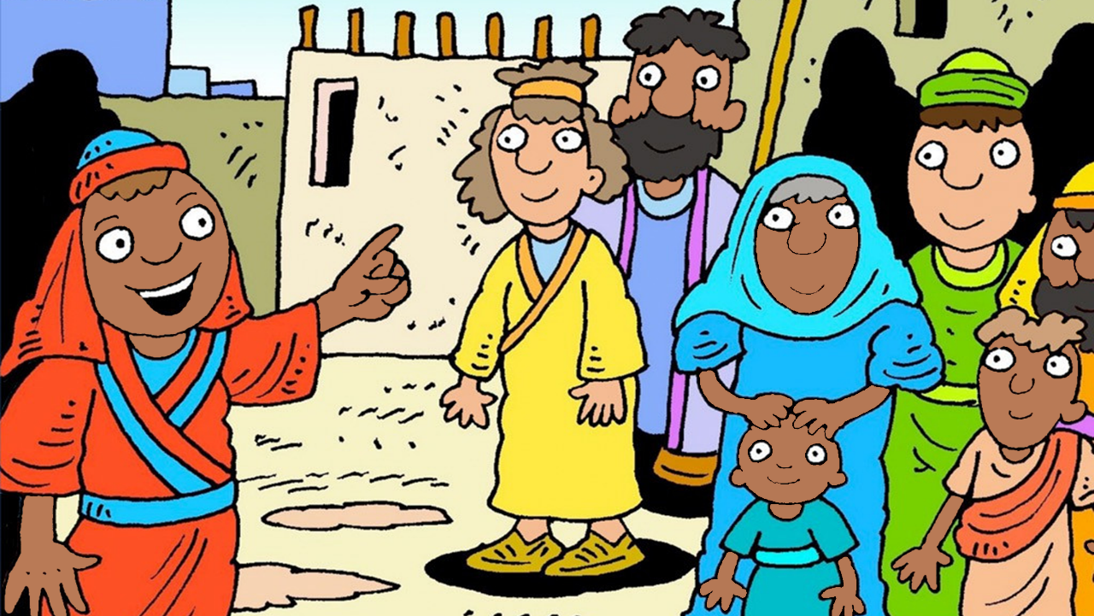

Slide 6
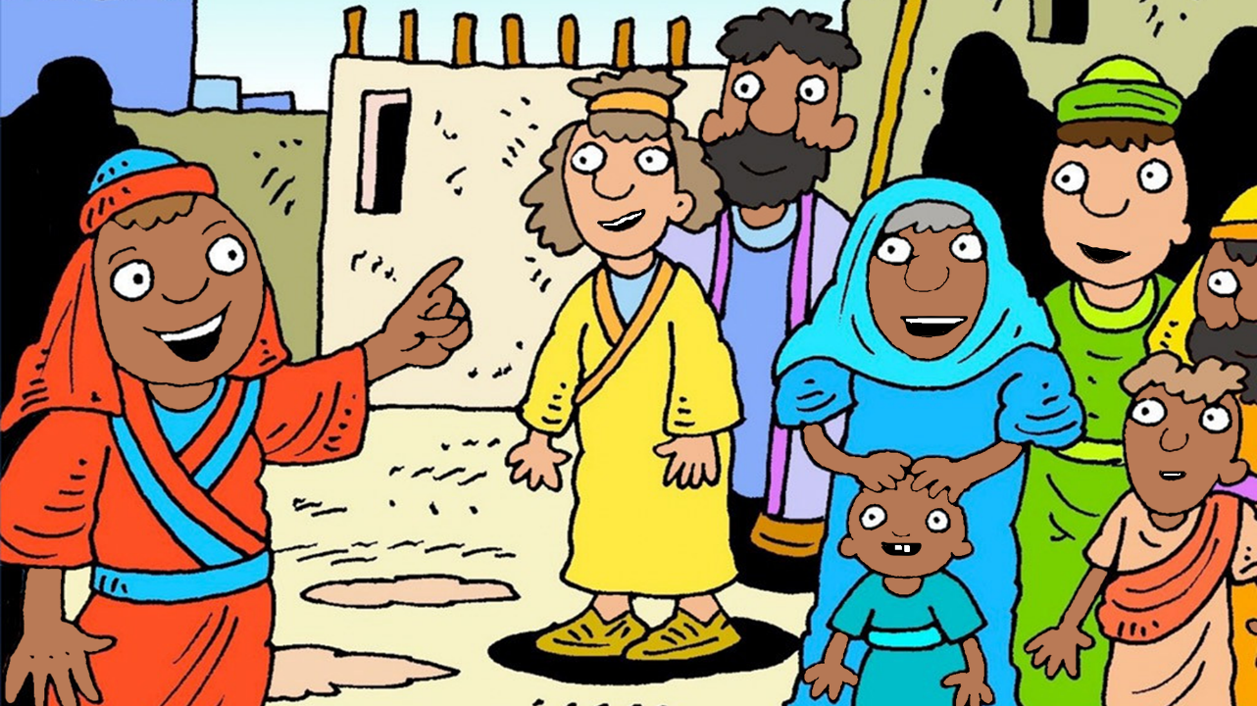

Slide 7
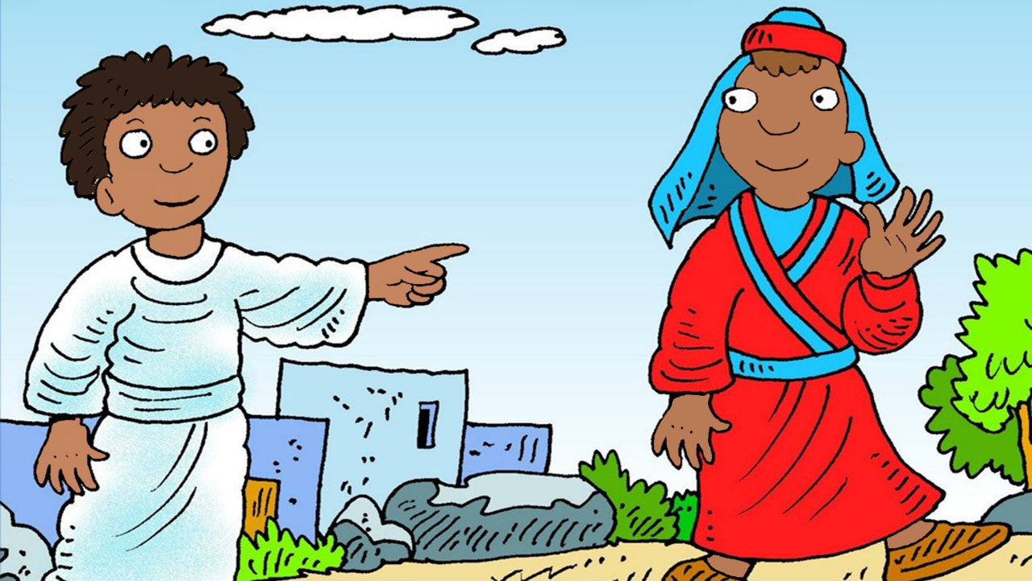

Slide 8
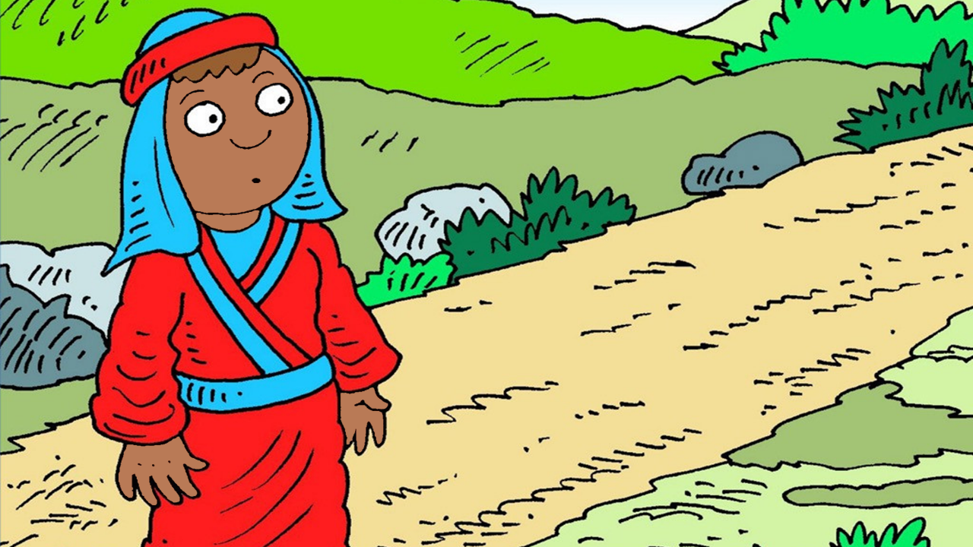

Slide 9
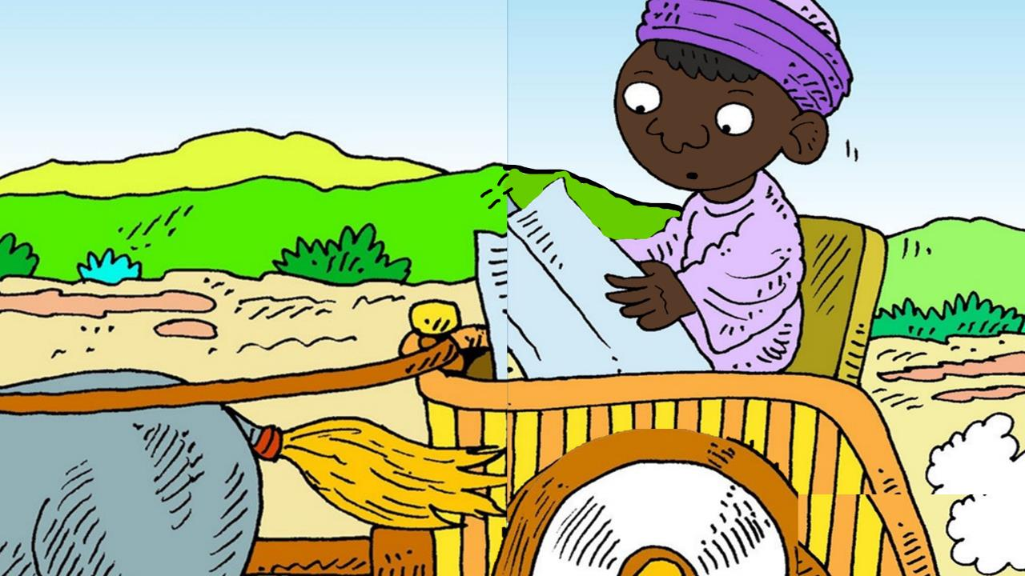

Slide 10
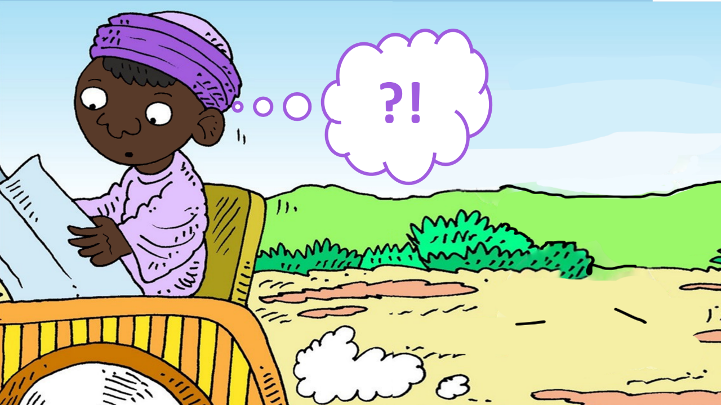

Slide 11
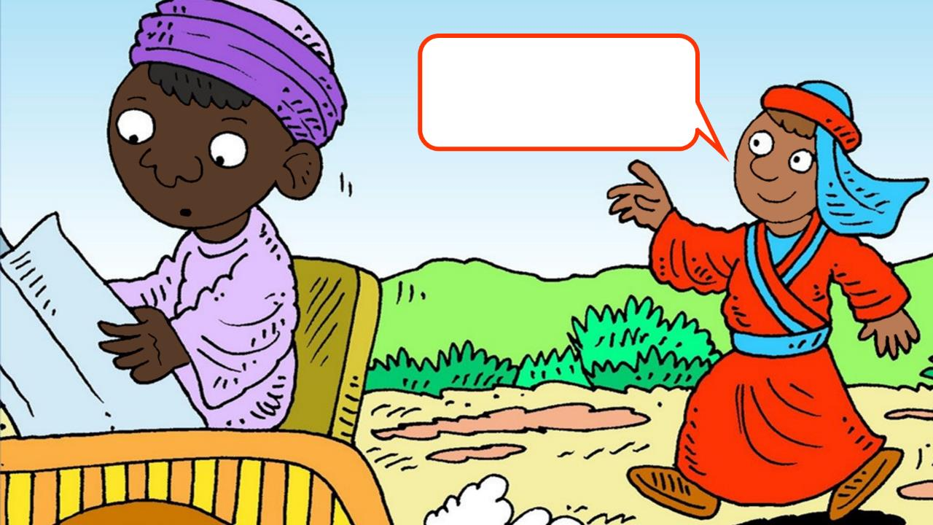

Slide 12
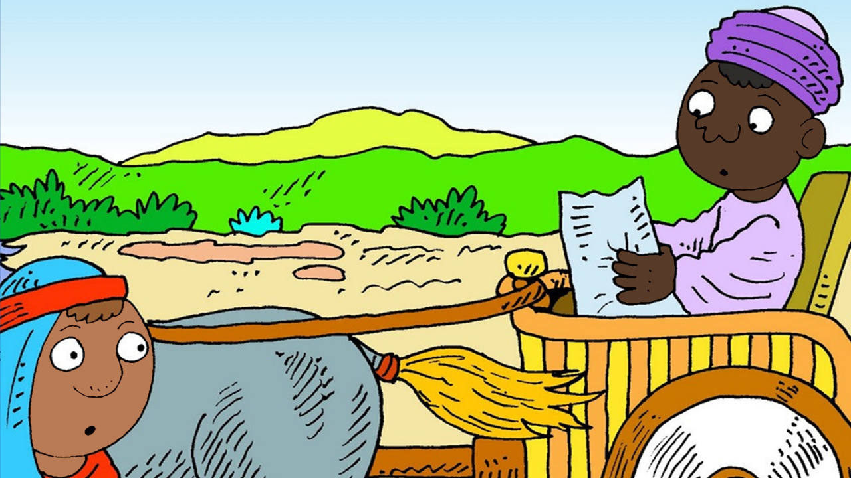

Slide 13
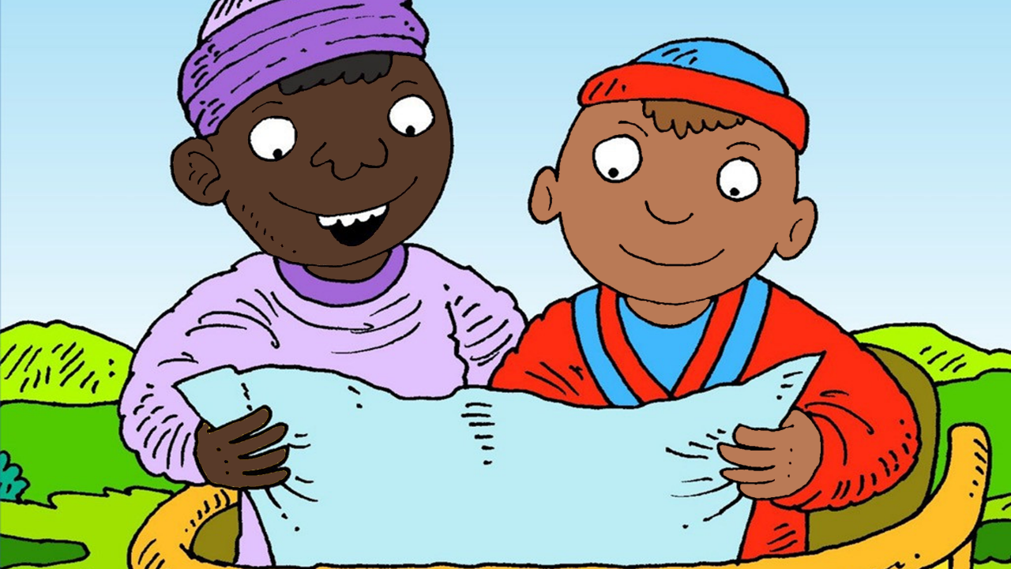

Slide 15
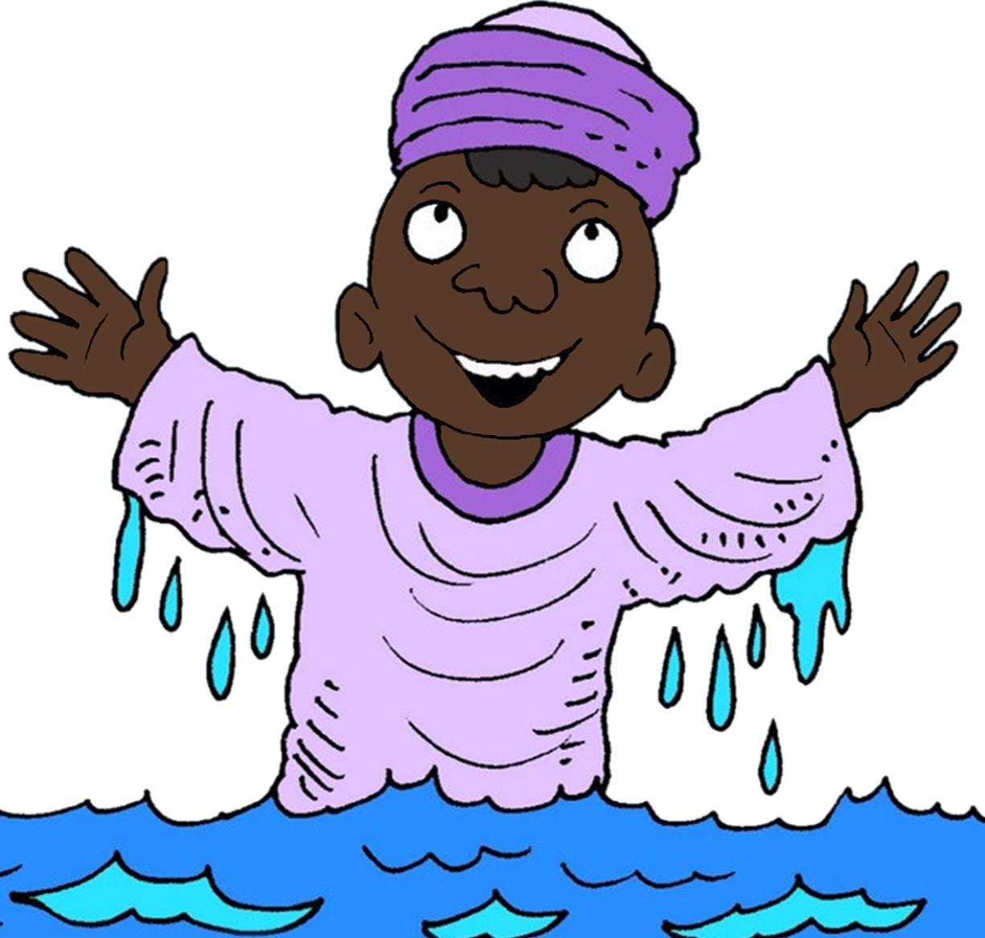

Slide 16
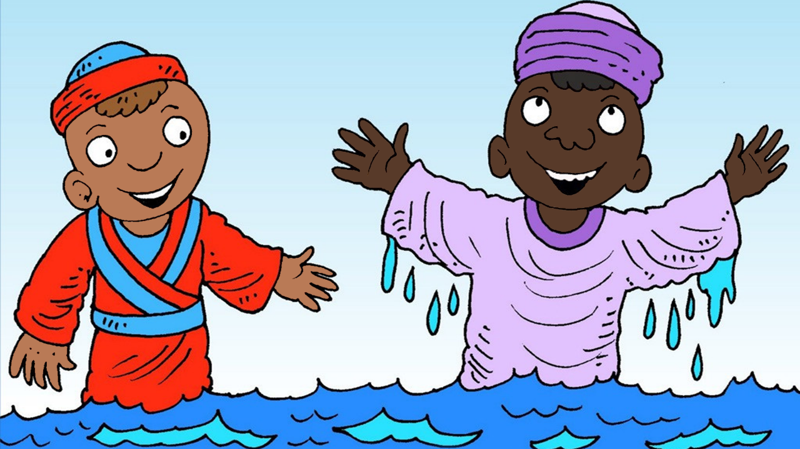

Slide 17
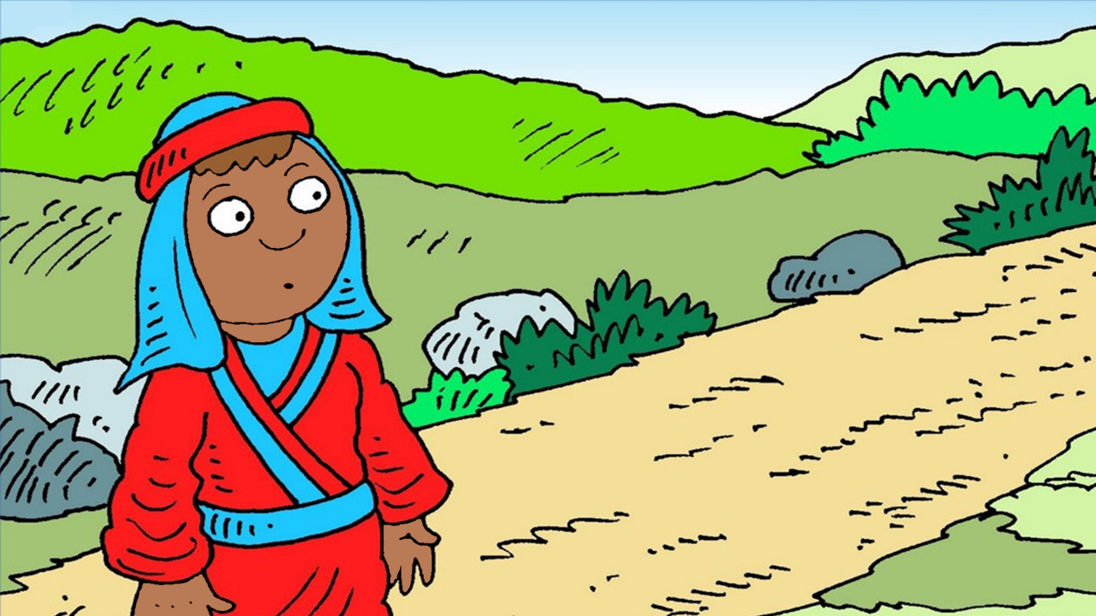

Slide 18
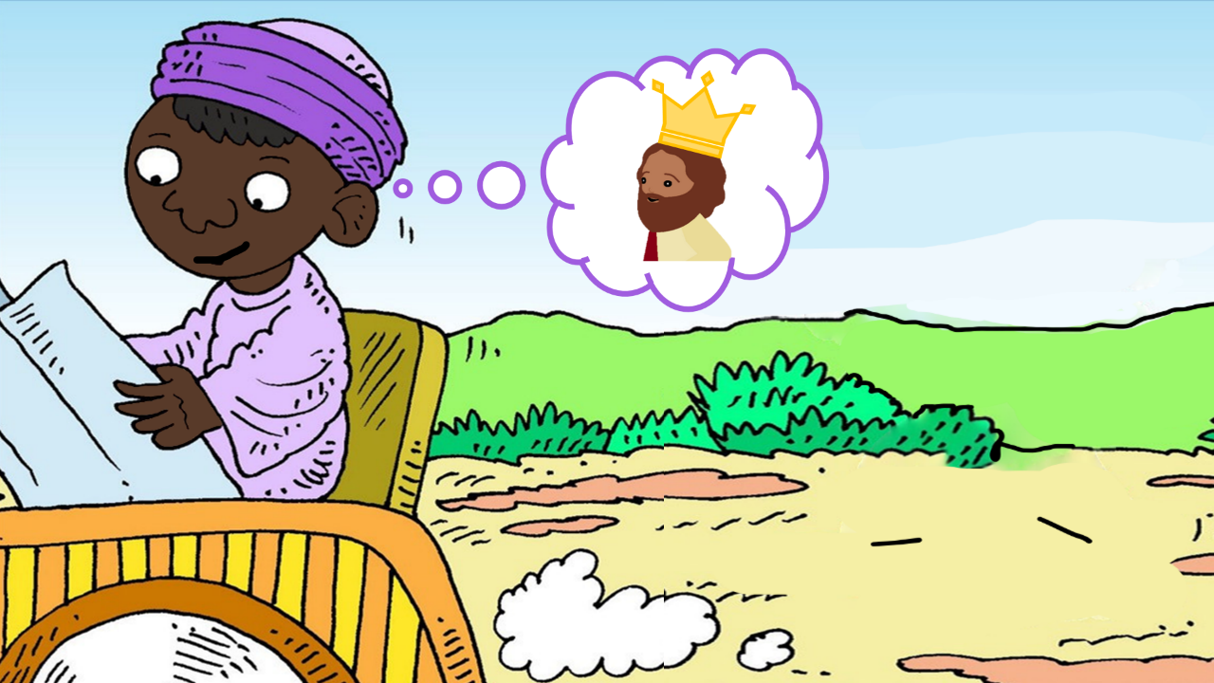

Slide 19
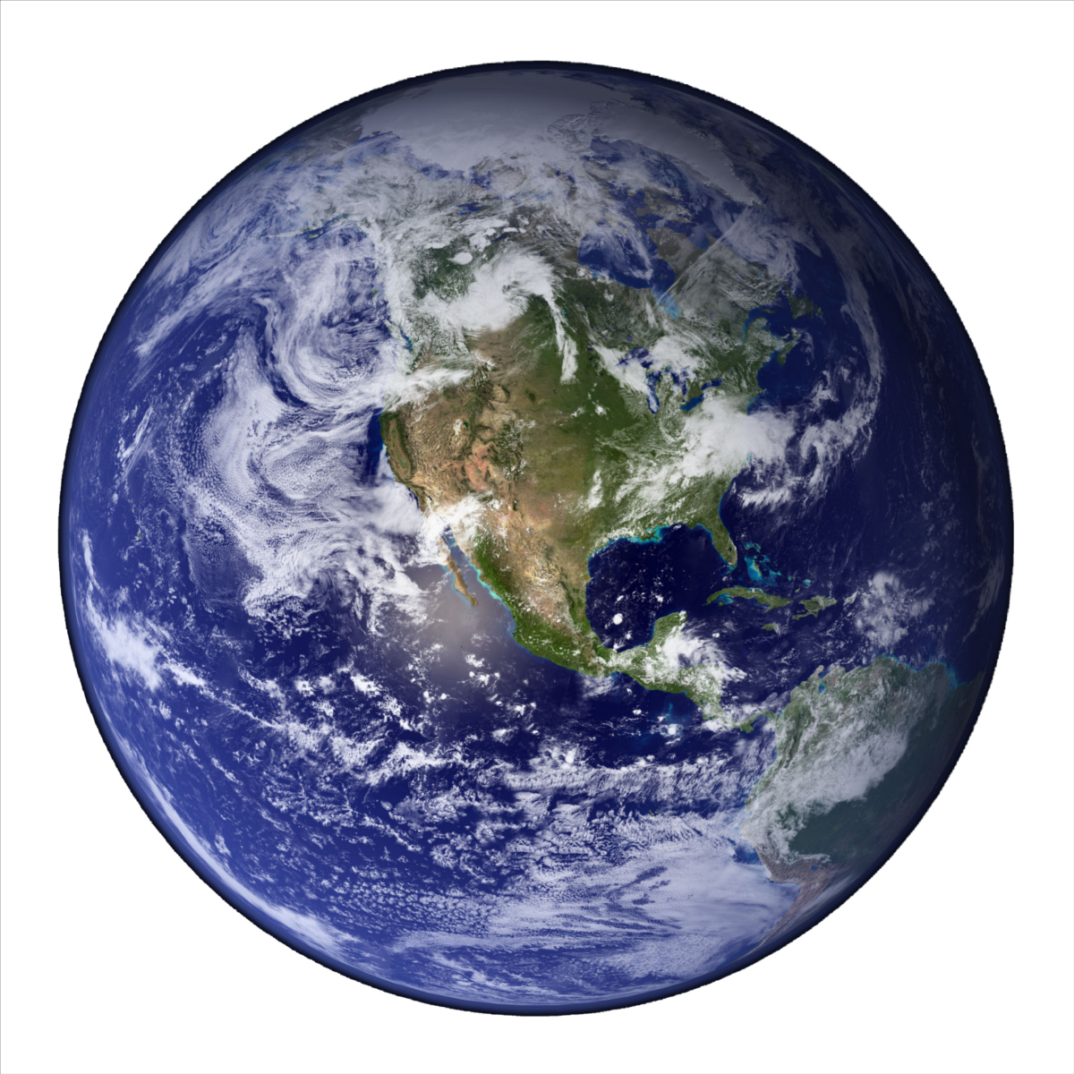
He’s got the whole world in his hands
He’s got the whole wide world in his hands
He’s got the whole world in his hands
He’s got the whole world in his hands
He’s got you and me in his hands…
He’s got everybody here in his hands...

Slide 20
A sailor went to sea, sea, sea
To see what he could see, see, see
But all that he could see, see, see
Was the bottom of the deep blue sea, sea, sea

Slide 21
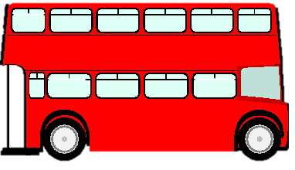
The wheels on the bus go round and round
Round and round, round and round
The wheels on the bus go round and round
All through the town.
Horn – Beep, Beep, Beep
Lights – Flash on and off
Doors – Open and Shut
People – Bounce up and down

Slide 22
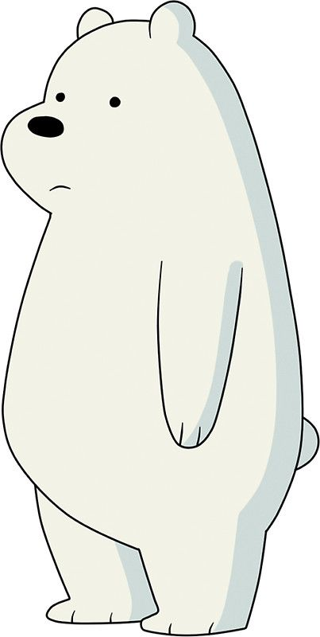
Row, row, row your boat gently down the stream
If you see a crocodile don’t forget to scream.
Row, row, row your boat gently to the shore
If you see a lion there don’t forget to roar.
Row, row, row your boat quickly down the river
If you see a polar bear don’t forget to shiver.
Rock, rock, rock your boat gently to and fro
Wibbly-wobbly, wibbly-wobbly
Into the water you go.

