Slide 1
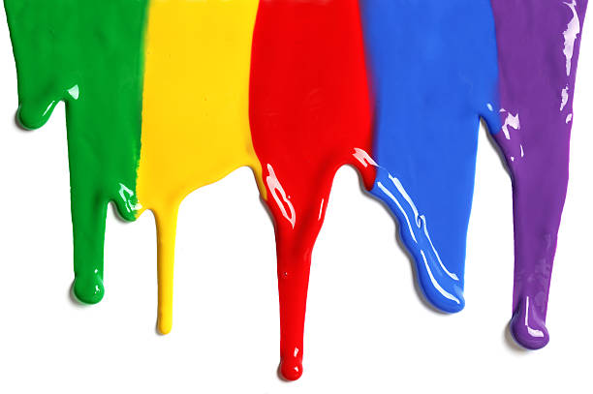
WELCOME
to the
Preschool Playgroup
Run by Holy Trinity Church
Find us on Facebook
playgroup@htcchicago.org

Slide 2
K
N
G
the
I
is here!

Slide 4
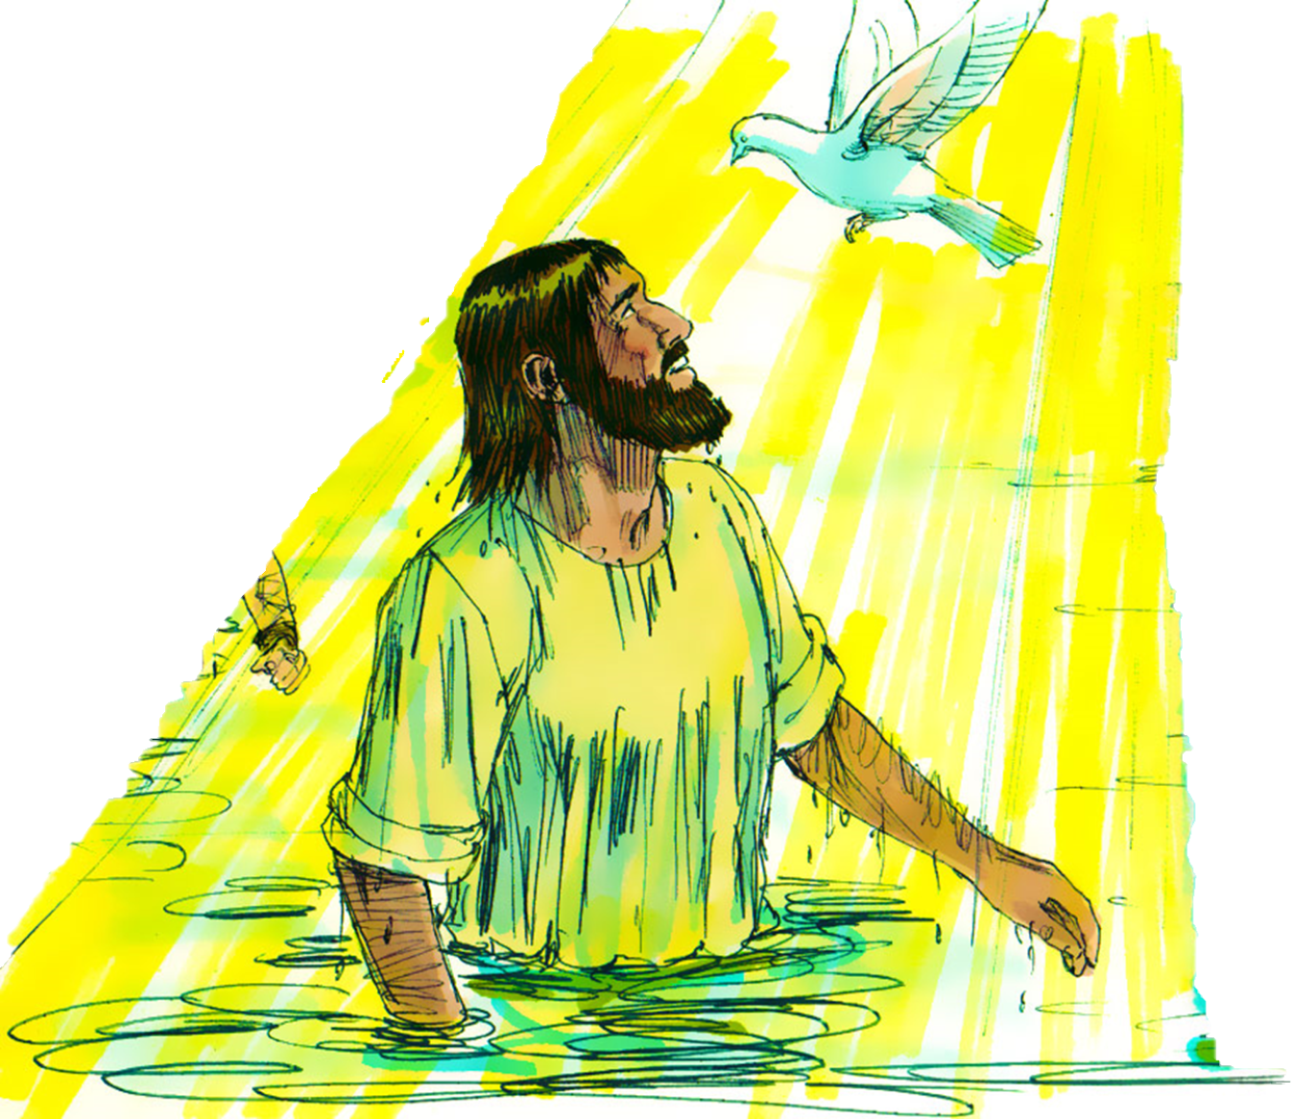

Slide 5
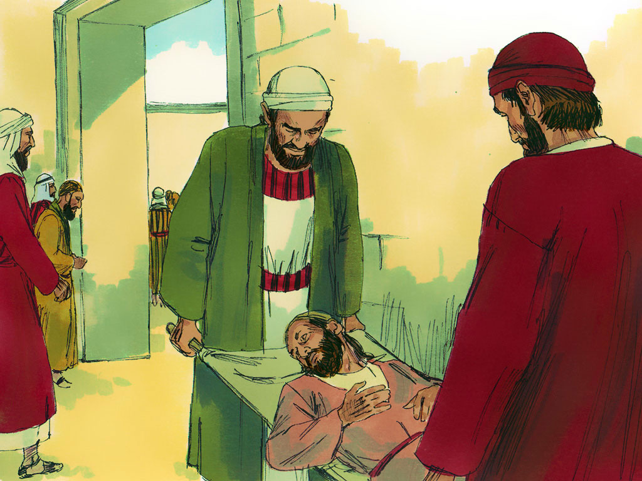

Slide 6
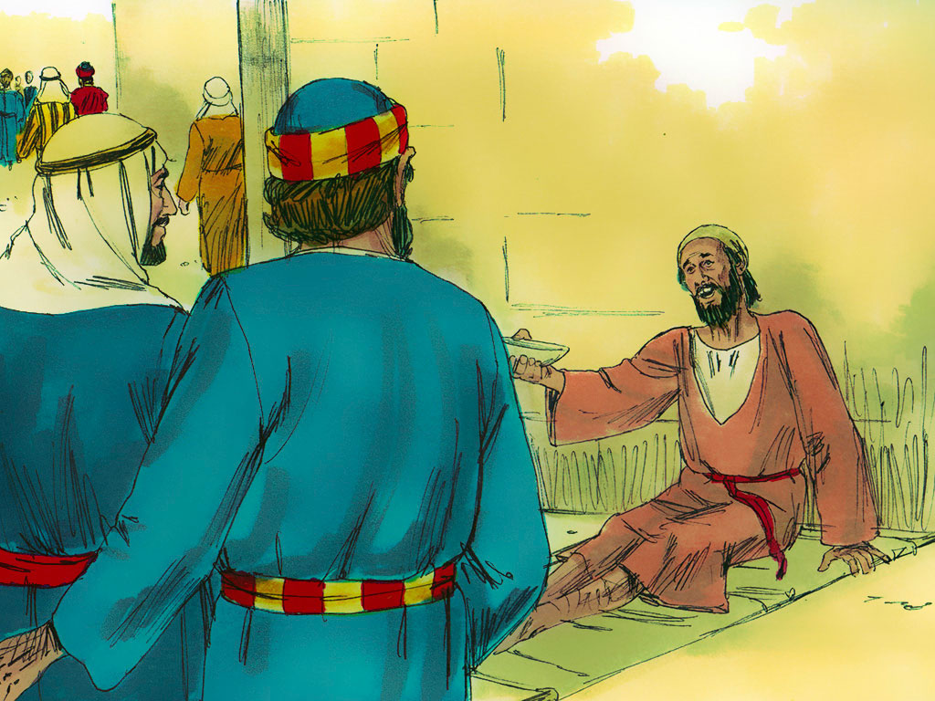

Slide 9
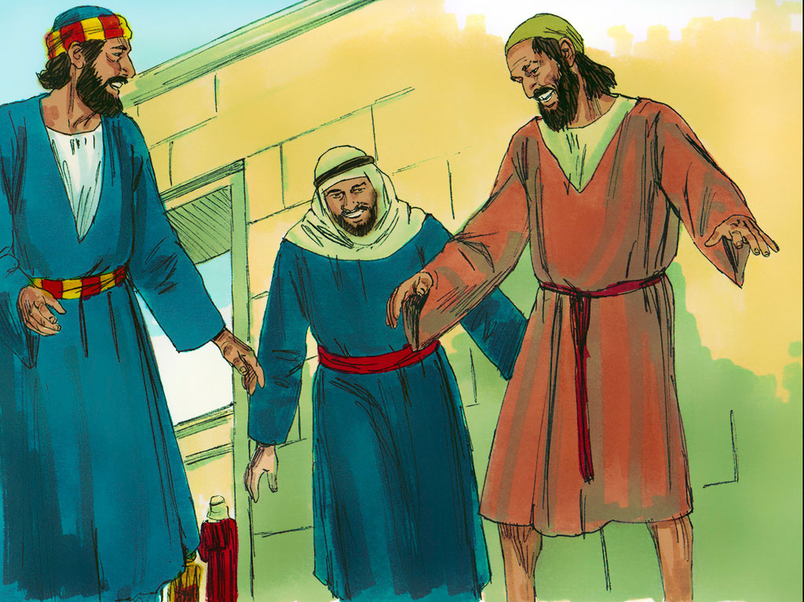
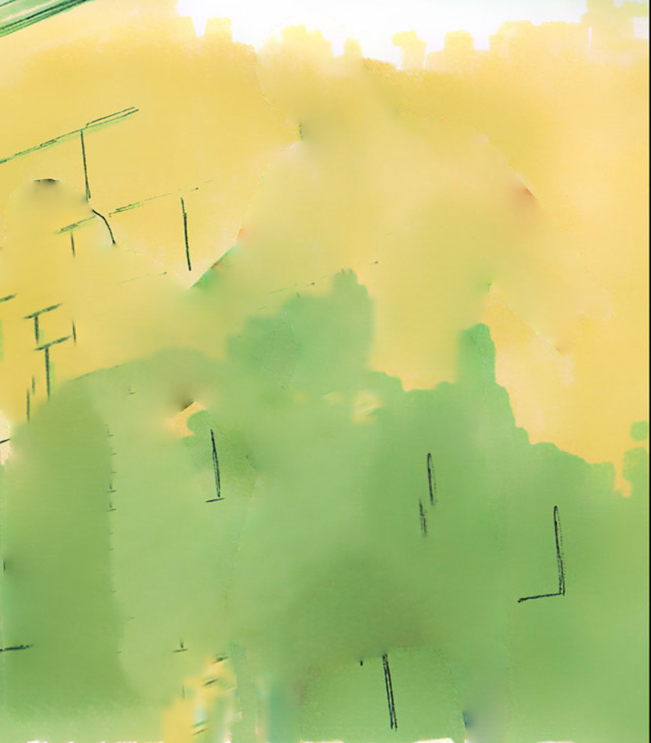

Slide 10
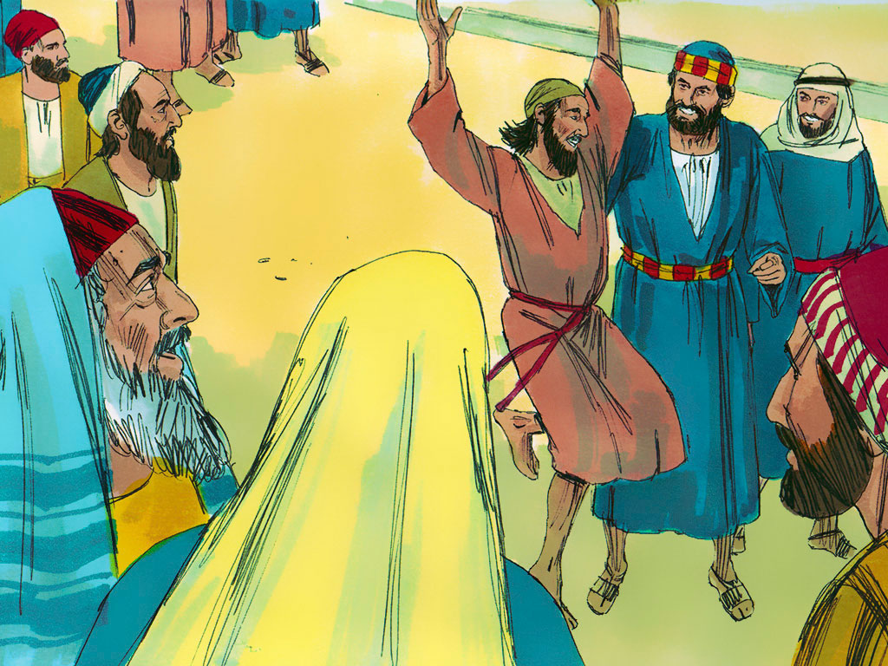

Slide 11
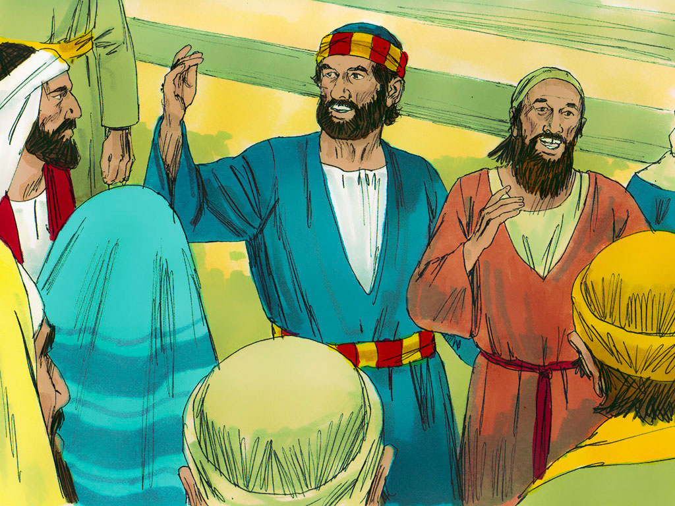

Slide 12
Head, shoulders, knees and toes,
Knees and toes,
Head, shoulders, knees and toes,
Knees and toes
And eyes and ears
and mouth and nose
Head, shoulders, knees and toes,
Knees and toes

Slide 13
If you’re happy and you know it clap your hands
If you’re happy and you know it clap your hands
If you’re happy and you know it
And you really want to show it
If you’re happy and you know it clap your hands

Slide 14
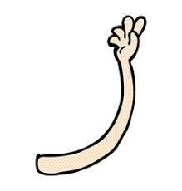
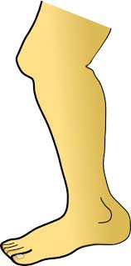
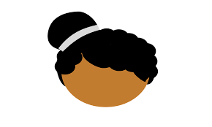
1 finger, 1 thumb keep moving
1 finger, 1 thumb keep moving
1 finger, 1 thumb keep moving
We’ll all be merry and bright
1 arm
1 leg
1 nod of the head
Stand up, sit down

Slide 15
Put your right arm in, your right arm out
In, out, in, out, shake it all about
You do the Hokey-Cokey and you turn around
That’s what it’s all about.
Woah-oh the Hokey-Cokey x3
Knees bend, arms stretch. Rah Rah Rah!

Slide 16
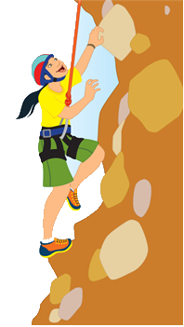
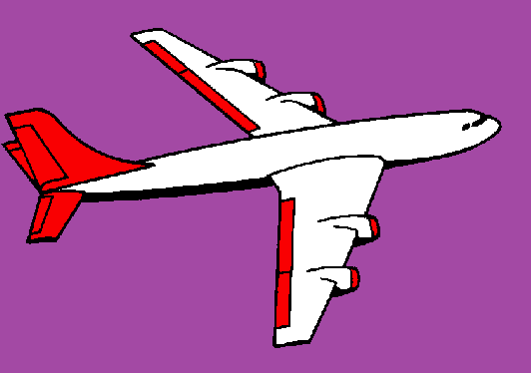
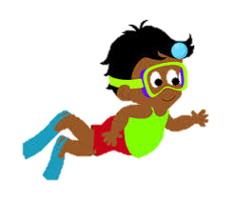
If I go climbing, climbing, climbing
If I go climbing; God is there
If I go climbing on the highest mountain
God is there ‘cos he is everywhere.
If I go flying in the biggest aeroplane
If I go driving far away
If I go swimming in the deepest ocean

