Slide 1
WELCOME
to the
Preschool Playgroup
Run by Holy Trinity Church
Find us on Facebook
playgroup@htcchicago.org

Slide 2
K
N
G
the
I
is here!

Slide 3
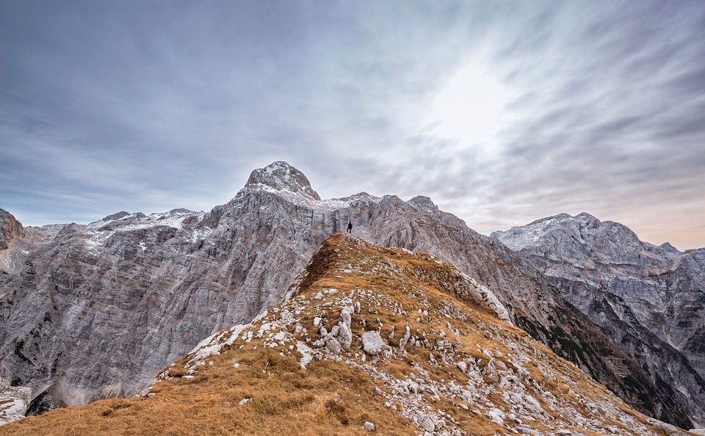
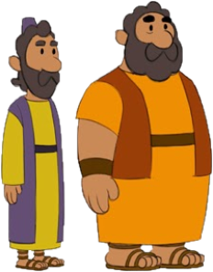
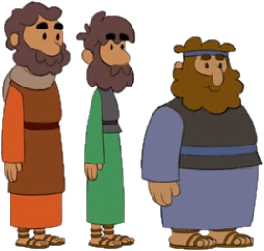
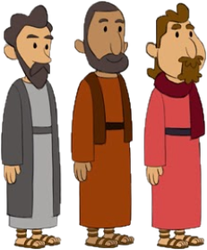
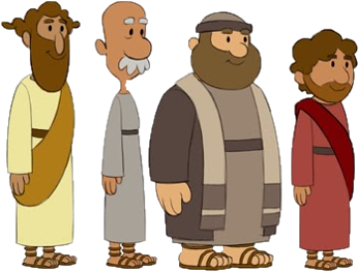

Slide 5
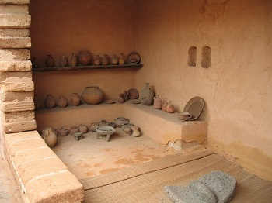

Slide 11
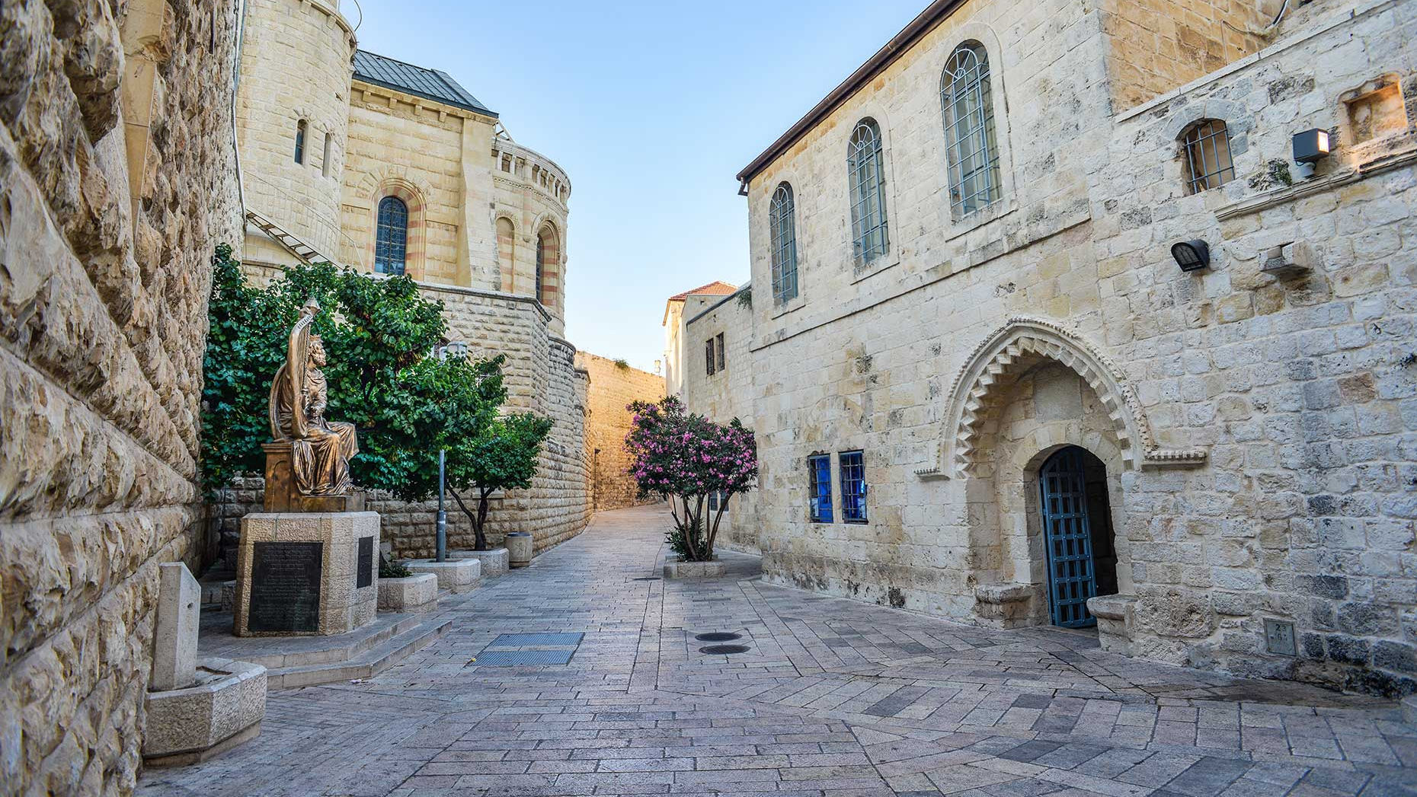

Slide 24
A
A B C D E F G
H I J K
L M N O P
Q R S
T U V
W X Y and Z
Now I know my ABCs
Next time won’t you sing with me?

Slide 25
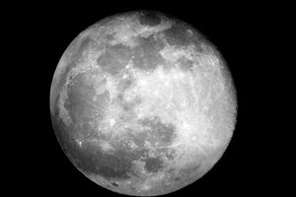
Zoom zoom zoom
We’re going to the moon
Zoom zoom zoom
We’ll be there very soon
If you want to take a trip
Climb aboard my rocket ship
Zoom zoom zoom
We’re going to the moon
Zoom zoom zoom
We’ll be there very soon
一
二
三
四
五
六
七
八
九
十

Slide 26
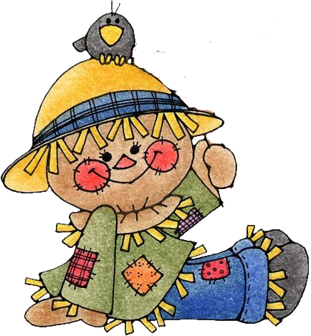
When all the cows are sleeping
And the sun has gone to bed
Up jumps the scarecrow and this is what he said
I’m a dingle dangle scarecrow With a flippy floppy hat
I can shake my arms like this I can shake my legs like that.
When all the hens are roosting and the sun’s behind a cloud
Up jumps the scarecrow and shouted very loud… The dogs are in the kennel
and the doves are in the loft
Up jumps the scarecrow and whispers very soft…

Slide 27
Skidamarink a dink a dink
Skidamarink a doo
I love you
I love you in the morning
And in the afternoon
I love you in the evening
And underneath the moon

Slide 28
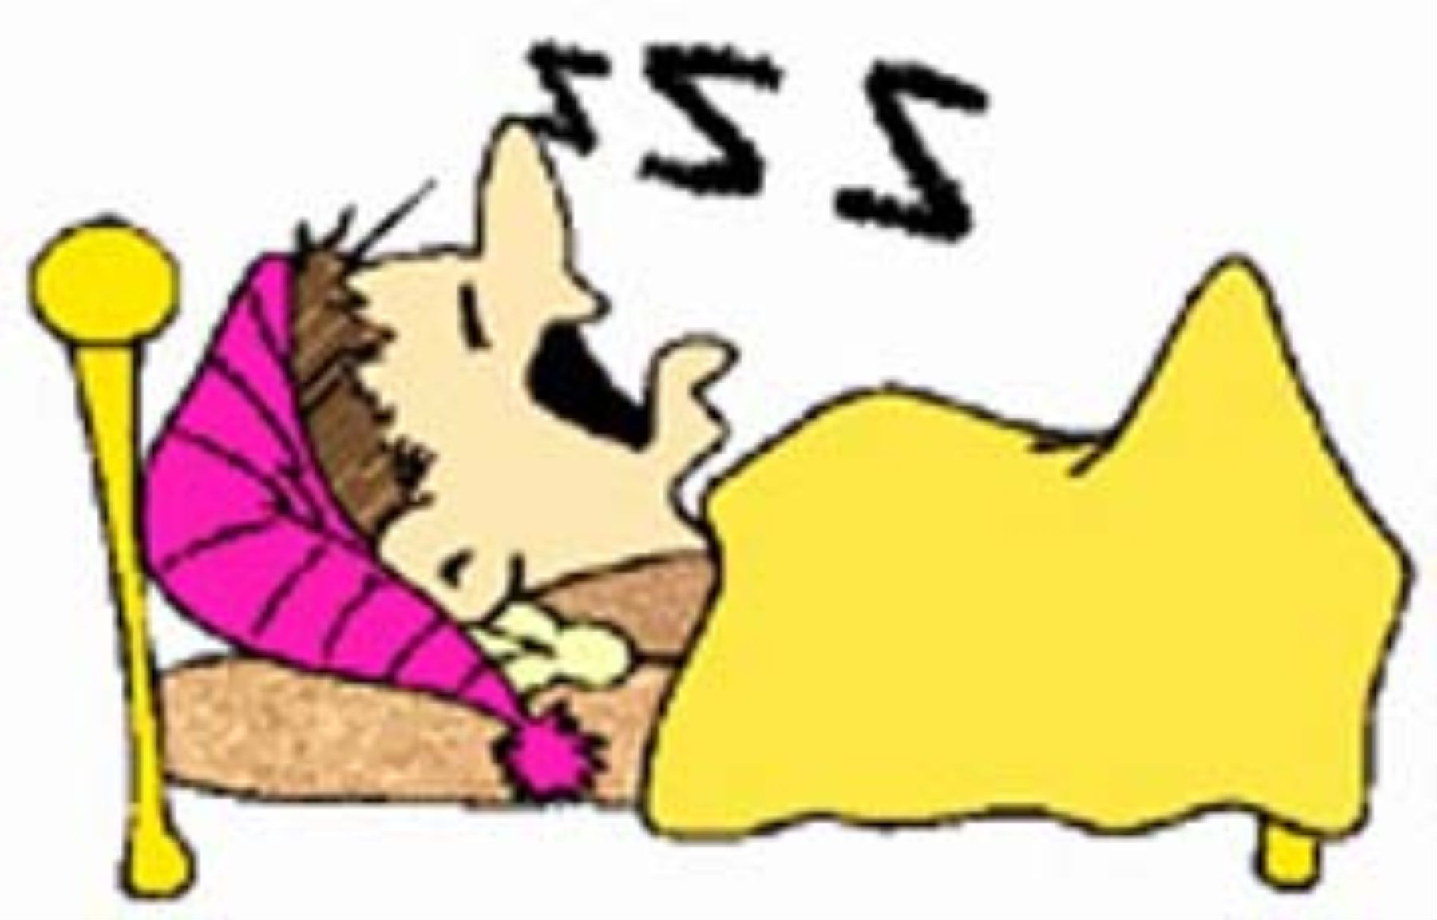
Frère Jacques Frère Jacques Dormez-vous? Dormez-vous?
Sonnez les matines Sonnez les matines Ding, dang, dong Ding, dang, dong
Are you sleeping?
Are you sleeping? Brother John,
Brother John, Morning bells are ringing!
Morning bells are ringing! Ding, dang, dong.
Ding, dang, dong.

