Slide 1
WELCOME
to the
Preschool Playgroup
Run by Holy Trinity Church
Find us on Facebook
playgroup@htcchicago.org

Slide 2
K
N
G
the
I
is here!

Slide 3
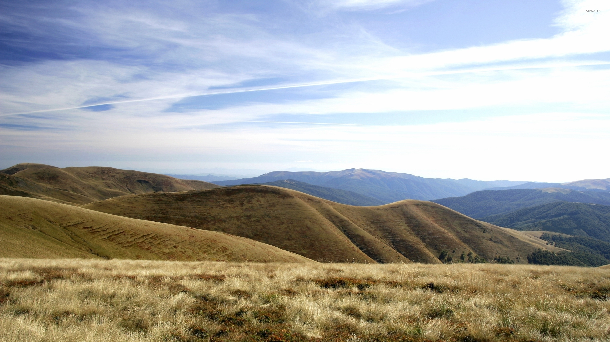
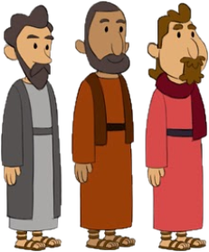
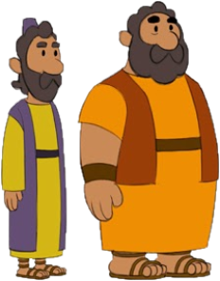
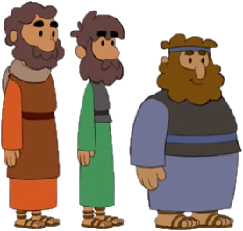
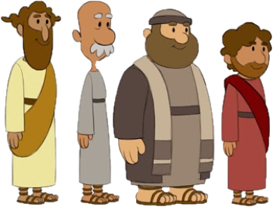

Slide 4
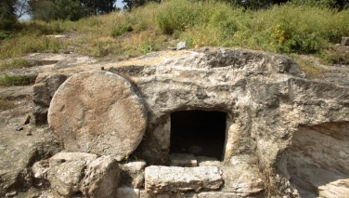
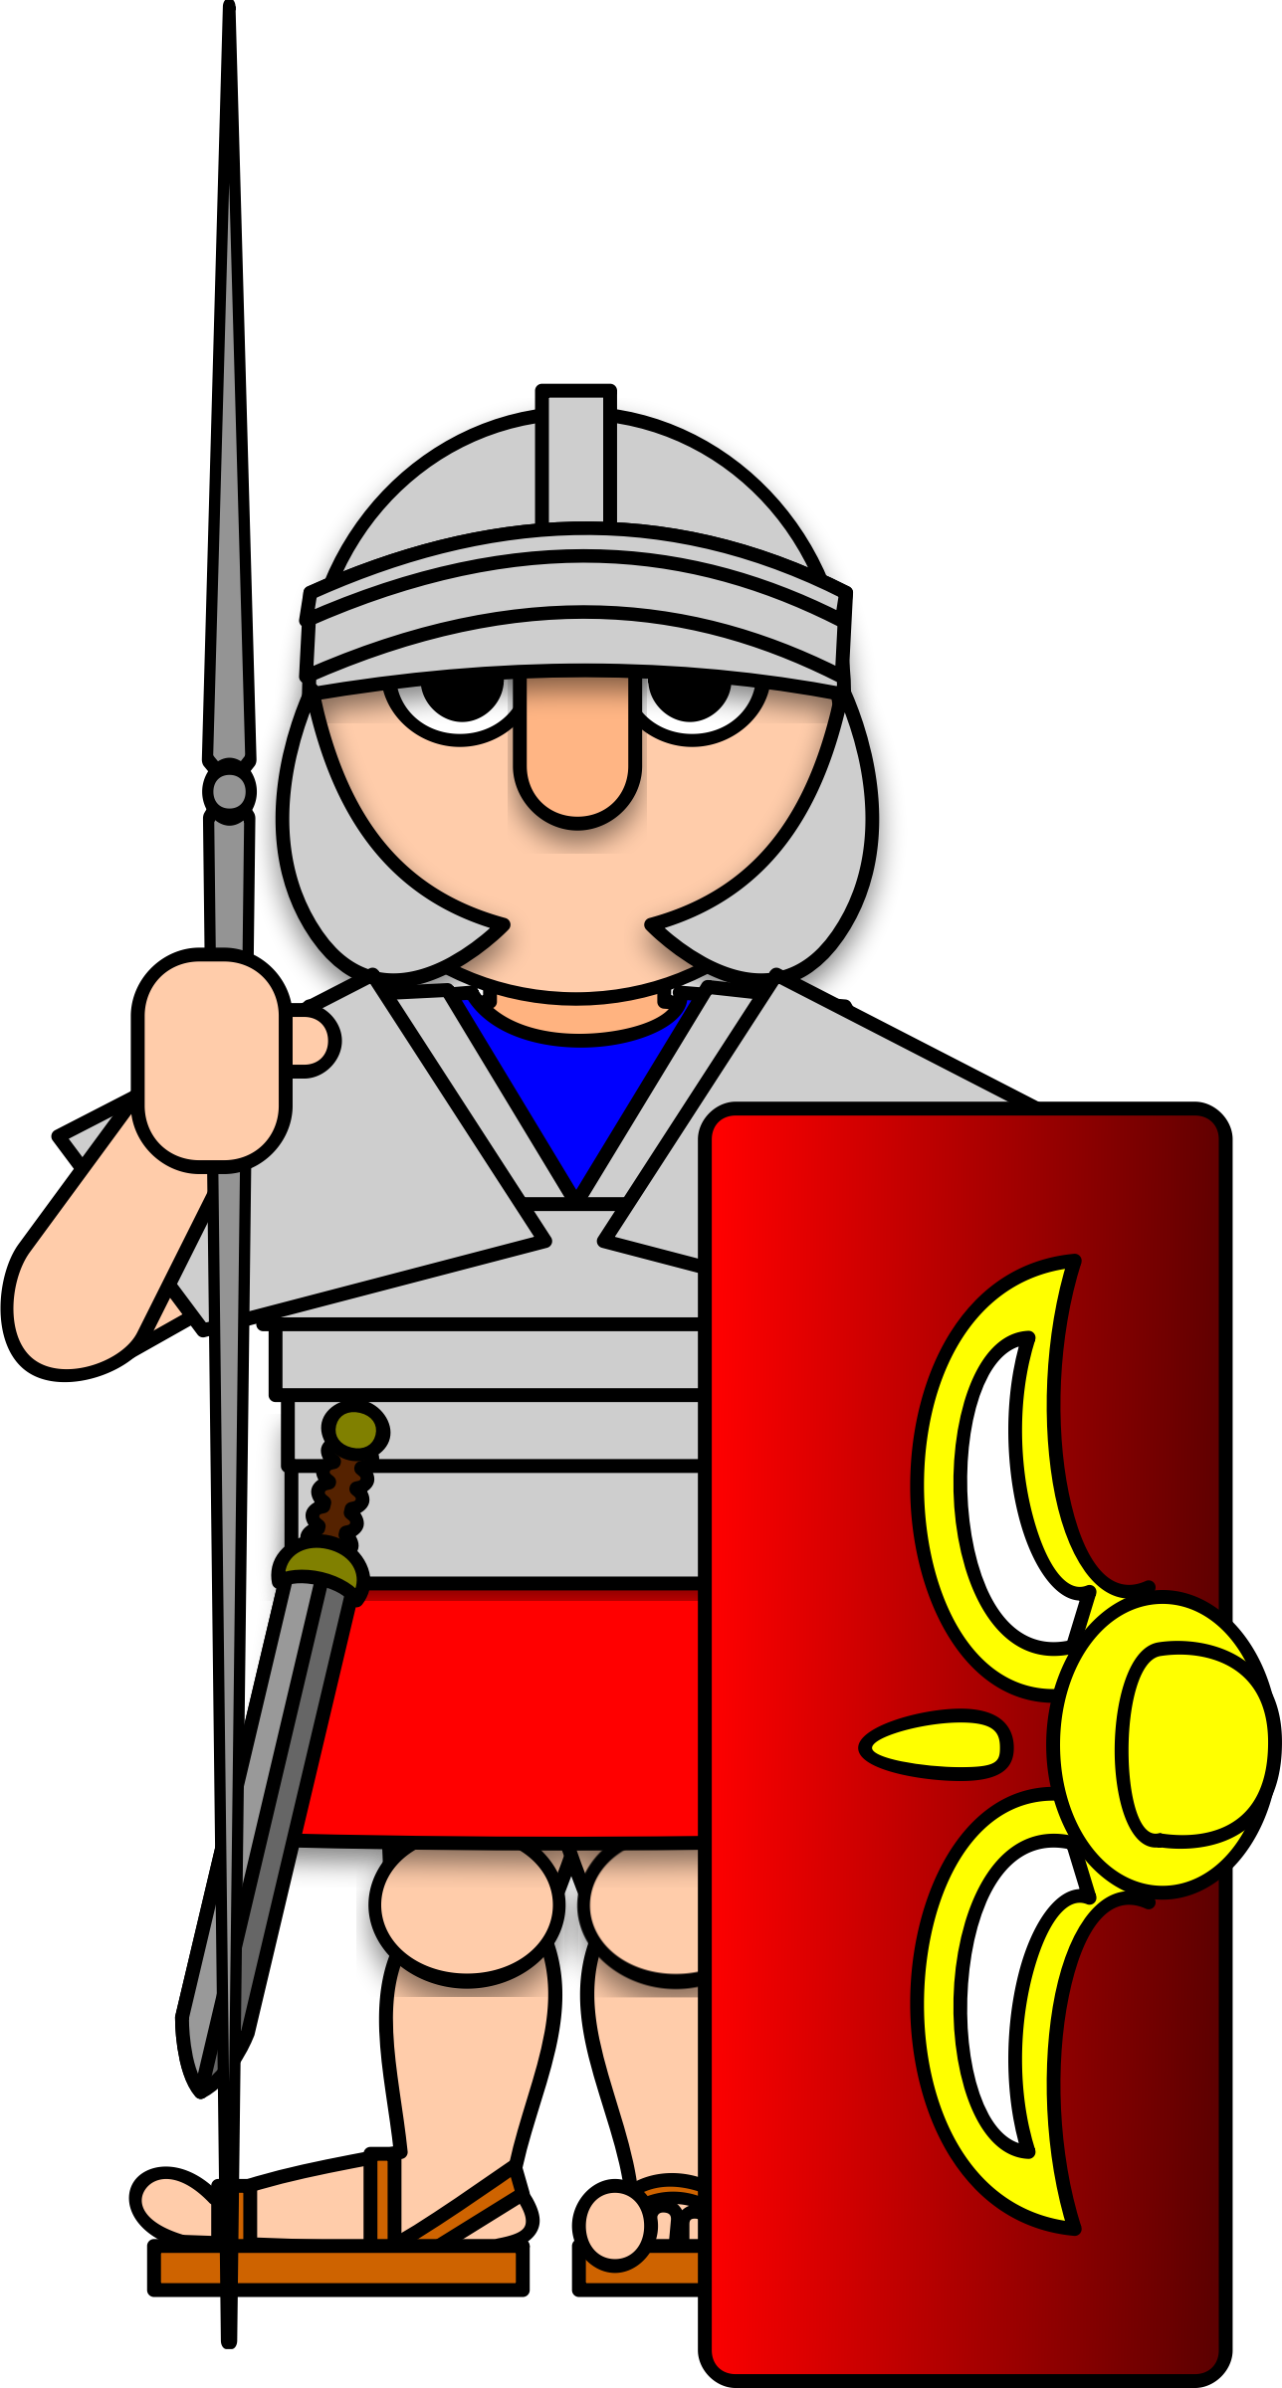

Slide 6
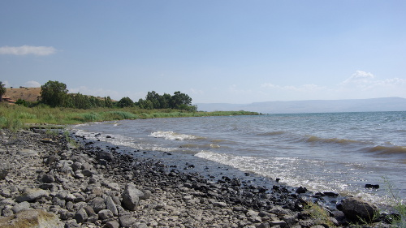

Slide 7
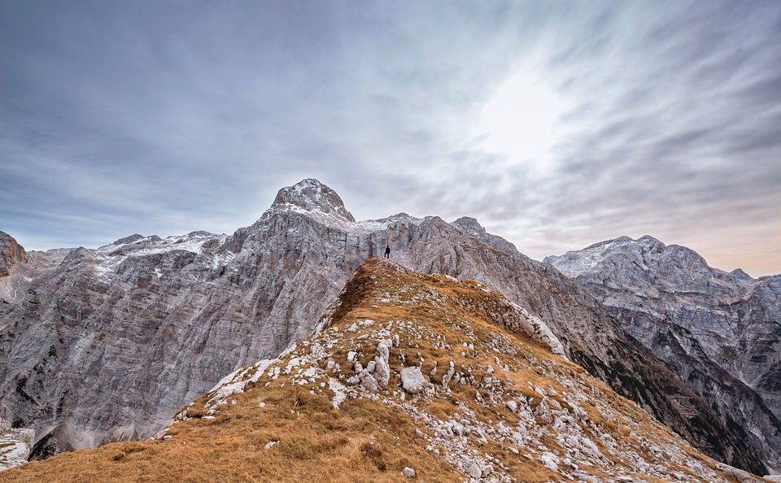

Slide 16
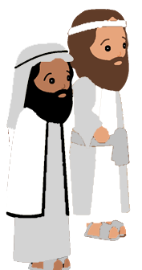

Slide 18
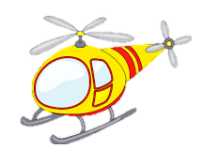
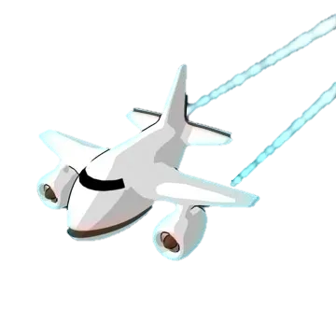
The blades on a copter go round and round
round and round, round and round
The blades on a copter go round and round
All through the town
The jets on a plane go vroom, vroom, vroom...
The wings of a bird flap up and down...
The wings on a fly go buzz, buzz, buzz

Slide 19
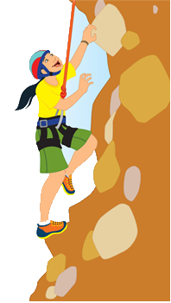
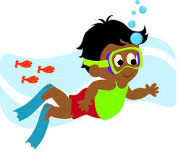
If I go climbing, climbing, climbing
If I go climbing; God is there
If I go climbing on the highest mountain
God is there ‘cos he is everywhere.
If I go flying in the biggest aeroplane
If I go driving far away
If I go swimming in the deepest ocean

Slide 20
Here is the bee hive
But where are the bees?
Hiding inside where nobody sees!
Here they come creeping out the hive
1 – 2 – 3 – 4 – 5
…
Here they come creeping out again
1 – 2 – 3 – 4 – 5 – 6 – 7 – 8 – 9 – 10

Slide 21
5 little ducks went flying one day
Over the hills and far away
Mummy duck said “Quack, quack, quack, quack.”
But only 4 little ducks came back.
4… 3… 2… 1… 0…
Mummy Duck went flying…
5 little ducks came flying right back

Slide 22
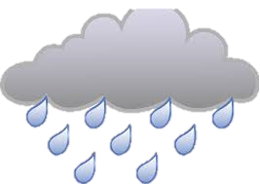
Itsy-Bitsy spider climbed up the water spout
Down came the rain and washed the spider out
Out came the sunshine and dried up all the rain
So Itsy-Bitsy spider climbed up the spout again.

