Slide 1
WELCOME
to the
Preschool Playgroup
Run by Holy Trinity Church
Find us on Facebook
playgroup@htcchicago.org

Slide 2
K
N
G
the
I
is here!

Slide 3
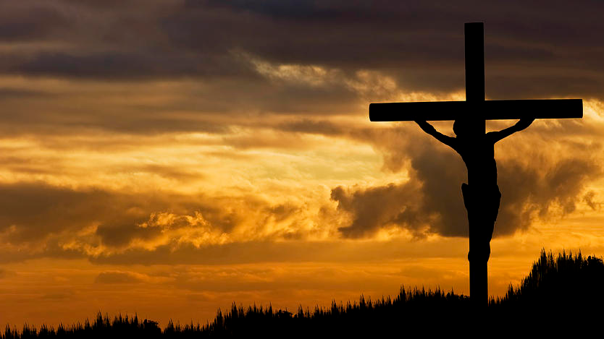

Slide 4
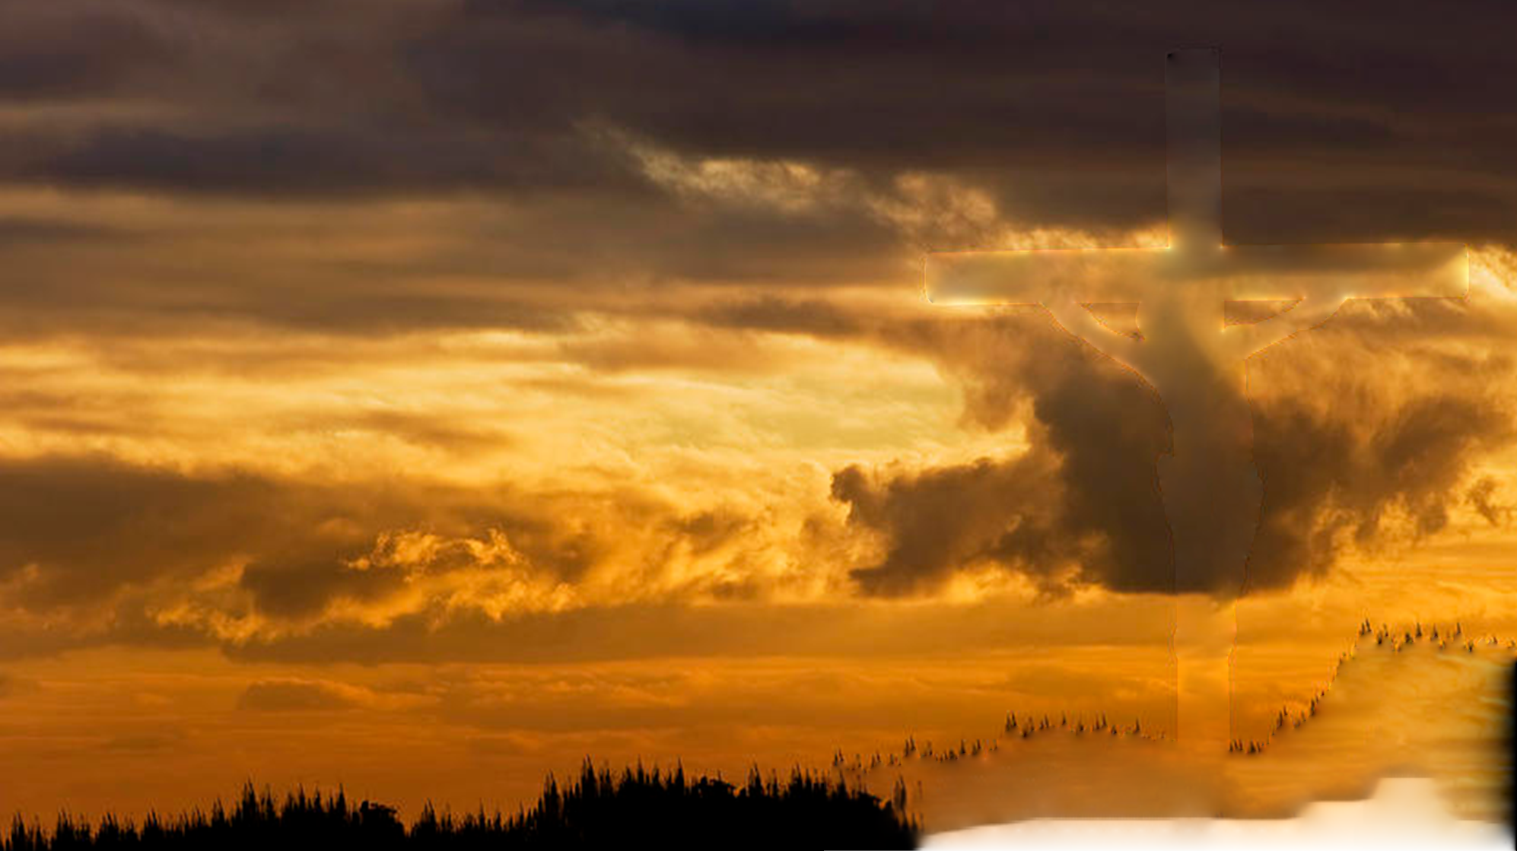
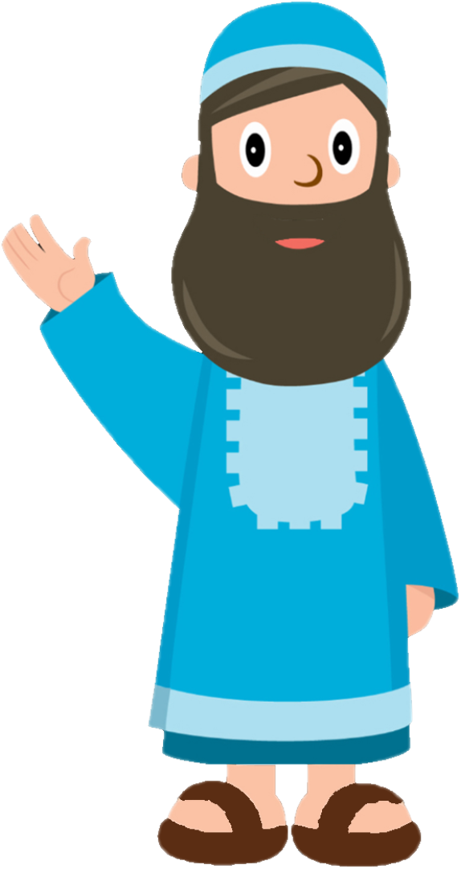
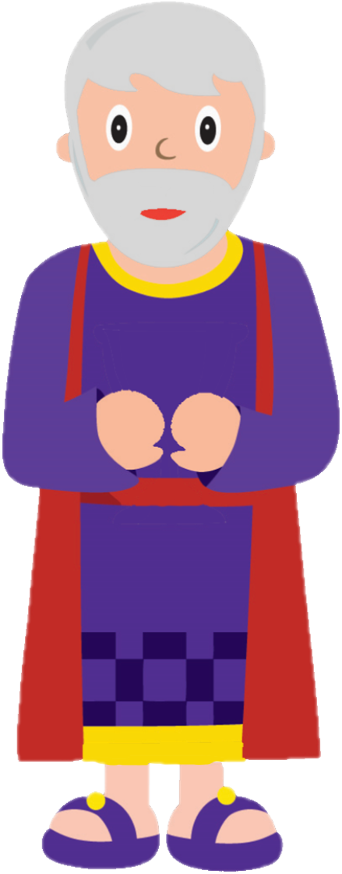
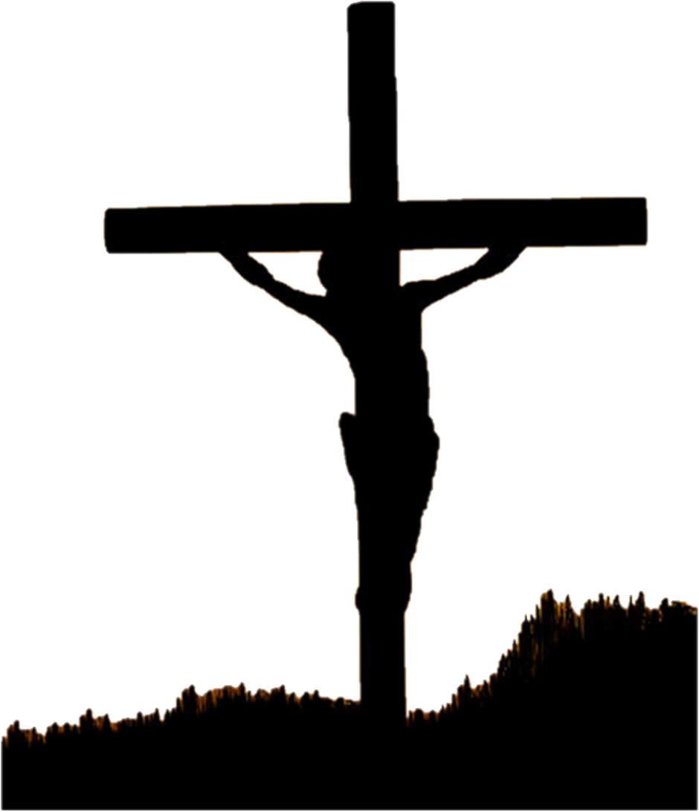

Slide 5
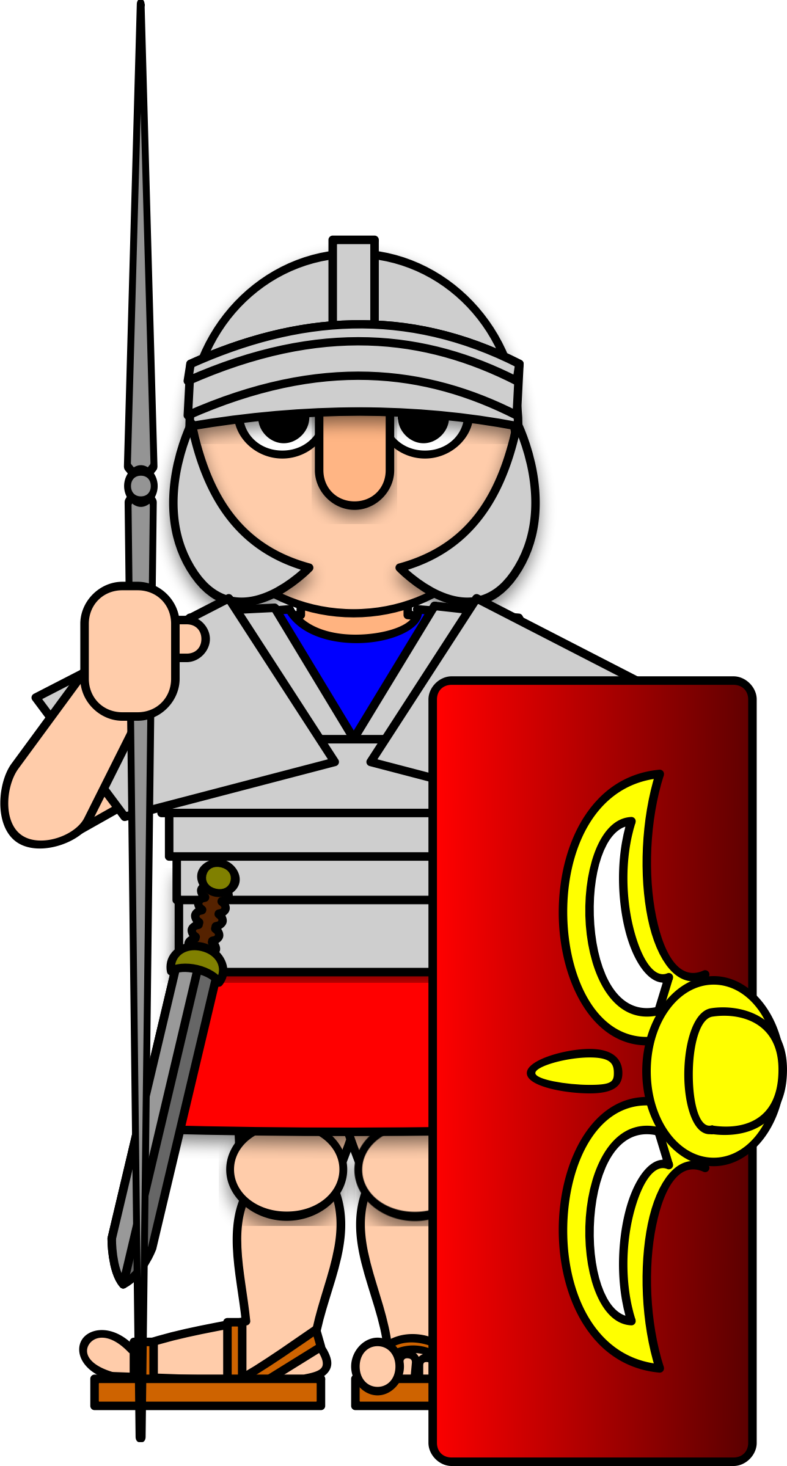

Slide 7
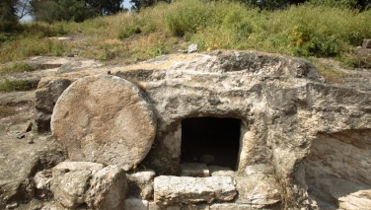

Slide 8
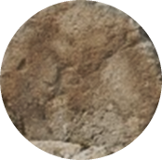

Slide 9
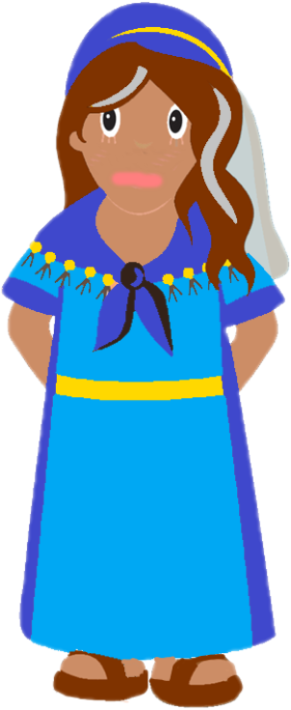
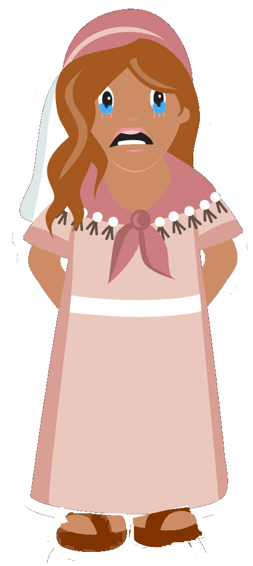

Slide 10
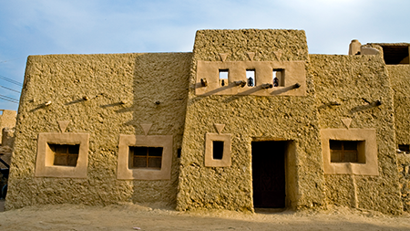

Slide 11
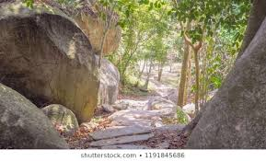

Slide 13
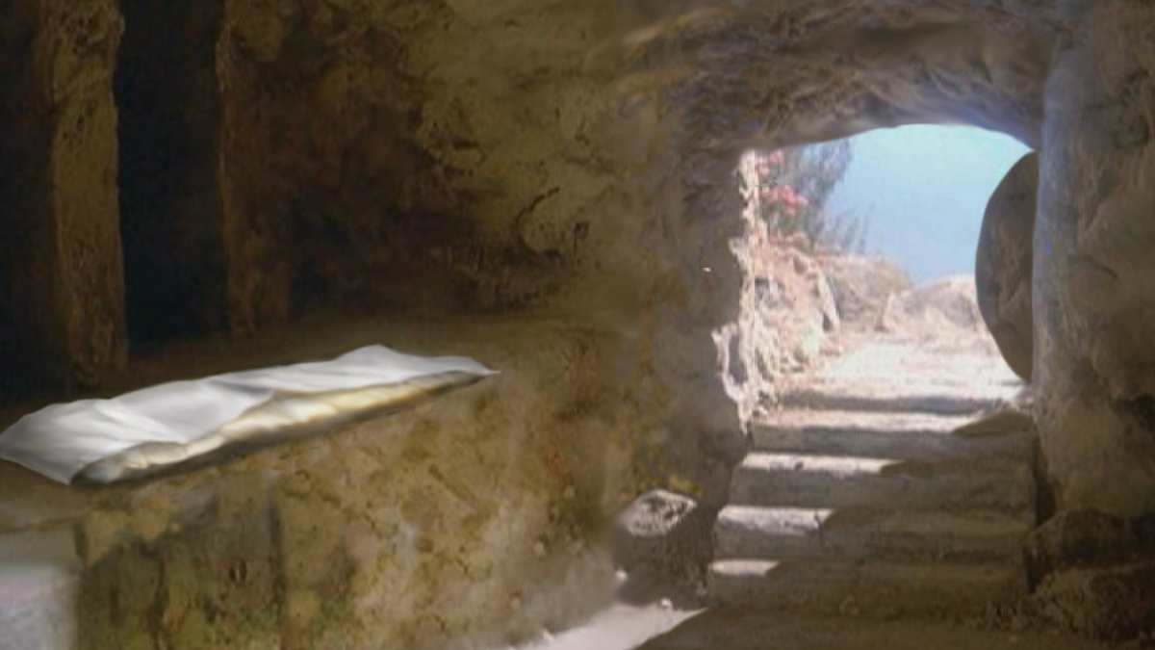

Slide 19
Skidamarink a dink a dink
Skidamarink a doo
I love you
I love you in the morning
And in the afternoon
I love you in the evening
And underneath the moon

Slide 20
He’s got the whole world in his hands
He’s got the whole wide world in his hands
He’s got the whole world in his hands
He’s got the whole world in his hands
He’s got you and me in his hands…
He’s got everybody here in his hands...

Slide 21
He died upon the cross
He died upon the cross
He died upon the cross
For me, for me, for, just for me
One day when I was lost
He died upon the cross
He died upon the cross
For me, for me, for, just for me
He rose up from the dead...

Slide 22
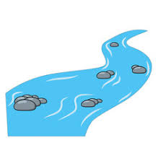
My God is so big, so strong and so mighty
There’s nothing that he cannot do
My God is so big, so strong and so mighty
There’s nothing that he cannot do
The mountains are his
The rivers are his
The stars are his handiwork too!
My God is so big, so strong and so mighty
There’s nothing that he cannot do

Slide 23
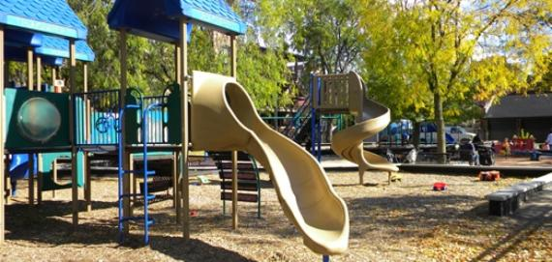
Next Week:
Join us at the park!

