Slide 1
WELCOME
to the
Preschool Playgroup
Run by Holy Trinity Church
Find us on Facebook
playgroup@htcchicago.org

Slide 2
God Rescues

Slide 3
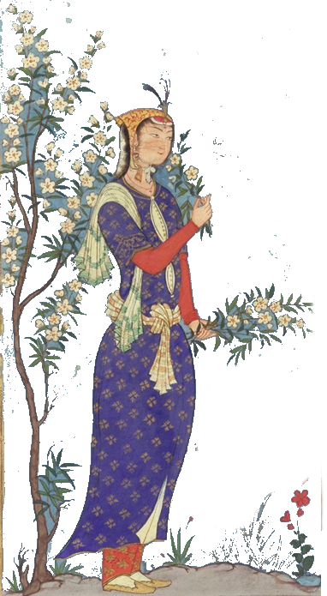

Slide 4
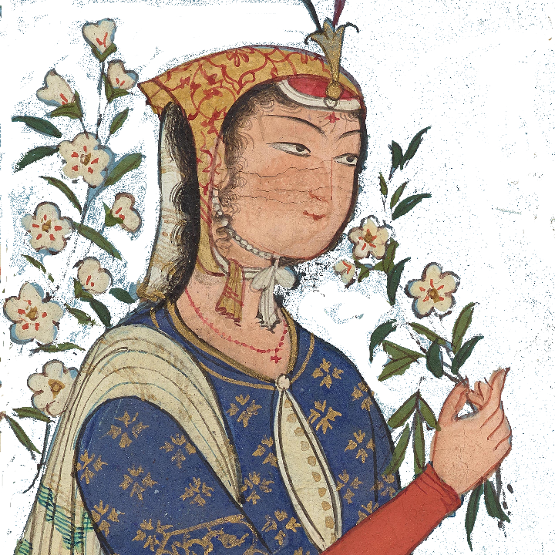
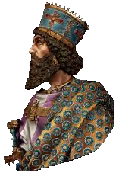
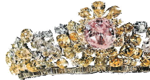

Slide 5
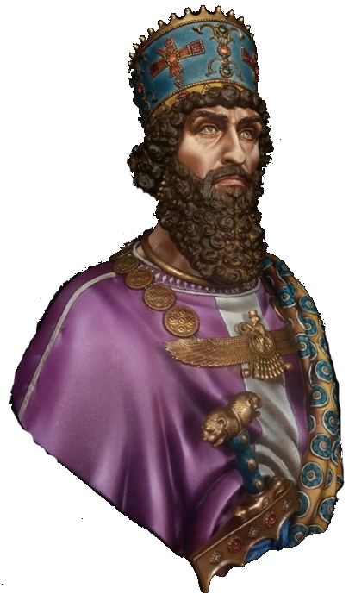
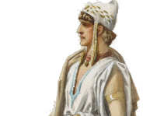

Slide 6
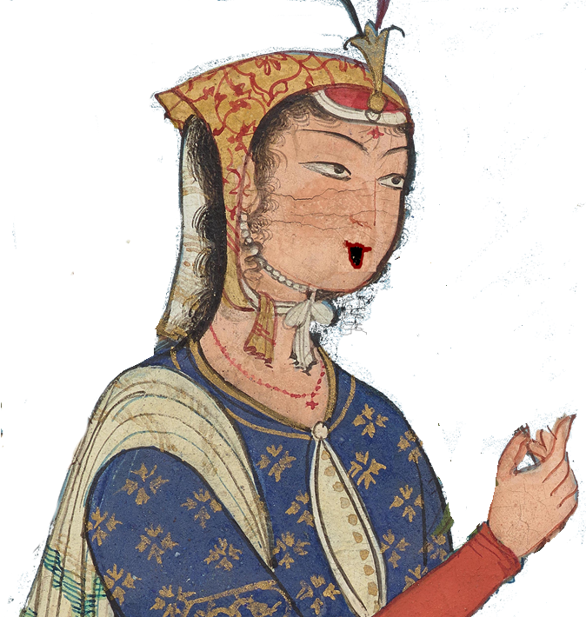

Slide 7
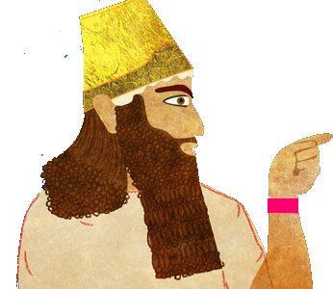

Slide 9
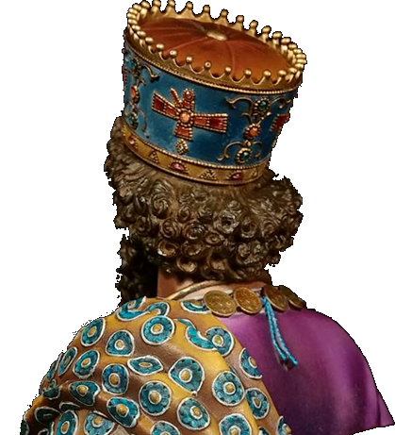

Slide 10
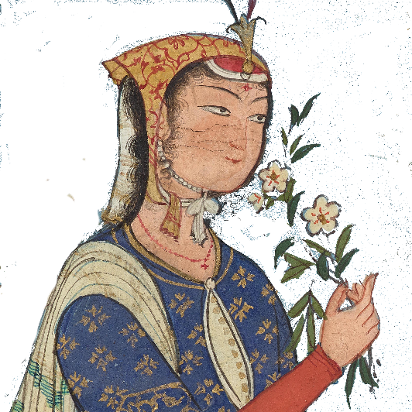

Slide 11
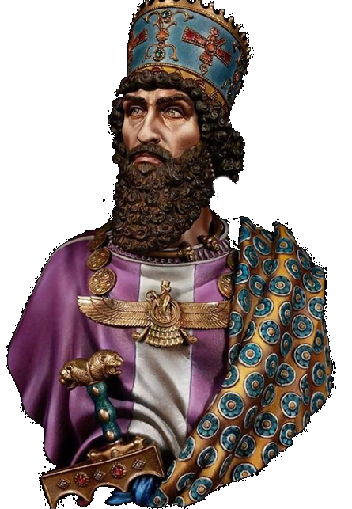

Slide 14
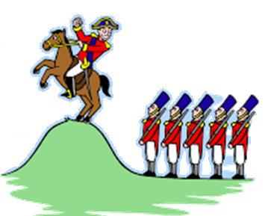
Oh, the grand old Duke of York
He had ten-thousand men
He marched them up to the top of the hill
And he marched them down again.
And when they were up, they were up
And when they were down, they were down
And when they were only half way up
They were neither up nor down.

Slide 15
5 little princes jumping on the bed
One fell off and bumped his head
They called the royal doctor and the doctor said
“No more princes jumping on the bed”
4 little princes…

Slide 16
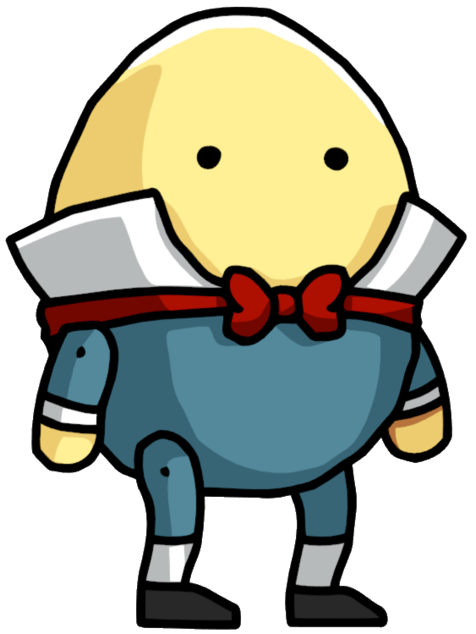
Humpty Dumpty sat on a wall
Humpty Dumpty had a great fall
All the kings horses and all the kings men
Couldn’t put humpty together again.

Slide 17
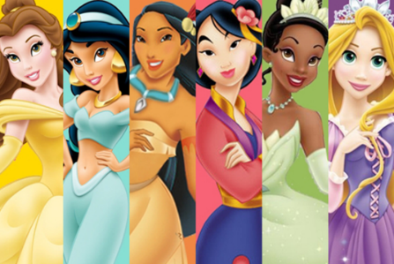
If you’re a princess and you know it clap your hands
If you’re a princess and you know it clap your hands
If you’re a princess and you know it
and you really want to show it
If you’re a princess and you know it clap your hands.

Slide 18
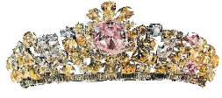
Crowns, shoulders, knees and toes,
Knees and toes,
Crowns, shoulders, knees and toes,
Knees and toes
And eyes and ears
and mouth and nose
Crowns, shoulders, knees and toes,
Knees and toes

Slide 19
What’s the best news you’ve ever heard?
A chance to ask your questions and investigate the basics about faith and Christianity.
Saturday evenings 7 weeks

