Slide 1
WELCOME
to the
Preschool Playgroup
Run by Holy Trinity Church
Find us on Facebook
playgroup@htcchicago.org

Slide 2
K
N
G
the
I
is here!

Slide 3
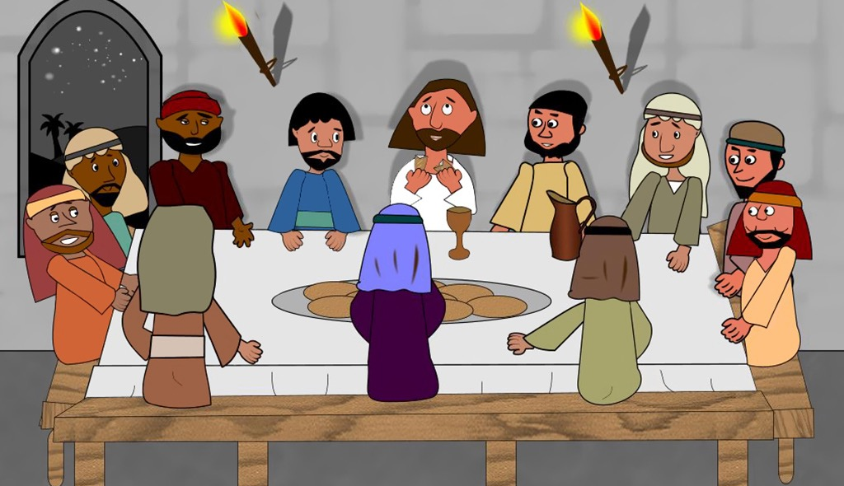

Slide 8
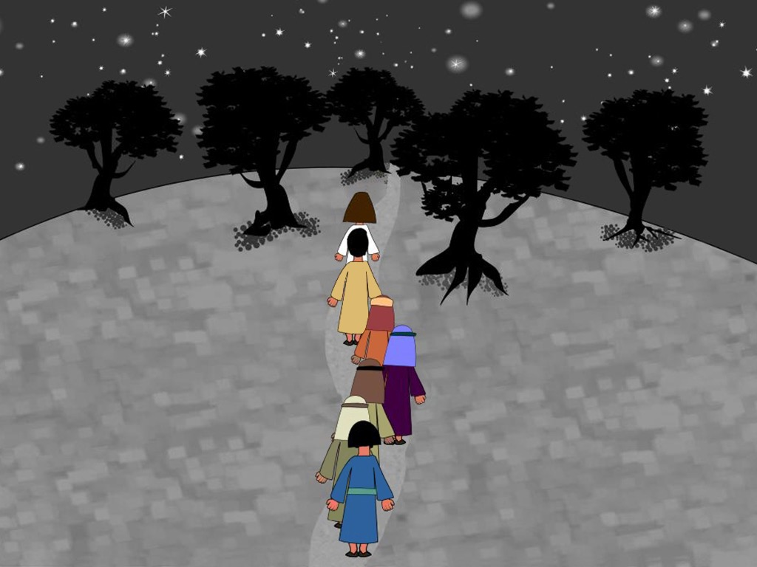

Slide 9
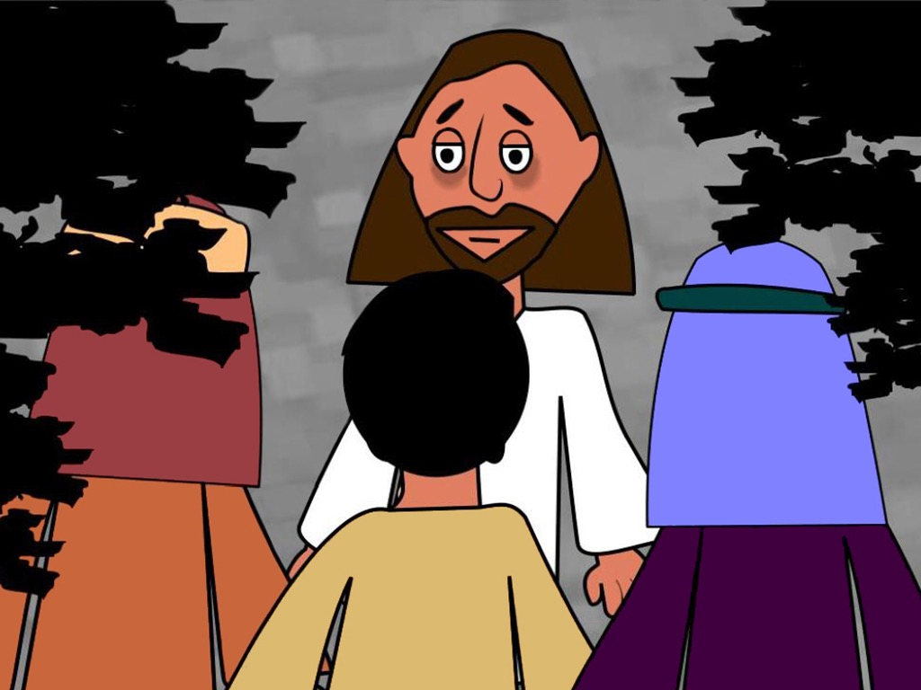

Slide 14
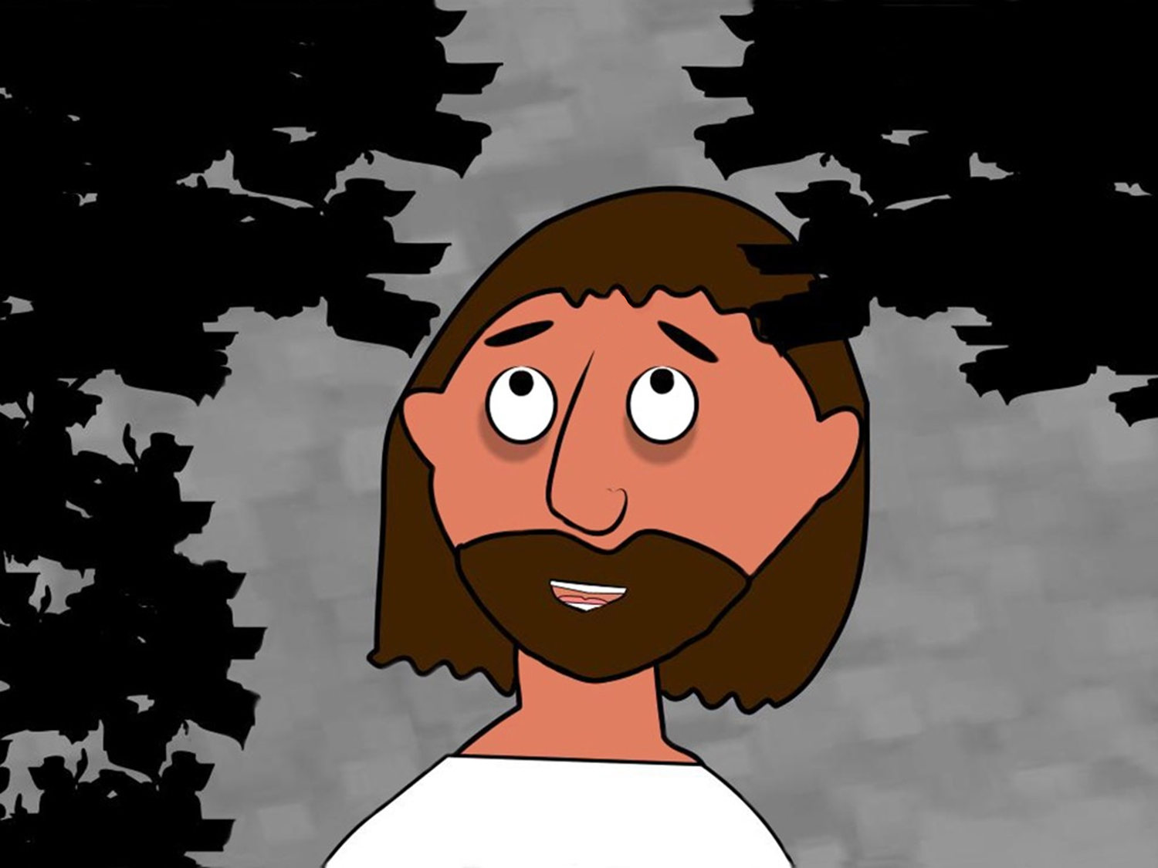

Slide 16
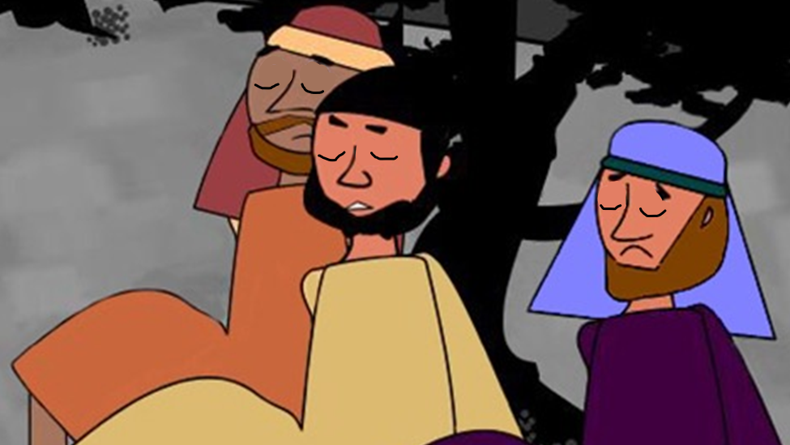

Slide 25
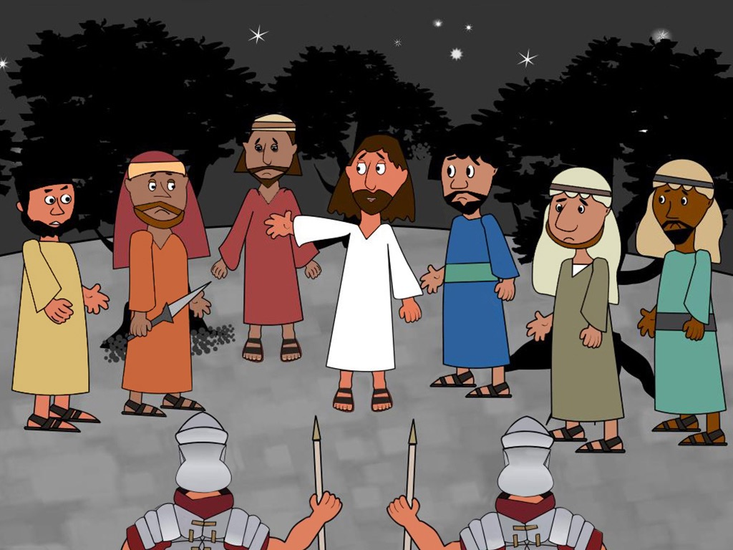

Slide 30
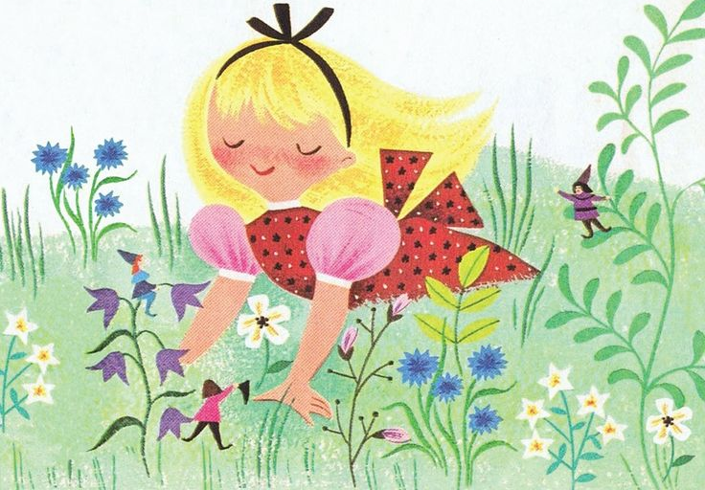
Mary, Mary, quite contrary
How does your garden grow?
With silver bells
And cockle shells
And pretty maids all in a row

Slide 31
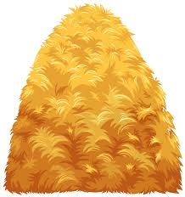
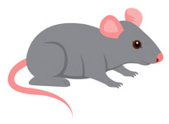
Round and round the garden
Like a teddy bear
One step, two steps
Tickle you under there
Round and round the haystack
Like a little mouse
One step, two steps
Right inside the house

Slide 32
Here is the bee hive
But where are the bees?
Hiding inside where nobody sees!
Here they come creeping out the hive
1 – 2 – 3 – 4 – 5
…
Here they come creeping out again
1 – 2 – 3 – 4 – 5 – 6 – 7 – 8 – 9 – 10

Slide 33
Ring a ring of roses
A pocket full of poses
Atishoo, atishoo
We all fall down
Fishes in the water
Fishes in the sea
We all jump up with a 1 – 2 – 3

Slide 34
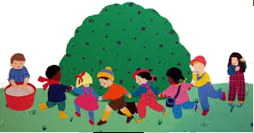
Here we go round the mulberry bush
The mulberry bush, the mulberry bush
Here we go round the mulberry bush
On a cold and frosty morning
This is the way we comb our hair…
This is the way we brush our teeth…
This is the way we put on clothes…

