Slide 1
WELCOME
to the
Preschool Playgroup
Run by Holy Trinity Church
Find us on Facebook
playgroup@htcchicago.org

Slide 2
K
N
G
the
I
is coming!

Slide 3
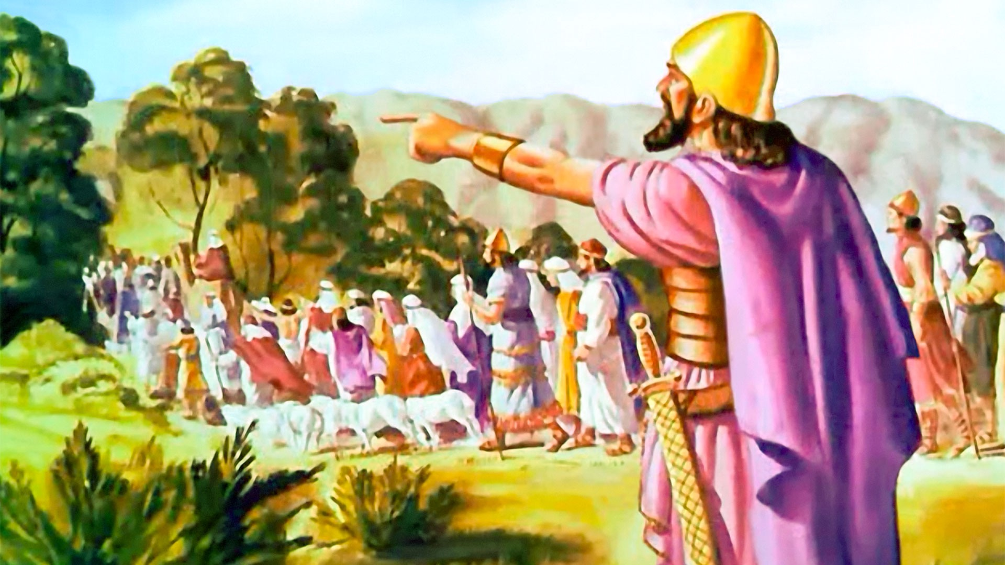

Slide 4
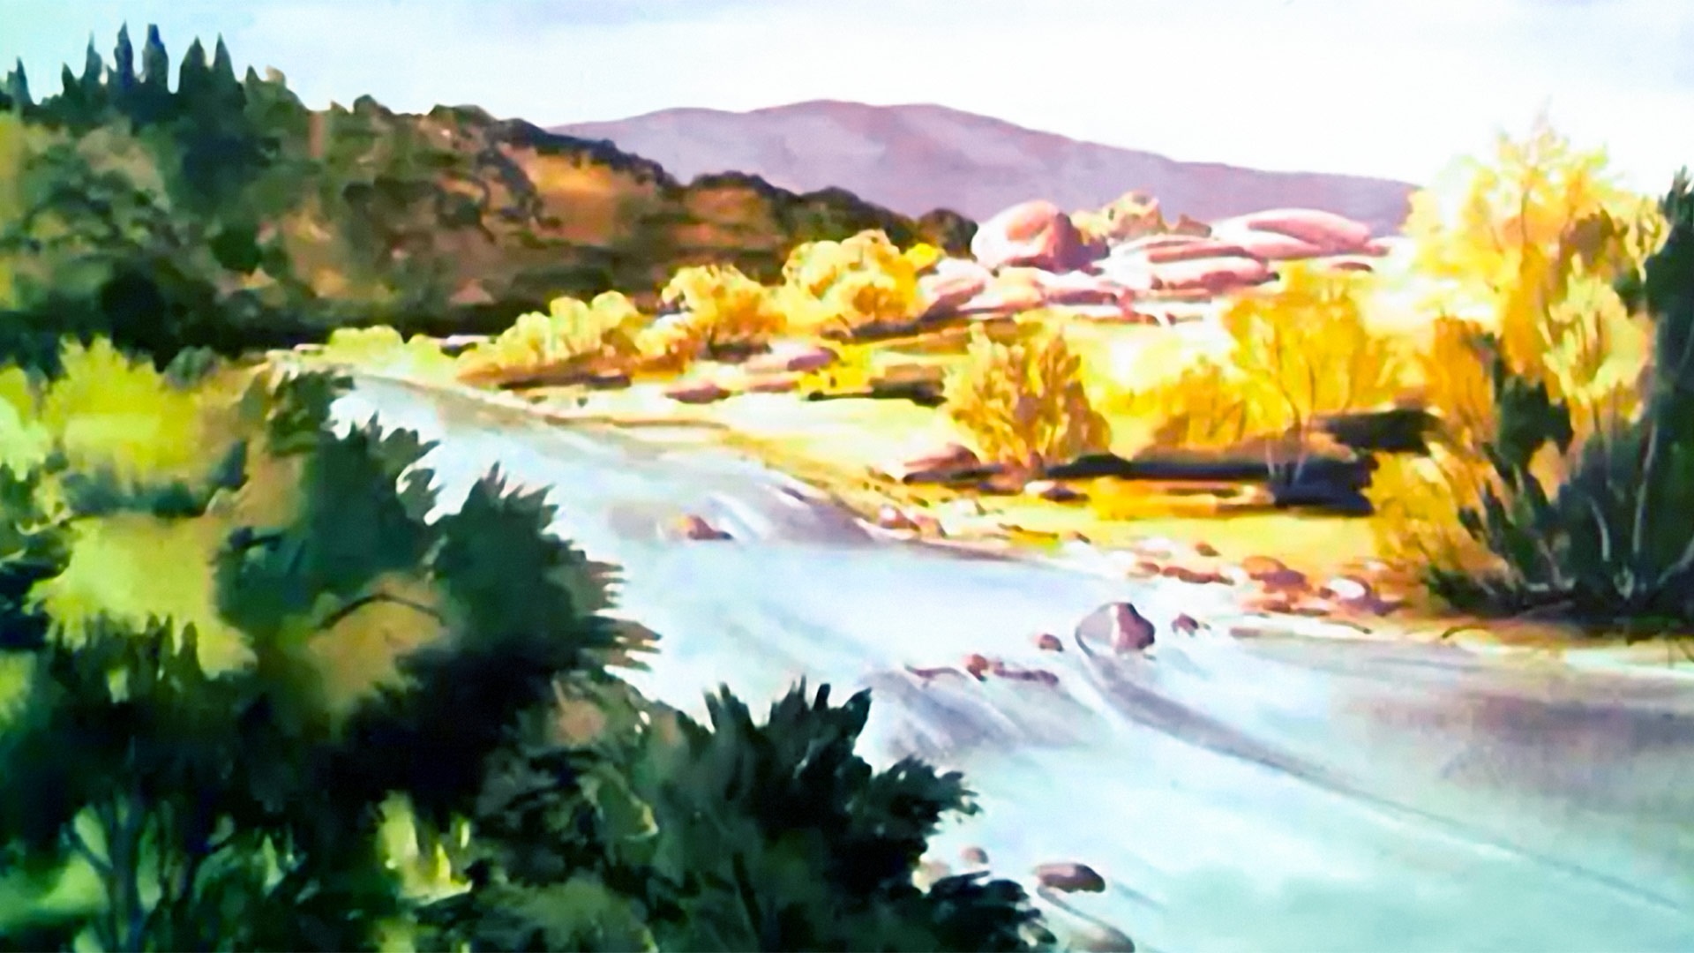

Slide 5
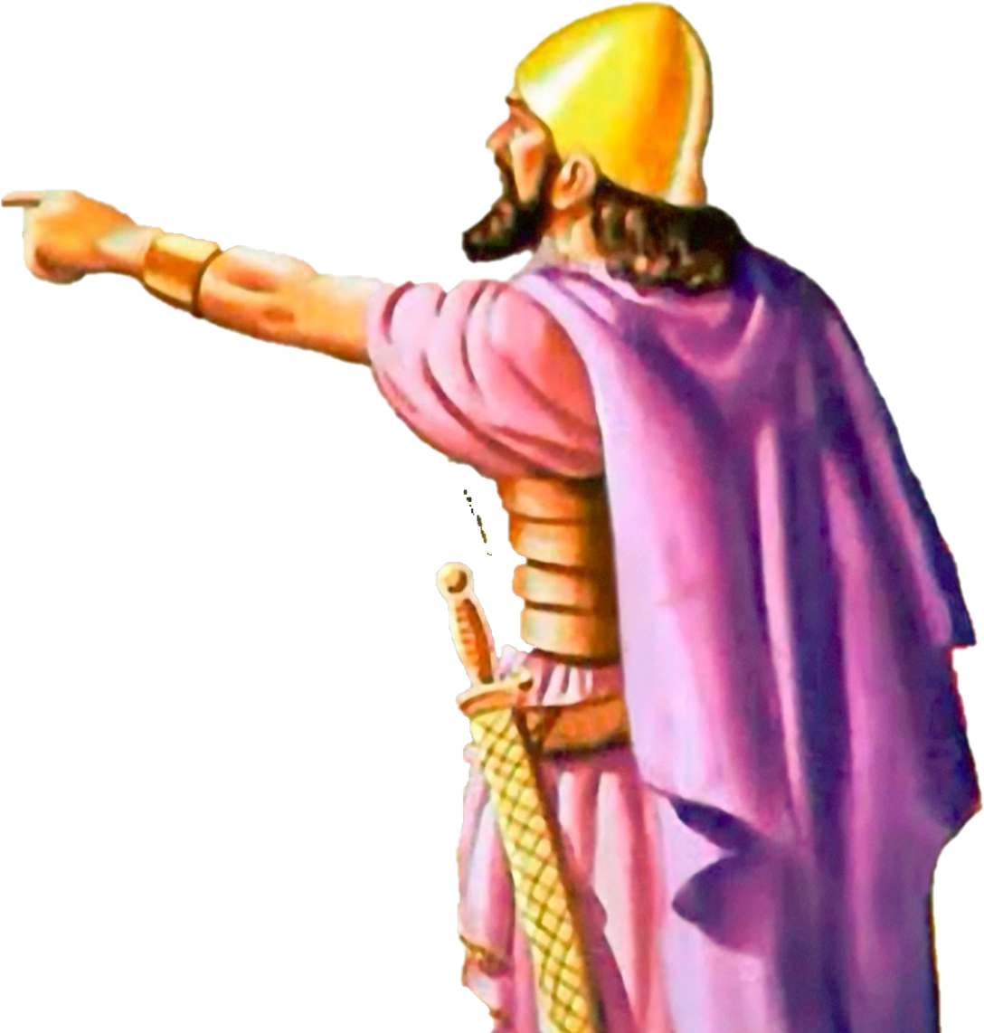

Slide 6
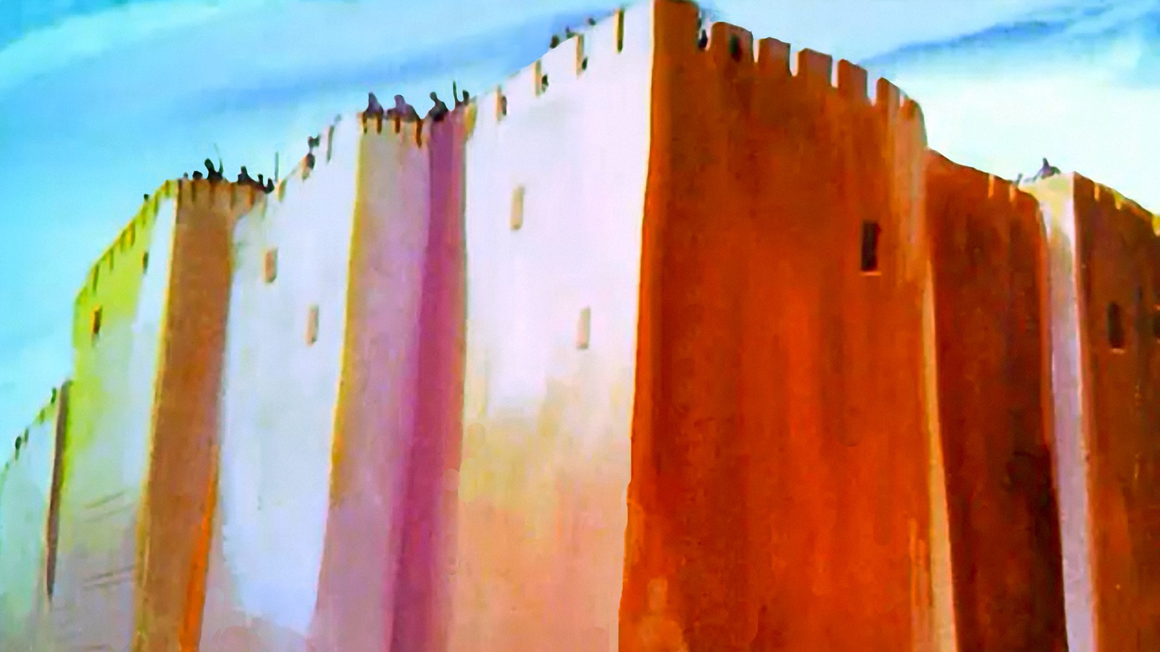

Slide 7
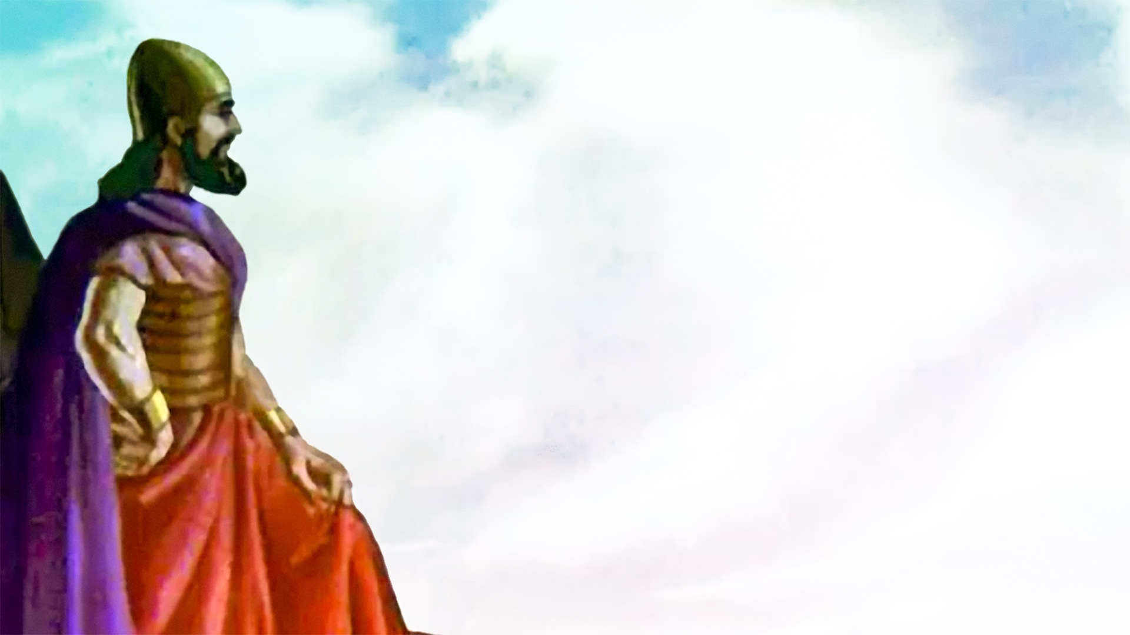

Slide 8
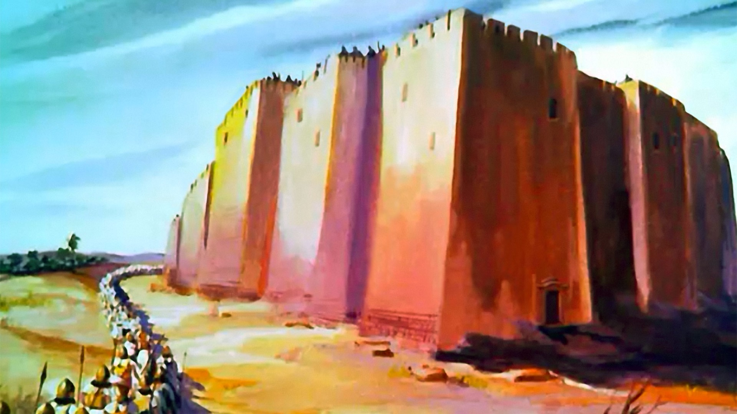

Slide 9
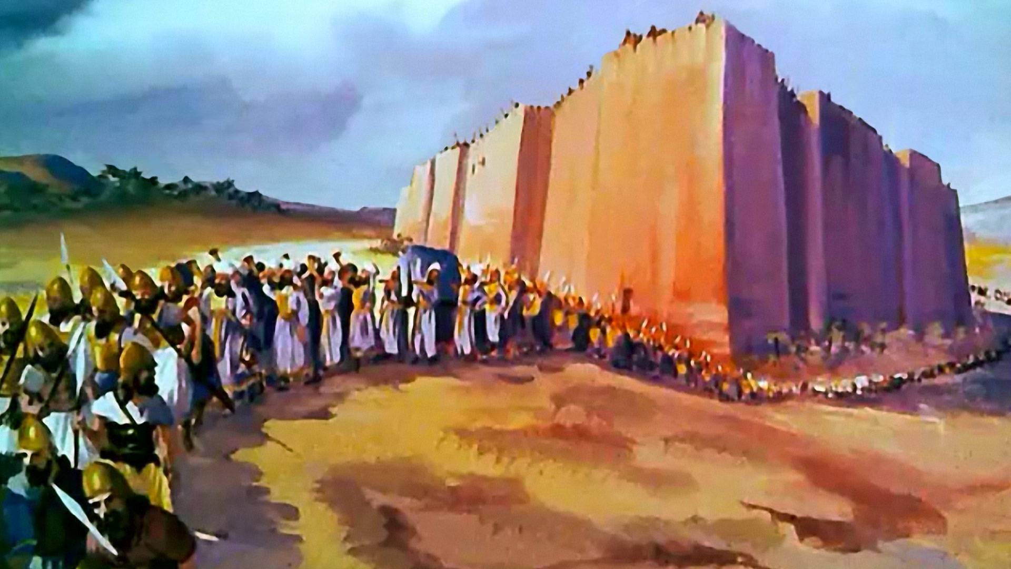

Slide 10
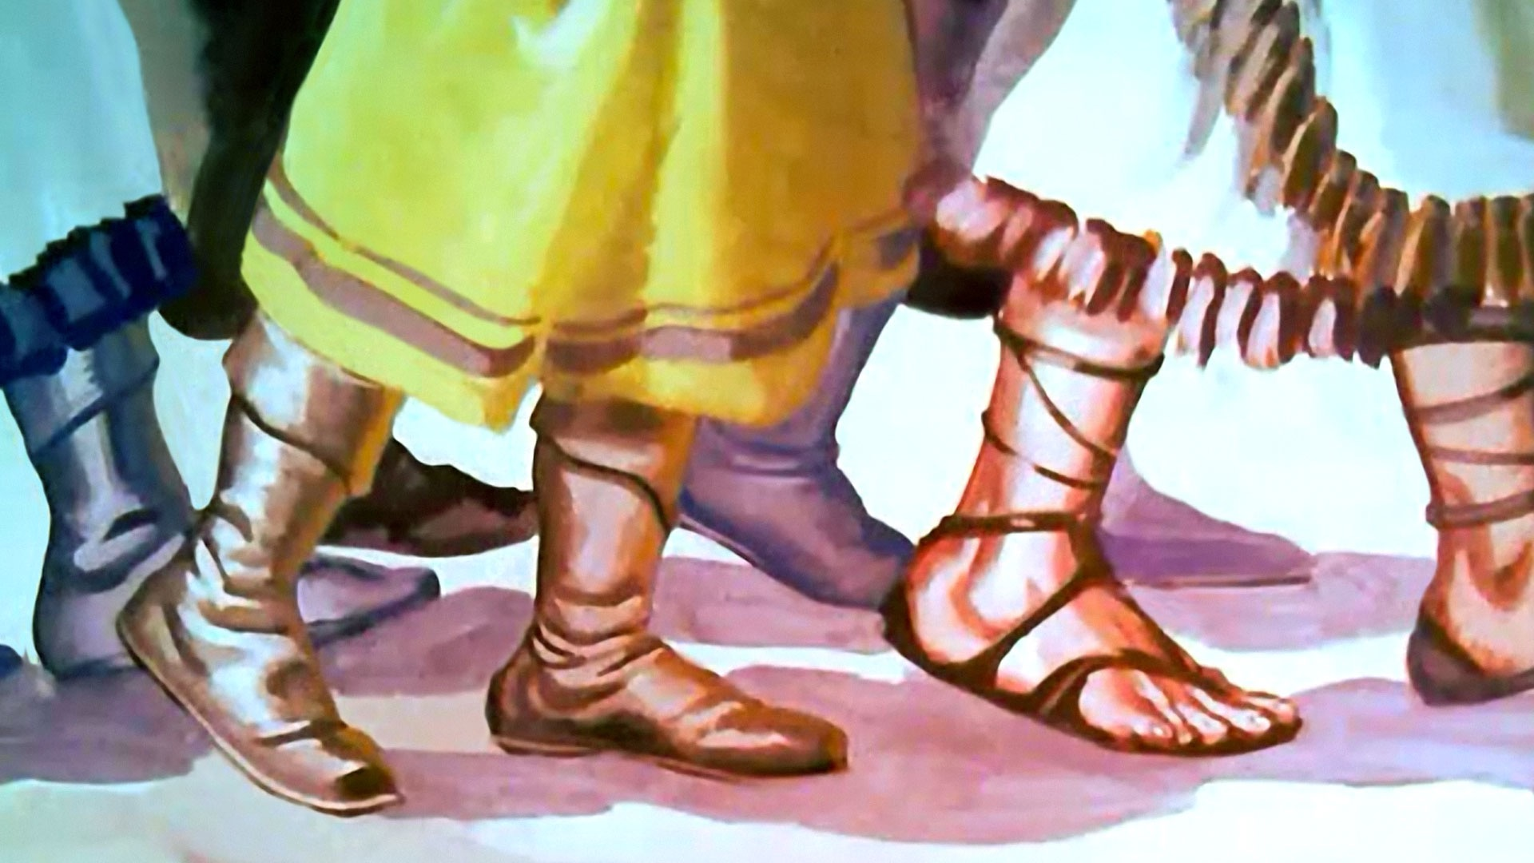
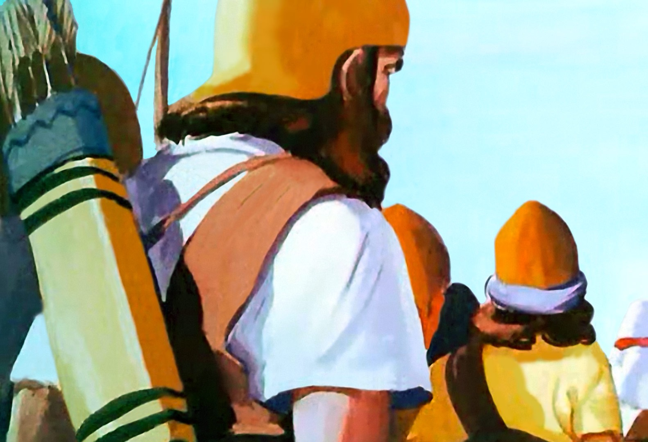

Slide 12
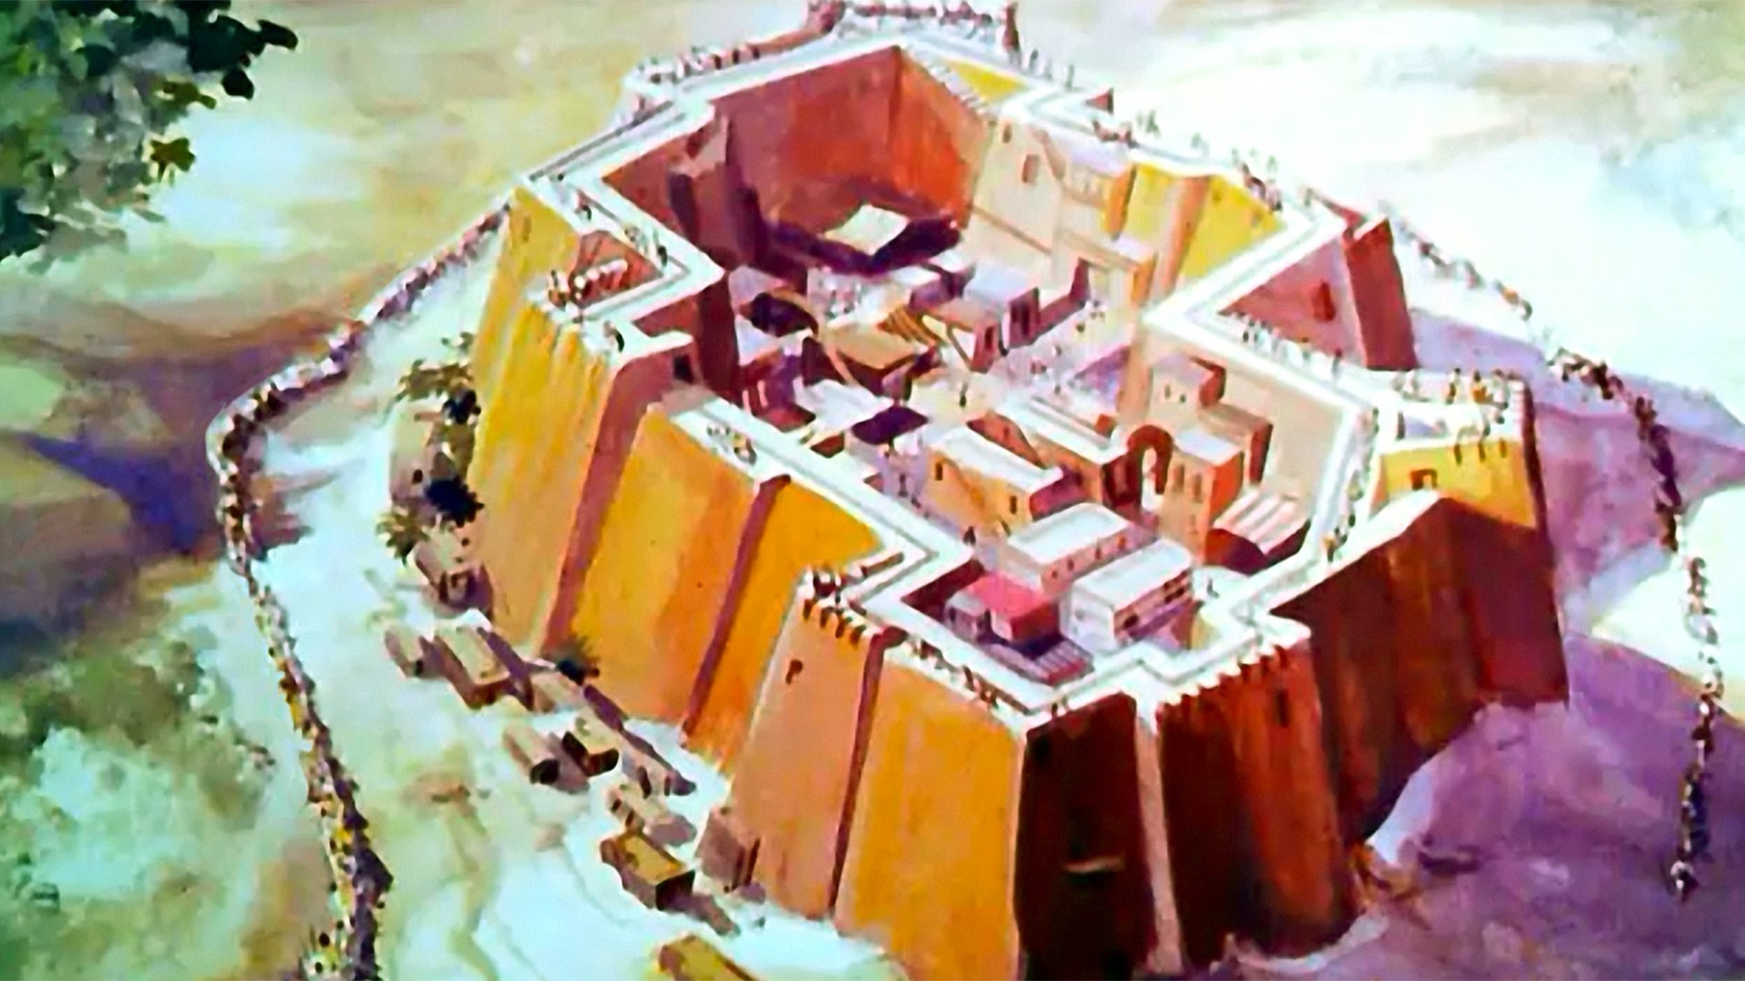

Slide 13
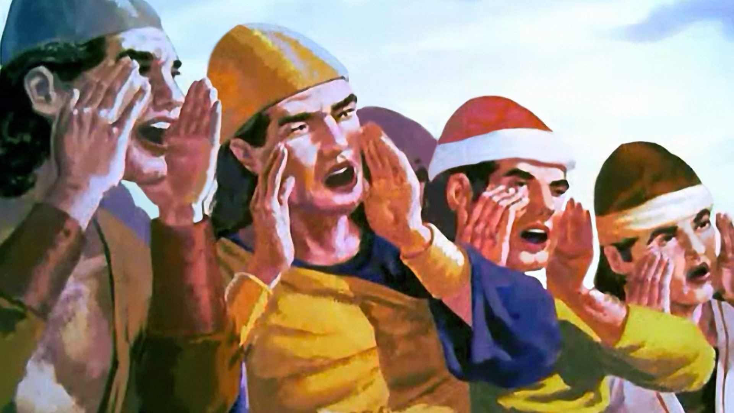

Slide 14
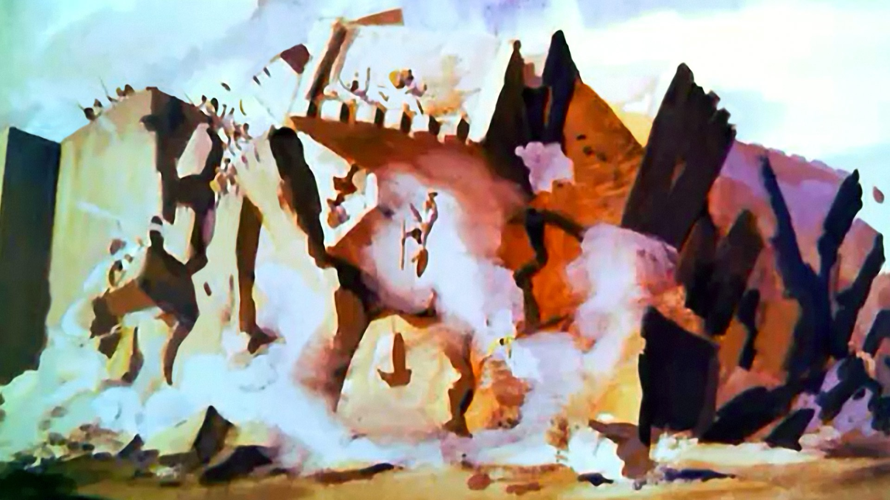

Slide 15
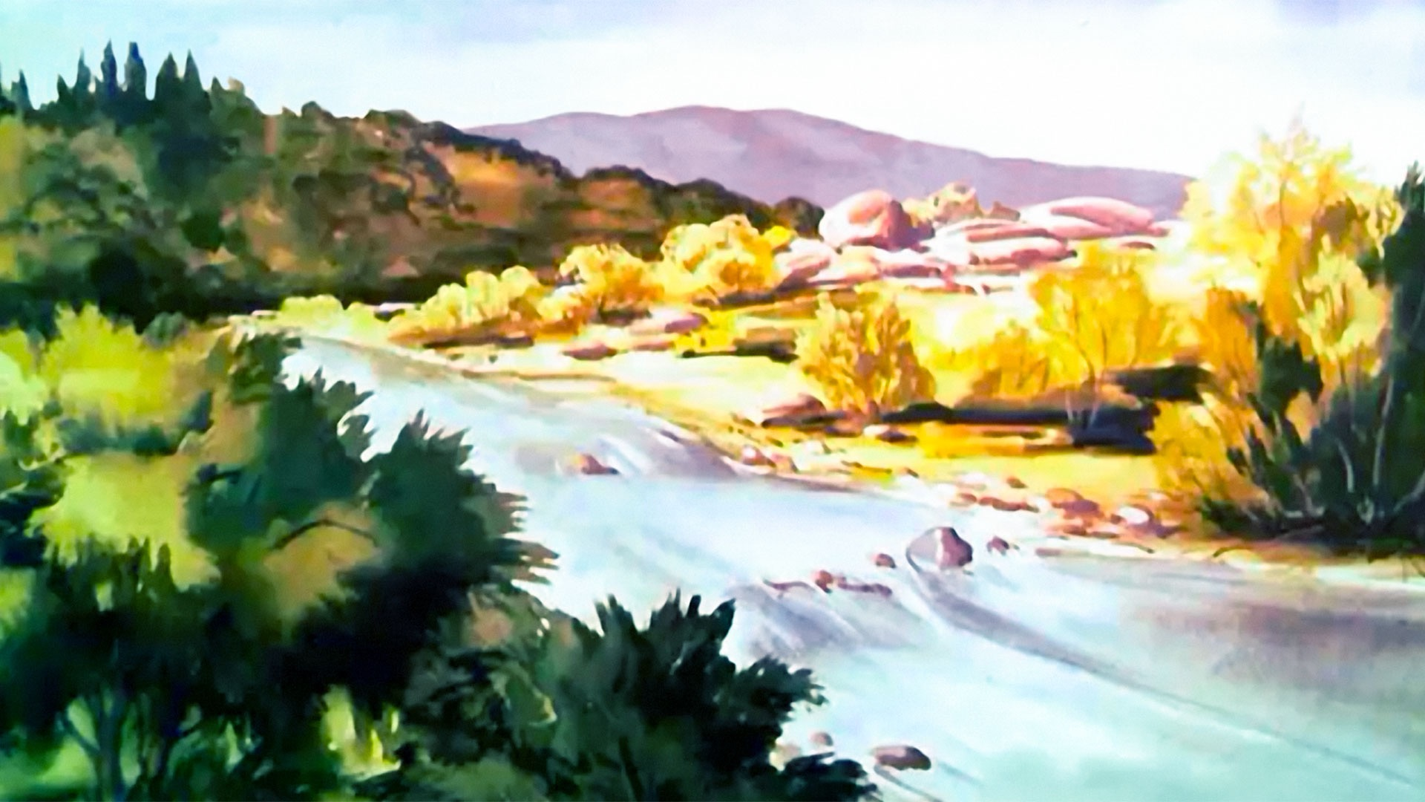

Slide 17
Here is the bee hive
But where are the bees?
Hiding inside where nobody sees!
Here they come creeping out the hive
1 – 2 – 3 – 4 – 5
…
Here they come creeping out again
1 – 2 – 3 – 4 – 5 – 6 – 7 – 8 – 9 – 10

Slide 18
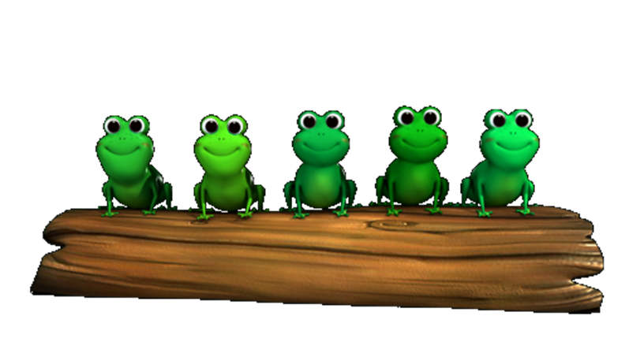
5 little speckled frogs sat on a speckled log
Eating the most delicious grubs; “yum-yum”
One jumped into the pool
Where it was nice and cool
Then there were 4 more speckled frogs ‘glub-glub’

Slide 19
1 2 3 4 5
Once I caught a fish alive
6 7 8 9 10
Then I threw it back again
Why did you let it go?
Because it bit my finger so
Which finger did it bite?
This little finger on my right.

Slide 20
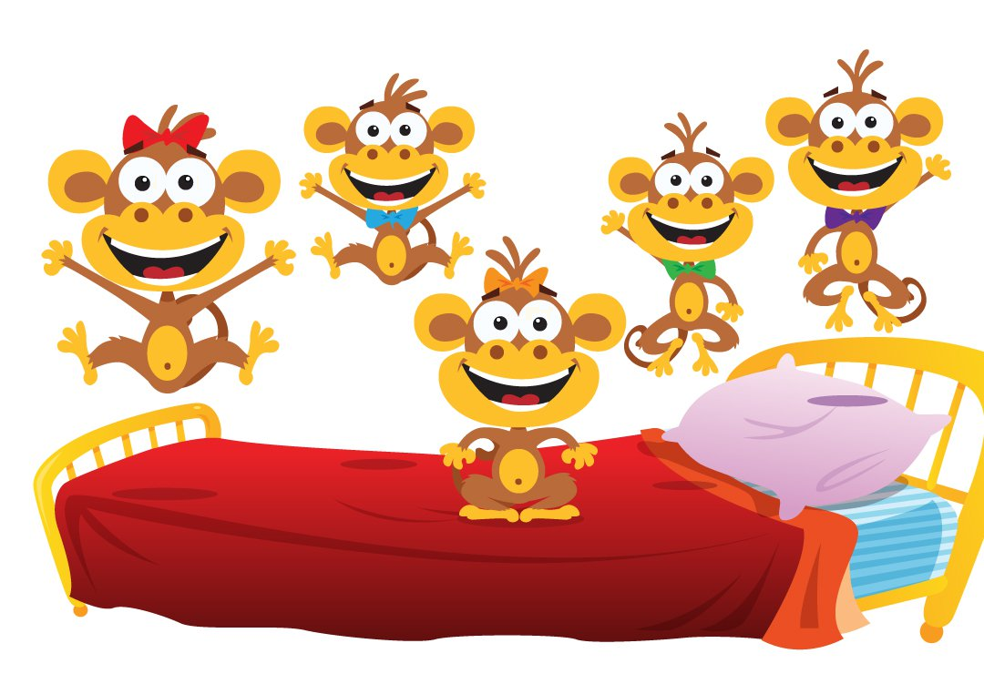
5 little monkeys jumping on the bed
One fell off and bumped his head
Mama called the doctor and the doctor said
“No more monkeys jumping on the bed”
4 little monkeys…
3
2
1

Slide 21
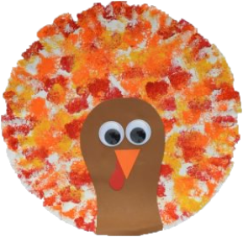
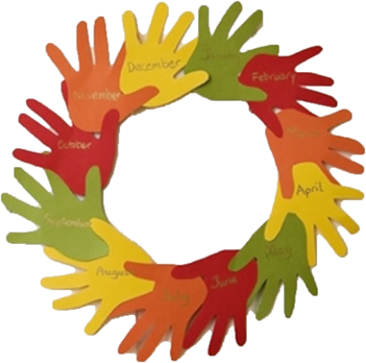
Thanksgiving Crafternoon
2-4pm
November 17th

