Slide 1
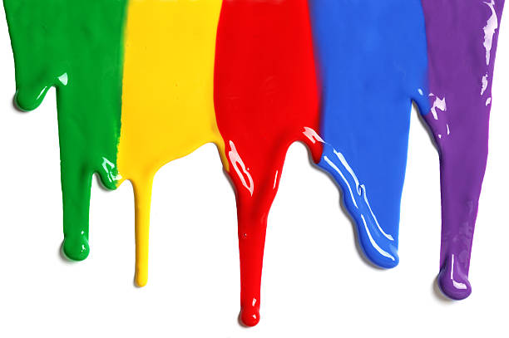
WELCOME
to the
Preschool Playgroup
Run by Holy Trinity Church
Find us on Facebook
playgroup@htcchicago.org

Slide 2
K
N
G
the
I
is here!

Slide 3
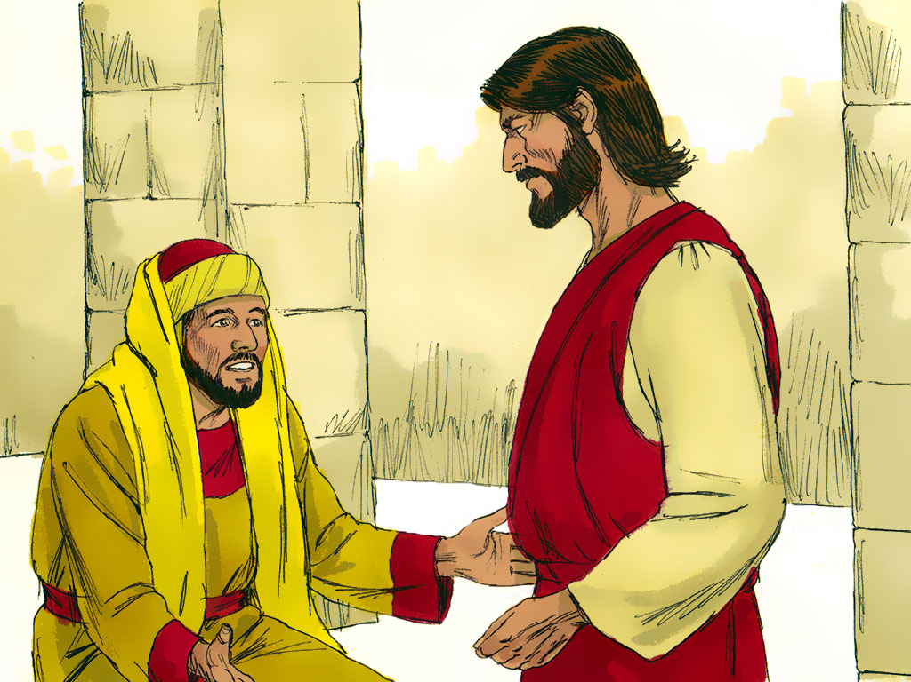

Slide 4
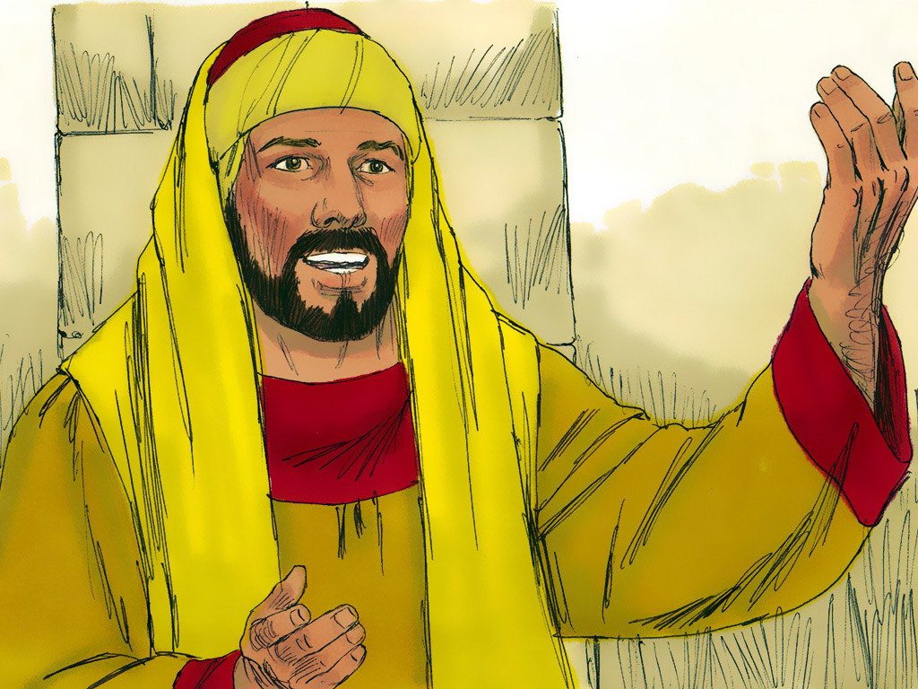

Slide 5
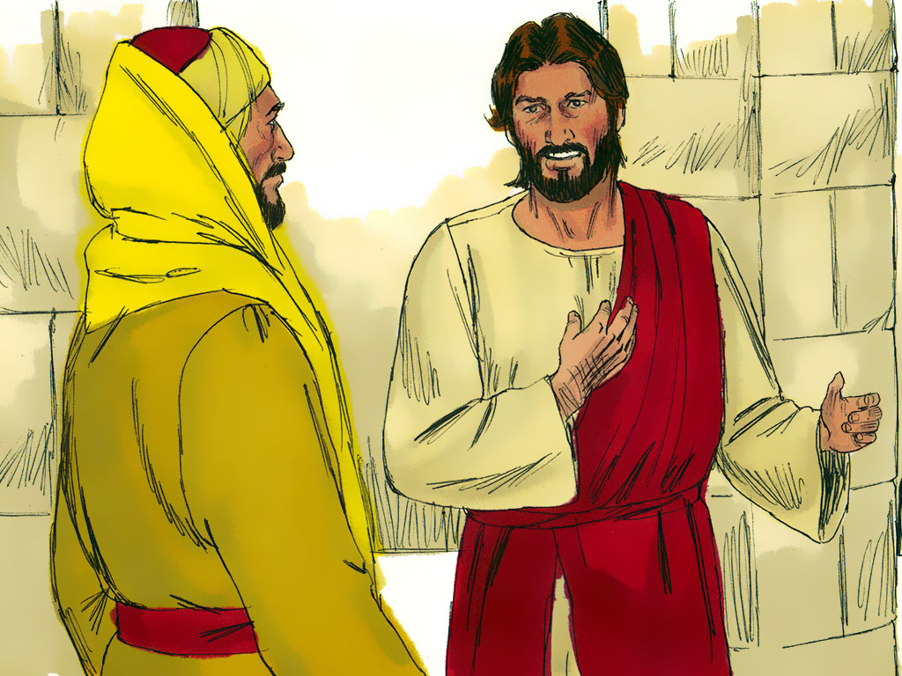

Slide 6
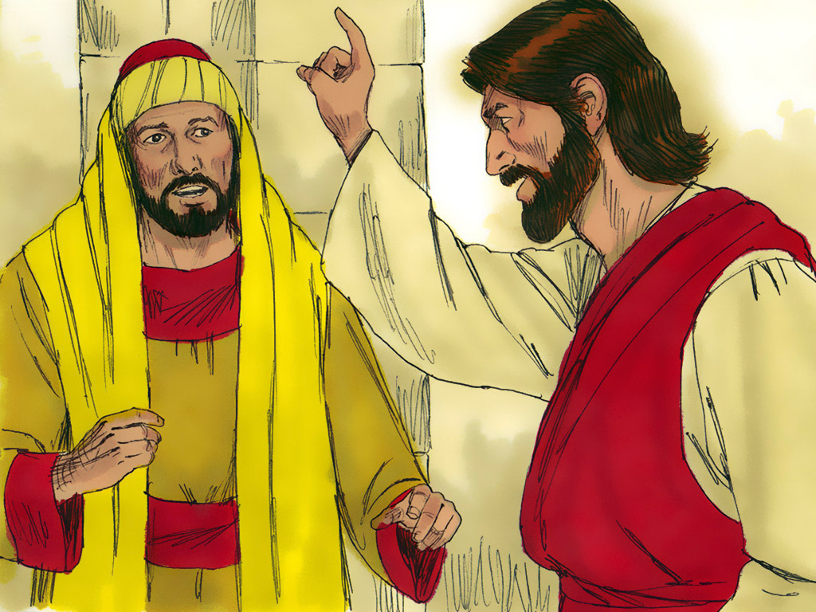

Slide 7
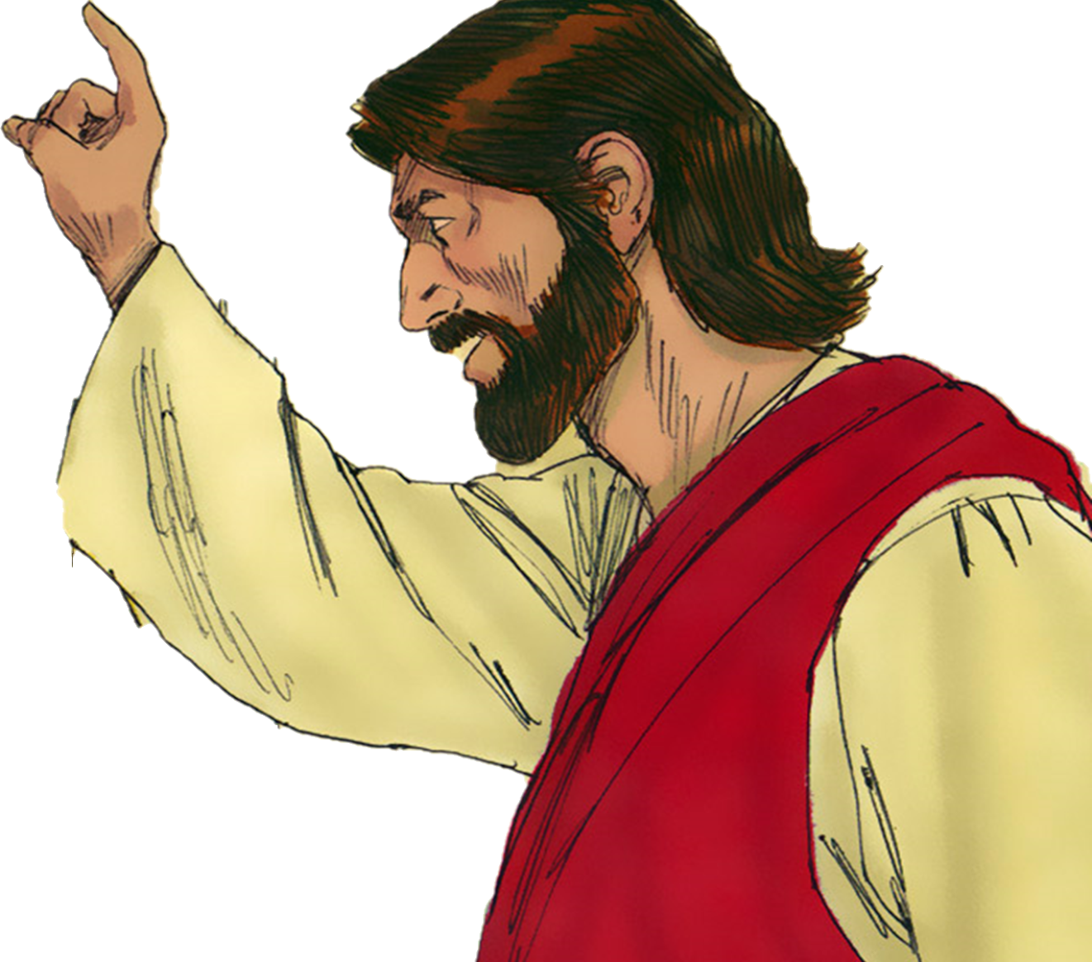

Slide 9
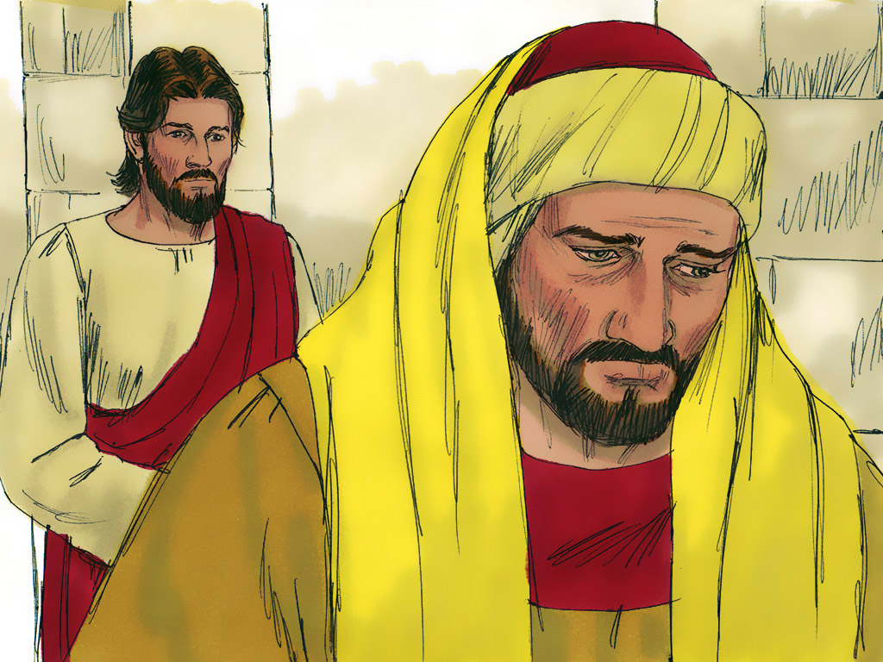

Slide 10
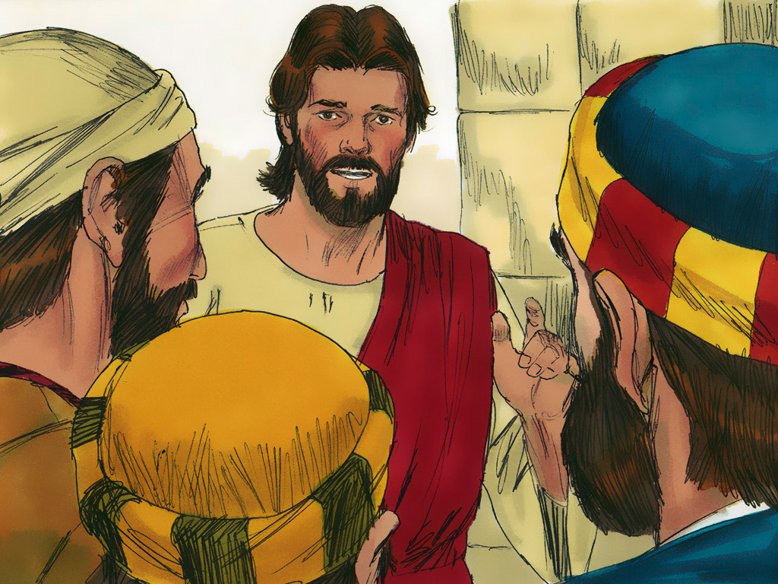

Slide 11
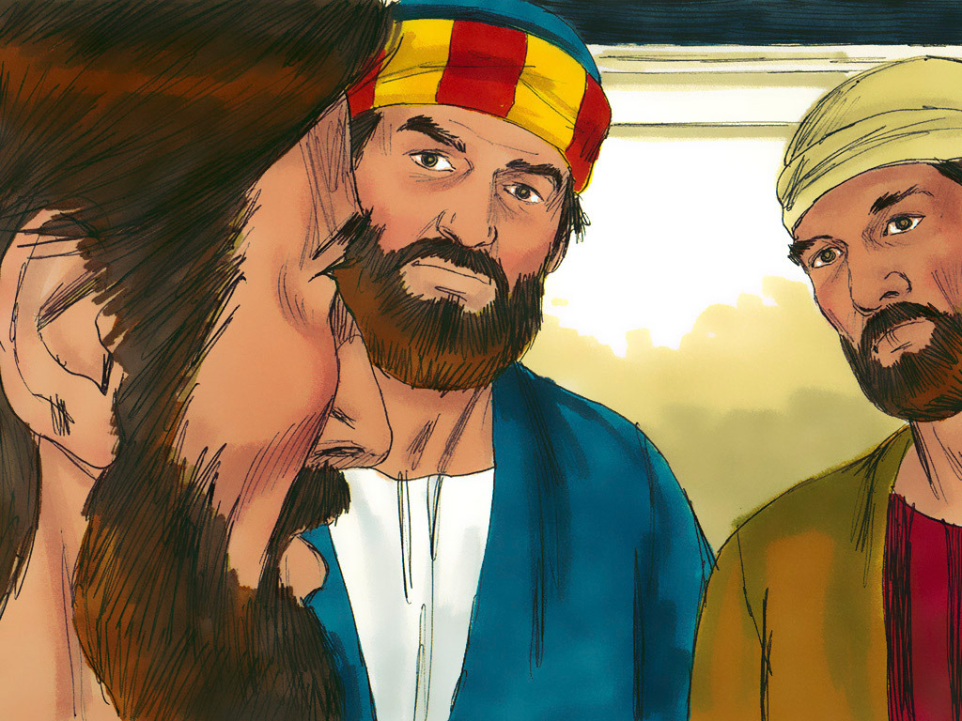

Slide 12
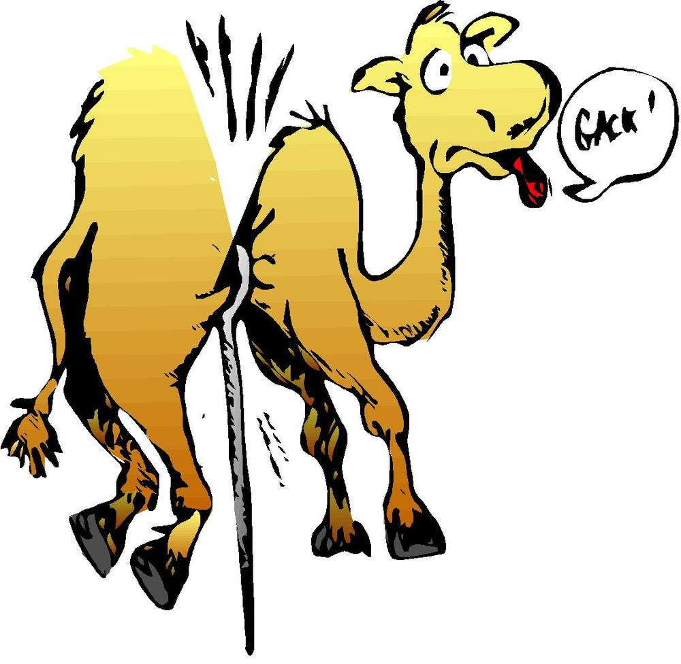

Slide 13
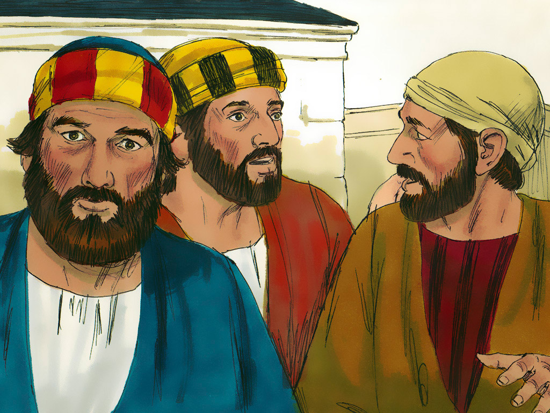

Slide 14
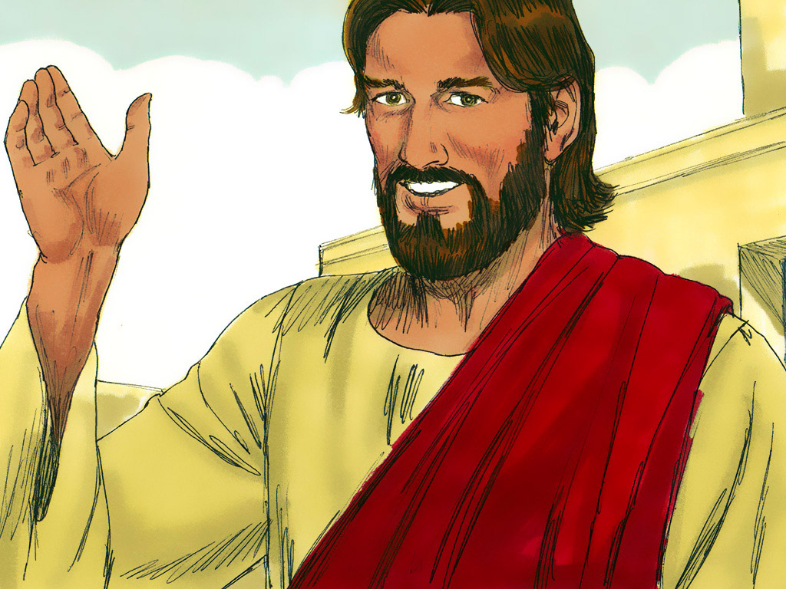

Slide 15
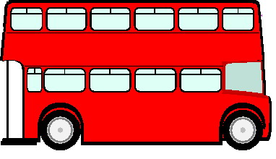
The wheels on the bus go round and round
Round and round, round and round
The wheels on the bus go round and round
All through the town.
Horn – Beep, Beep, Beep
Lights – Flash on and off
Doors – Open and Shut
People – Bounce up and down

Slide 16
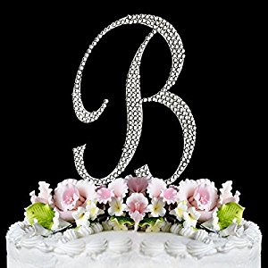
Pat-a-cake, pat-a-cake baker’s man
Bake me a cake as fast as you can
Pat it and prick it an mark it with B
Put it in the oven for baby and me

Slide 17
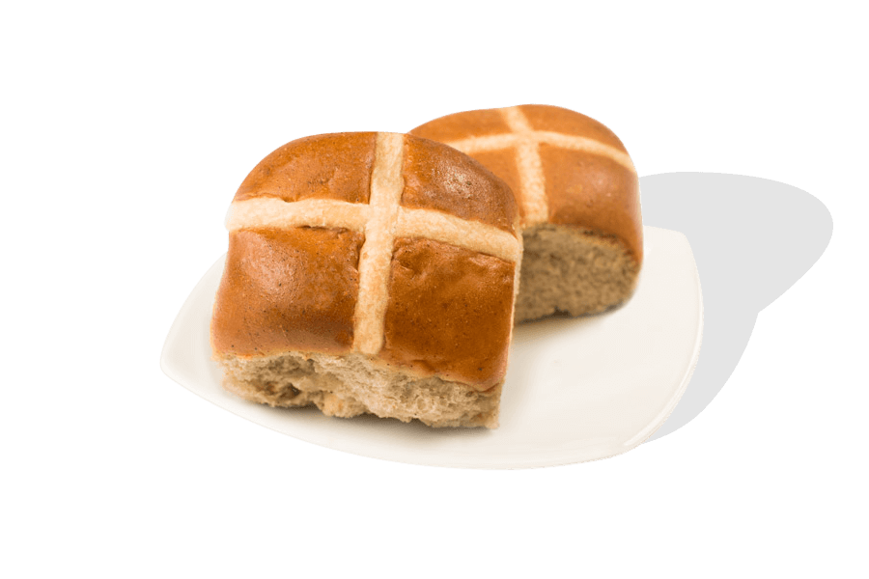
Hot Cross Buns Hot cross buns
1 a penny. 2 a penny.
Hot cross buns
Give them to your daughters
Give them to your sons
1 a penny. 2 a penny
Hot cross buns

Slide 18
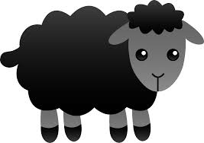
Baa baa black sheep have you any wool?
Yes sir, yes sir, three bags full
One for the master
One for the dame
And one for the little boy who lives down the lane.

Slide 19
A Pizza Hut, a Pizza Hut
Kentucky Fried Chicken and a Pizza Hut
A Pizza Hut, a Pizza Hut
Kentucky Fried Chicken and a Pizza Hut
McDonalds, McDonalds
Kentucky Fried Chicken and a Pizza Hut
McDonalds, McDonalds
Kentucky Fried Chicken and a Pizza Hut

