Slide 1
WELCOME
to the
Preschool Playgroup
Run by Holy Trinity Church
Find us on Facebook
playgroup@htcchicago.org

Slide 2
K
N
G
the
I
is coming!

Slide 6
1
2
3
4
5
6
7
8
9
10

Slide 11
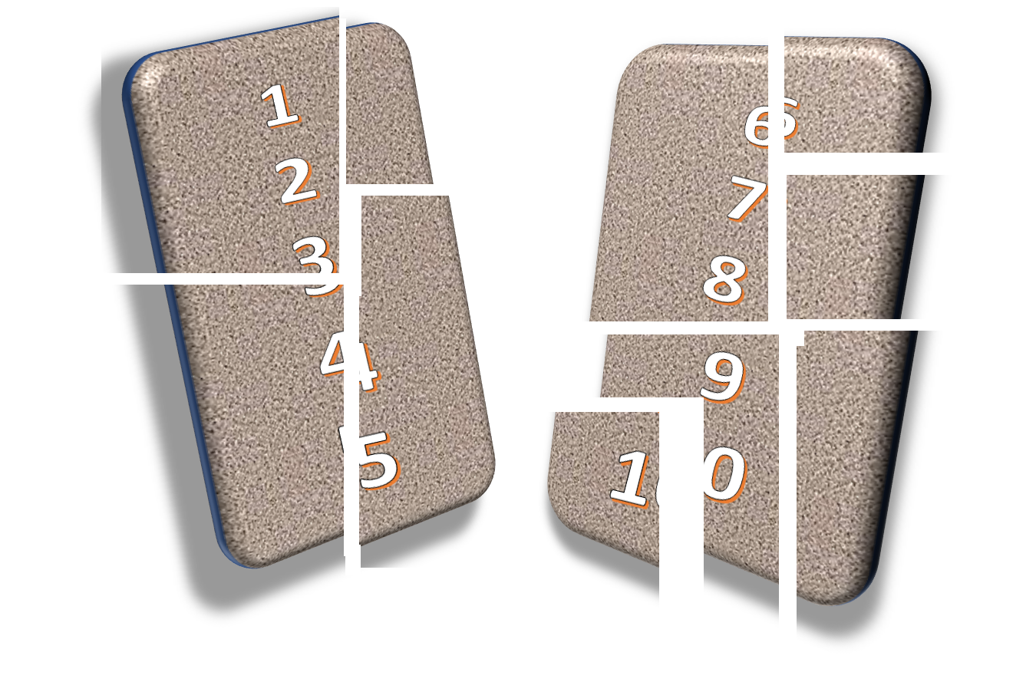

Slide 12
1
2
3
4
5
6
7
8
9
10

Slide 14
1
2
3
4
5
6
7
8
9
10

Slide 16
Skidamarink a dink a dink
Skidamarink a doo
I love you
I love you in the morning
And in the afternoon
I love you in the evening
And underneath the moon

Slide 17
He’s got the whole world in his hands
He’s got the whole wide world in his hands
He’s got the whole world in his hands
He’s got the whole world in his hands
He’s got you and me in his hands…
He’s got everybody here in his hands...

Slide 18
If I go climbing, climbing, climbing
If I go climbing; God is there
If I go climbing on the highest mountain
God is there ‘cos he is everywhere.
If I go flying in the biggest aeroplane
If I go driving far away
If I go swimming in the deepest ocean

Slide 19
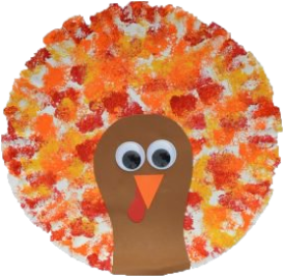
Thanksgiving
Crafternoon

