Slide 1
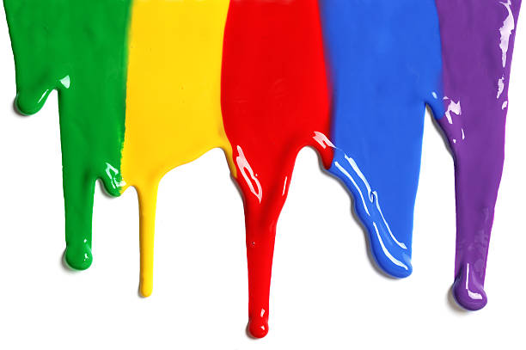
WELCOME
to the
Preschool Playgroup
Run by Holy Trinity Church
Find us on Facebook
playgroup@htcchicago.org

Slide 2
God Rescues

Slide 4
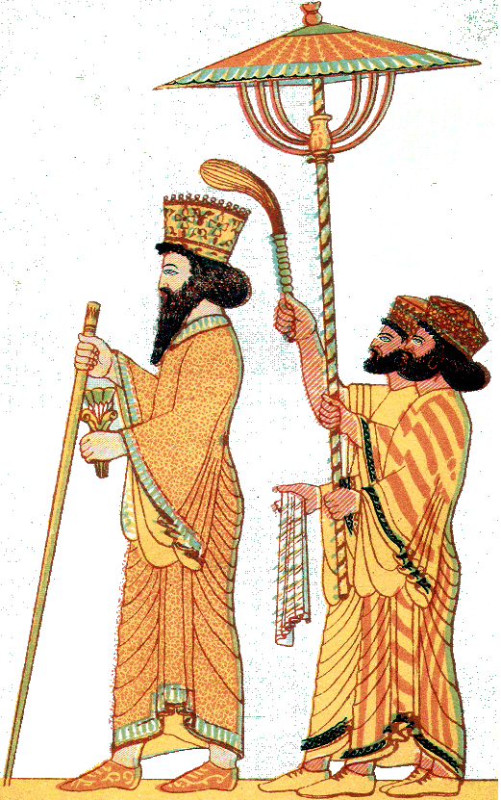

Slide 5
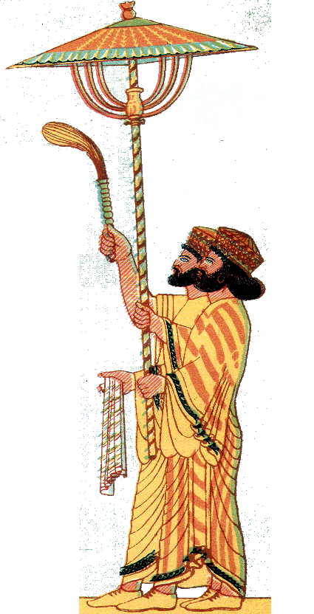
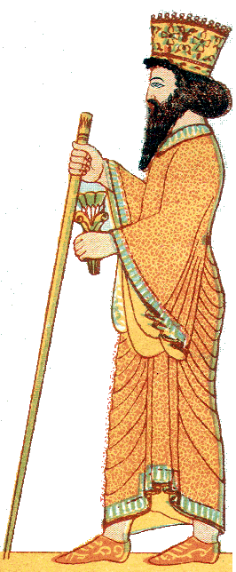
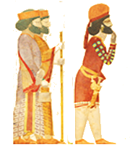

Slide 12
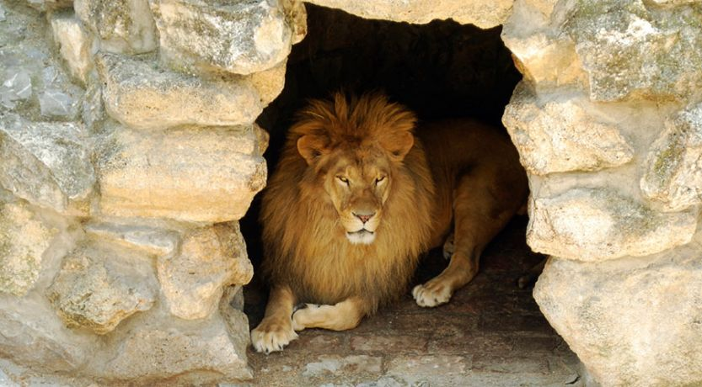

Slide 14
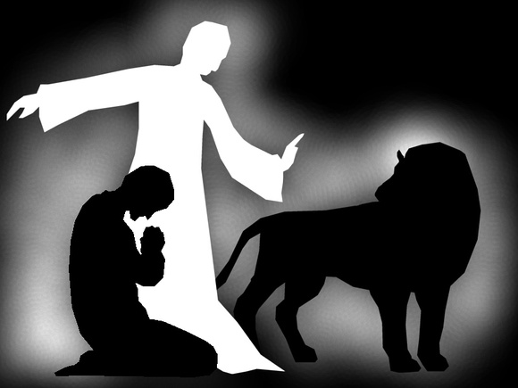

Slide 16
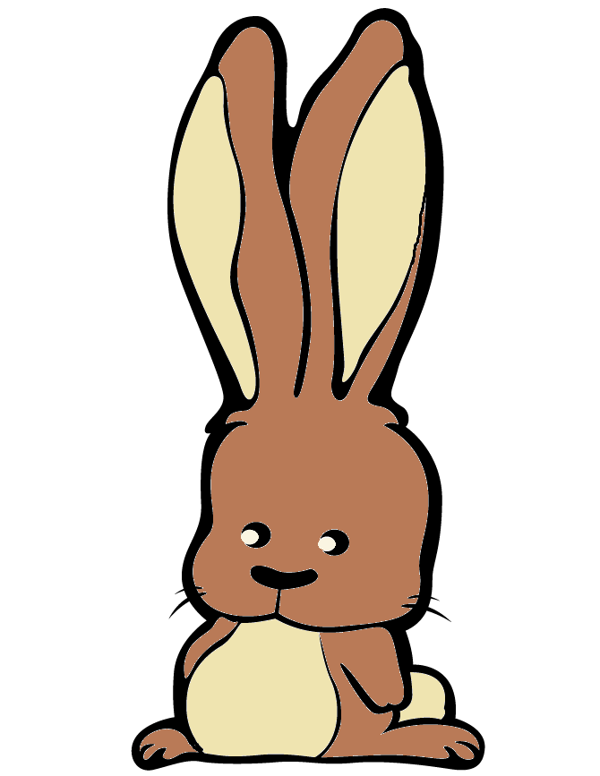
See the little bunnies sleeping ‘til noon
Shall we try and wake them with a merry tune?
They’re so still, are they ill?
Wake up soon!
Hop little bunnies, hop, hop, hop x3
Hop and Stop!

Slide 17
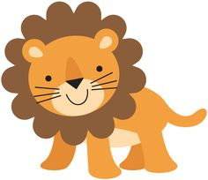
Old Macdonald had a farm
E-I-E-I-O
And on that farm he had a lion
E-I-E-I-O
With a roar-roar here and a roar-roar there
Here a roar there a roar everywhere a roar-roar Old Macdonald had a farm
E-I-E-I-O

Slide 18
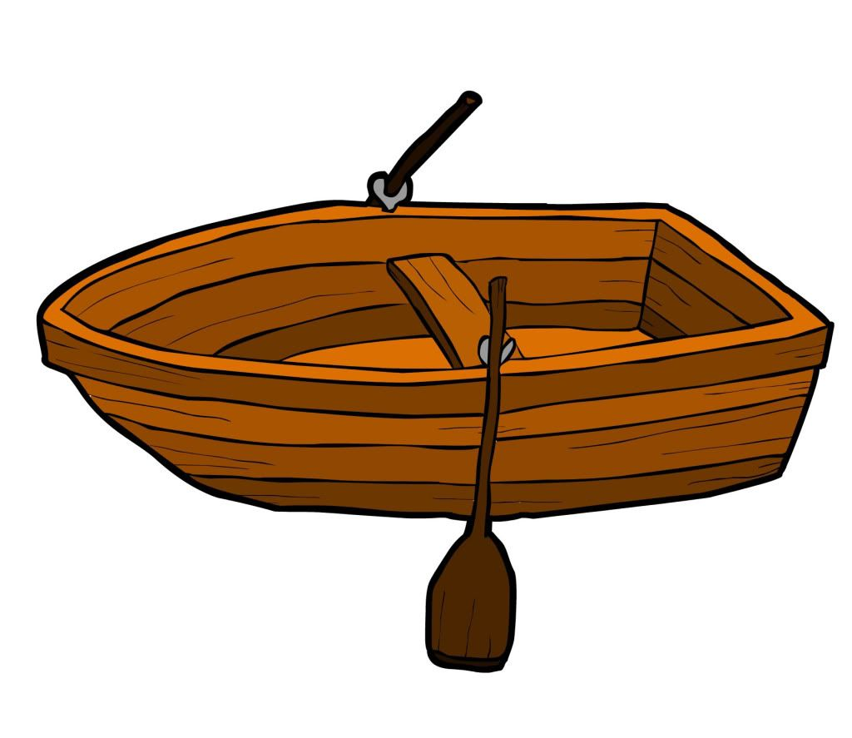
Row, row, row your boat gently down the stream
Merrily, merrily, merrily, merrily
Life is but a dream
Row, row, row your boat gently to the shore
If you see a lion there don’t forget to roar.
Rock, rock, rock your boat gently to and fro
Wibbly-wobbly, wibbly-wobbly
Into the water you go.

Slide 19
If you’re a lion and you know it roar out loud
If you’re a lion and you know it roar out loud
If you’re a lion and you know it
and you really want to show it
If you’re a lion and you know it roar out loud.

Slide 20
What’s the best news you’ve ever heard?
A chance to ask your questions and investigate the basics about faith and Christianity.
Saturday evenings 7 weeks

