Slide 1
WELCOME
to the
Preschool Playgroup
Run by Holy Trinity Church
Find us on Facebook
playgroup@htcchicago.org

Slide 2
God Rescues

Slide 3
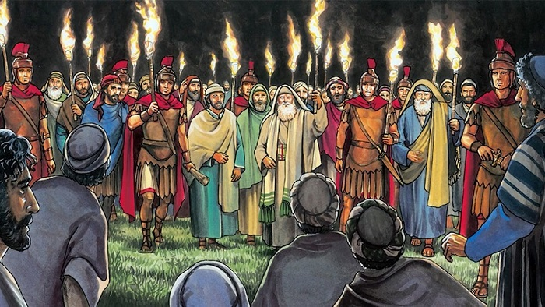

Slide 4
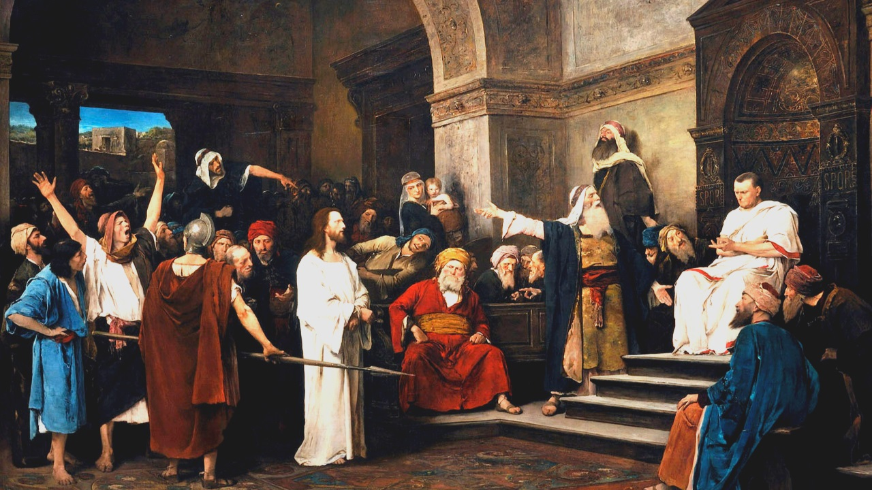

Slide 5
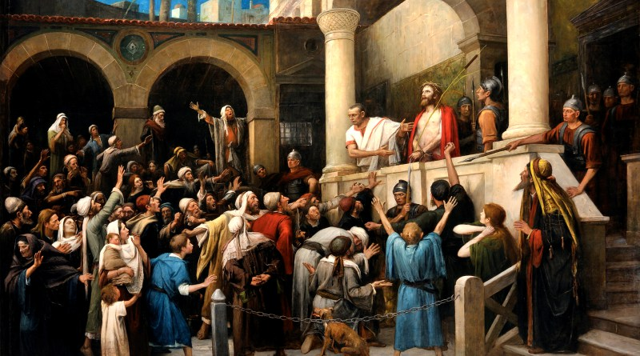

Slide 6
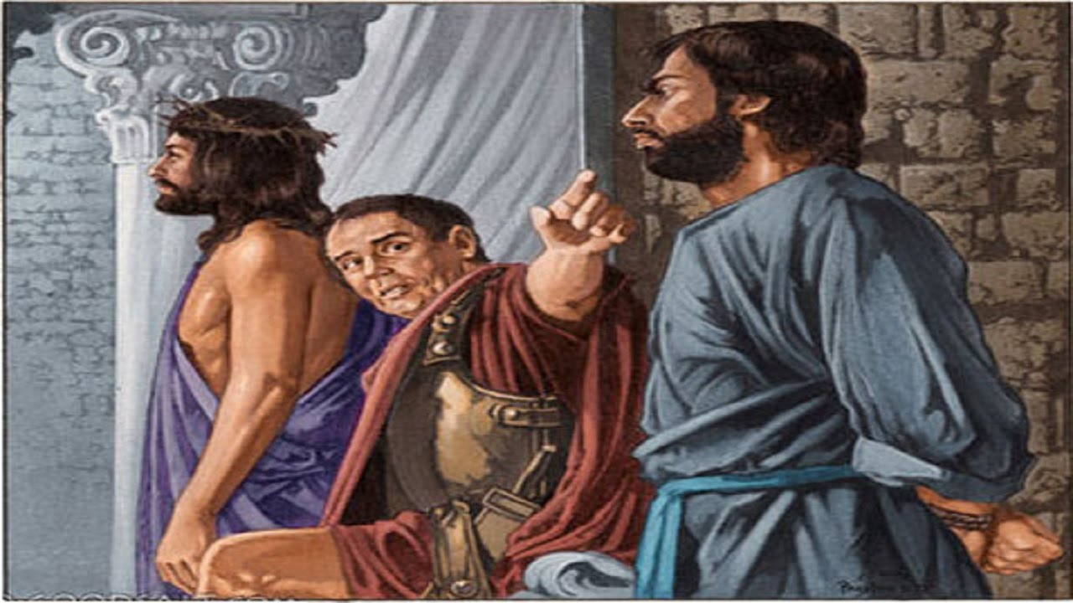

Slide 7
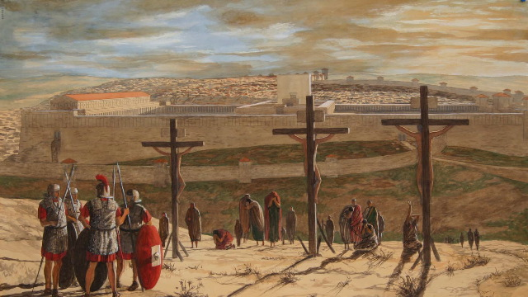

Slide 9
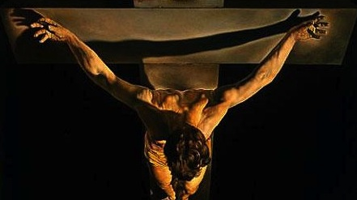

Slide 10
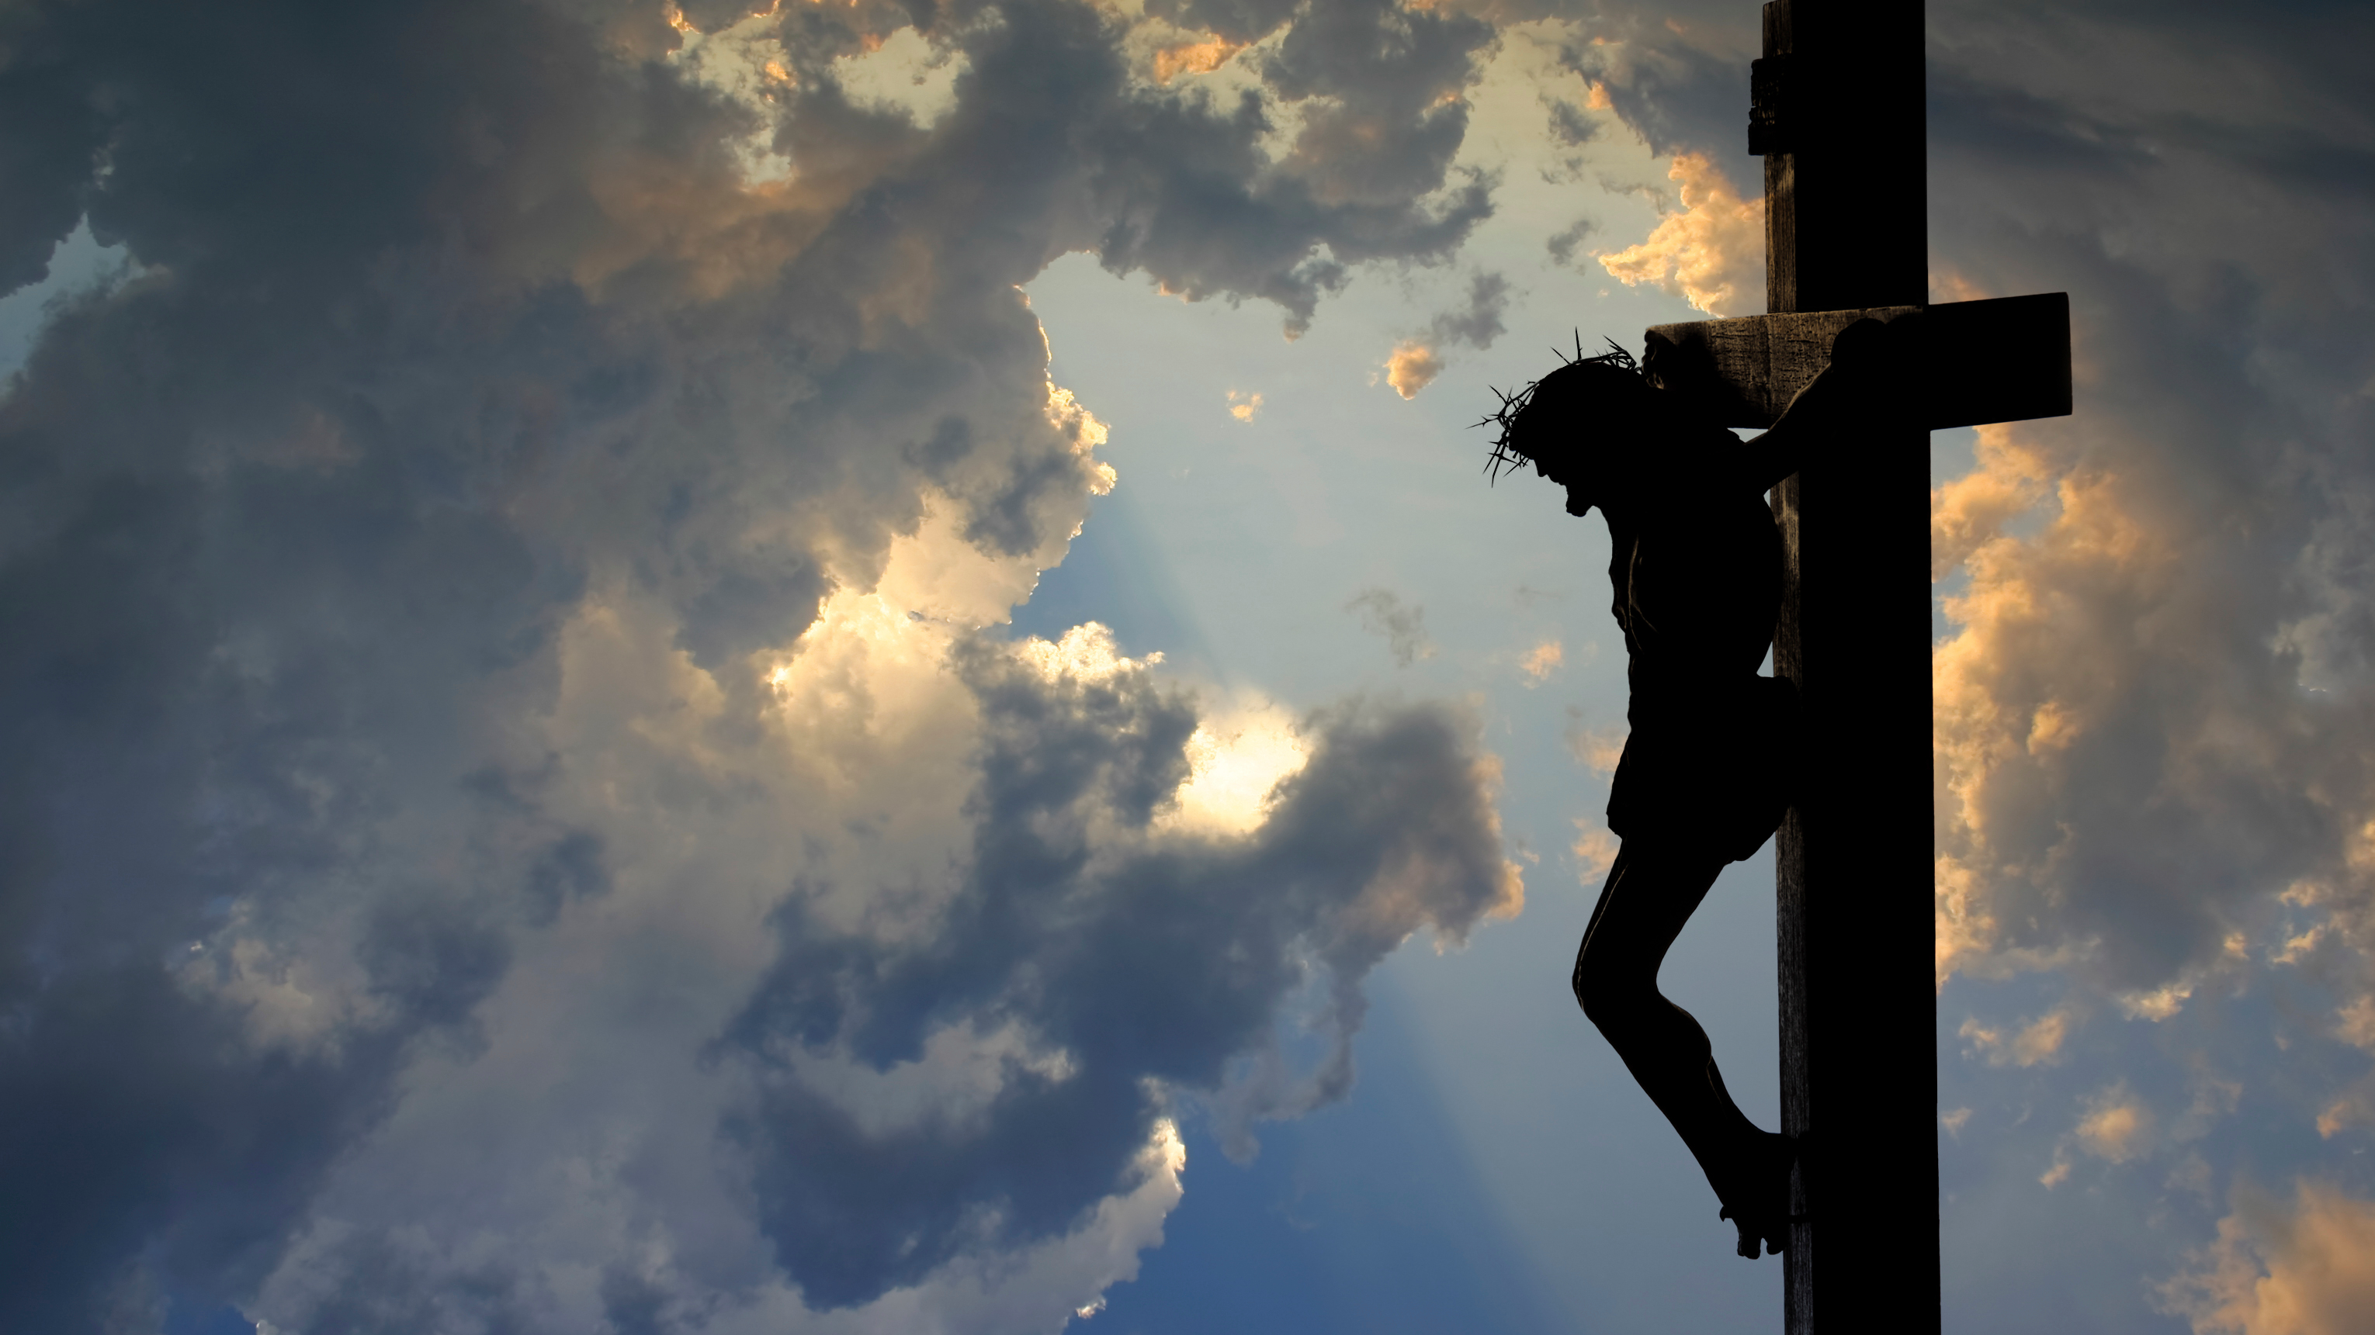

Slide 11
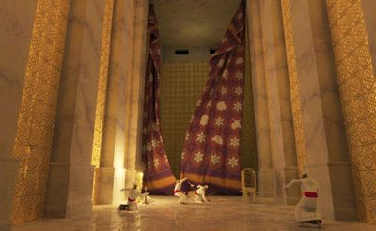

Slide 12
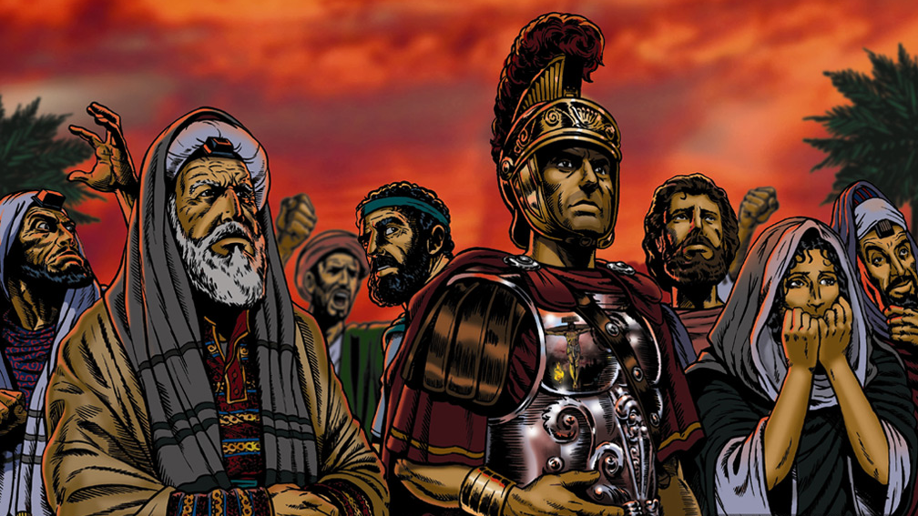

Slide 13
Skidamarink a dink a dink
Skidamarink a doo
I love you
I love you in the morning
And in the afternoon
I love you in the evening
And underneath the moon

Slide 14
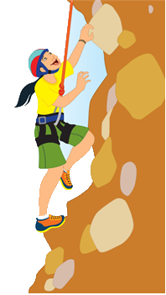
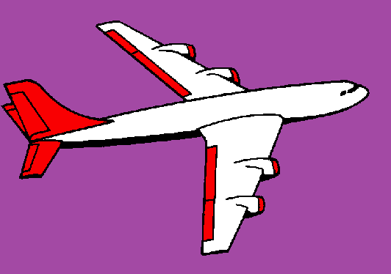
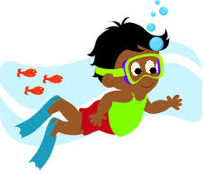
If I go climbing, climbing, climbing
If I go climbing; God is there
If I go climbing on the highest mountain
God is there ‘cos he is everywhere.
If I go flying in the biggest aeroplane
If I go driving far away
If I go swimming in the deepest ocean

Slide 15
He’s got the whole world in his hands
He’s got the whole wide world in his hands
He’s got the whole world in his hands
He’s got the whole world in his hands
He’s got you and me in his hands…
He’s got everybody here in his hands...

Slide 16
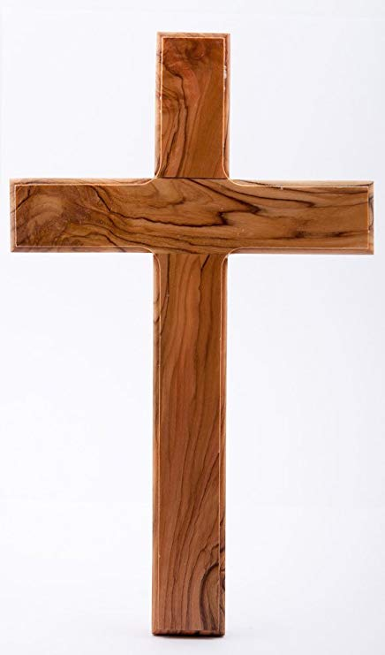
He died upon the cross
He died upon the cross
He died upon the cross
For me, for me, for, just for me
One day when I was lost
He died upon the cross
He died upon the cross
For me, for me, for, just for me

