Slide 1
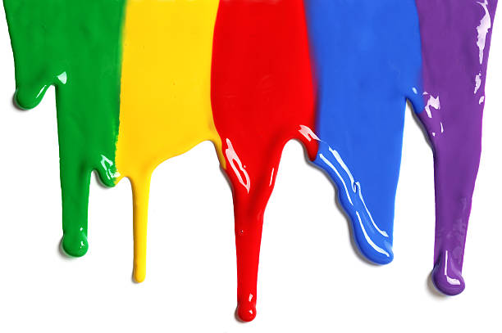
WELCOME
to the
Preschool Playgroup
Run by Holy Trinity Church
Find us on Facebook
playgroup@htcchicago.org

Slide 2
K
N
G
the
I
is coming!

Slide 3
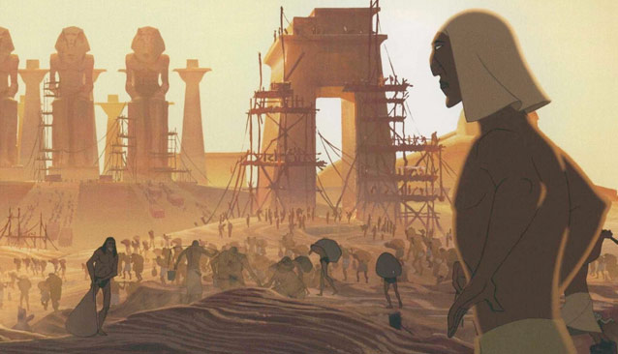

Slide 5
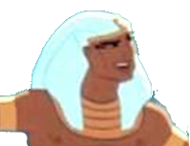

Slide 6
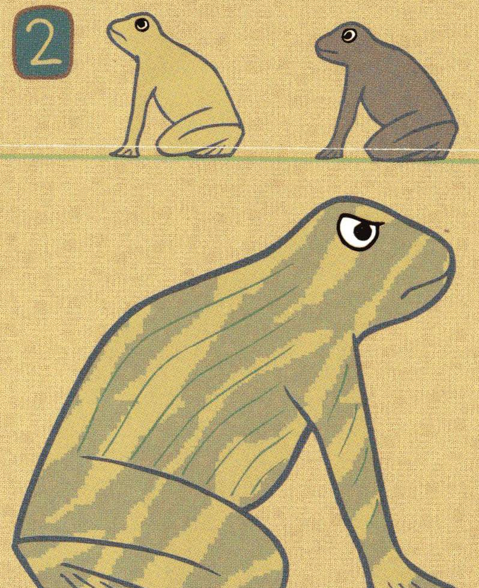

Slide 8
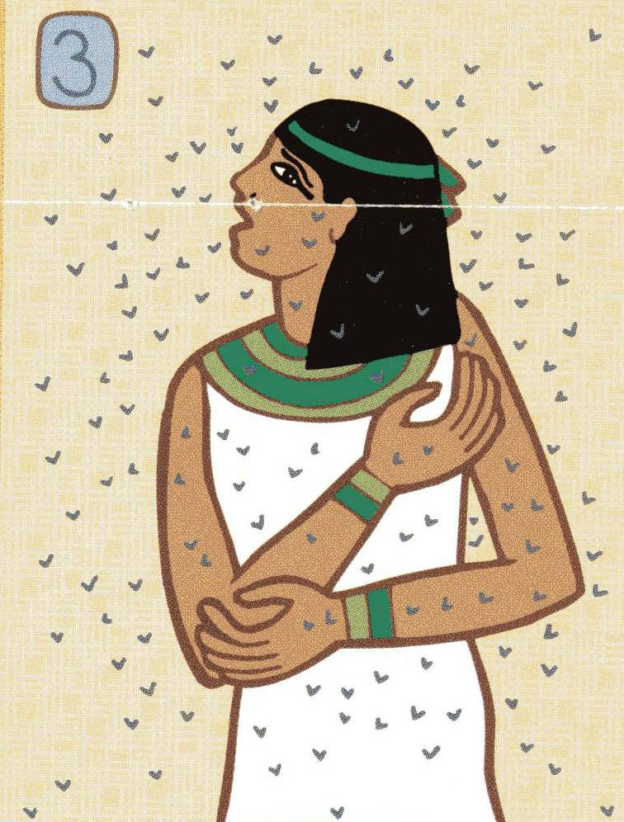

Slide 10
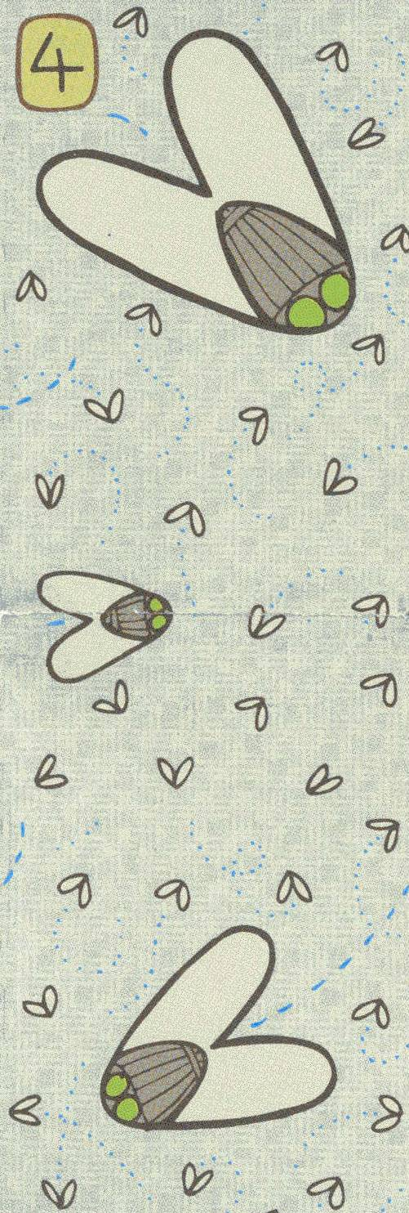

Slide 12
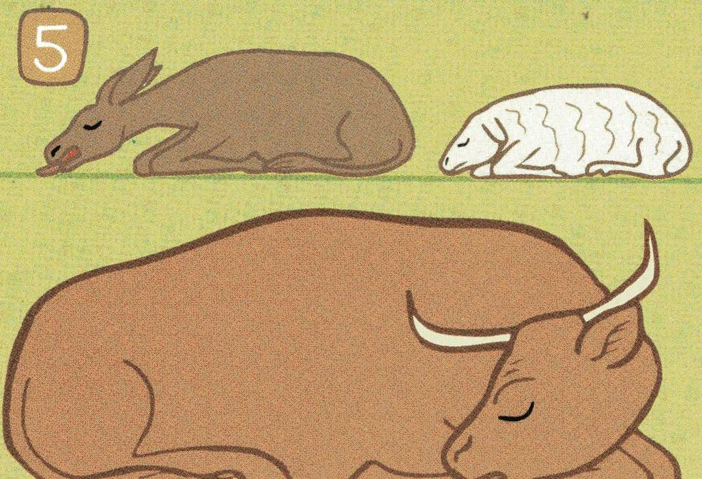

Slide 14
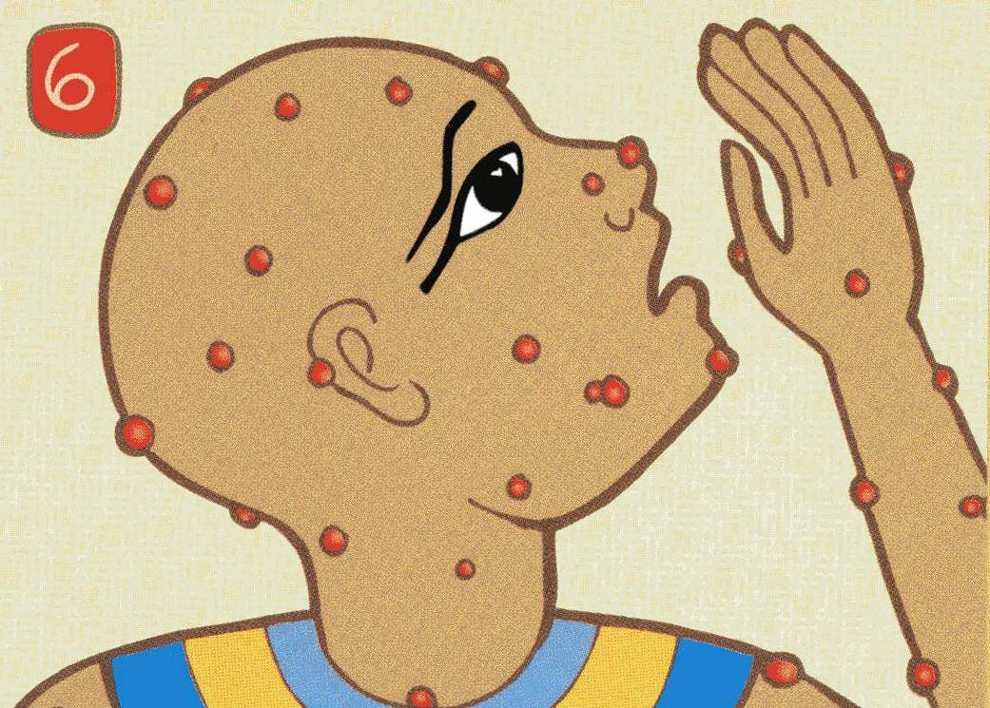

Slide 16
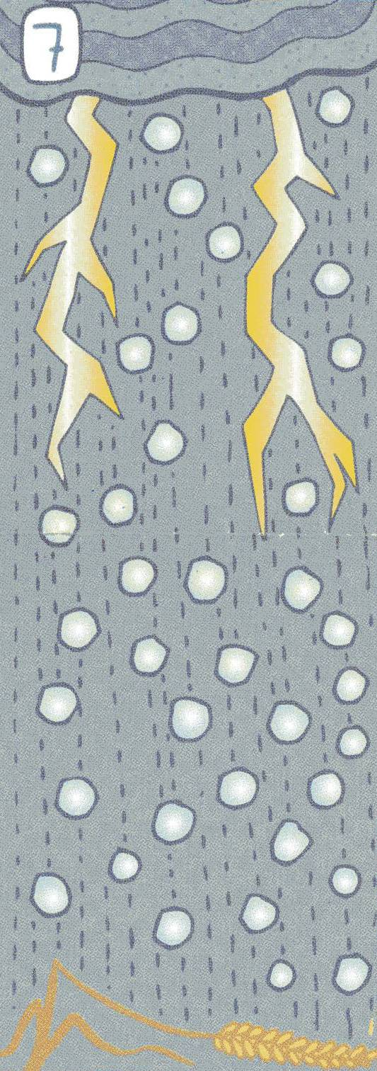

Slide 18
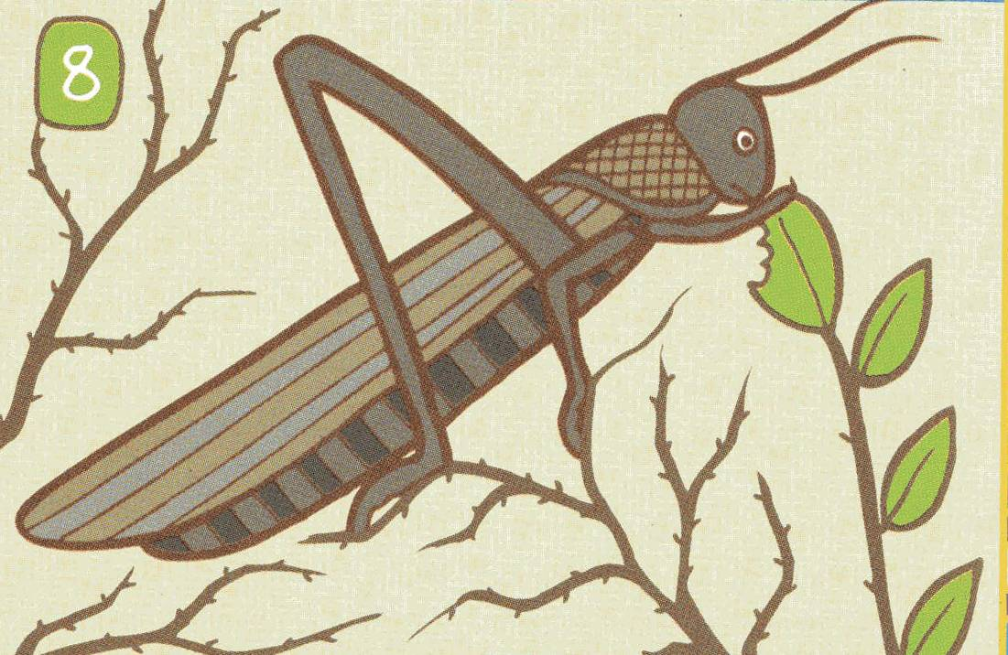

Slide 22
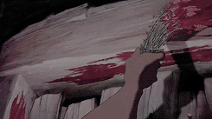

Slide 23
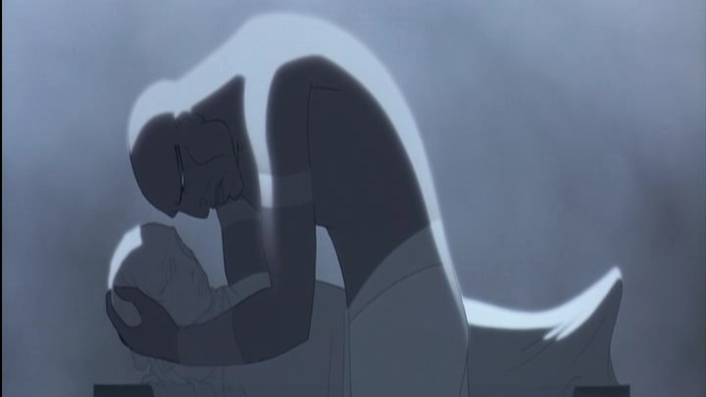

Slide 24
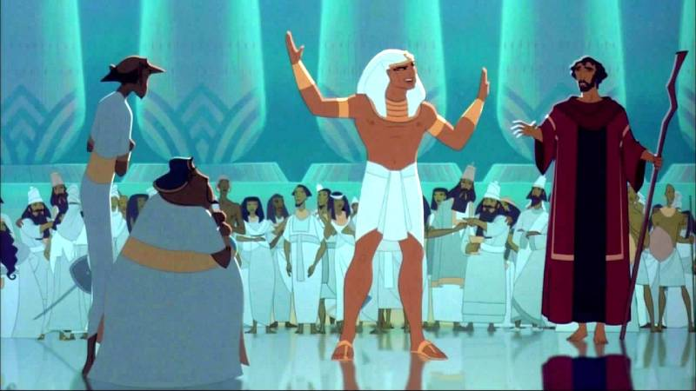

Slide 25
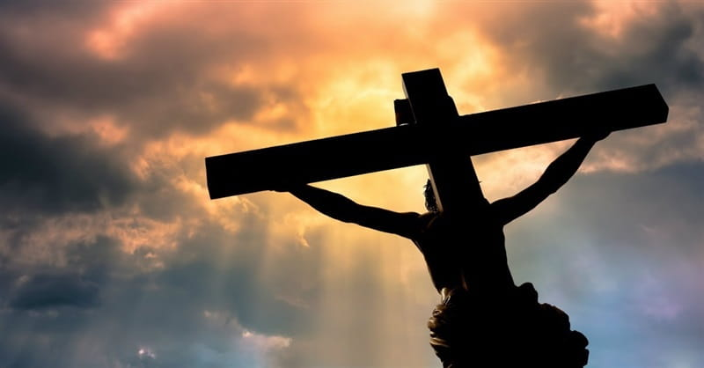

Slide 26
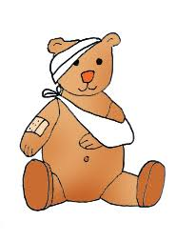
Miss Polly had a dolly who was sick, sick, sick.
She called for the doctor to come quick, quick, quick
So the doctor came with his bag and his hat
And he knocked on the door with a rat-a-tat-tat
He looked at the dolly and he shook his head
He said ‘Miss Polly, put her straight to bed’ He wrote on his paper for some pills,
- pills, pills ‘I’ll be back in the morning with my bills,
- bills, bills’

Slide 27
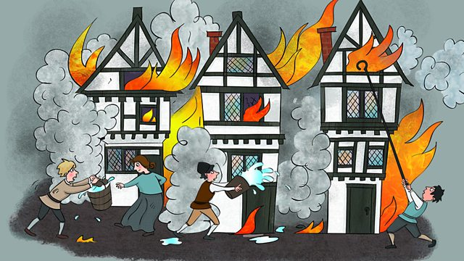
London’s burning. London’s burning.
Fetch the engines. Fetch the engines.
Fire! Fire! Fire! Fire!
Pour on water. Pour on water

Slide 28
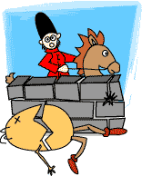
Humpty Dumpty sat on the wall
Humpty Dumpty had a great fall
All the kings horses
And all the kings men
Couldn’t put humpty together again

Slide 29
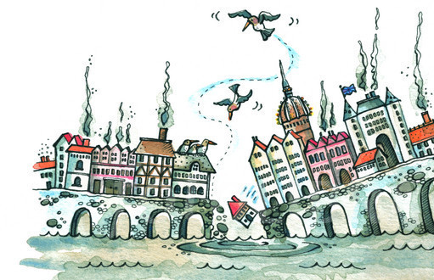
London Bridge is falling down
Falling down, falling down
London Bridge is falling down
My fair lady.
Build it up with bricks and mortar…
Bricks and mortar will not stay…

Slide 30
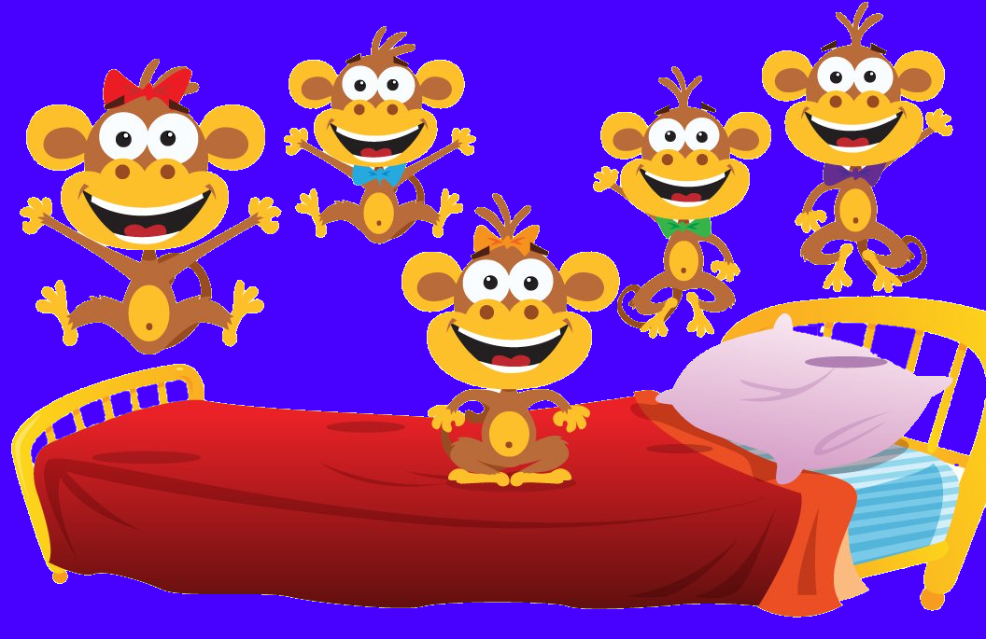
5 little monkeys jumping on the bed
One fell off and bumped his head
Mommy called the doctor and the doctor said
“No more monkeys jumping on the bed”
4 little monkeys…

Slide 31
K
N
G
the
I
is coming!

