Slide 1
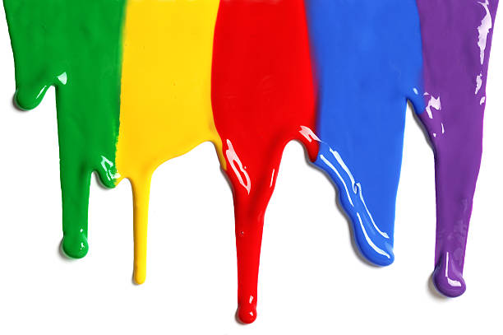
WELCOME
to the
Preschool Playgroup
Run by Holy Trinity Church
Find us on Facebook
playgroup@htcchicago.org

Slide 2
God Rescues

Slide 3
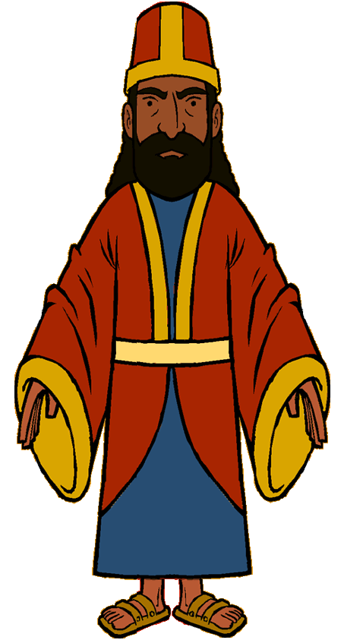
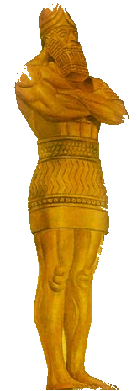

Slide 4
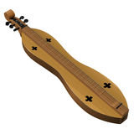
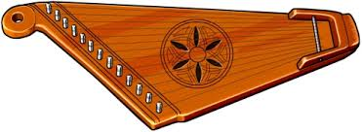

Slide 5
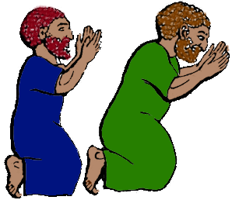

Slide 6
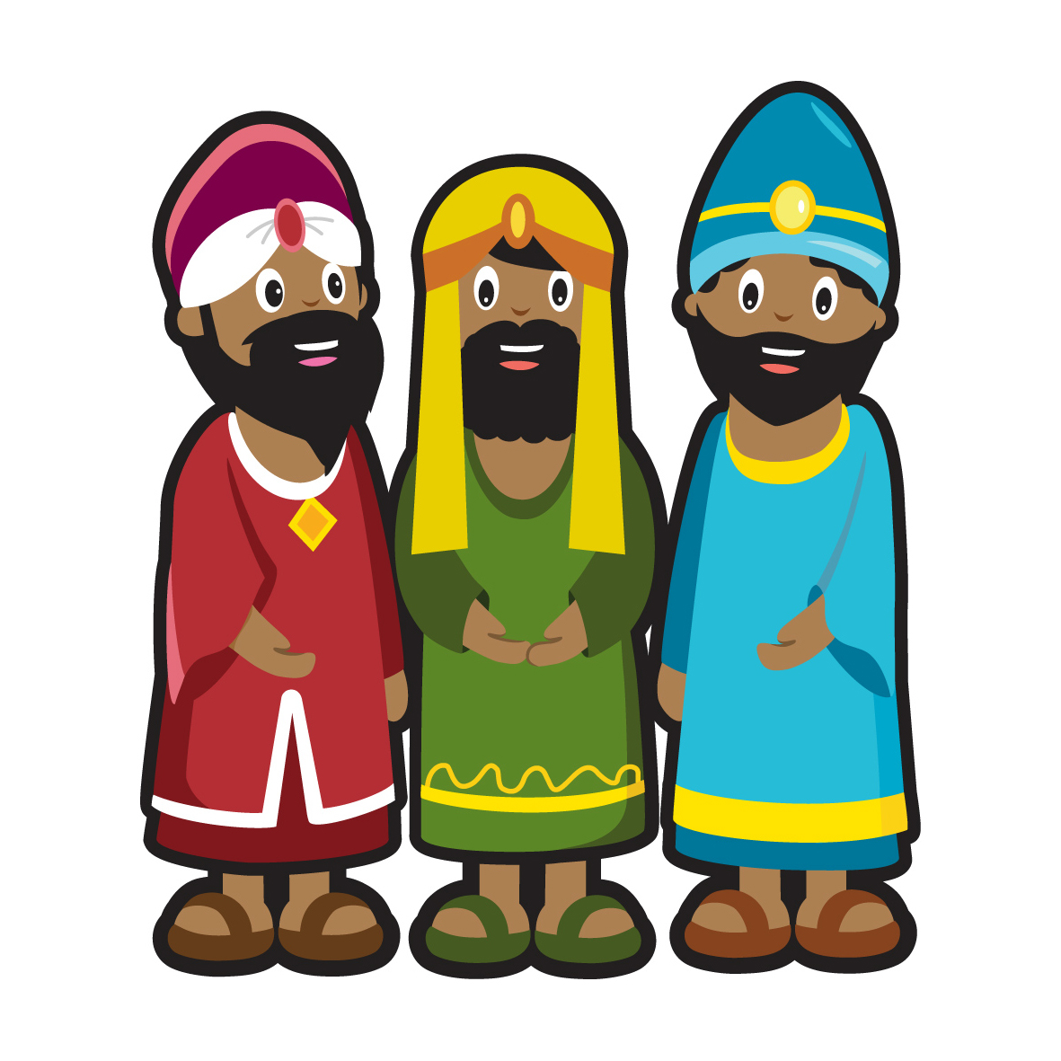

Slide 8
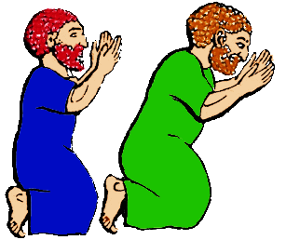
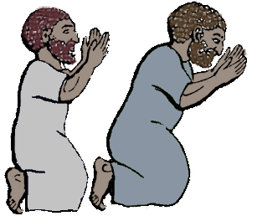
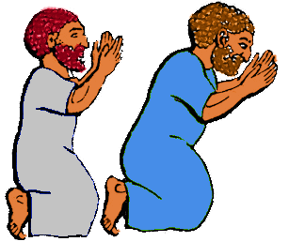

Slide 14
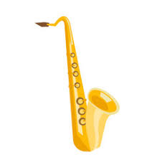
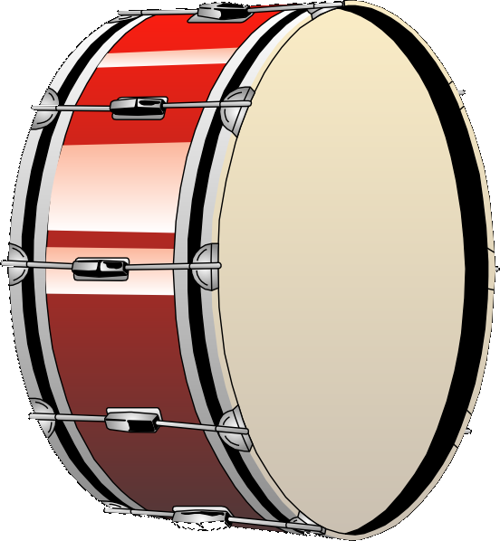
I am the music man, I come from far away
And I can play. What can you play?
I play the piano.
Pia-pia-piano-piano-piano. Pia-pia-piano. Pia-piano.
… I play the violin …
… I play the saxophone …
… I play the big bass drum …
… I play the guitar…

Slide 15
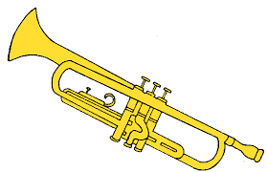
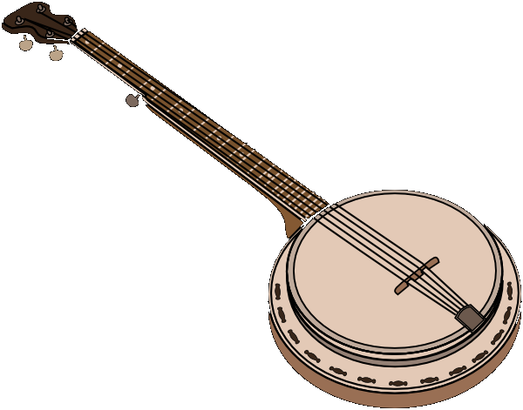
Old MacDonald had a band. La-la-la-la-la.
And in that band he had a trumpet. La-la-la-la-la.
With a toot-toot here
And a toot-toot there
Here a toot. There a toot. Everywhere a toot-toot.
Old MacDonald had a band. La-la-la-la-la.
Triangle – ting-ting
Banjo – twang-twang
Cymbals – Crash-crash

Slide 16
Let’s make a loud noise to say that God is great.
Let’s make a loud noise unto the Lord.
Here is my loud noise to say that God is great.
Here is my loud noise unto the Lord.
quiet
fast
slow

Slide 17
What’s the best news you’ve ever heard?
A chance to ask your questions and investigate the basics about faith and Christianity.
Saturday evenings 7 weeks

