Slide 1
WELCOME
to the
Preschool Playgroup
Run by Holy Trinity Church
Find us on Facebook
playgroup@htcchicago.org

Slide 2
God Rescues

Slide 3
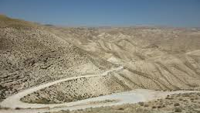
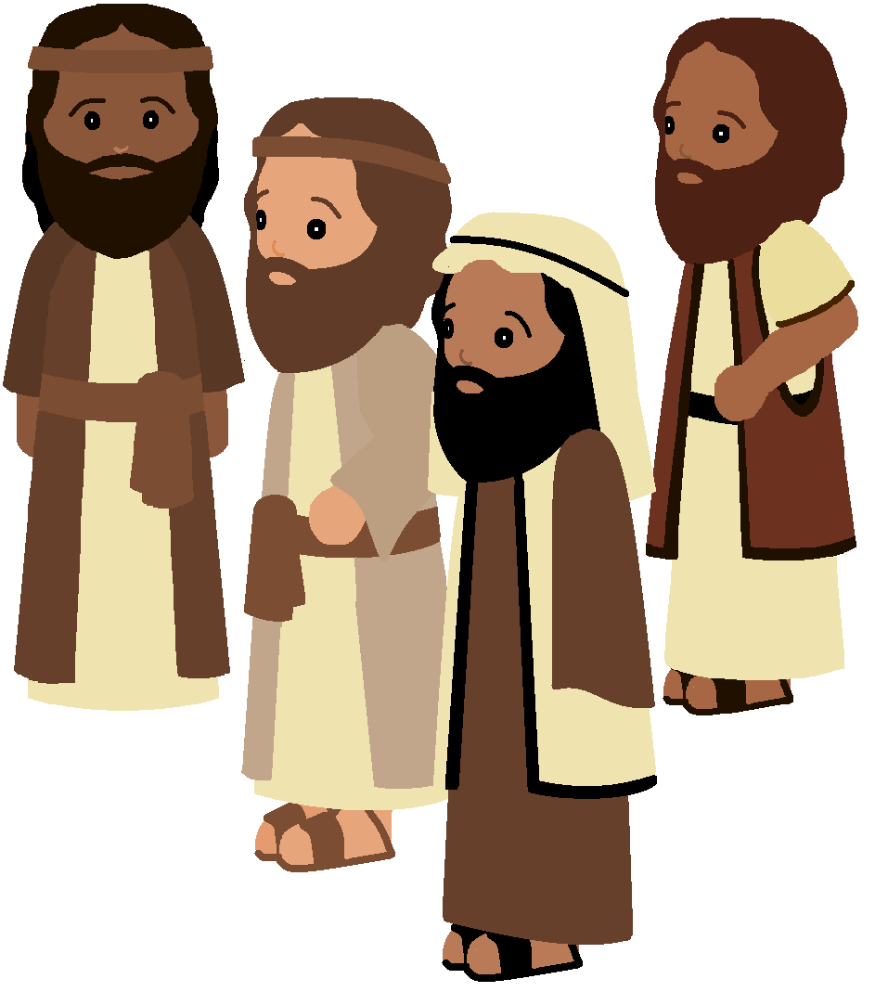

Slide 4
Is it Jesus?
Will he do a miracle?
What will he do?
Is he coming here?
What will he say?

Slide 5
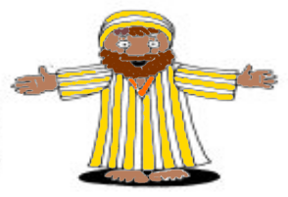

Slide 7
No way, Zach!
Go away, Zach!
Not today, Zach!

Slide 8
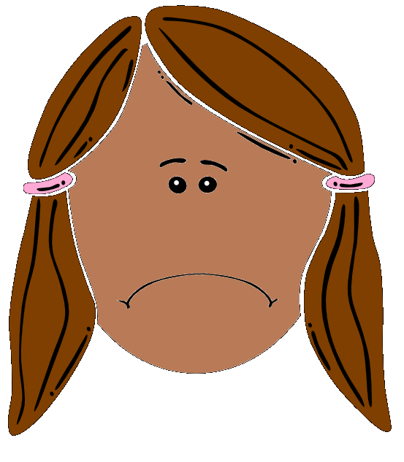

Slide 9
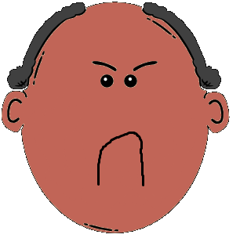

Slide 10
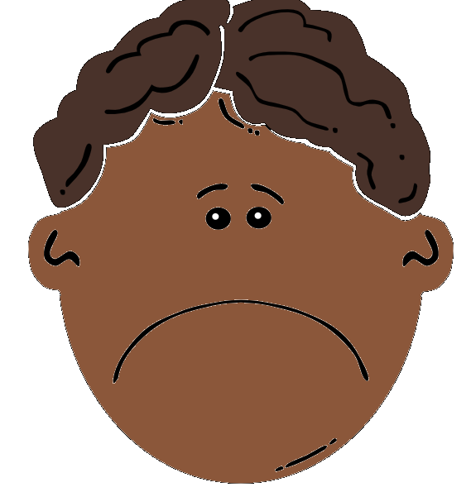

Slide 11
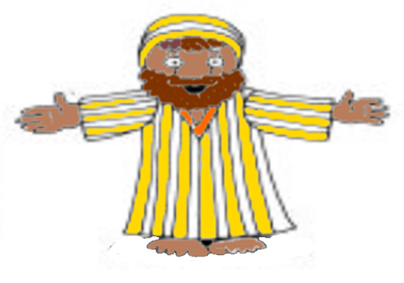

Slide 12
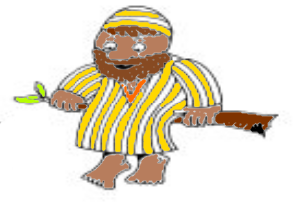

Slide 13
Oh,hey Zach! Get out of that tree.
I’m coming to your house to dinner and to stay the night.

Slide 14
Why did Jesus go to Zach’s house?
He’s a bad friend and a mean man!
Don’t go to Zach’s!

Slide 15
I’ve always been greedy
But now I’m not going to take what isn’t mine.
I’ve always had lots of stuff
But now I’m going to share it with those who have nothing.
If I’ve taken something from you
I’m going to give it back; and give you more than I ever took.

Slide 16
I’ve come to rescue people like Zach.
.
After all people in trouble are the ones who need rescuing”

Slide 17
Oh Hey, Zach!
Wanna play, Zach?
Have a nice day, Zach!

Slide 18
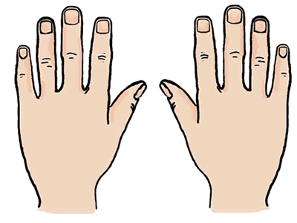
10 fat sausages sizzling in a pan
1 went POP and the other went BANG
8 fat sausages…
3
8
2
4
7
9
1
10
5
6

Slide 19
5 little peas
In a pea-pod pressed
1 grew, 2 grew
And so did all the rest
They grew and they grew
And they did not stop
Until one day the pod went
POP!
5 little peas
In a pea-pod pressed
1 grew, 2 grew
And so did all the rest
They grew and they grew
So fat and round
Then all the peas
Fell to the ground

Slide 20
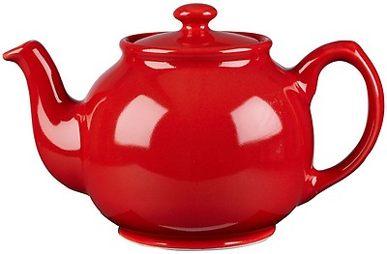
I’m a little teapot, short and stout,
Here’s my handle, here’s my spout.
When I start to whistle; hear me shout,
Pick me up and pour me out.

Slide 21
Pease porridge hot, Pease porridge cold
Pease porridge in the pot; 9 days old.
Some like it hot, Some like it cold
Some like it in the pot; 9 days old.

Slide 22
A Pizza Hut, a Pizza Hut
Kentucky Fried Chicken and a Pizza Hut
A Pizza Hut, a Pizza Hut
Kentucky Fried Chicken and a Pizza Hut
McDonalds, McDonalds
Kentucky Fried Chicken and a Pizza Hut
McDonalds, McDonalds
Kentucky Fried Chicken and a Pizza Hut

Slide 23
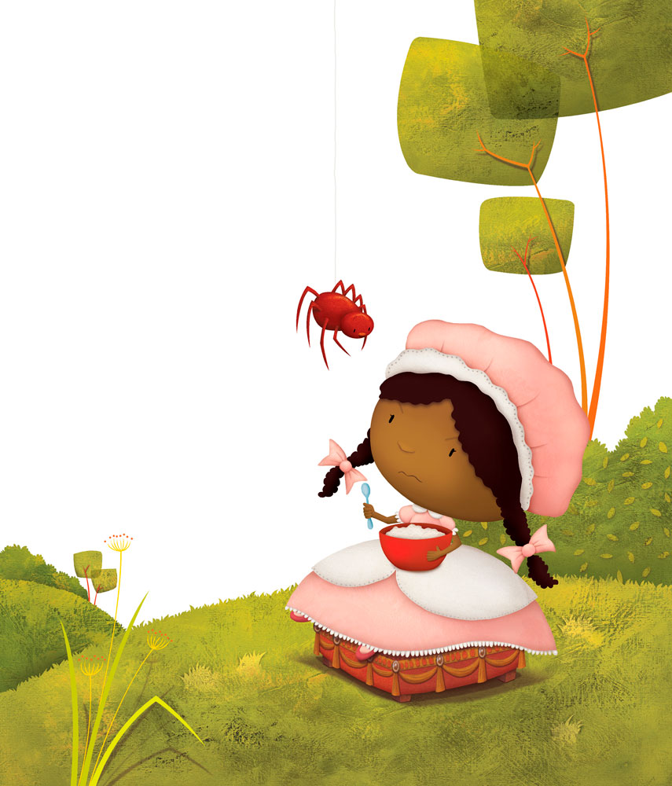
Little Miss Muffet sat on a tuffet
Eating her curds and whey
Along came a spider
And sat down beside her
And frightened Miss Muffet away.

