Slide 1
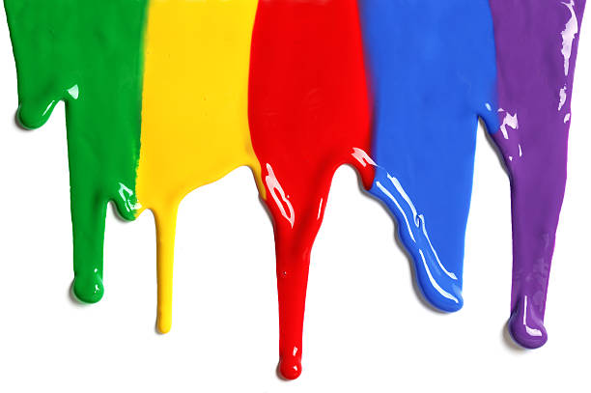
WELCOME
to the
Preschool Playgroup
Run by Holy Trinity Church
Find us on Facebook
playgroup@htcchicago.org

Slide 2
K
N
G
the
I
is here!

Slide 3
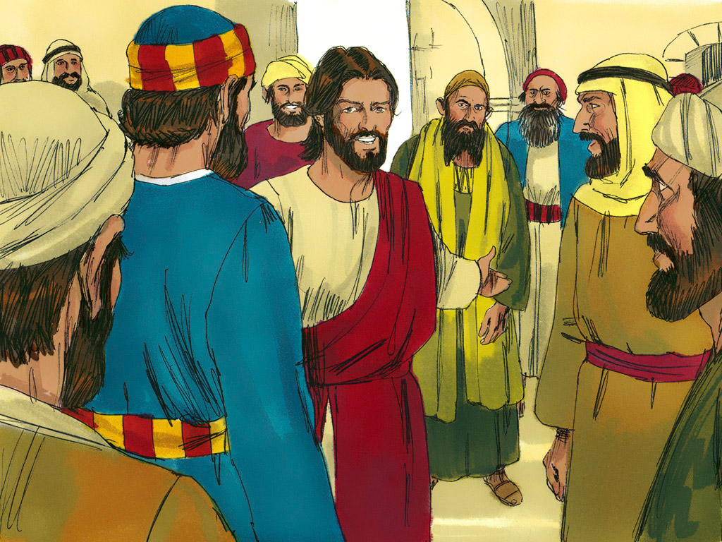

Slide 4
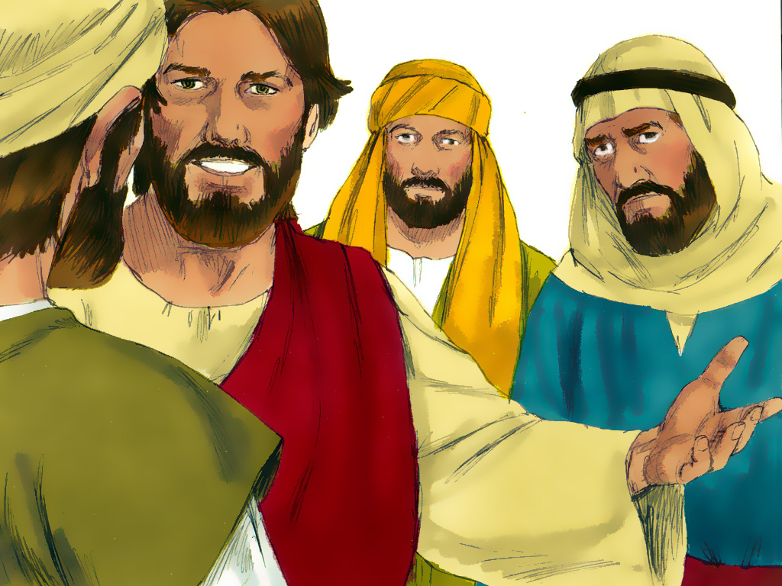

Slide 6
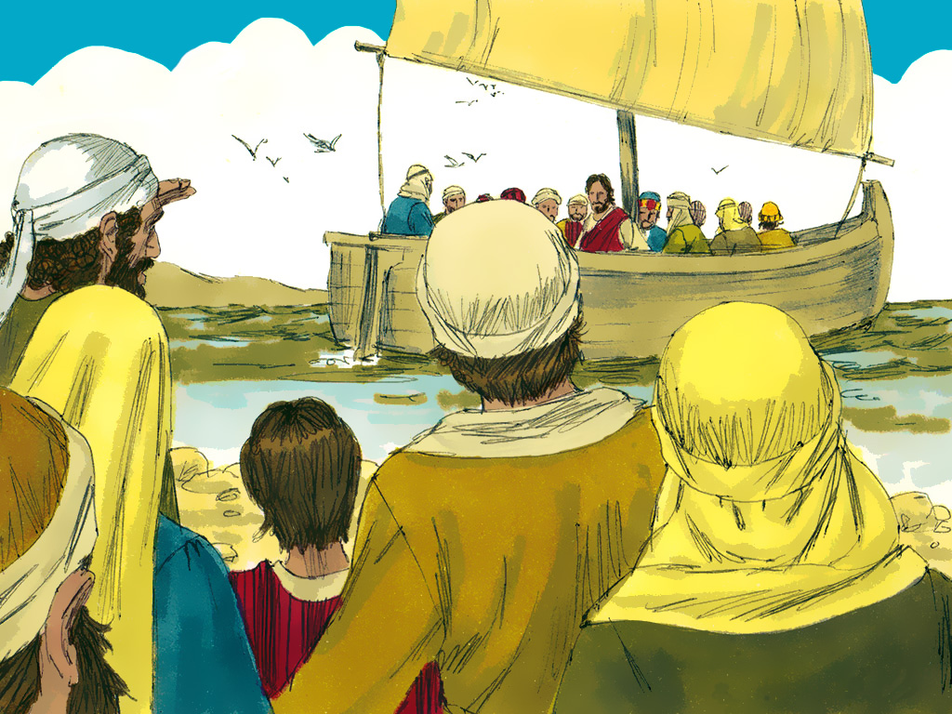

Slide 7
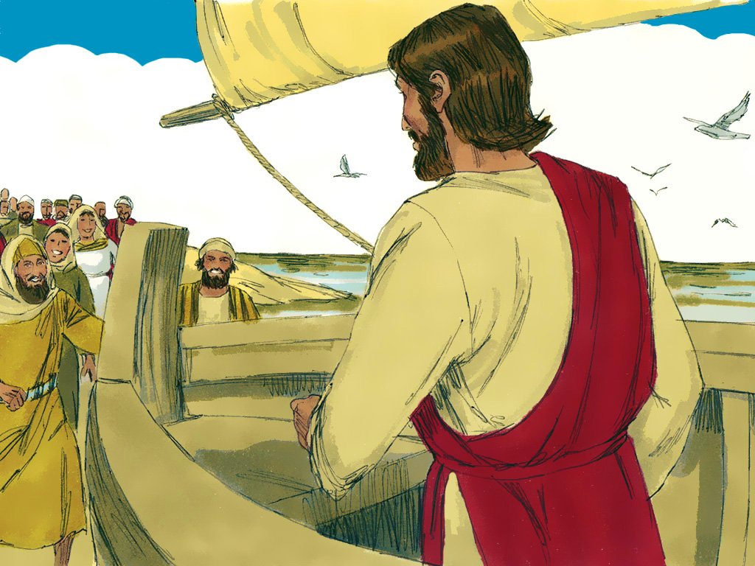

Slide 8
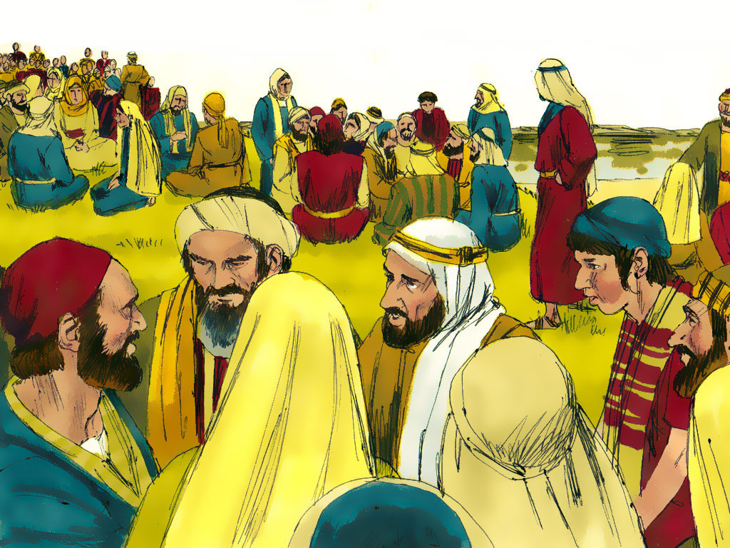

Slide 9
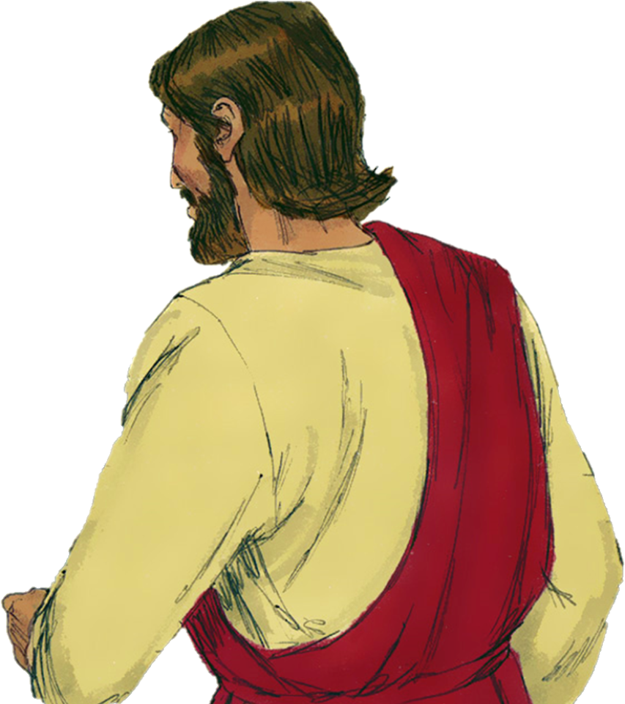

Slide 11
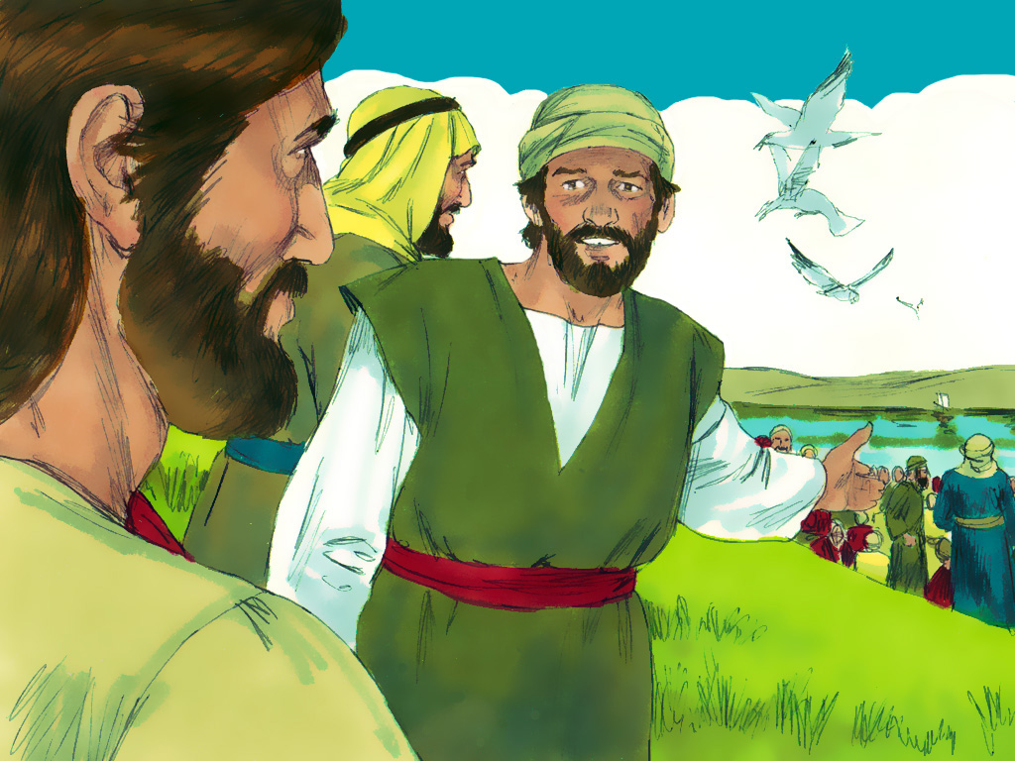

Slide 14
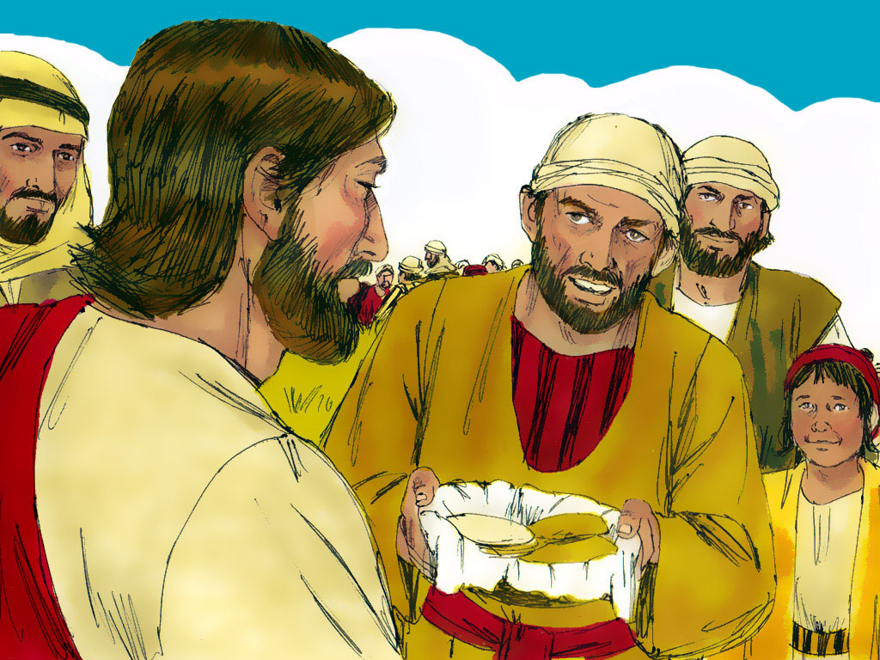

Slide 17
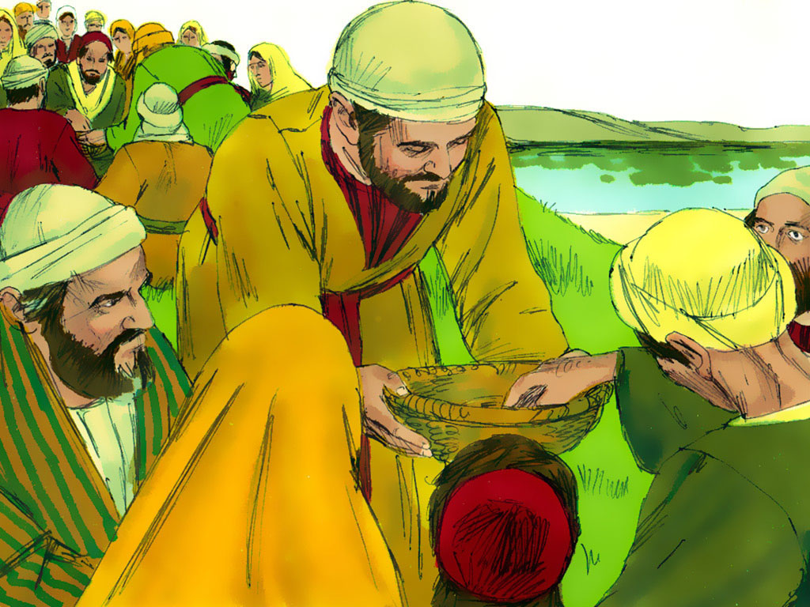

Slide 20
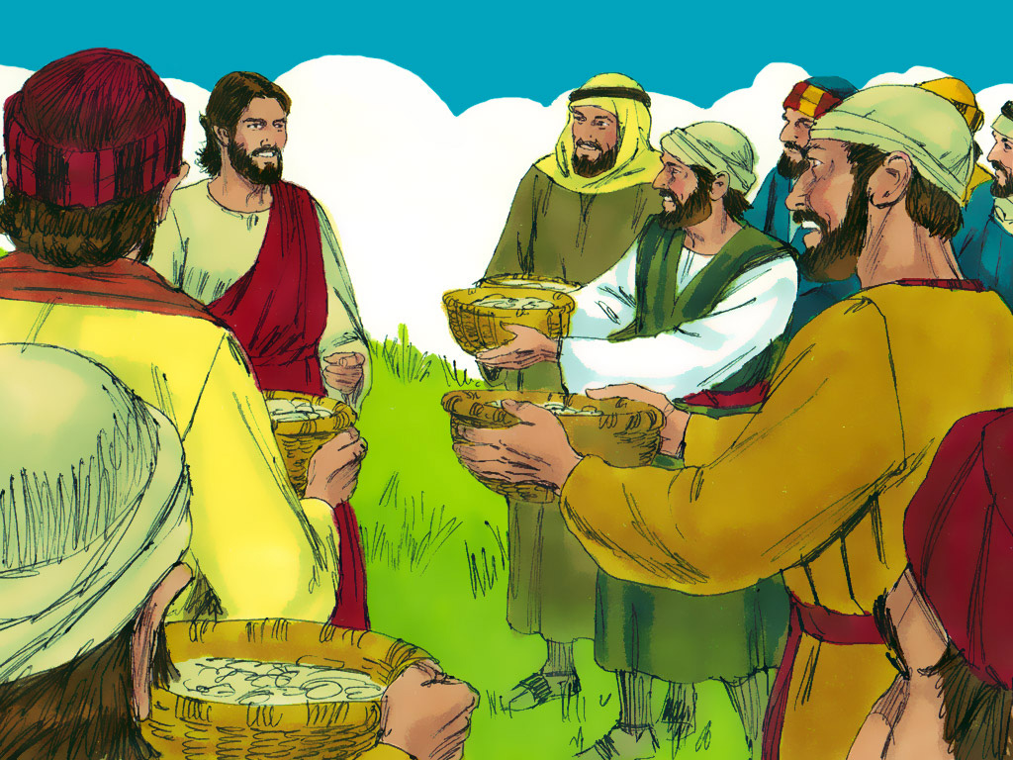

Slide 21
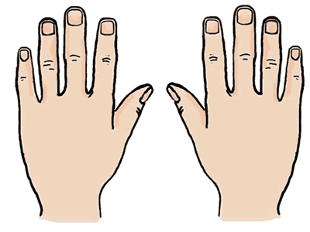
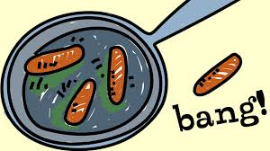
10 fat sausages sizzling in a pan
1 went POP and the other went BANG
8 fat sausages…
3
8
2
4
7
9
1
10
5
6

Slide 22
A Pizza Hut, a Pizza Hut
Kentucky Fried Chicken and a Pizza Hut
A Pizza Hut, a Pizza Hut
Kentucky Fried Chicken and a Pizza Hut
McDonalds, McDonalds
Kentucky Fried Chicken and a Pizza Hut
McDonalds, McDonalds
Kentucky Fried Chicken and a Pizza Hut

Slide 23
5 little peas
In a pea-pod pressed
1 grew, 2 grew
And so did all the rest
They grew and they grew
And they did not stop
Until one day the pod went
POP!
5 little peas
In a pea-pod pressed
1 grew, 2 grew
And so did all the rest
They grew and they grew
So fat and round
Then all the peas
Fell to the ground

Slide 24
Pat-a-cake, pat-a-cake baker’s man
Bake me a cake as fast as you can
Pat it and prick it and mark it with B
Put it in the oven for baby and me

Slide 25
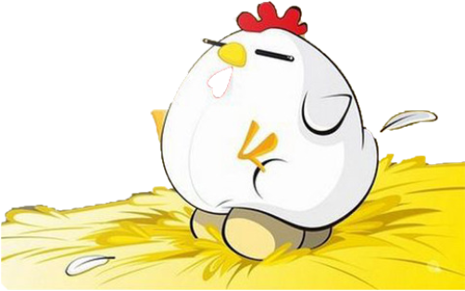
Chick, chick, chick, chick, chicken, Lay a little egg for me. Chick, chick, chick, chick, chicken, I want one for my tea. I haven't had an egg since Easter, And now it's half past three. So, chick, chick, chick, chicken, Lay a little egg for me.

