Slide 1
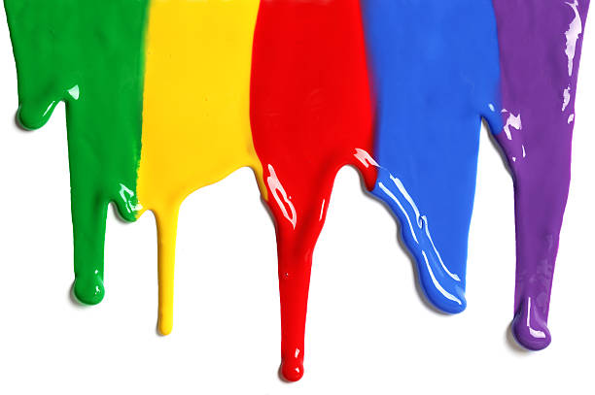
WELCOME
to the
Preschool Playgroup
Run by Holy Trinity Church
Find us on Facebook
playgroup@htcchicago.org

Slide 2
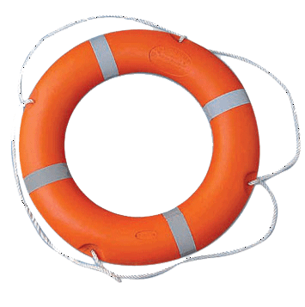
God Rescues

Slide 3
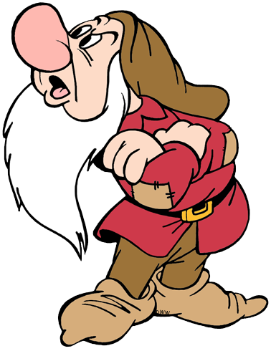

Slide 4
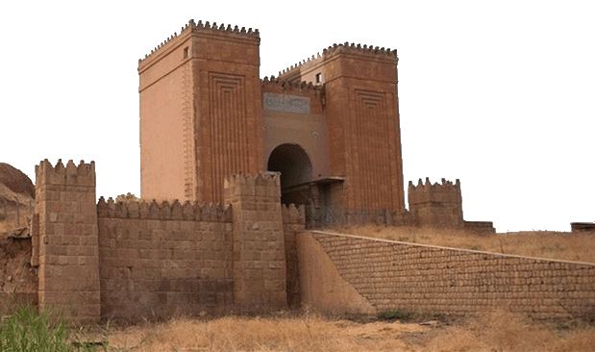

Slide 5
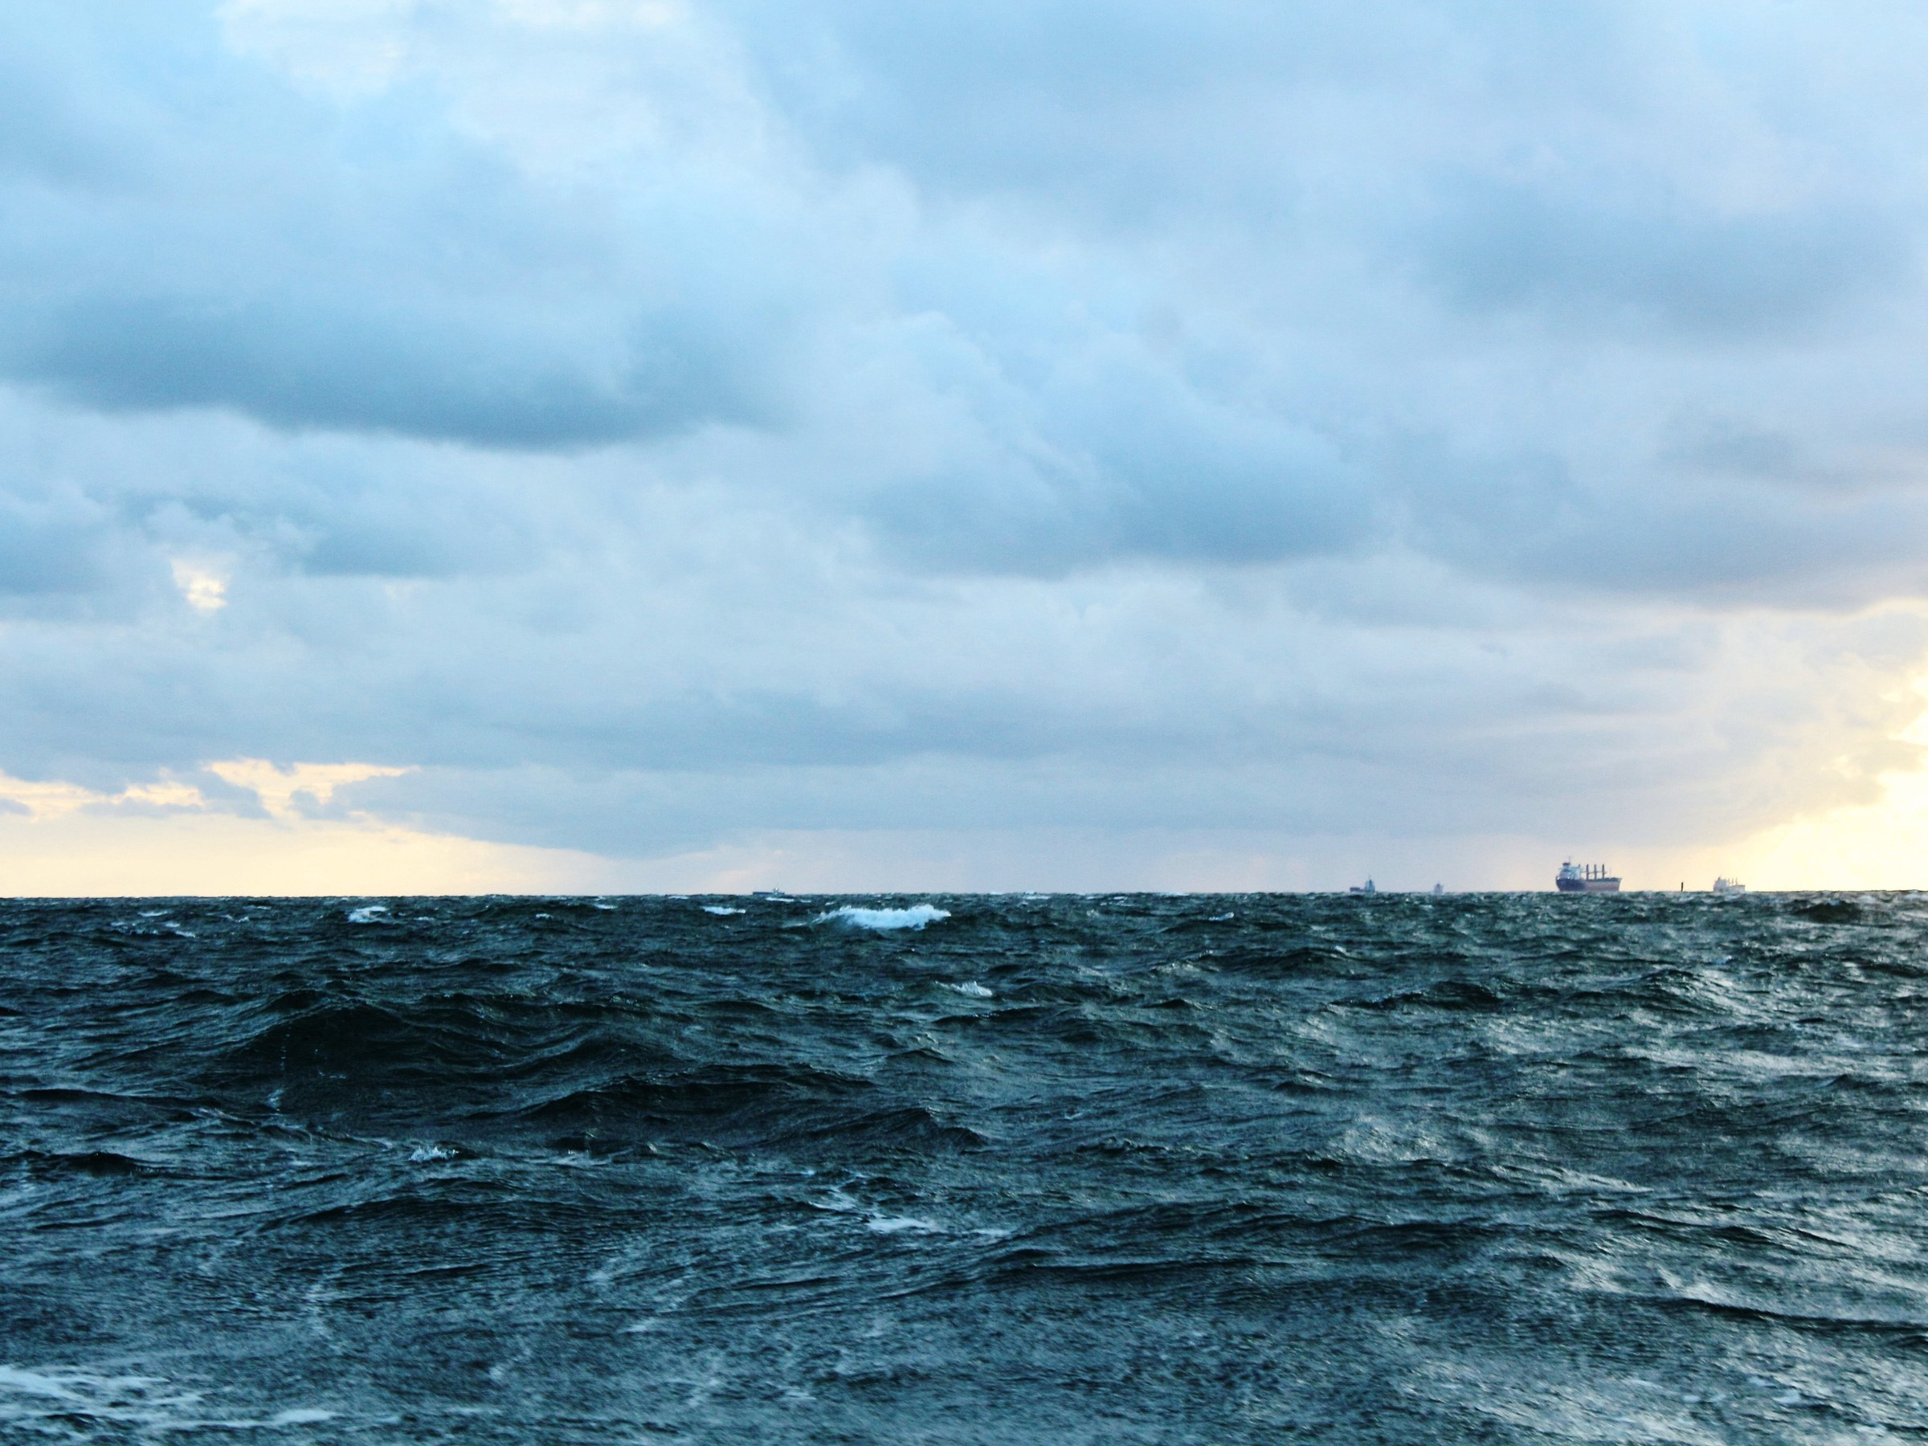
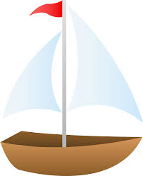
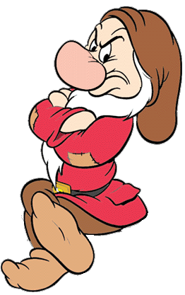

Slide 6
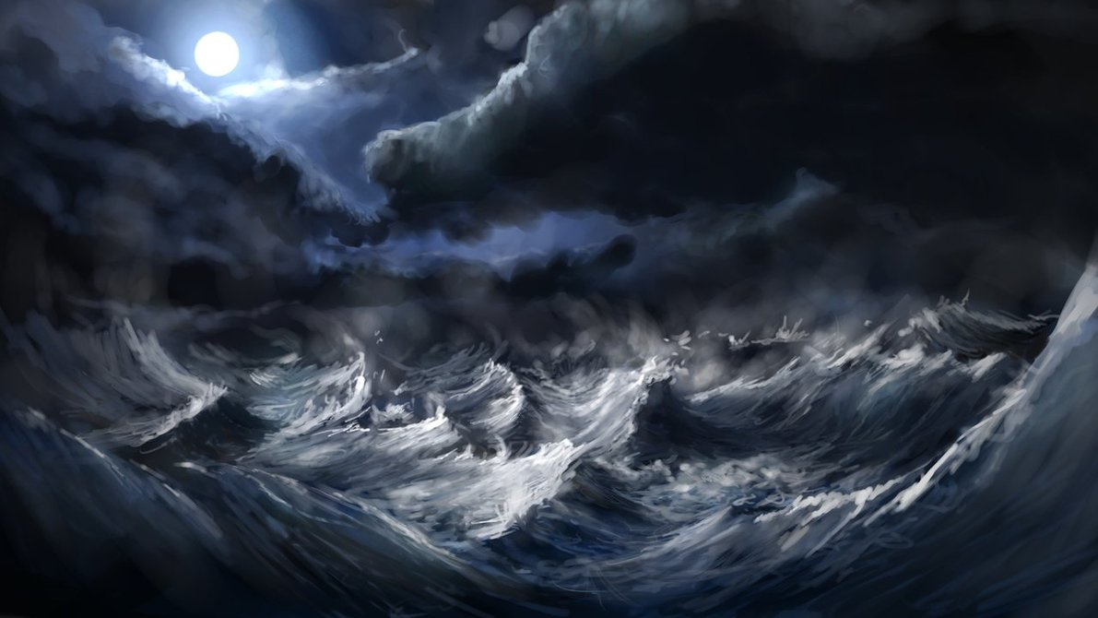

Slide 7
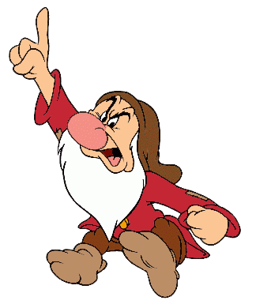

Slide 8
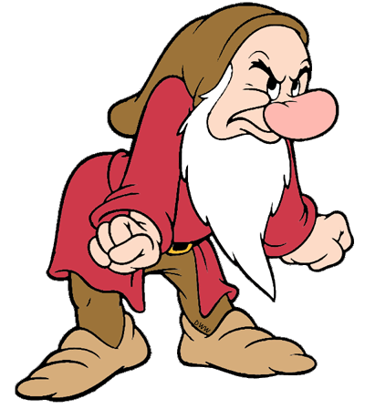

Slide 9
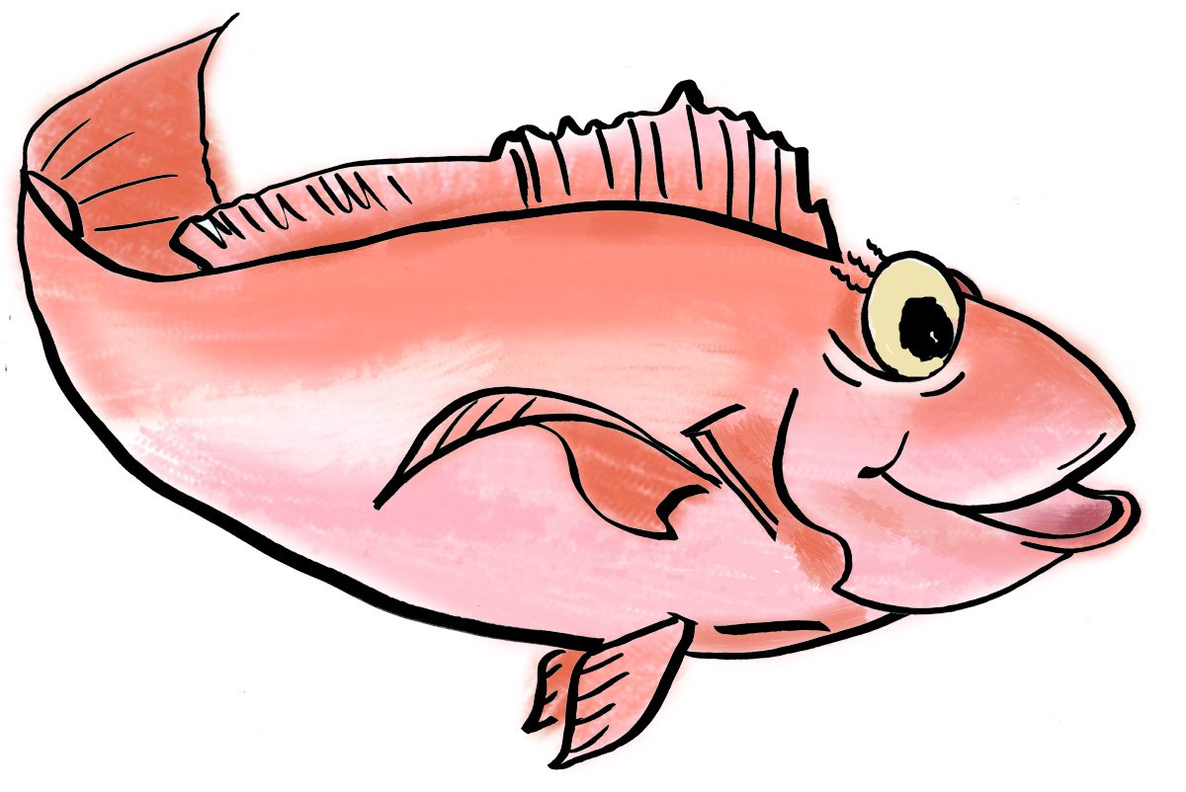

Slide 10
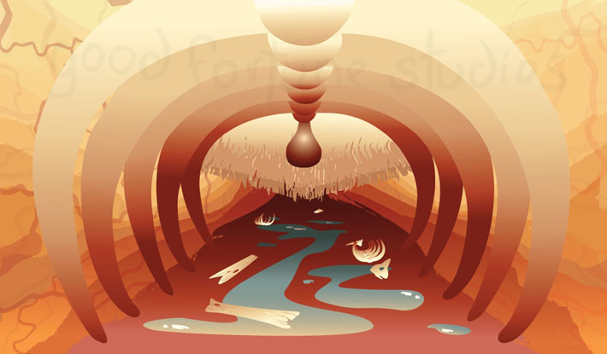
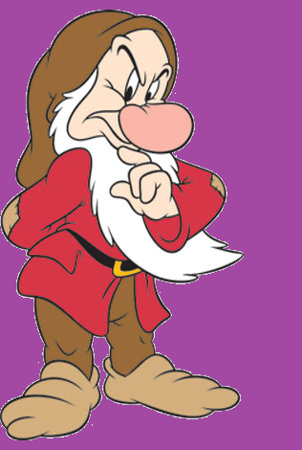

Slide 11
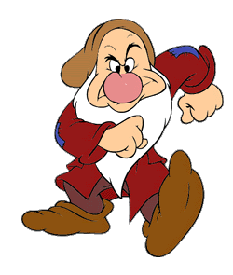

Slide 12
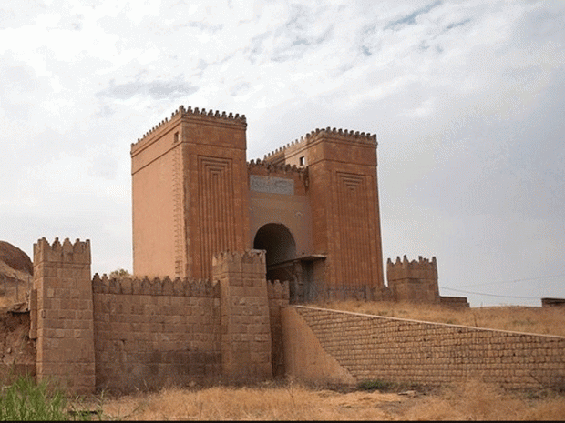
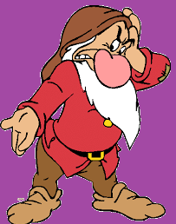

Slide 14
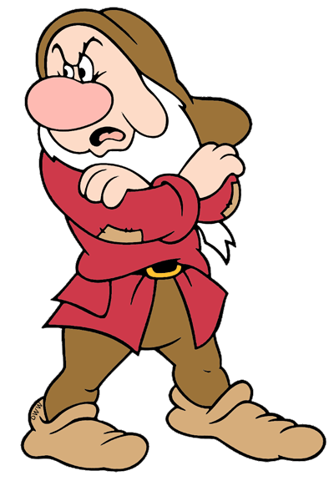
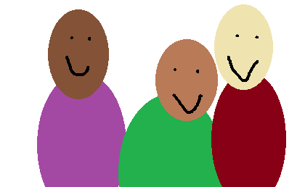

Slide 15
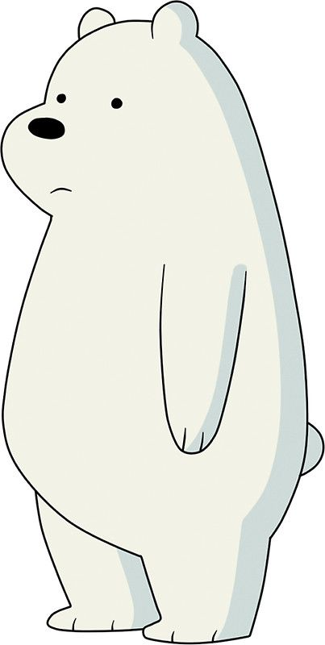
Row, row, row your boat gently down the stream
If you see a crocodile don’t forget to scream.
Row, row, row your boat gently to the shore
If you see a lion there don’t forget to roar.
Row, row, row your boat quickly down the river
If you see a polar bear don’t forget to shiver.
Rock, rock, rock your boat gently to and fro
Wibbly-wobbly, wibbly-wobbly
Into the water you go.

Slide 16
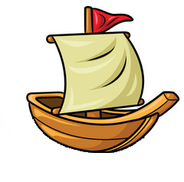
A sailor went to sea, sea, sea
To see what he could see, see, see
But all that he could see, see, see
Was the bottom of the deep blue sea, sea, sea

Slide 17
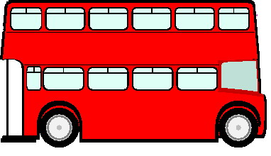
The wheels on the bus go round and round
Round and round, round and round
The wheels on the bus go round and round
All through the town.
Horn – Beep, Beep, Beep
Lights – Flash on and off
Doors – Open and Shut
People – Bounce up and down

Slide 18
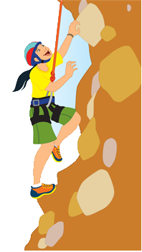
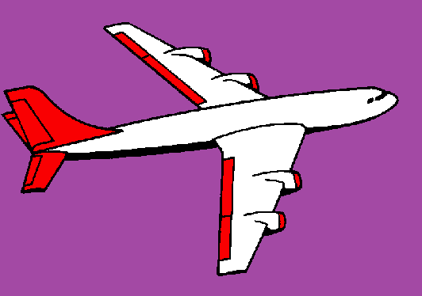
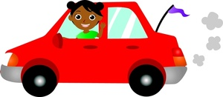
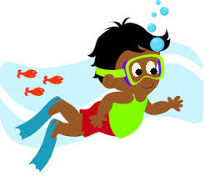
If I go climbing, climbing, climbing
If I go climbing; God is there
If I go climbing on the highest mountain
God is there ‘cos he is everywhere.
If I go flying in the biggest aeroplane
If I go driving far away
If I go swimming in the deepest ocean

