Slide 1
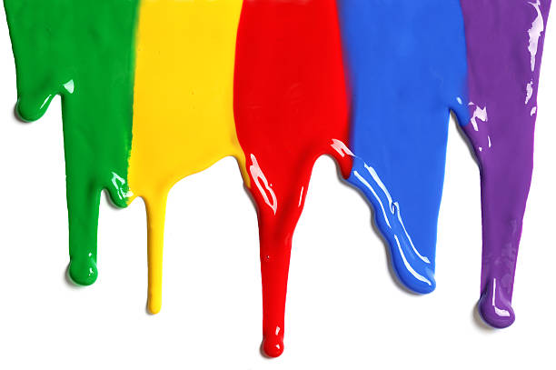
WELCOME
to the
Preschool Playgroup
Run by Holy Trinity Church
Find us on Facebook
playgroup@htcchicago.org

Slide 2
K
N
G
the
I
is coming!

Slide 3
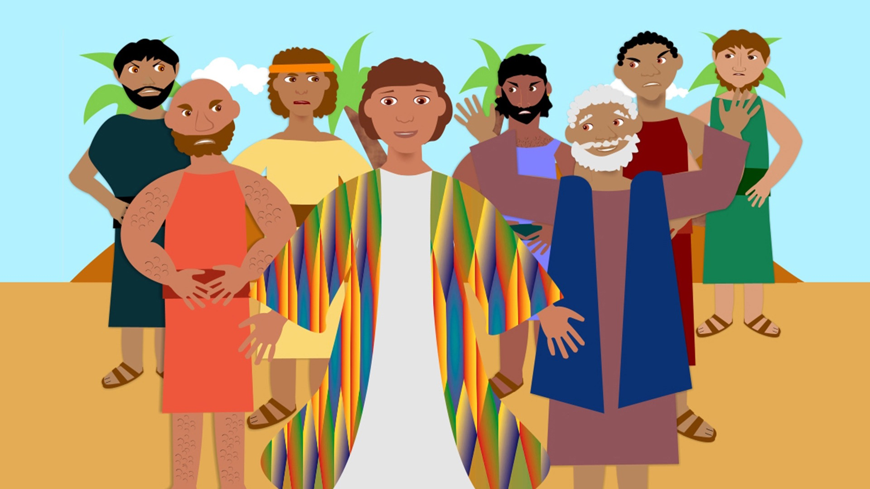

Slide 4
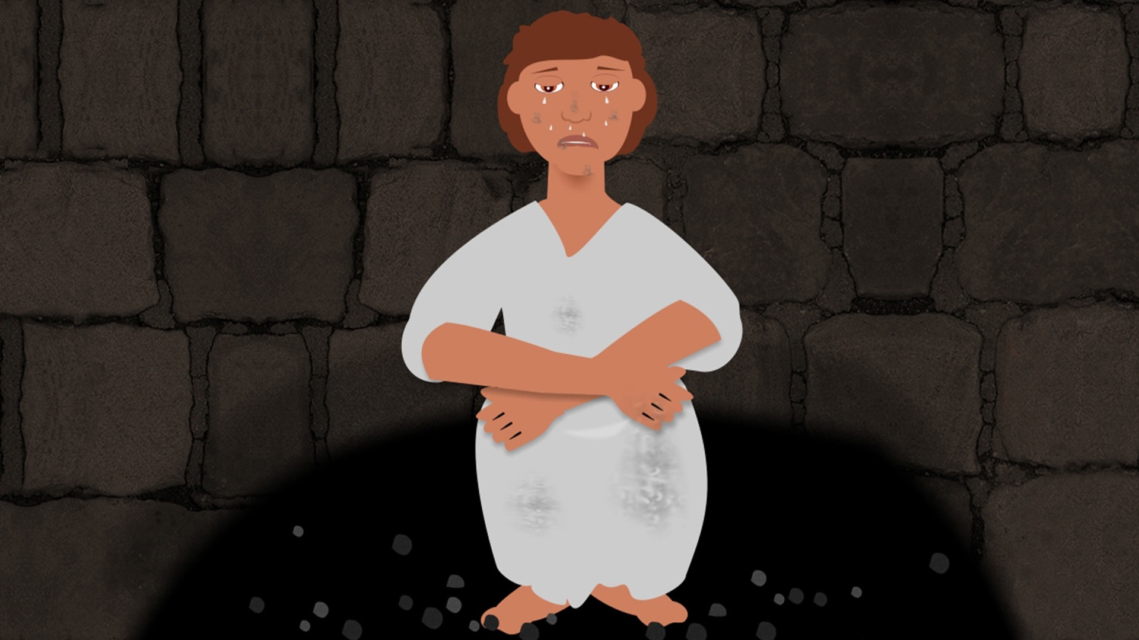

Slide 5
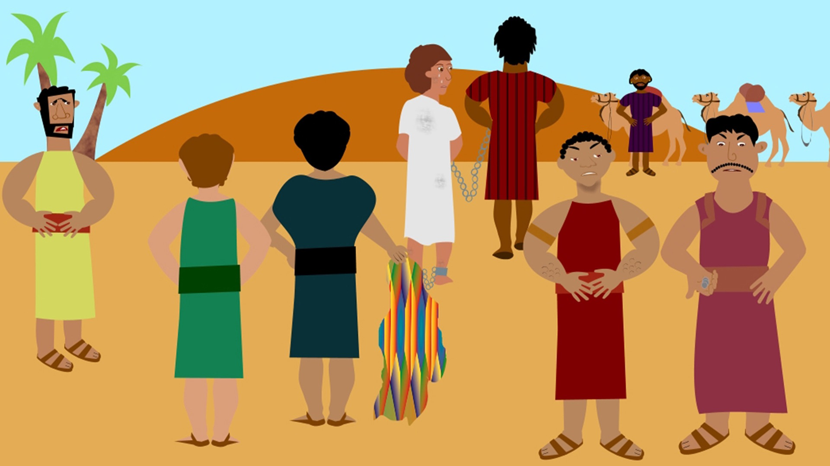

Slide 6
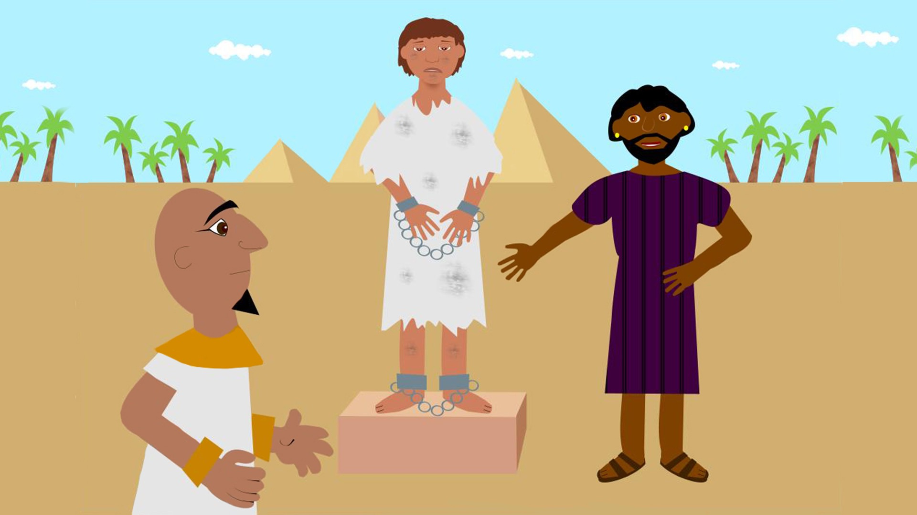

Slide 7
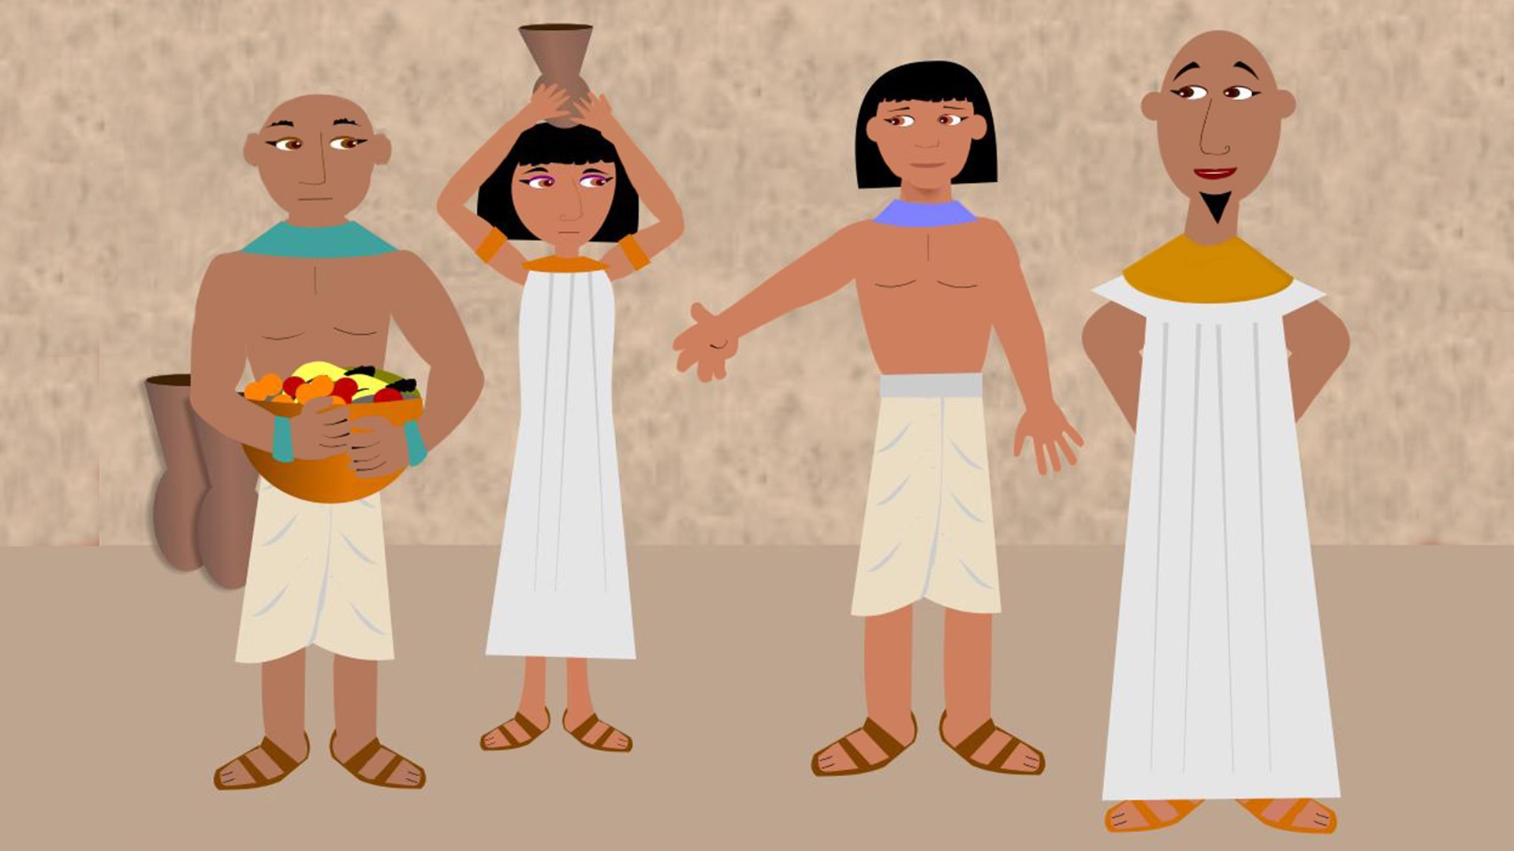

Slide 8
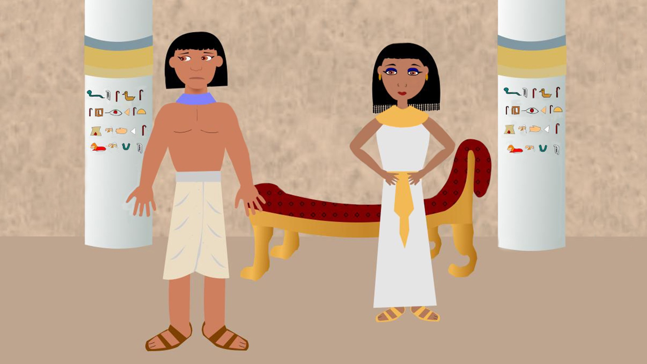

Slide 9
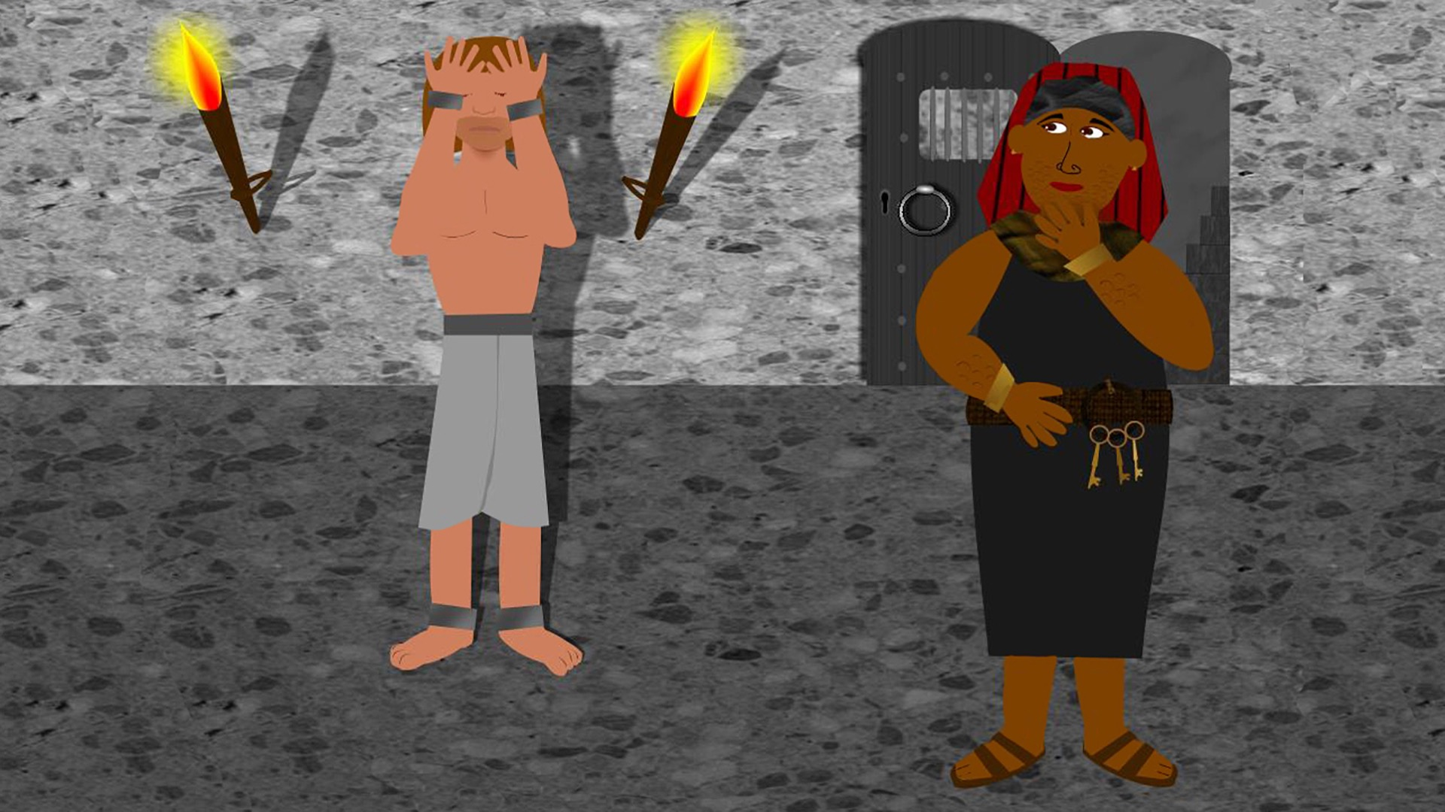

Slide 10
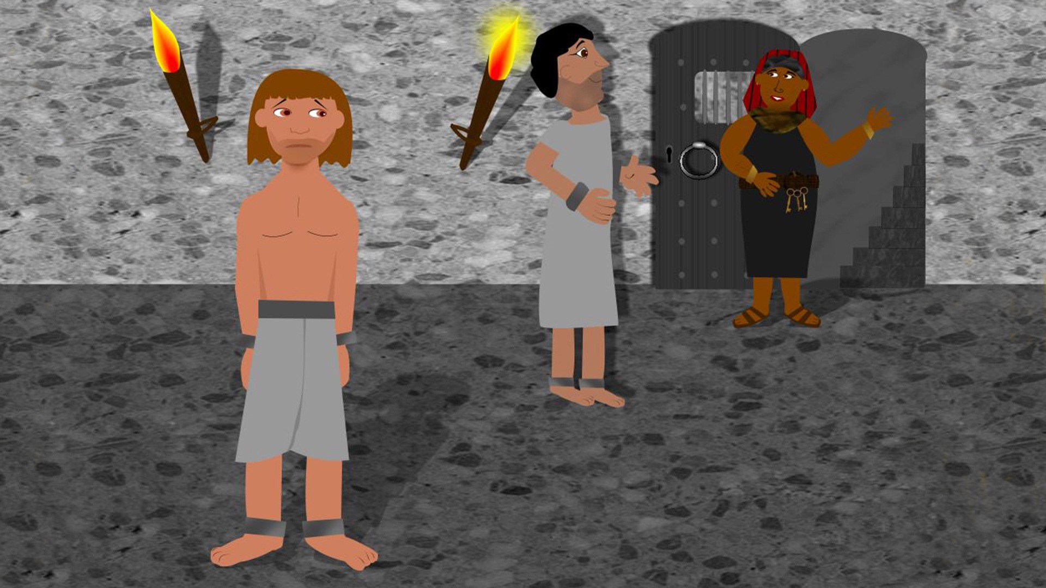

Slide 11
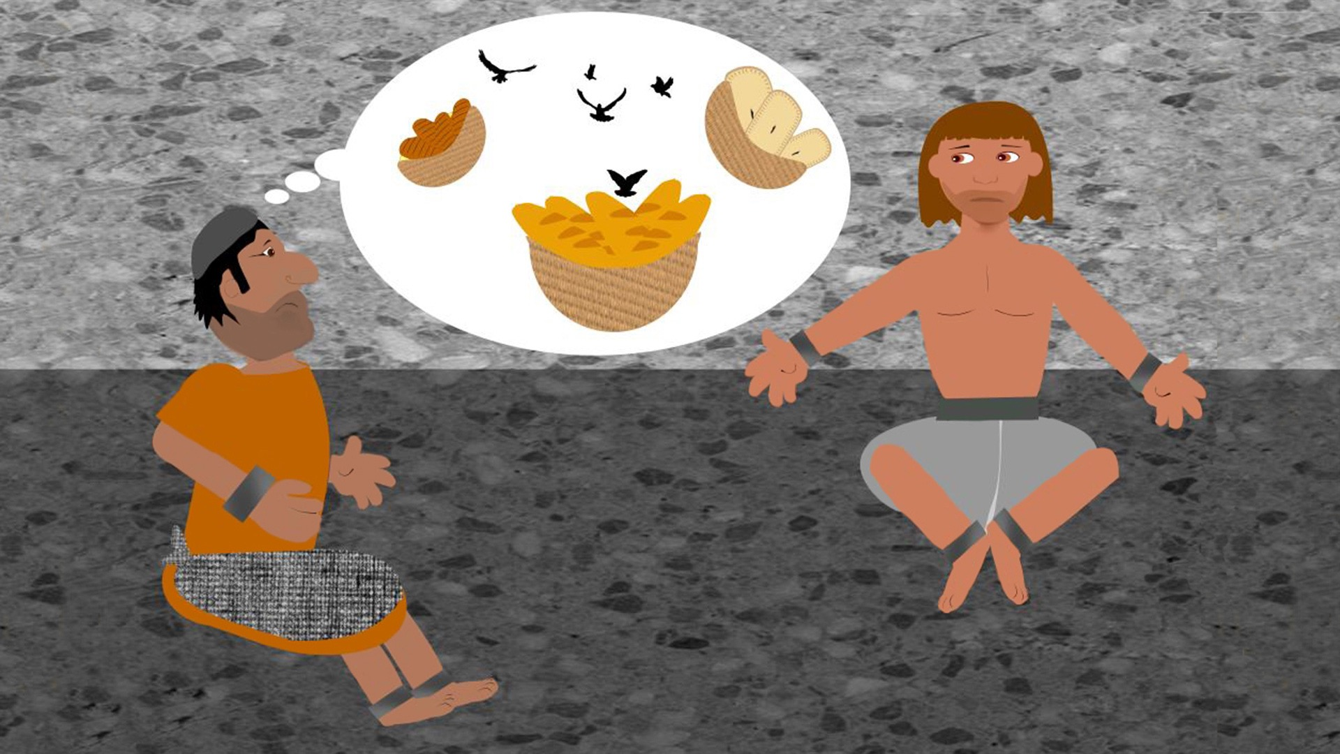

Slide 13
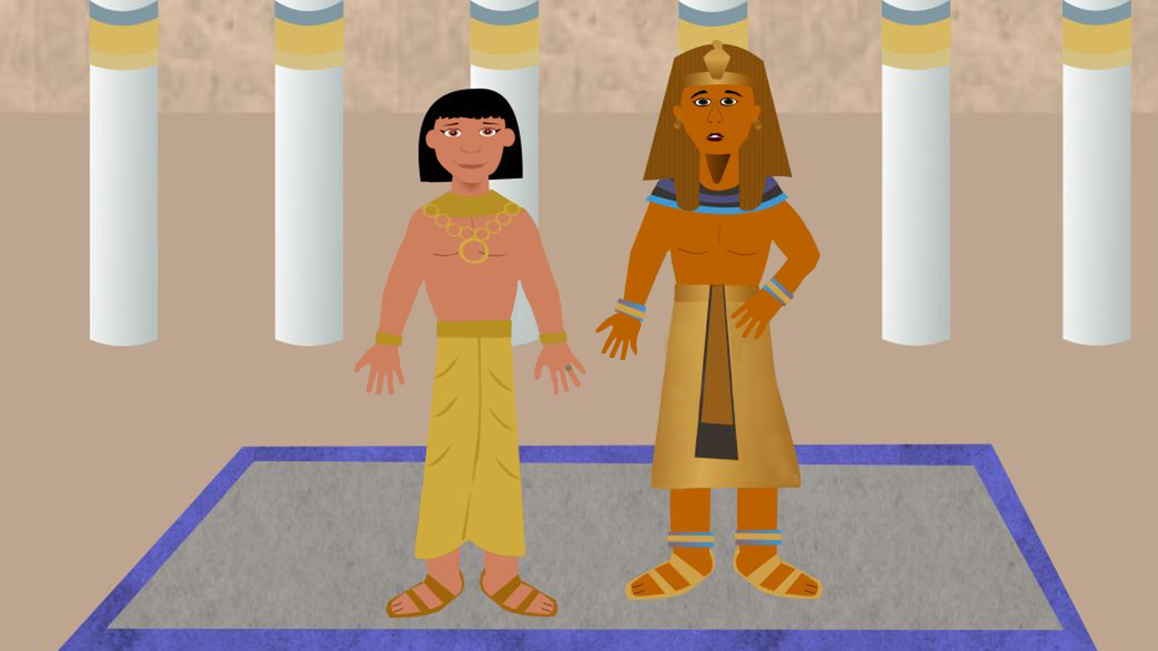

Slide 14
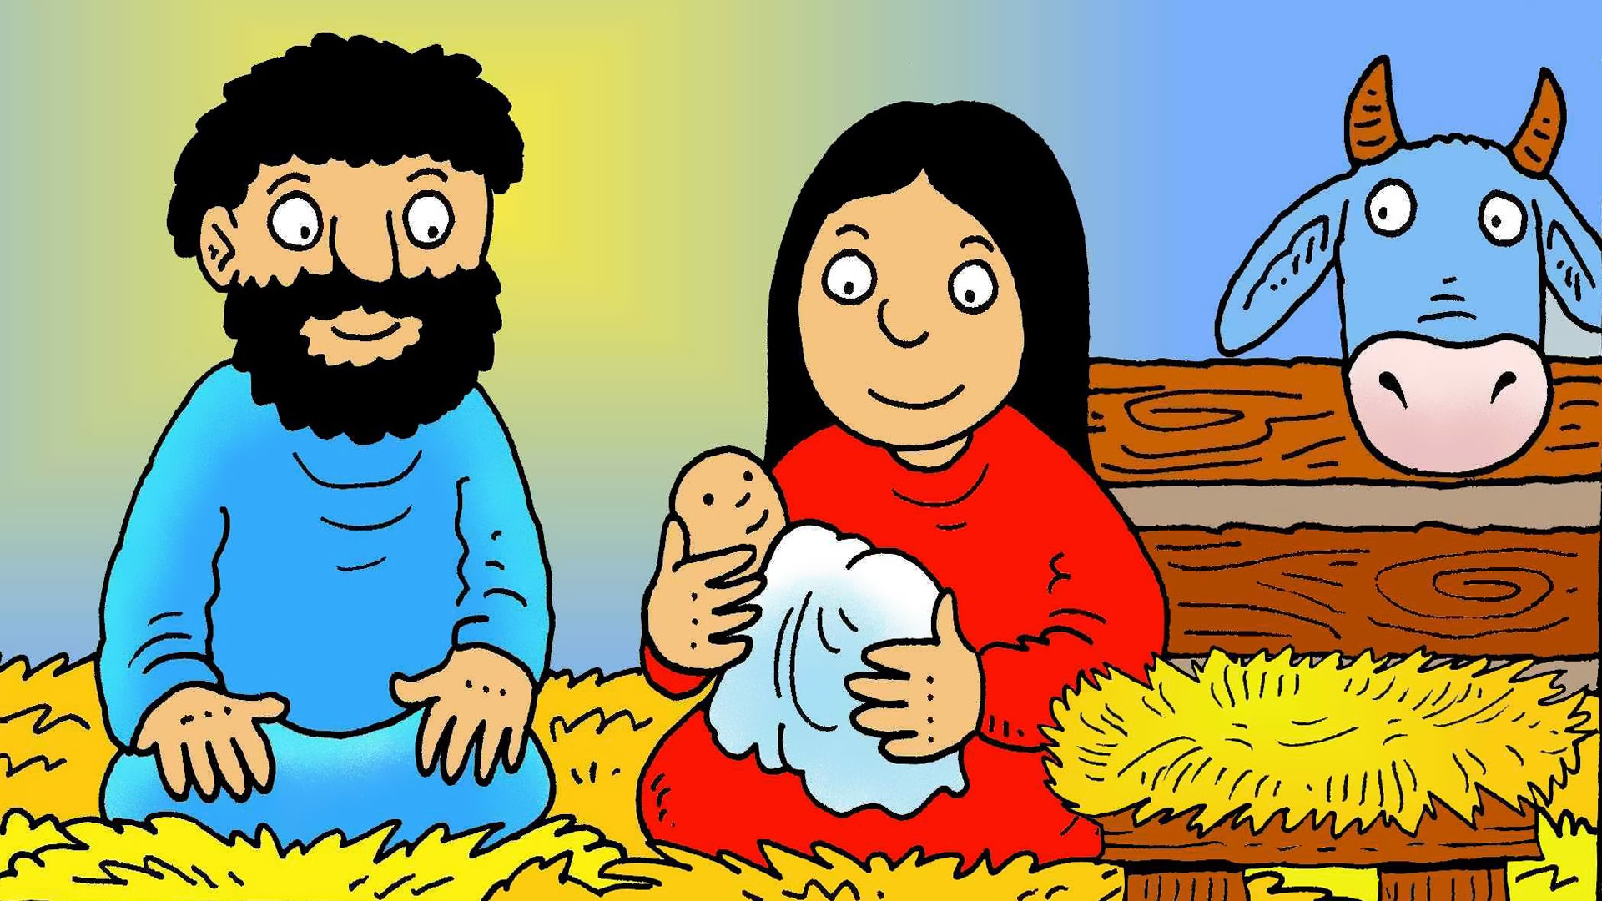
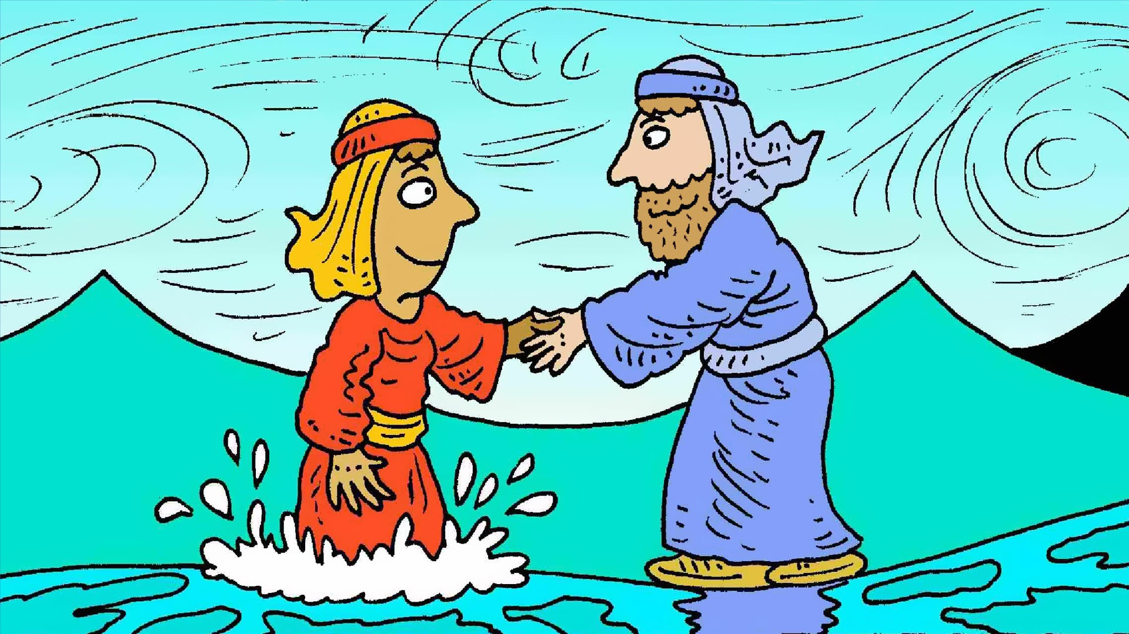
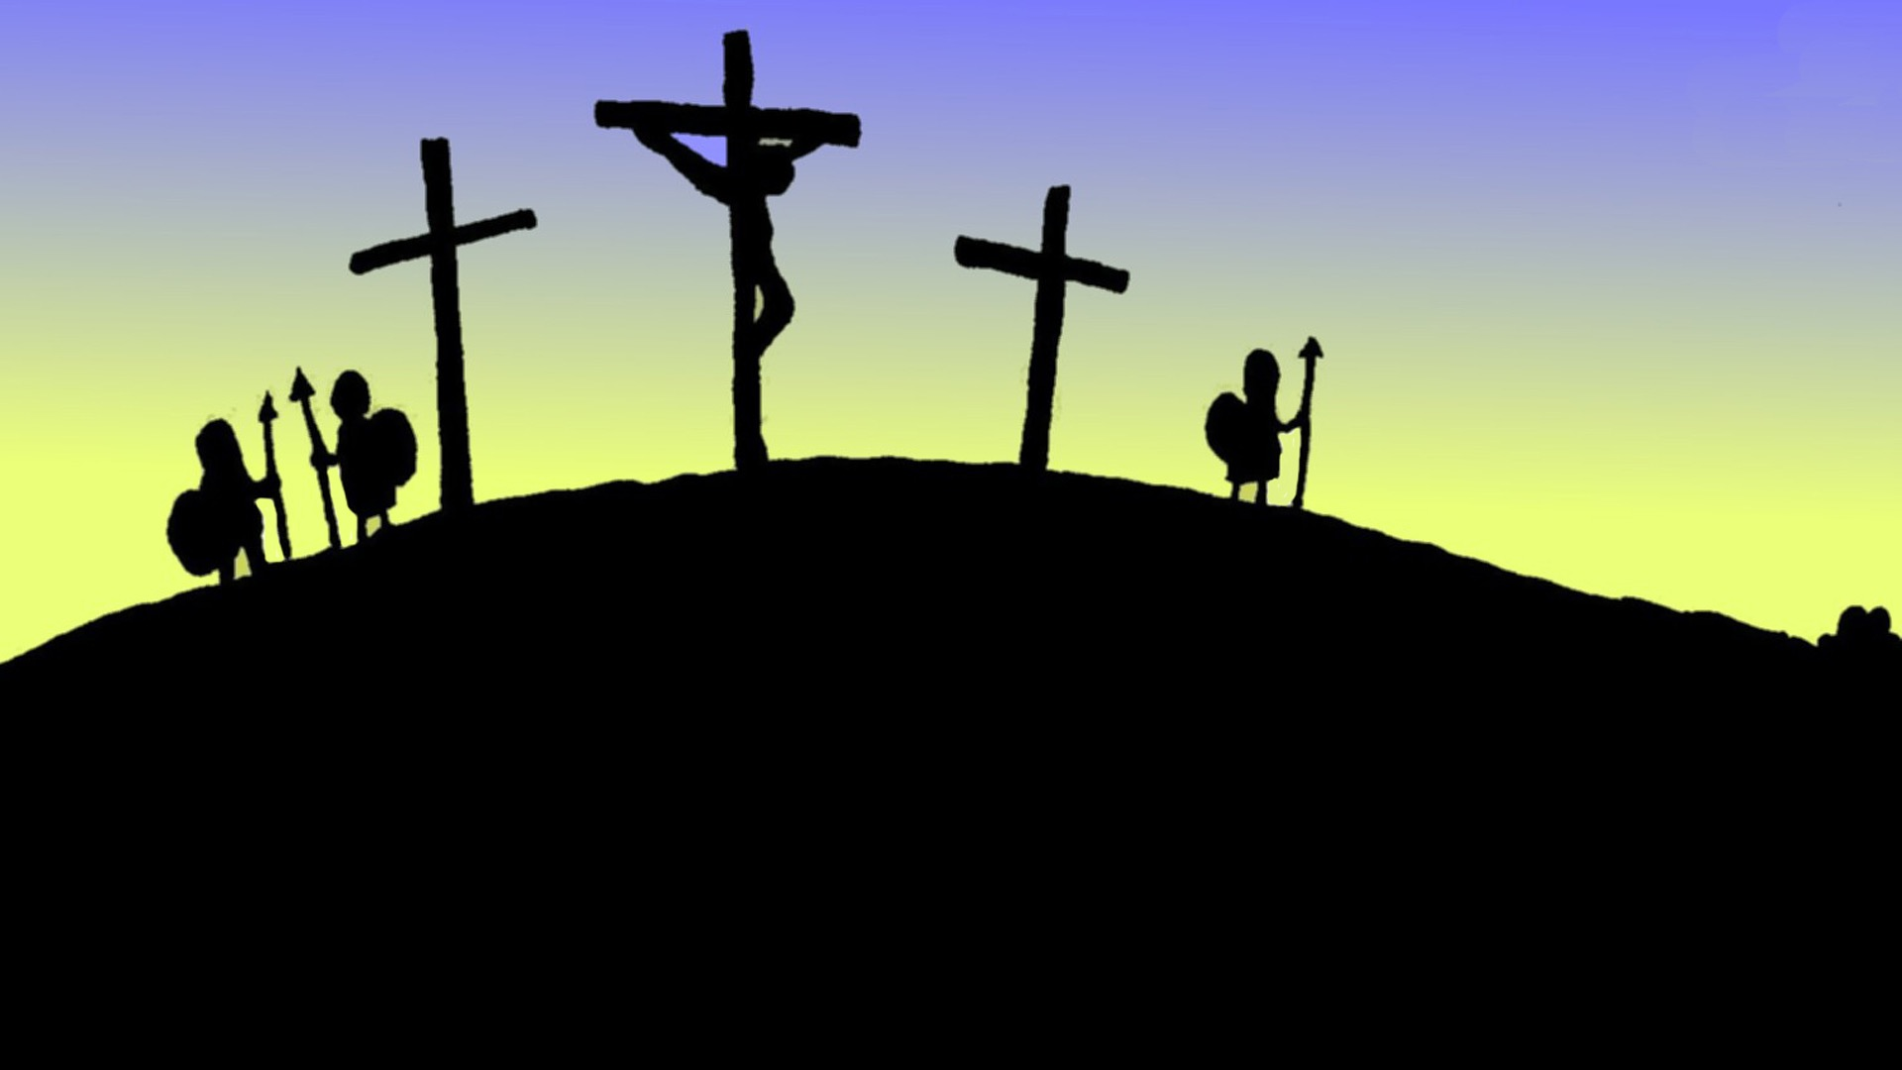
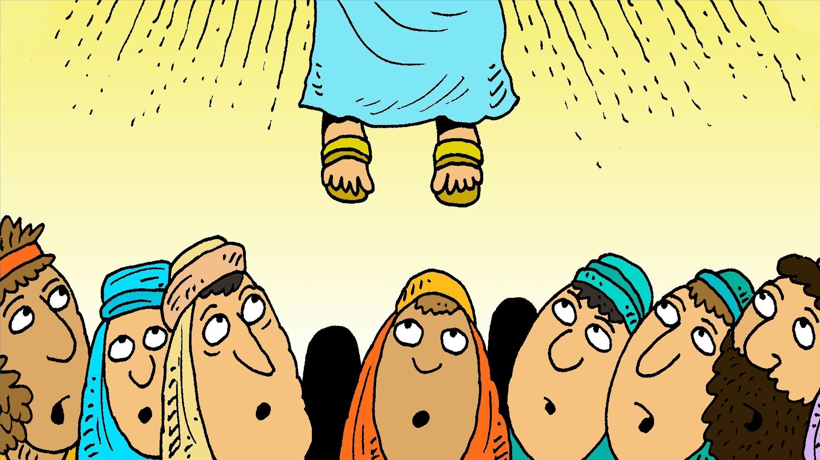

Slide 15
A sailor went to sea, sea, sea
To see what he could see, see, see
But all that he could see, see, see
Was the bottom of the deep blue sea, sea, sea

Slide 16
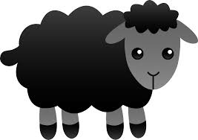
Baa baa black sheep have you any wool?
Yes sir, yes sir, three bags full
One for the master
One for the dame
And one for the little boy who lives down the lane.

Slide 17
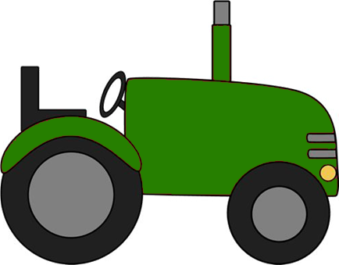
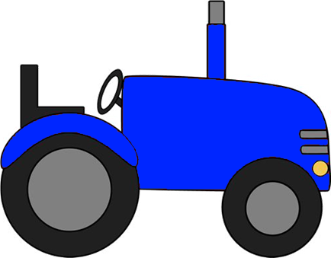
Bouncing along on a big red tractor
Bouncing along on a big red tractor
Bouncing along on a big red tractor
Going to get hay – HEY!
Bouncing along on a slow green tractor
Climbing up the hill – HEY!
Bouncing along on a fast blue tractor
Racing down the hill – HEY!

Slide 18
Red and yellow
And pink and green Purple and orange and blue I can sing a rainbow Sing a rainbow Sing a rainbow too

