Slide 1
WELCOME
to the
Preschool Playgroup
Run by Holy Trinity Church
Find us on Facebook
playgroup@htcchicago.org

Slide 2
God Rescues

Slide 3
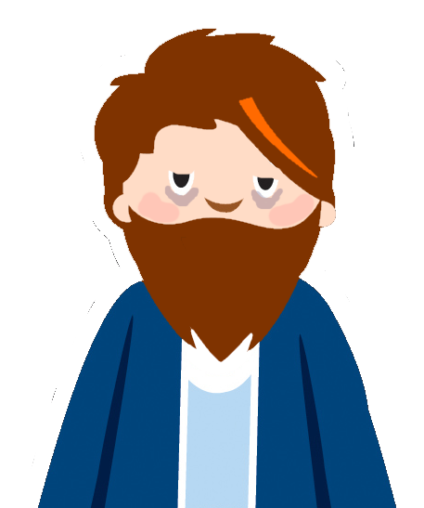

Slide 4
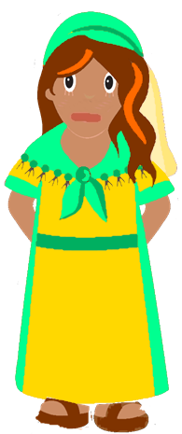
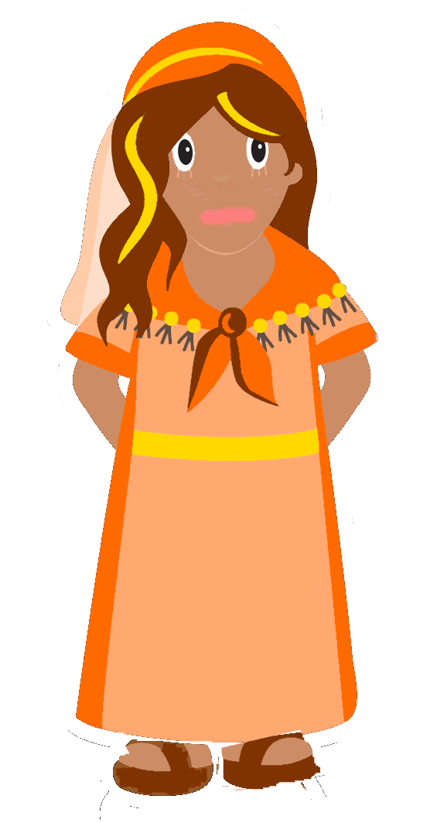

Slide 6
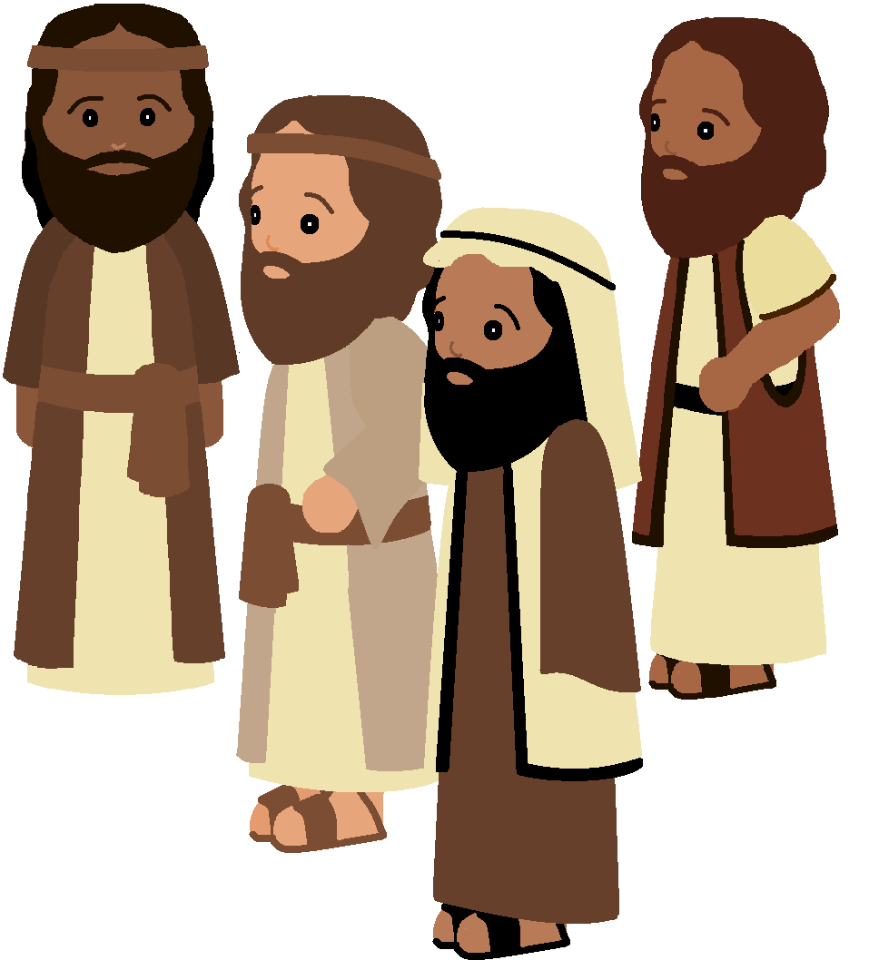

Slide 10
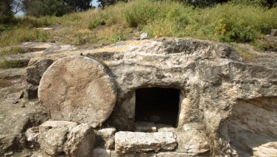

Slide 15
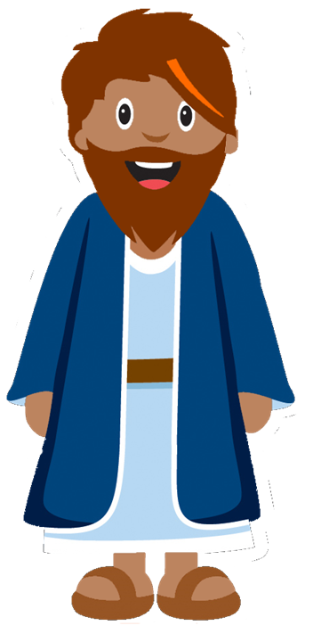

Slide 16
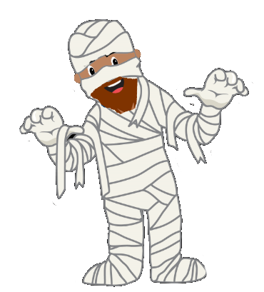
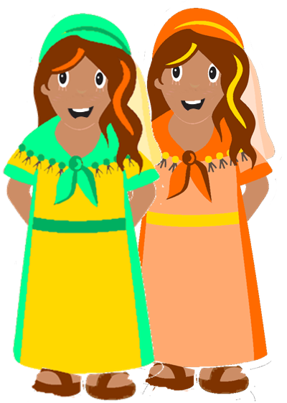

Slide 17
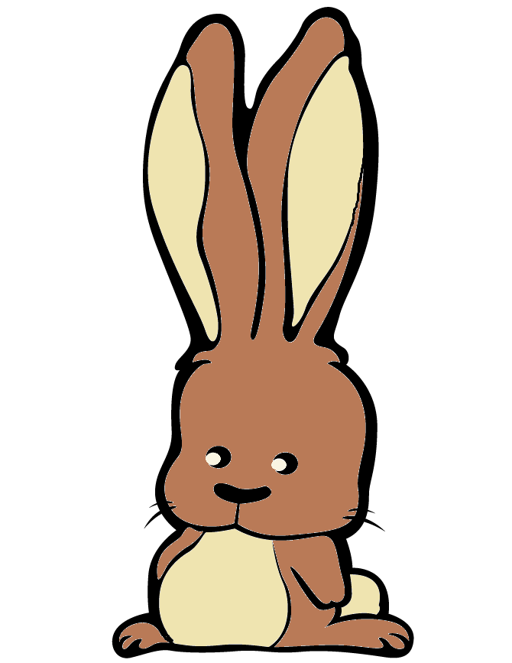
See the little bunnies sleeping ‘til noon
Shall we try and wake them with a merry tune?
They’re so still, are they ill?
Wake up soon!
Hop little bunnies, hop, hop, hop x3
Hop and Stop!

Slide 18
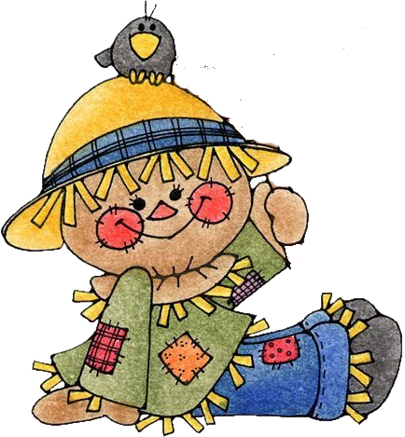
When all the cows are sleeping
And the sun has gone to bed
Up jumps the scarecrow and this is what he said
I’m a dingle dangle scarecrow With a flippy floppy hat
I can shake my arms like this I can shake my legs like that.
When all the hens are roosting and the sun’s behind a cloud
Up jumps the scarecrow and shouted very loud… The dogs are in the kennel
and the doves are in the loft
Up jumps the scarecrow and whispers very soft…

Slide 19
Twinkle twinkle little star
How I wonder what you are
Up above the world so high
Like a diamond in the sky
Twinkle twinkle little star
How I wonder what you are

Slide 20
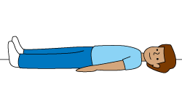
If you’re sleepy and you know it lie right down
If you’re sleepy and you know it lie right down
If you’re sleepy and you know it
And you really want to show it
If you’re sleepy and you know it lie right down
lie right down
Say goodnight
Close your eyes

Slide 21
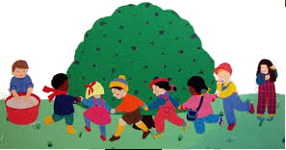
Here we go round the mulberry bush
The mulberry bush, the mulberry bush
Here we go round the mulberry bush
On a cold and frosty morning
This is the way we comb our hair…
This is the way we brush our teeth…
This is the way we put on clothes…

