Slide 1
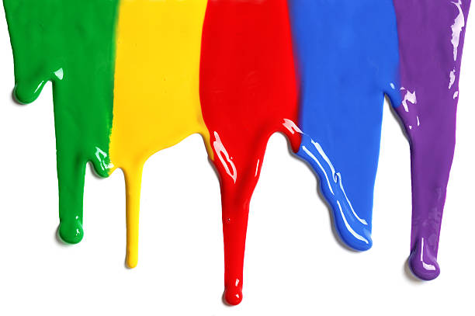
WELCOME
to the
Preschool Playgroup
Run by Holy Trinity Church
Find us on Facebook
playgroup@htcchicago.org

Slide 2
K
N
G
the
I
is here!

Slide 3
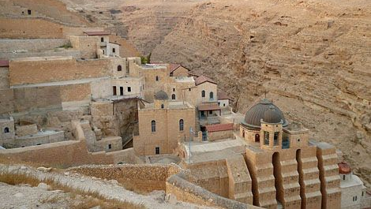

Slide 4
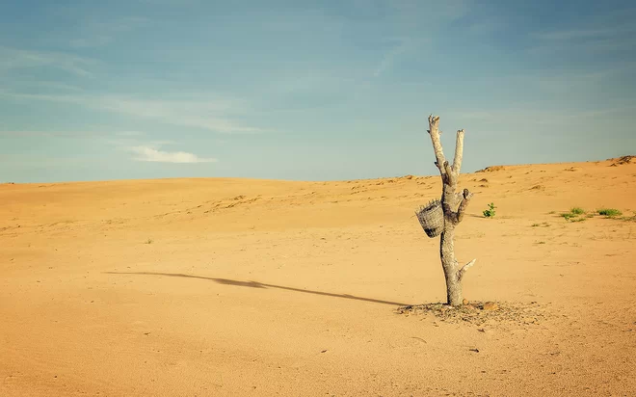

Slide 5
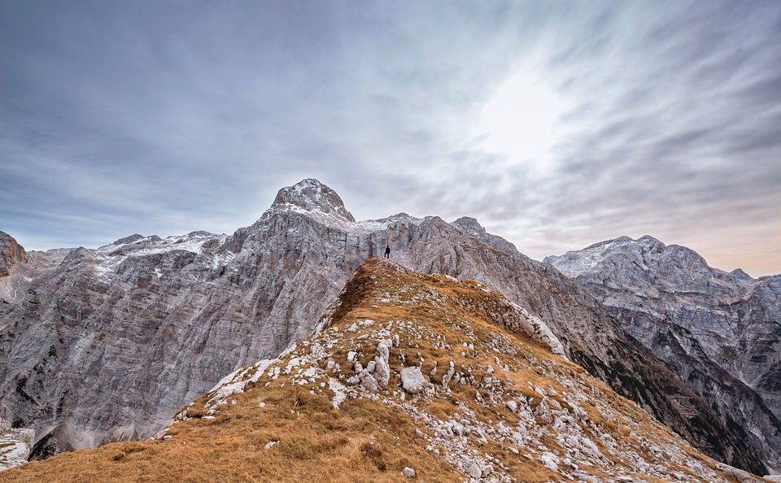
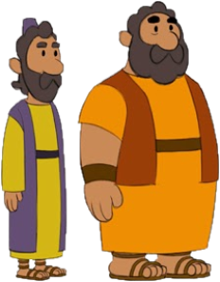
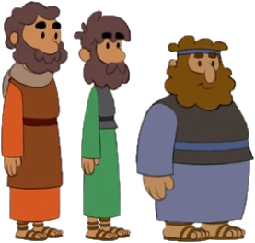
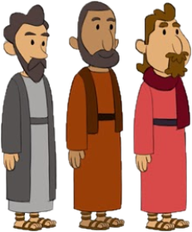
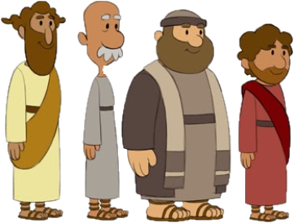

Slide 6
Philip
James
Bartholomew
John
Matthew
Thomas
James
Peter
Thaddeus
Andrew
Simon
Judas

Slide 7
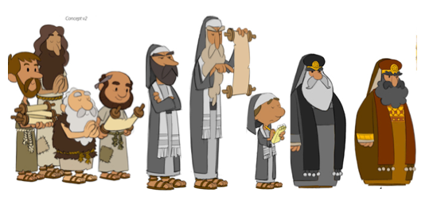
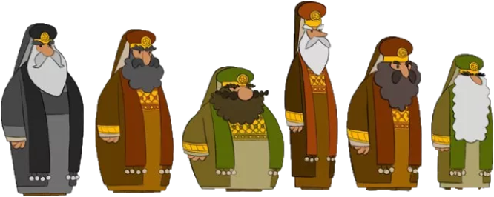
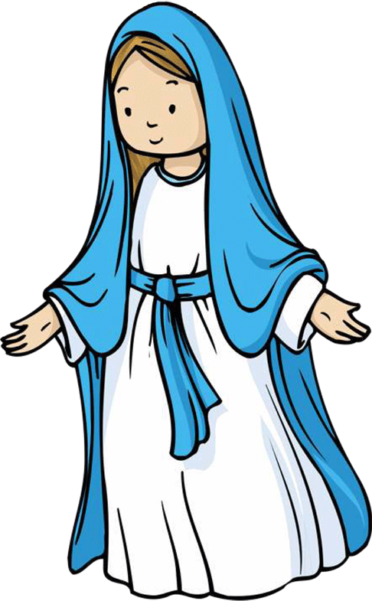

Slide 9
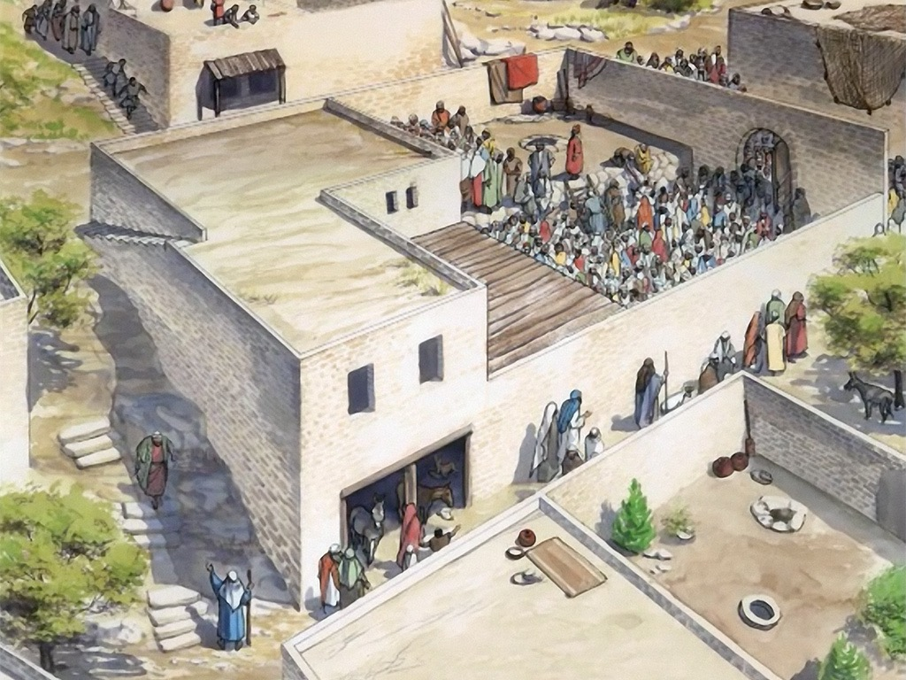

Slide 12
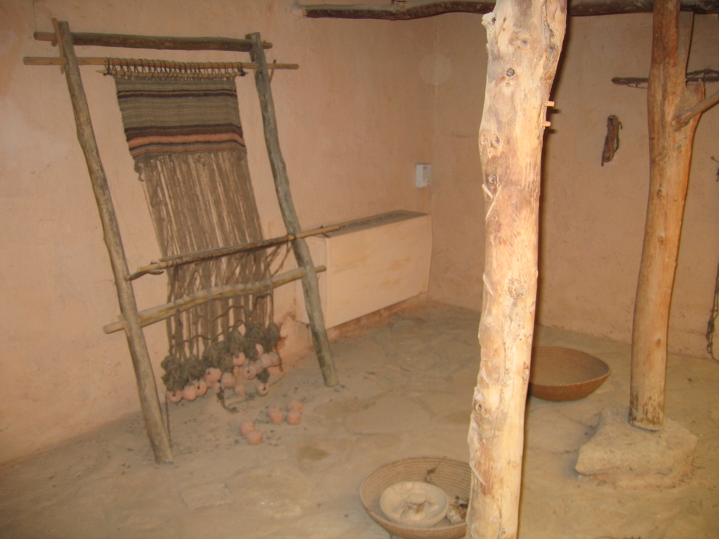

Slide 18
5 little ducks went swimming one day
Over the hills and far away
Mummy duck said “Quack, quack, quack, quack.”
But only 4 little ducks came back.
4… 3… 2… 1… 0…
Mummy Duck went swimming…
5 little ducks came swimming right back

Slide 19
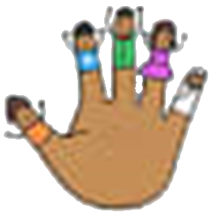
Tommy Thumb, Tommy Thumb,
Where are you?
Here I am, here I am
How do you do?
Peter Pointer
Toby Tall
Ruby Ring
Baby Small

Slide 20
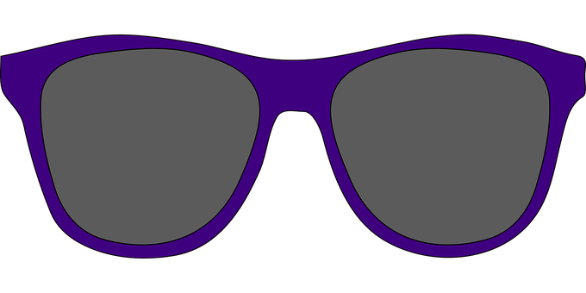
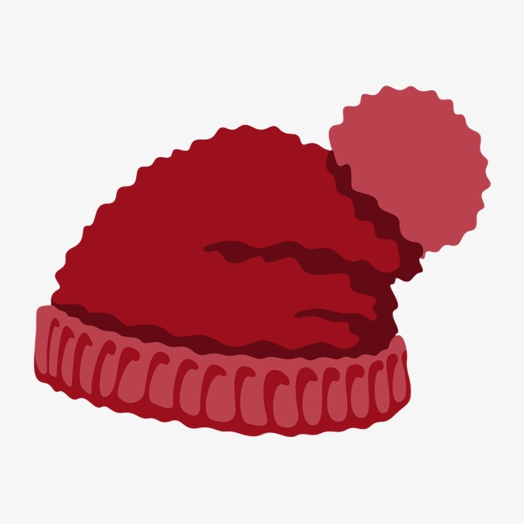
These are grandmother’s glasses. This is grandmother's hat. This is the way she folds her hands, And puts them on her lap.
These are Grandpa's glasses This is Grandpa's hat Here's the way he folds his arms And THAT IS THAT!

Slide 21
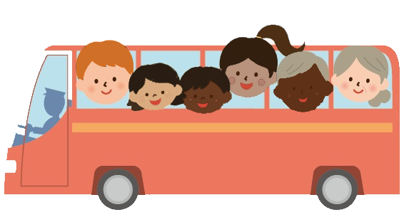
The wheels on the bus go round and round
Round and round, round and round
The wheels on the bus go round and round
All through the town.
Babies – Wah, wah, wah
Daddies – Nod, nod, nod
Mummies – Chatter, chatter, chatter
Children – Bounce up and down

