Slide 1
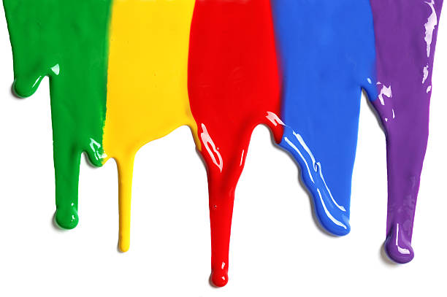
WELCOME
to the
Preschool Playgroup
Run by Holy Trinity Church
Find us on Facebook
playgroup@htcchicago.org

Slide 2
God Rescues

Slide 3
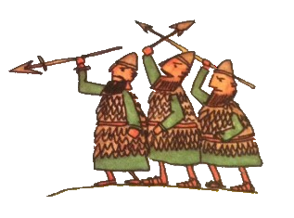

Slide 5
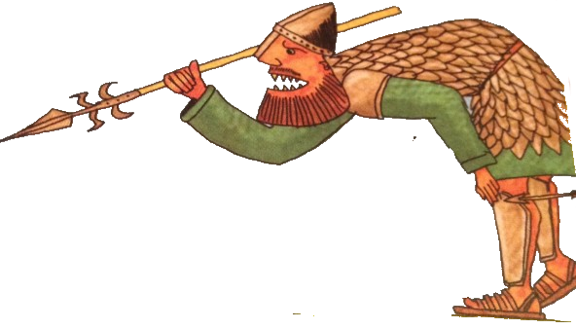

Slide 6
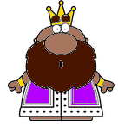

Slide 7
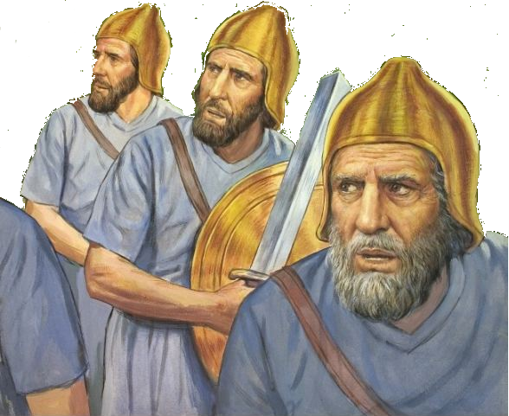

Slide 8
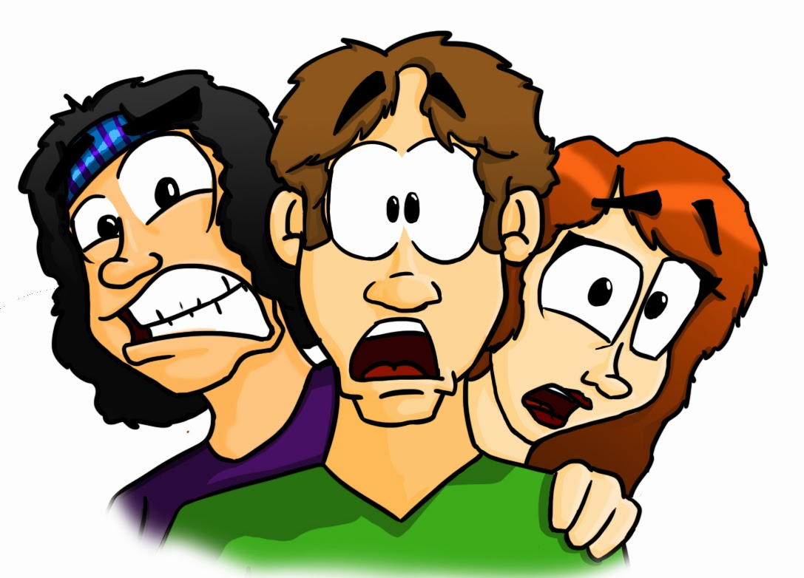

Slide 9
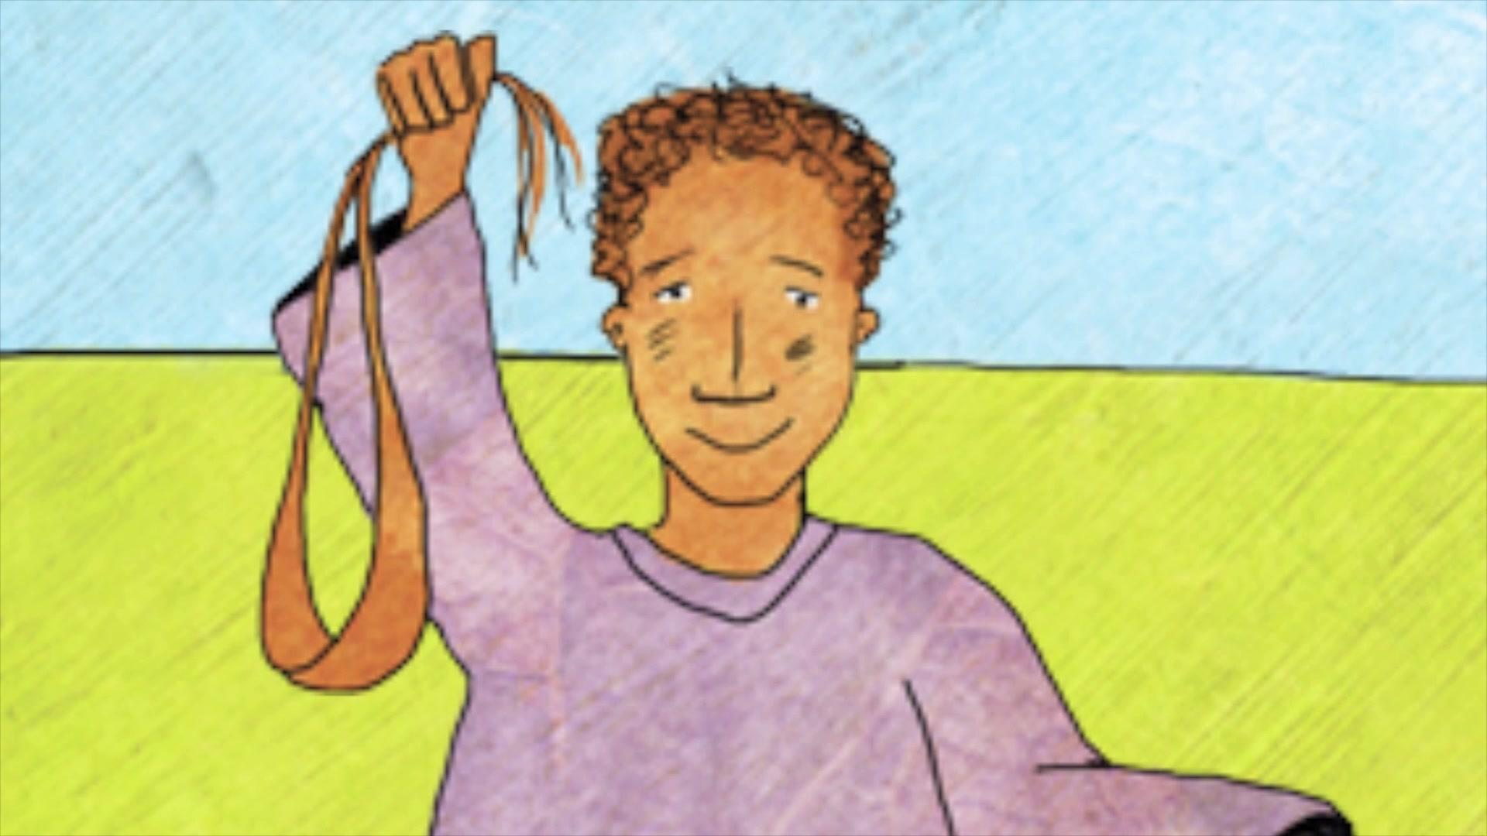

Slide 12
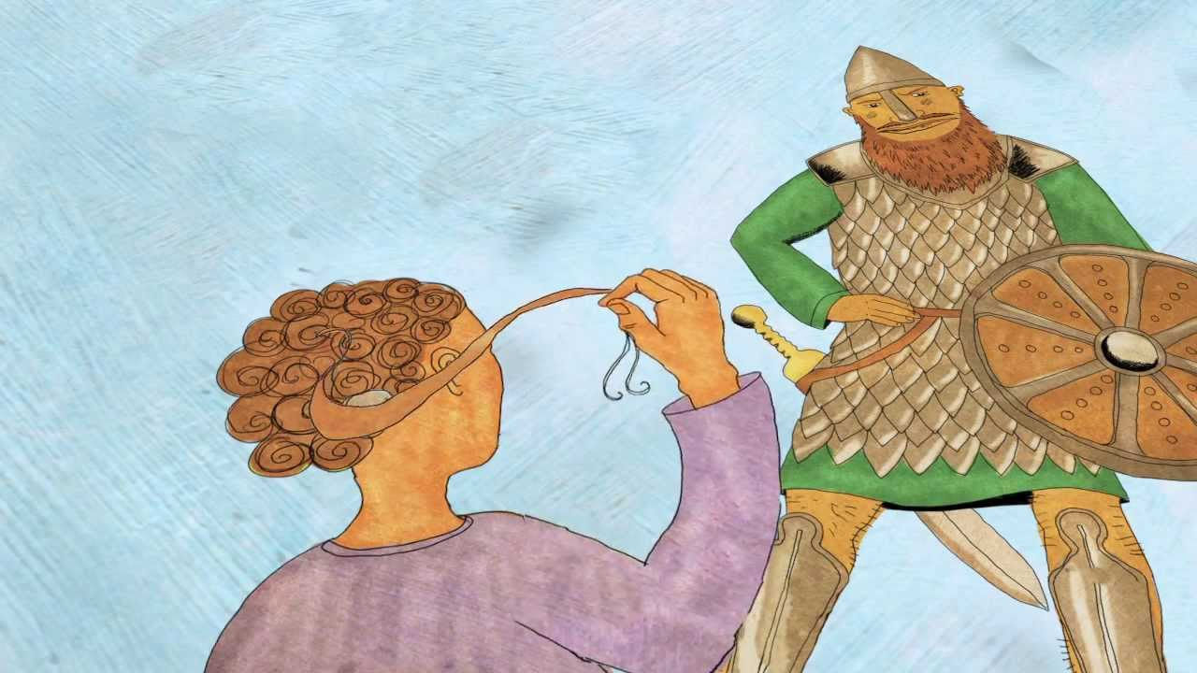

Slide 13
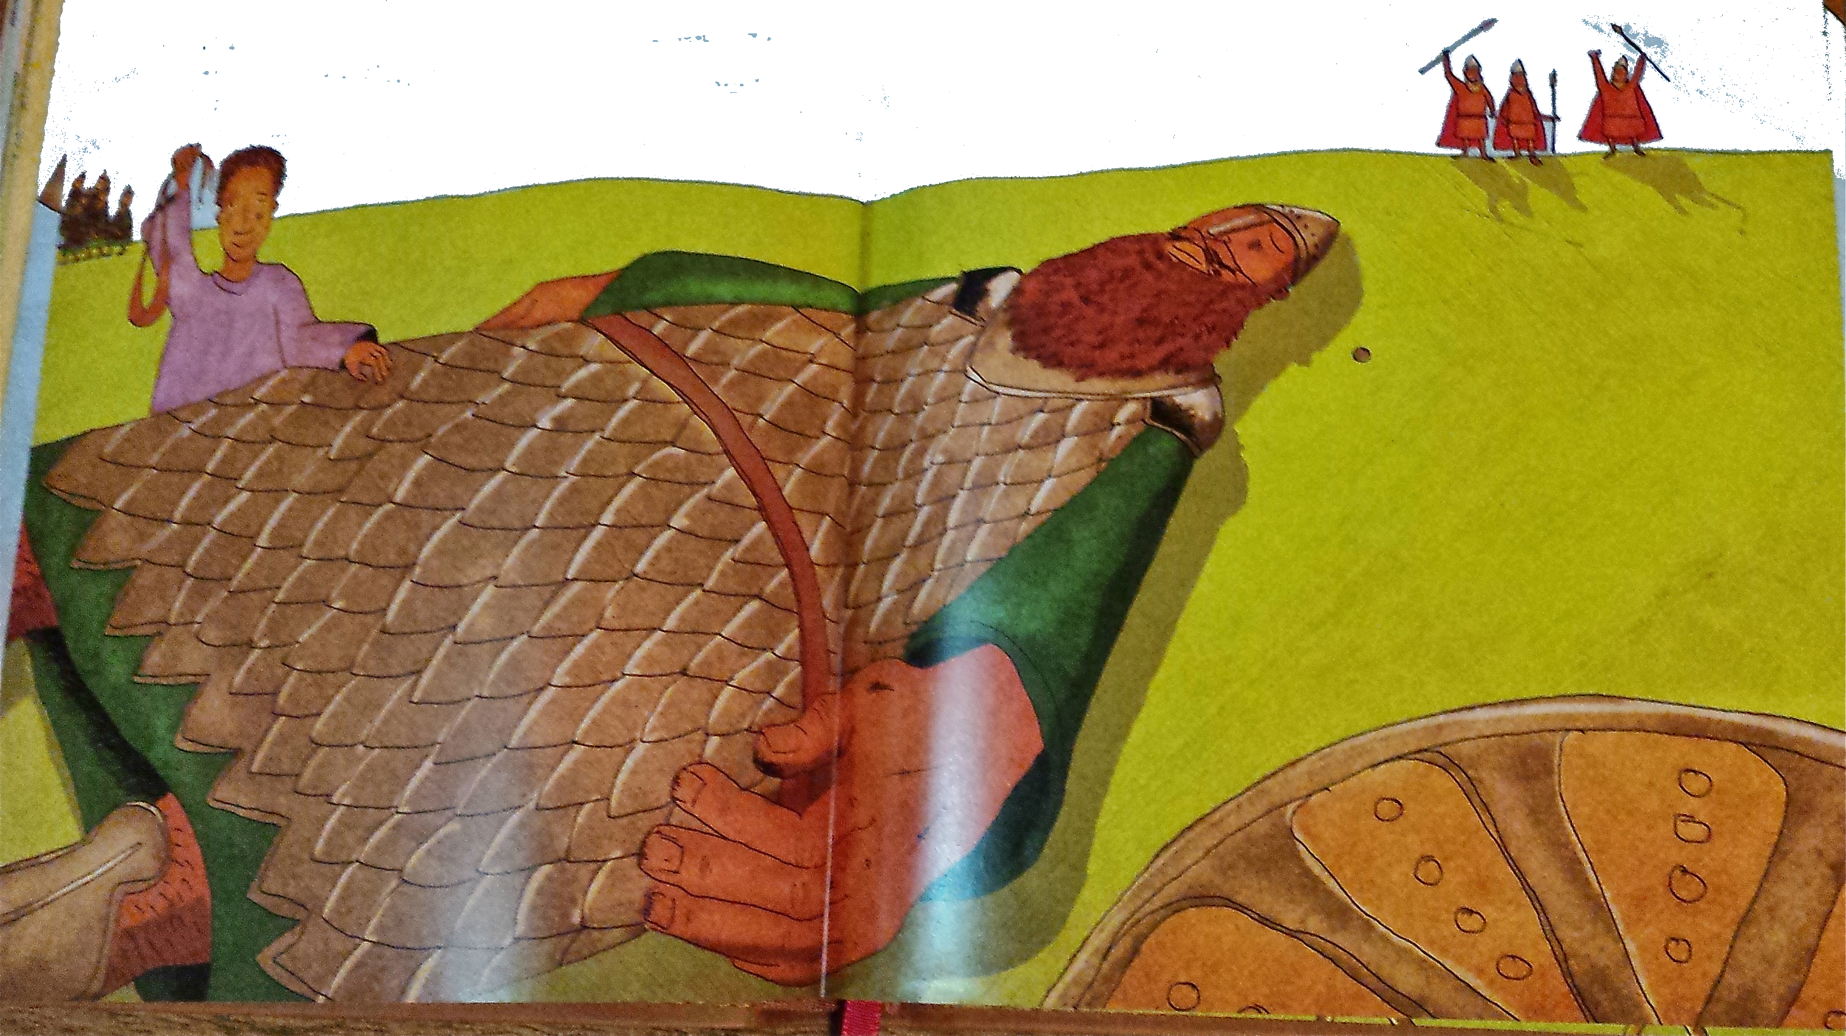

Slide 14
Some pictures
taken from the:

Slide 15
Head, shoulders, knees and toes,
Knees and toes,
Head, shoulders, knees and toes,
Knees and toes
And eyes and ears
and mouth and nose
Head, shoulders, knees and toes,
Knees and toes

Slide 16
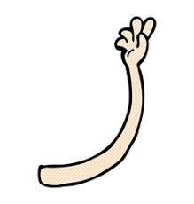
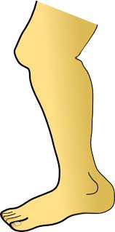
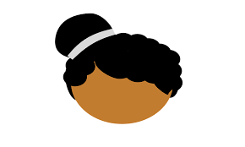
1 finger, 1 thumb keep moving
1 finger, 1 thumb keep moving
1 finger, 1 thumb keep moving
We’ll all be merry and bright
1 arm
1 leg
1 nod of the head
Stand up, sit down

Slide 17
If you’re happy and you know it clap your hands
If you’re happy and you know it clap your hands
If you’re happy and you know it
And you really want to show it
If you’re happy and you know it clap your hands

Slide 18
Put your right arm in, your right arm out
In, out, in, out, shake it all about
You do the Hokey-Cokey and you turn around
That’s what it’s all about.
Woah-oh the Hokey-Cokey x3
Knees bend, arms stretch. Rah Rah Rah!

Slide 19
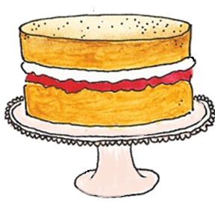
Happy Birthday to you
Happy Birthday to you
Happy Birthday dear Joshua
Happy Birthday to you

