Slide 1
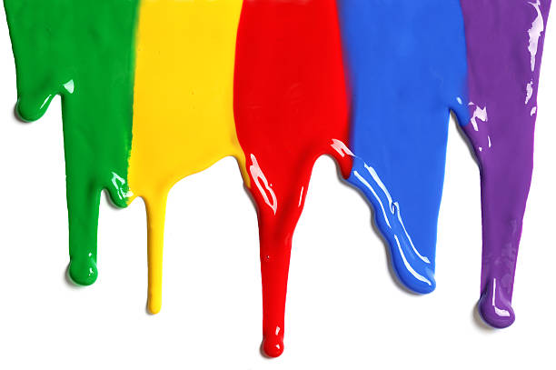
WELCOME
to the
Preschool Playgroup
Run by Holy Trinity Church
Find us on Facebook
playgroup@htcchicago.org

Slide 2
God Rescues

Slide 3
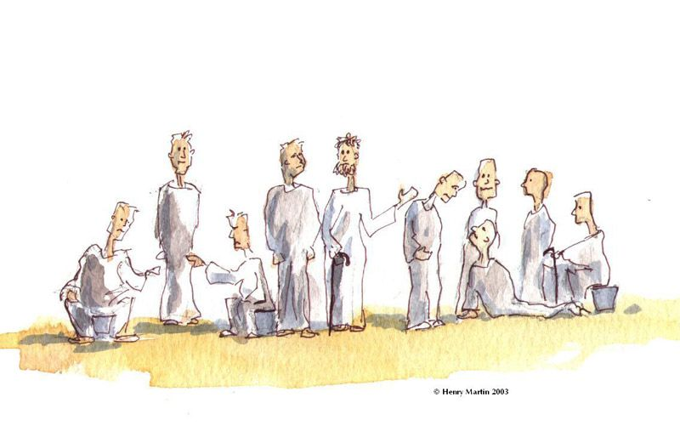

Slide 4
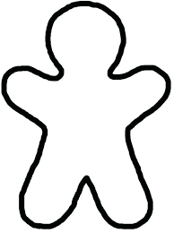
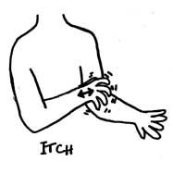

Slide 5
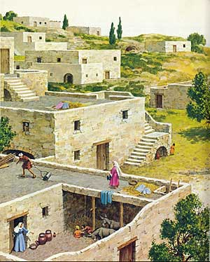

Slide 6
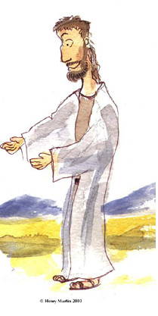

Slide 12
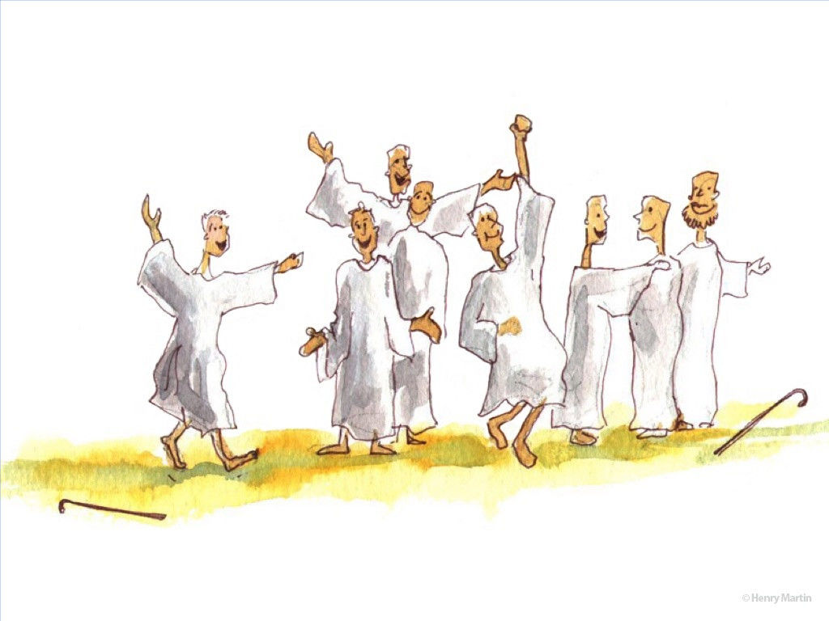

Slide 13
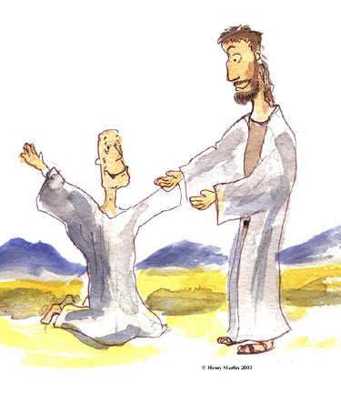

Slide 14
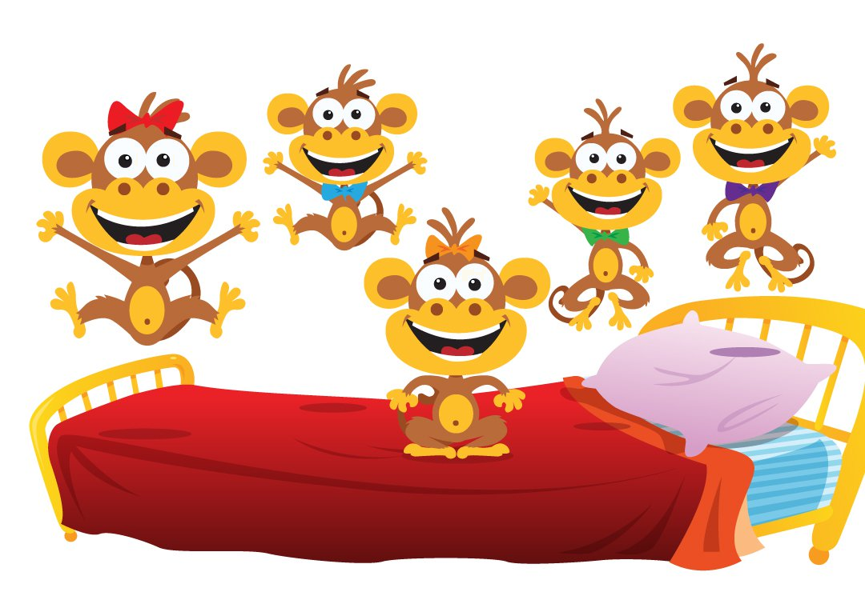
5 little monkeys jumping on the bed
One fell off and bumped his head
Mama called the doctor and the doctor said
“No more monkeys jumping on the bed”
4 little monkeys…
3
2
1

Slide 15
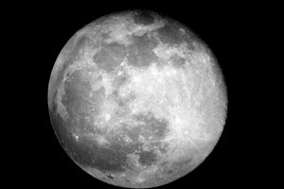
Zoom zoom zoom
We’re going to the moon
Zoom zoom zoom
We’ll be there very soon
If you want to take a trip
Climb aboard my rocket ship
Zoom zoom zoom
We’re going to the moon
Zoom zoom zoom
We’ll be there very soon

Slide 16
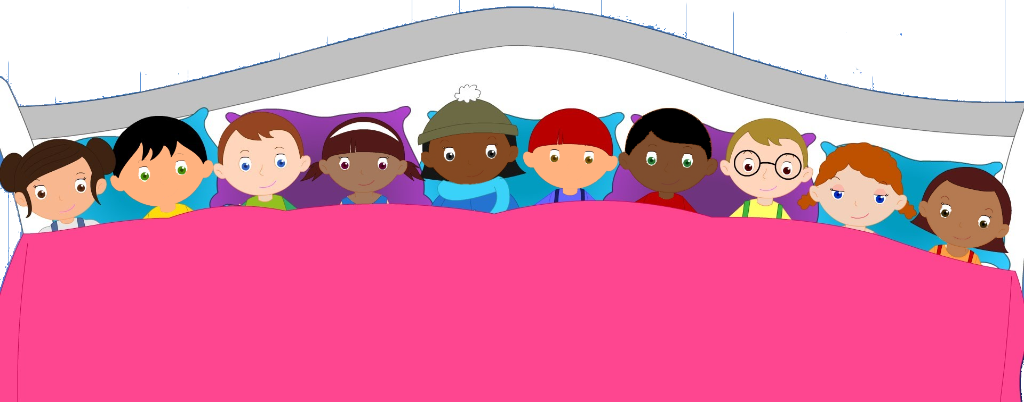
There were 10 in the bed and the little one said
“Roll over, roll over”
So they all rolled over and one fell out.
6
5
4
8
7
3
9
2
10
1

Slide 17
1 2 3 4 5
Once I caught a fish alive
6 7 8 9 10
Then I threw it back again
Why did you let it go?
Because it bit my finger so
Which finger did it bite?
This little finger on my right.

