Slide 1
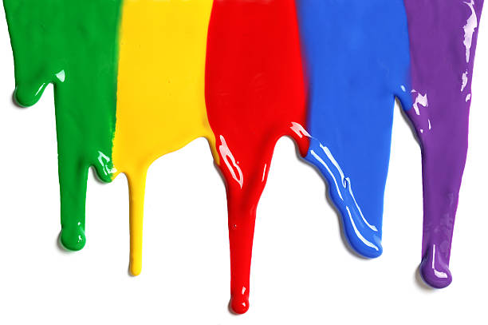
WELCOME
to the
Preschool Playgroup
Run by Holy Trinity Church
Find us on Facebook
playgroup@htcchicago.org

Slide 2
God Rescues

Slide 3
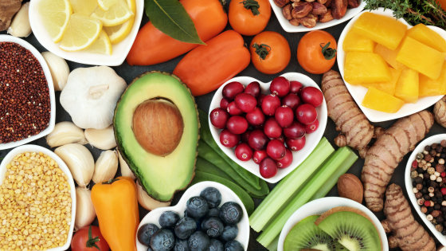

Slide 5
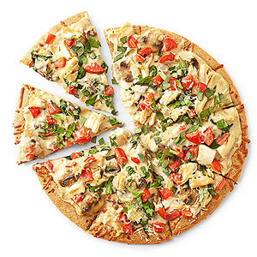
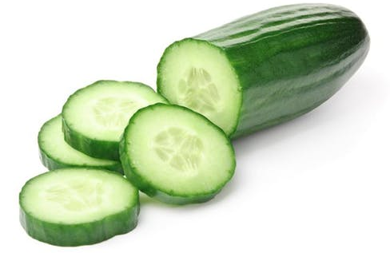
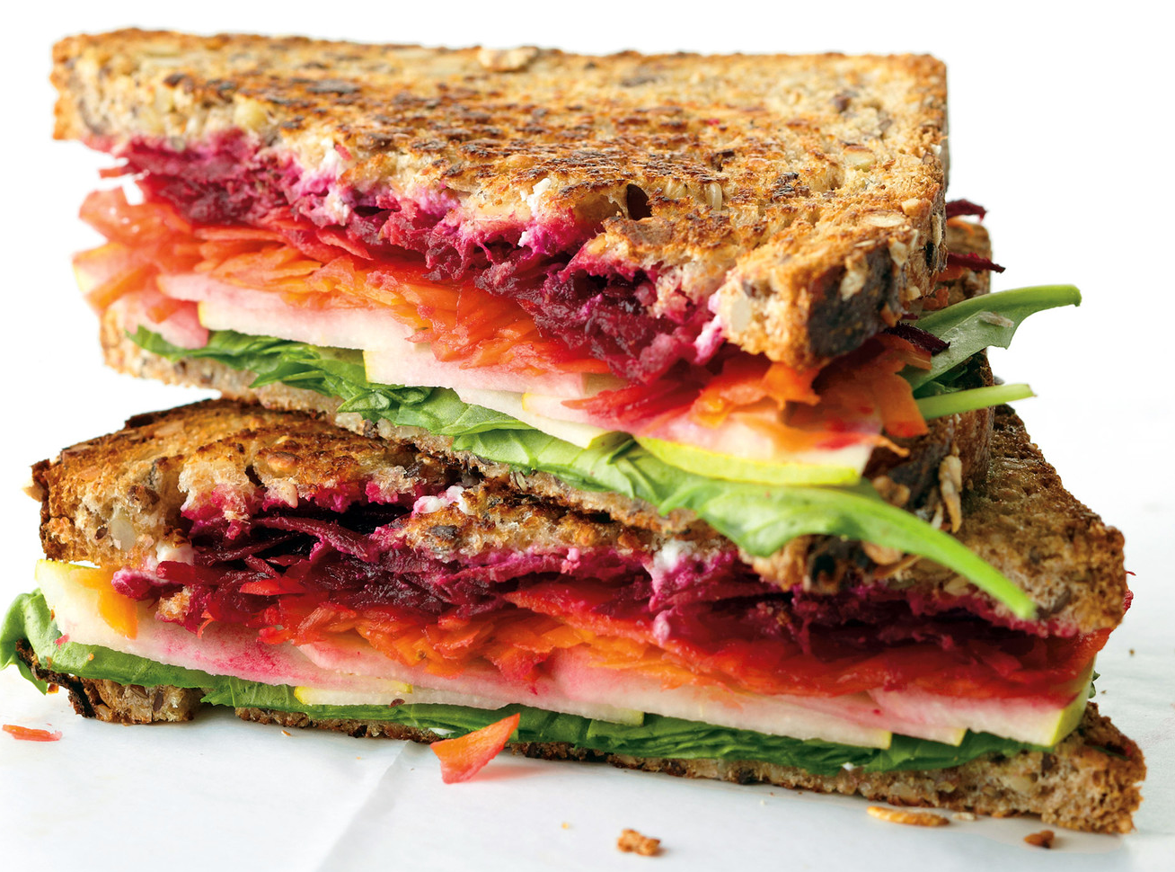

Slide 6
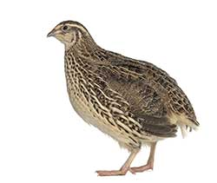
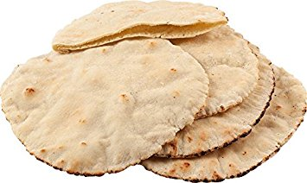

Slide 8
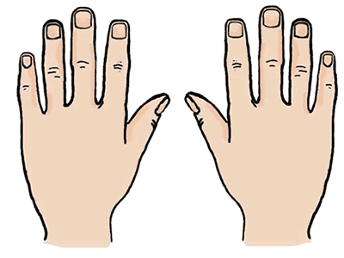
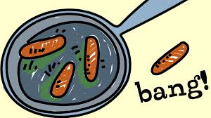
10 fat sausages sizzling in a pan
1 went POP and the other went BANG
8 fat sausages…
3
8
2
4
7
9
1
10
5
6

Slide 9
A Pizza Hut, a Pizza Hut
Kentucky Fried Chicken and a Pizza Hut
A Pizza Hut, a Pizza Hut
Kentucky Fried Chicken and a Pizza Hut
McDonalds, McDonalds
Kentucky Fried Chicken and a Pizza Hut
McDonalds, McDonalds
Kentucky Fried Chicken and a Pizza Hut

Slide 10
5 little peas
In a pea-pod pressed
1 grew, 2 grew
And so did all the rest
They grew and they grew
And they did not stop
Until one day the pod went
POP!
5 little peas
In a pea-pod pressed
1 grew, 2 grew
And so did all the rest
They grew and they grew
So fat and round
Then all the peas
Fell to the ground

Slide 11
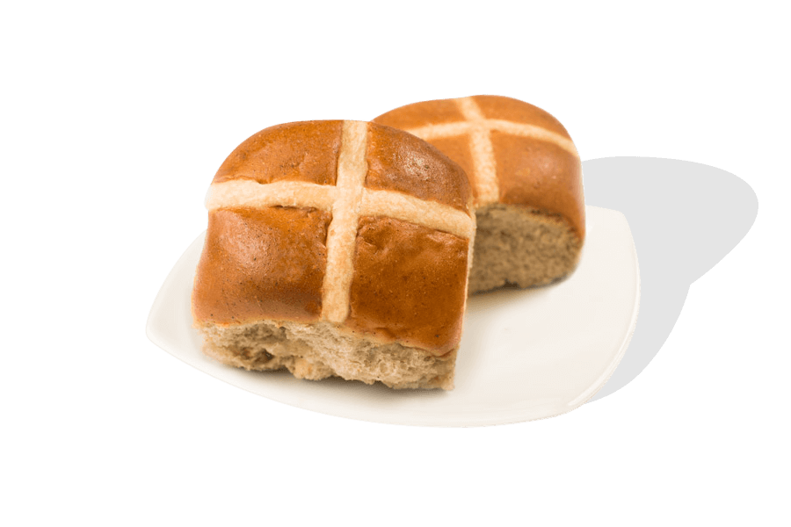
Hot Cross Buns Hot cross buns
1 a penny. 2 a penny.
Hot cross buns
Give them to your daughters
Give them to your sons
1 a penny. 2 a penny
Hot cross buns

Slide 12
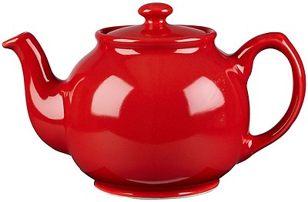
I’m a little teapot, short and stout,
Here’s my handle, here’s my spout.
When I start to whistle; hear me shout,
Pick me up and pour me out.

