Slide 1
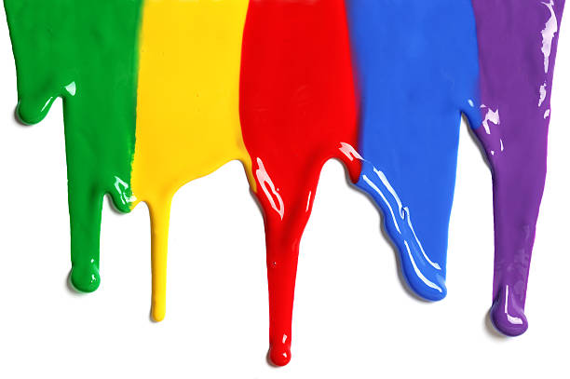
WELCOME
to the
Preschool Playgroup
Run by Holy Trinity Church
Find us on Facebook
playgroup@htcchicago.org

Slide 2
K
N
G
the
I
is coming!

Slide 3
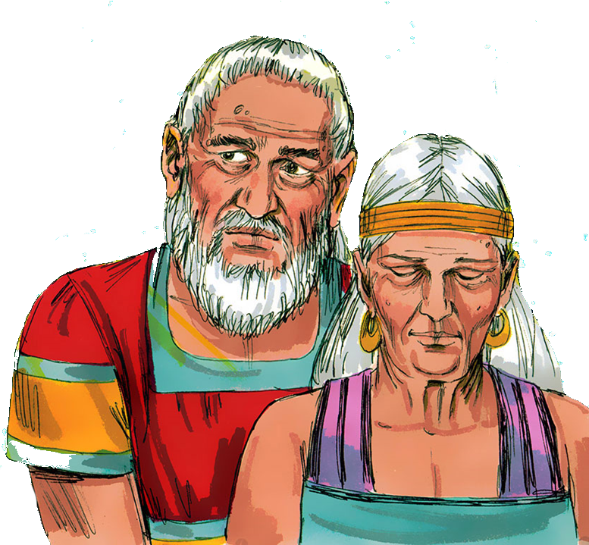

Slide 4
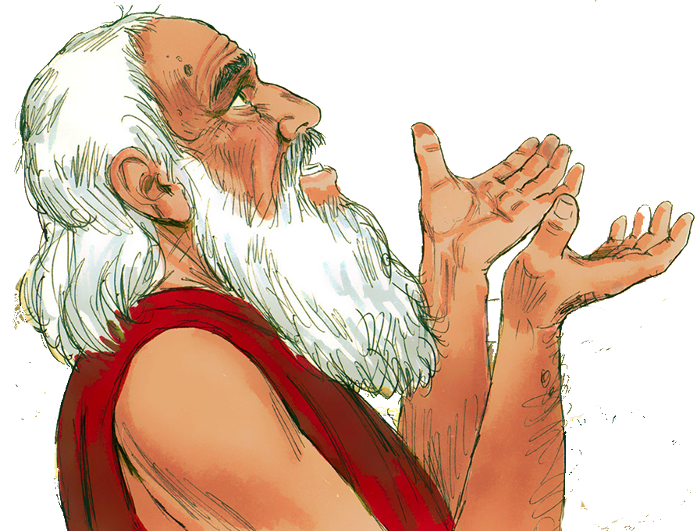

Slide 5
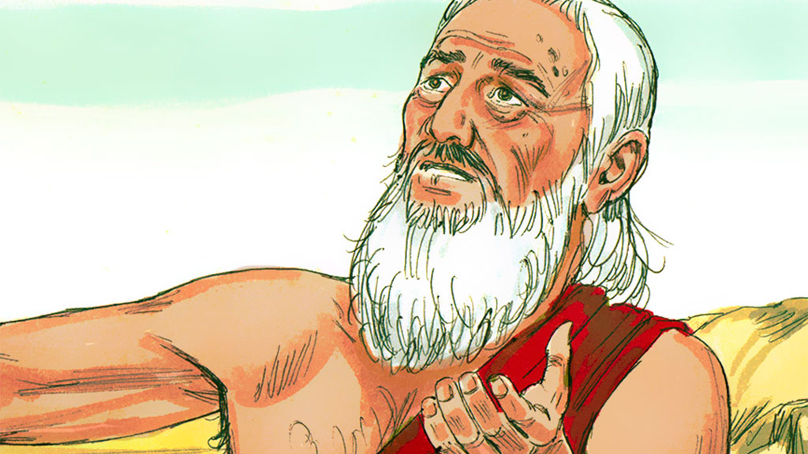

Slide 7
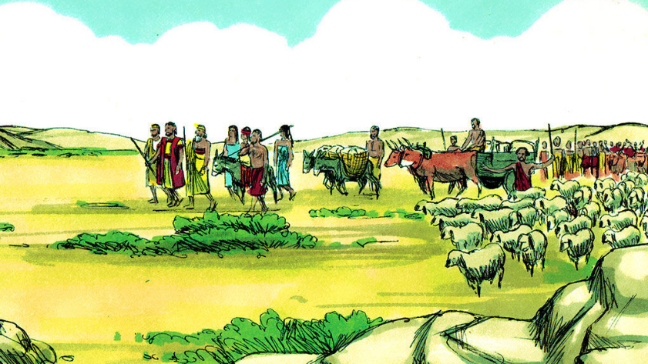

Slide 9
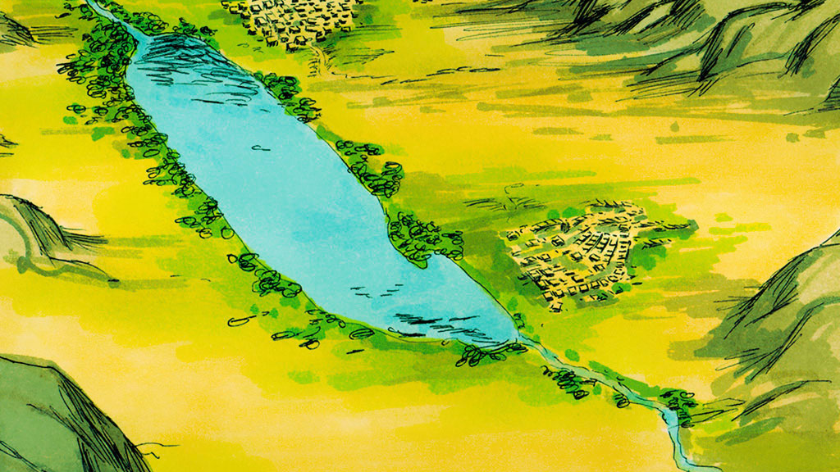

Slide 12
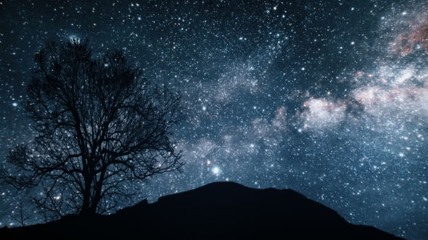

Slide 14
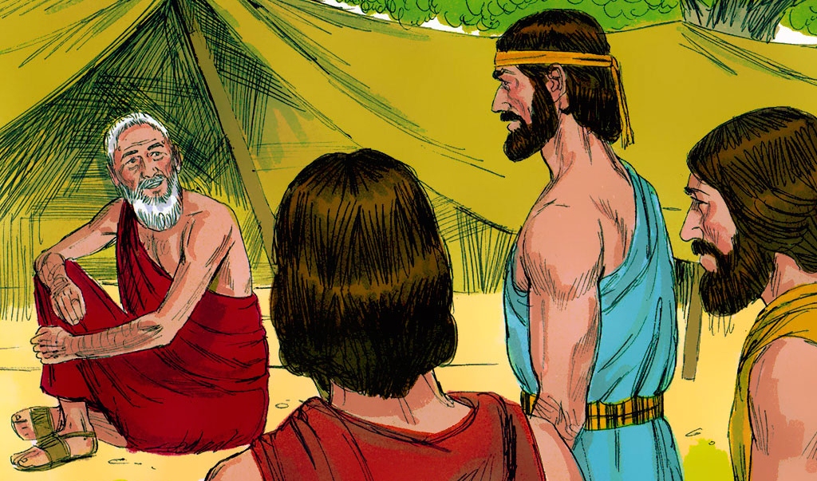

Slide 16
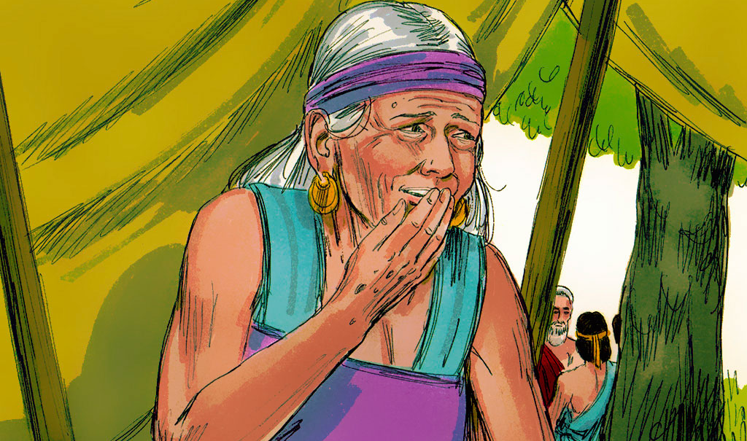

Slide 17
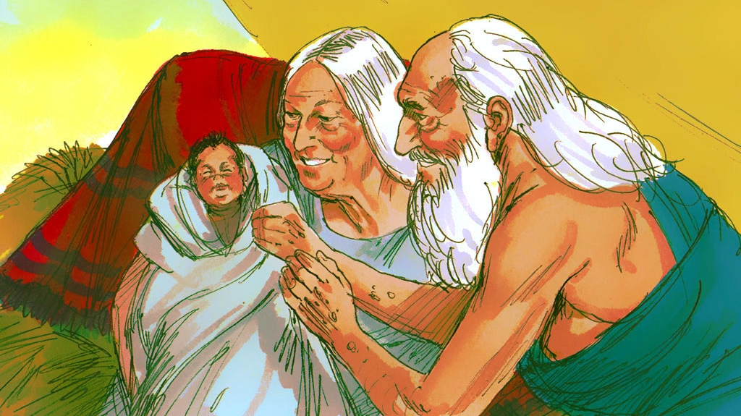

Slide 18
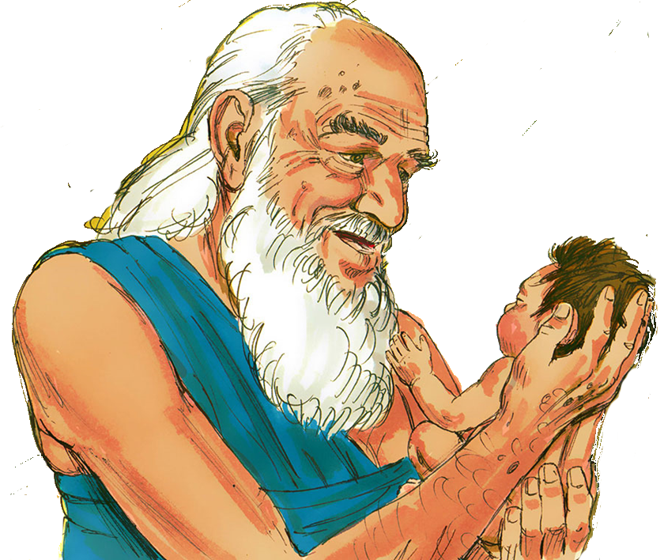

Slide 19
1 2 3 4 5
Once I caught a fish alive
6 7 8 9 10
Then I threw it back again
Why did you let it go?
Because it bit my finger so
Which finger did it bite?
This little finger on my right.

Slide 20
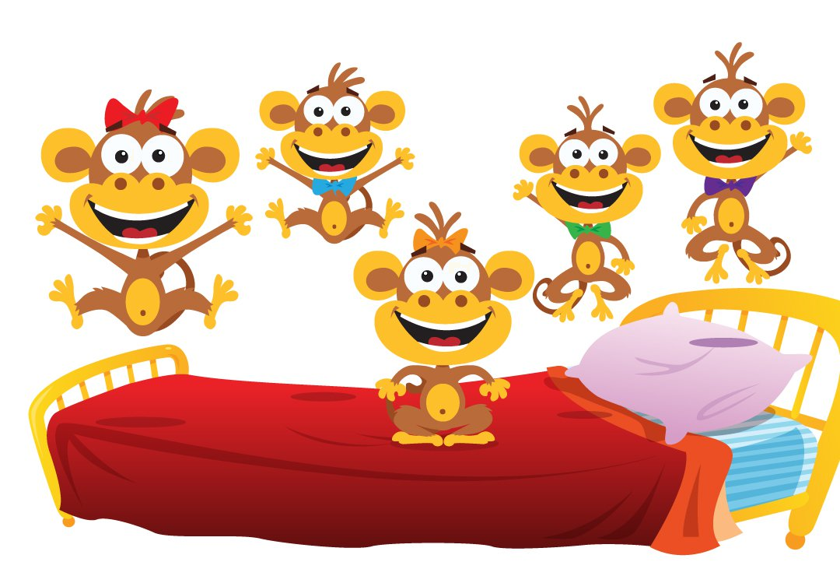
5 little monkeys jumping on the bed
One fell off and bumped his head
Mama called the doctor and the doctor said
“No more monkeys jumping on the bed”
4 little monkeys…
3
2
1

Slide 21
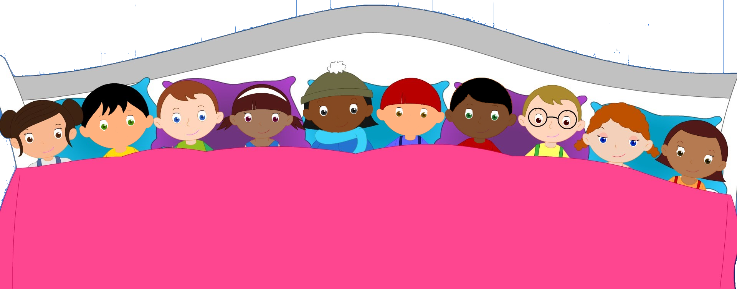
There were 10 in the bed and the little one said
“Roll over, roll over”
So they all rolled over and one fell out.
6
5
4
8
7
3
9
2
10
1

Slide 22
Here is the bee hive
But where are the bees?
Hiding inside where nobody sees!
Here they come creeping out the hive
1 – 2 – 3 – 4 – 5
…
Here they come creeping out again
1 – 2 – 3 – 4 – 5 – 6 – 7 – 8 – 9 – 10

Slide 23
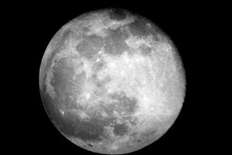
Zoom zoom zoom
We’re going to the moon
Zoom zoom zoom
We’ll be there very soon
If you want to take a trip
Climb aboard my rocket ship
Zoom zoom zoom
We’re going to the moon
Zoom zoom zoom
We’ll be there very soon
一
二
三
四
五
六
七
八
九
十

