Slide 1
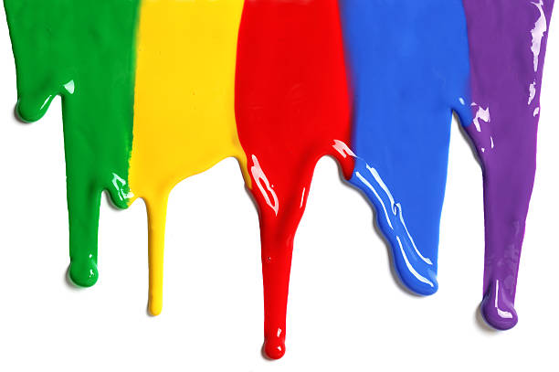
WELCOME
to the
Preschool Playgroup
Run by Holy Trinity Church
Find us on Facebook
playgroup@htcchicago.org

Slide 2
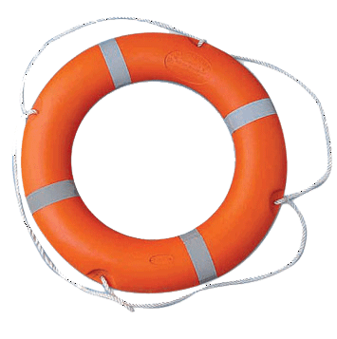
God Rescues

Slide 11
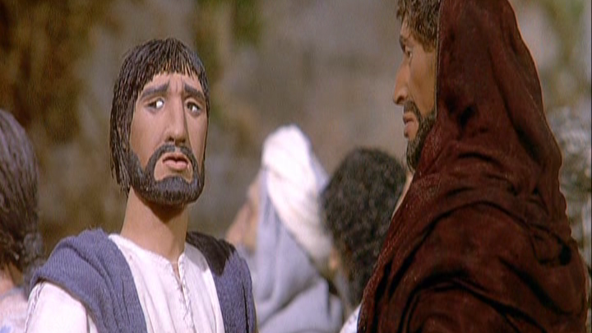

Slide 14
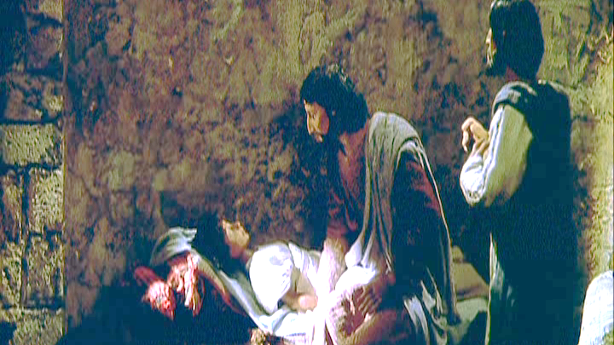

Slide 15
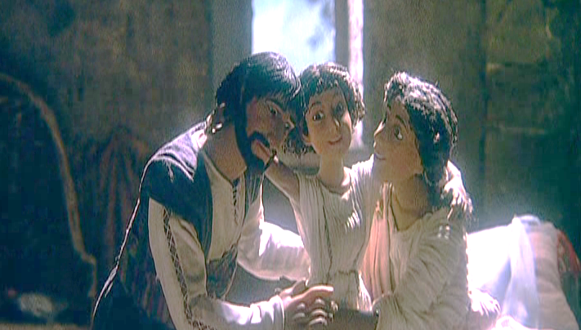

Slide 16
Today’s
Pictures
Are from:

Slide 17
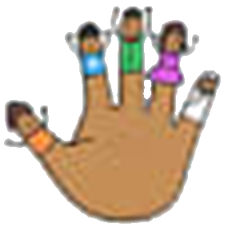
Daddy Finger, Daddy Finger,
Where are you?
Here I am, here I am
How do you do?
Mummy Finger
Brother Finger
Sister Finger
Baby Finger

Slide 18
5 little ducks went swimming one day
Over the hills and far away
Mummy duck said “Quack, quack, quack, quack.”
But only 4 little ducks came back.
4… 3… 2… 1… 0…
Mummy Duck went swimming…
5 little ducks came swimming right back

Slide 19
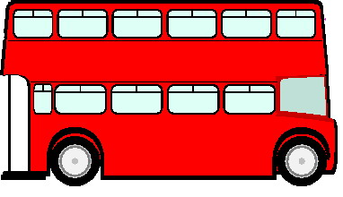
The wheels on the bus go round and round
Round and round, round and round
The wheels on the bus go round and round
All through the town.
Children – Bounce up and down
Mommies – Chat, chat, chat
Babies – Wah, wah, wah
Daddies – Nod, nod, nod

