Slide 1
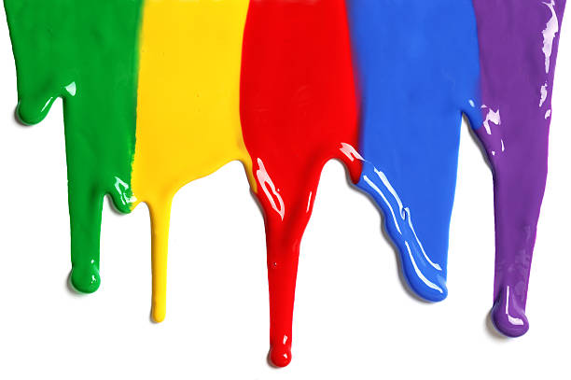
WELCOME
to the
Preschool Playgroup
Run by Holy Trinity Church
Find us on Facebook
playgroup@htcchicago.org

Slide 2
K
N
G
the
I
is here!

Slide 3
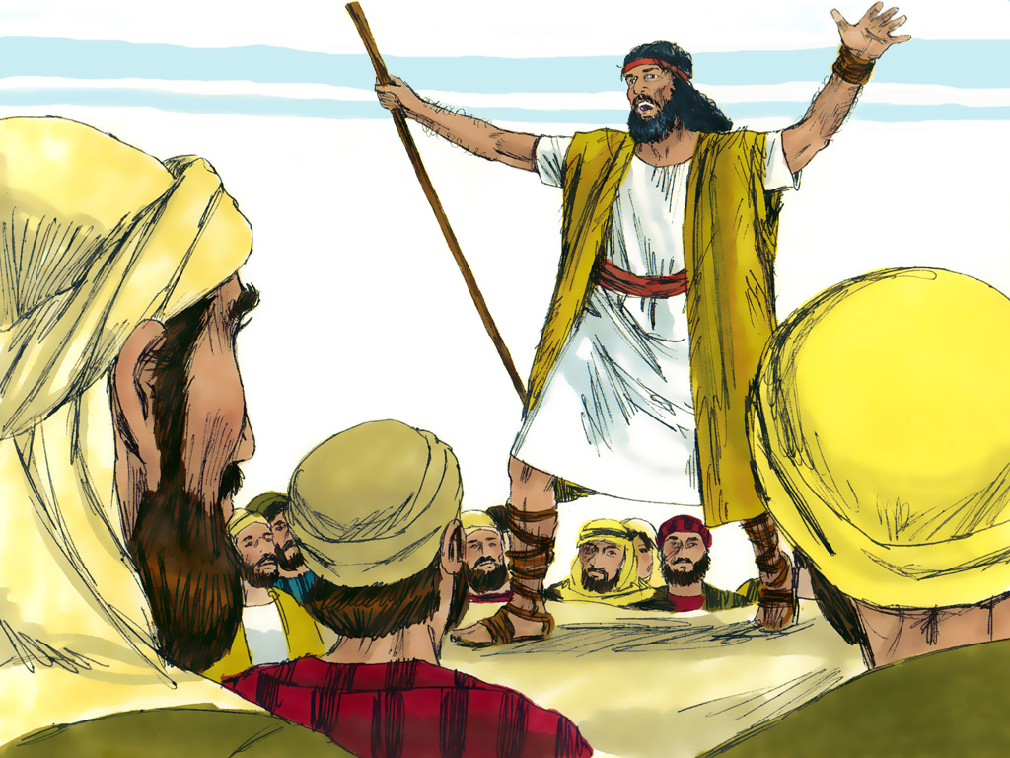

Slide 5
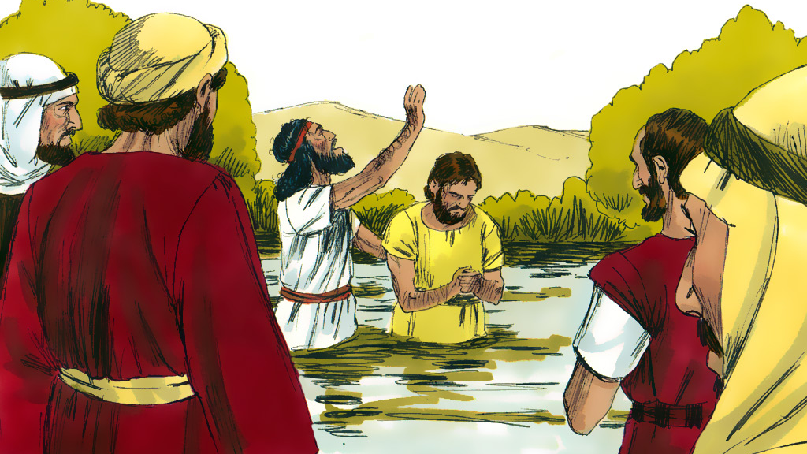

Slide 6
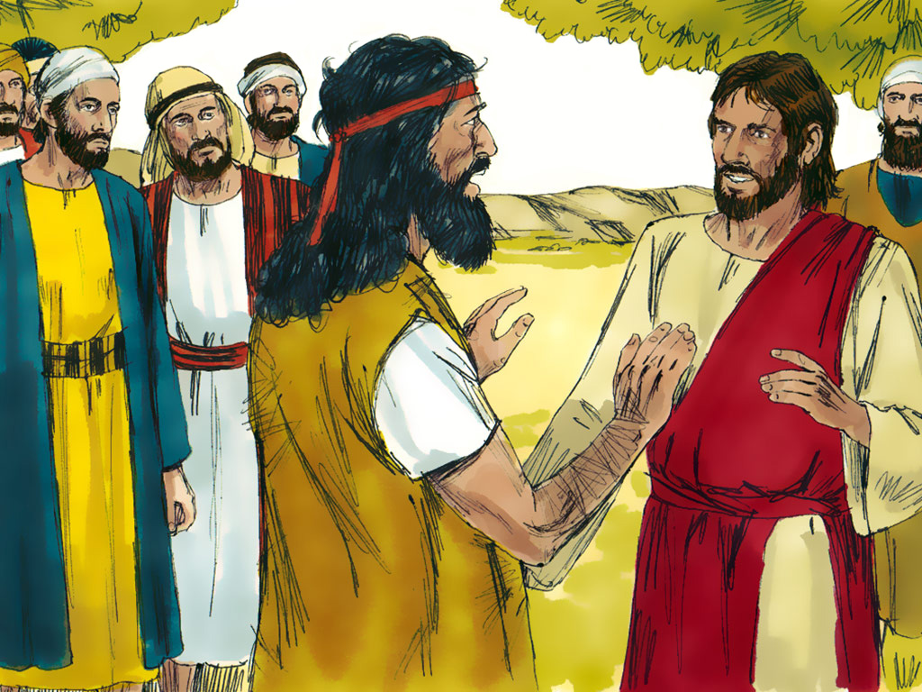

Slide 7
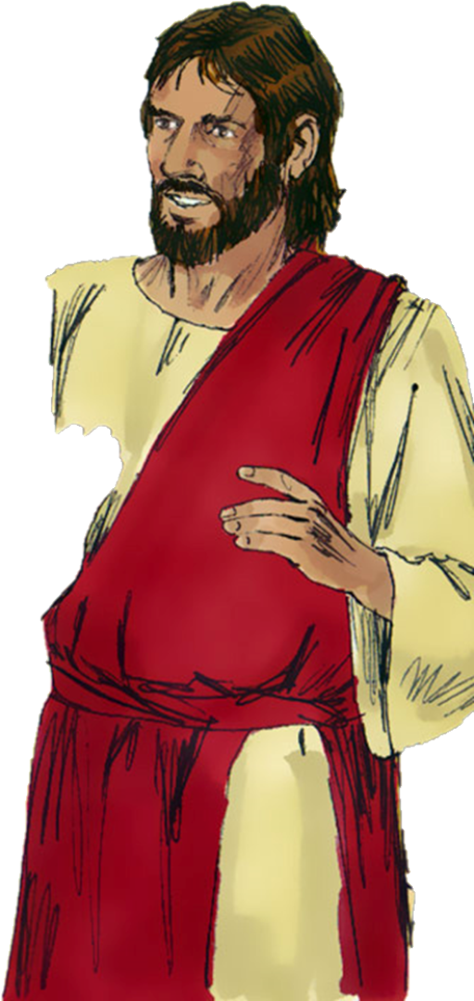

Slide 8
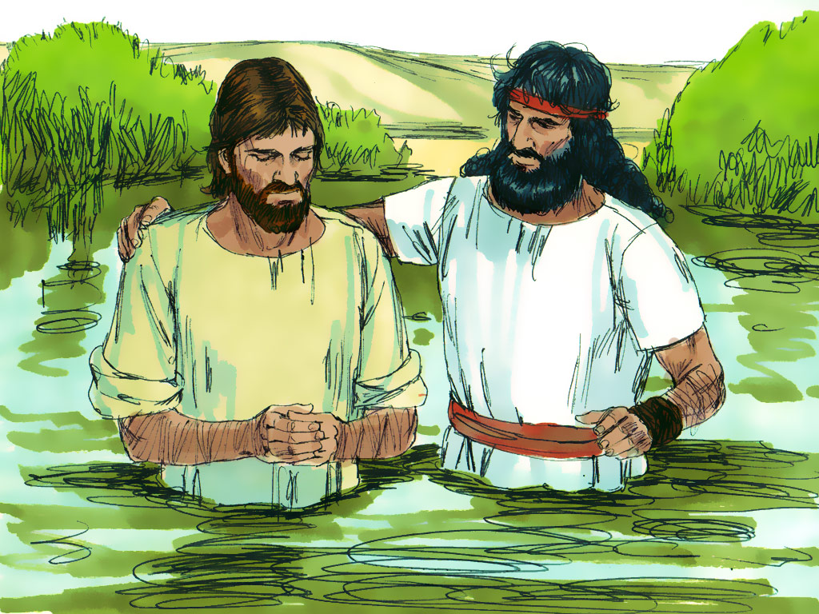

Slide 9
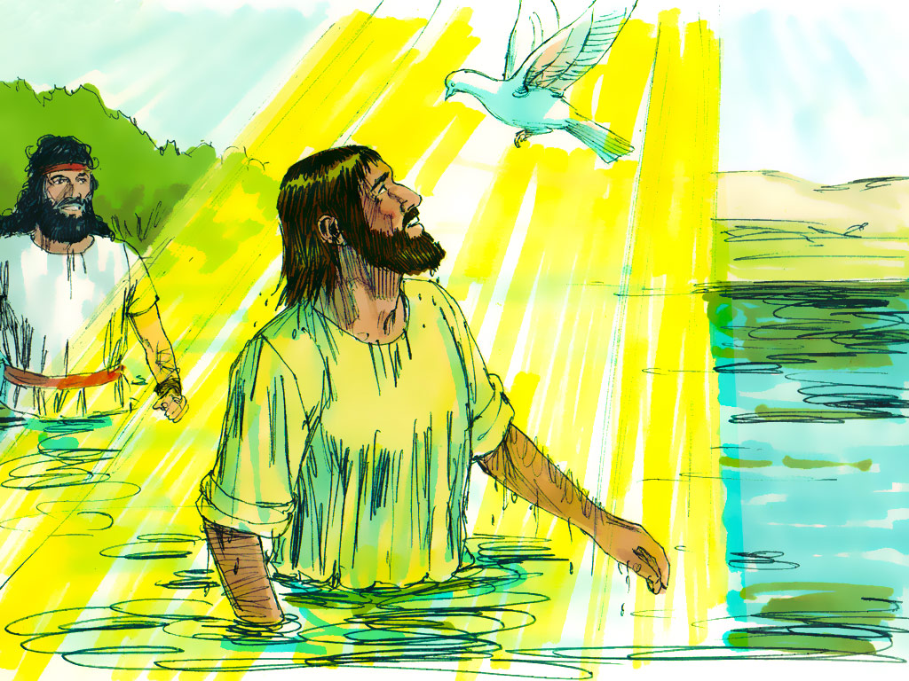

Slide 11
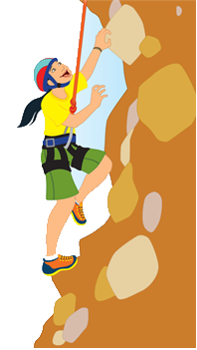
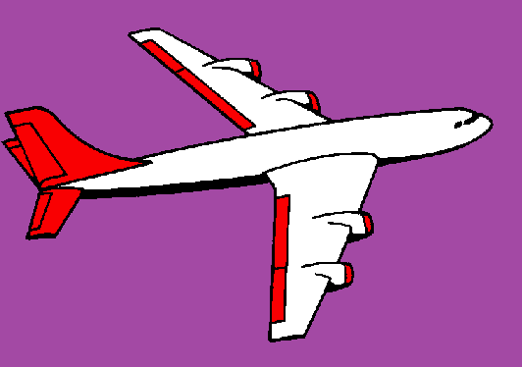
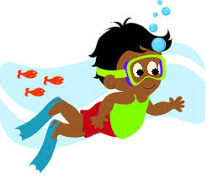
If I go climbing, climbing, climbing
If I go climbing; God is there
If I go climbing on the highest mountain
God is there ‘cos he is everywhere.
If I go flying in the biggest aeroplane
If I go driving far away
If I go swimming in the deepest ocean

Slide 12
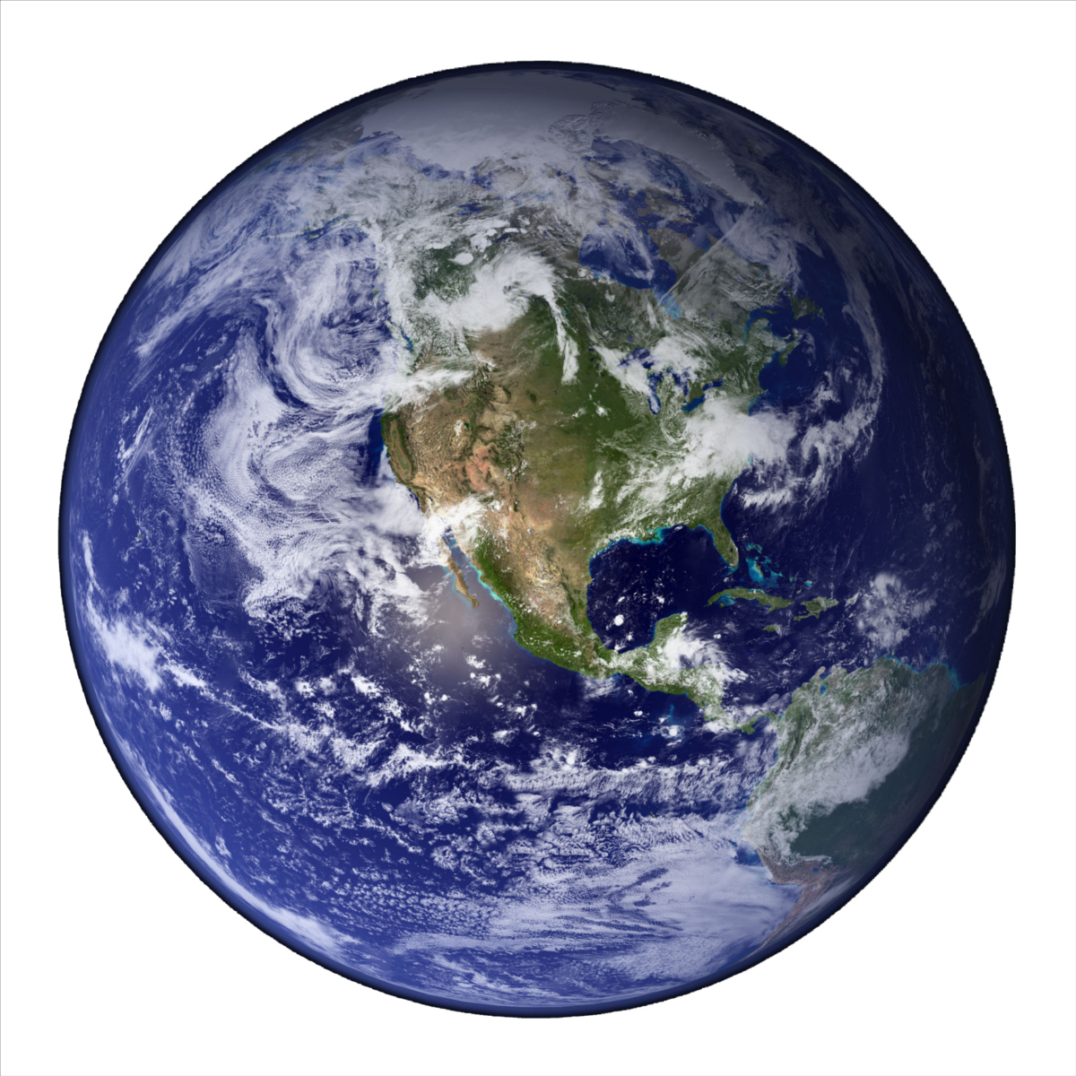
He’s got the whole world in his hands
He’s got the whole wide world in his hands
He’s got the whole world in his hands
He’s got the whole world in his hands
He’s got you and me in his hands…
He’s got everybody here in his hands...

Slide 13
5 little ducks went swimming one day
Over the hills and far away
Mummy duck said “Quack, quack, quack, quack.”
But only 4 little ducks came back.
4… 3… 2… 1… 0…
Mummy Duck went swimming…
5 little ducks came swimming right back

Slide 14
Skidamarink a dink a dink
Skidamarink a doo
I love you
I love you in the morning
And in the afternoon
I love you in the evening
And underneath the moon

Slide 15
If you’re happy and you know it clap your hands
If you’re happy and you know it clap your hands
If you’re happy and you know it
And you really want to show it
If you’re happy and you know it clap your hands

