Slide 1
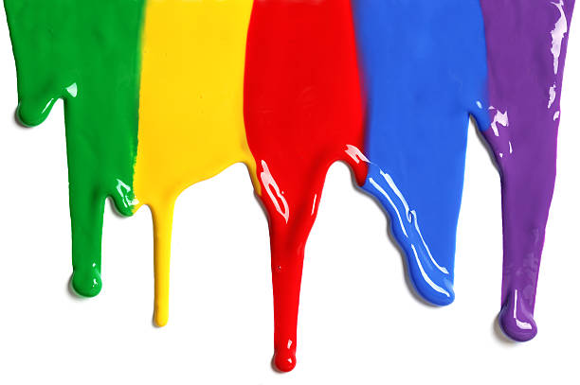
WELCOME
to the
Preschool Playgroup
Run by Holy Trinity Church
Find us on Facebook
playgroup@htcchicago.org

Slide 2
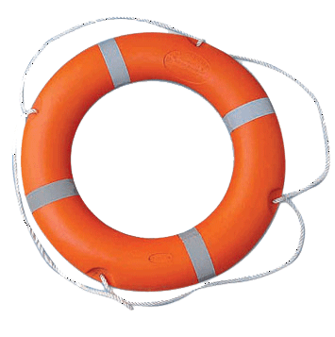
God Rescues

Slide 3
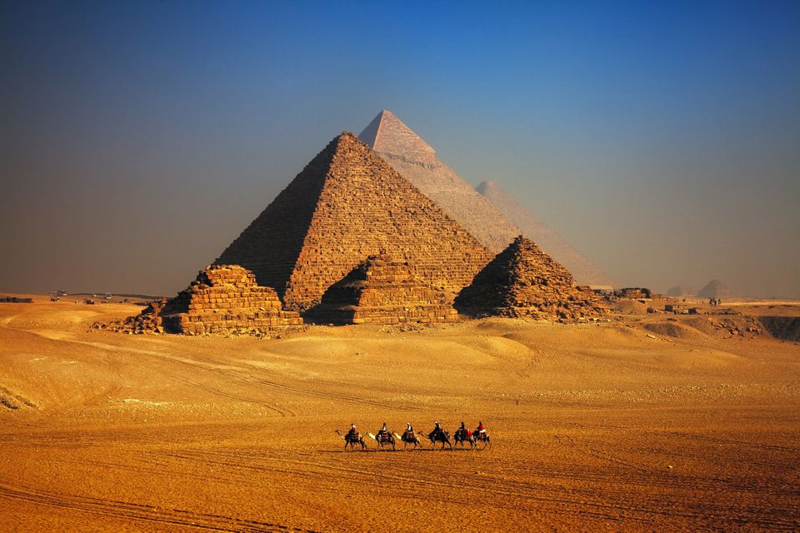

Slide 4
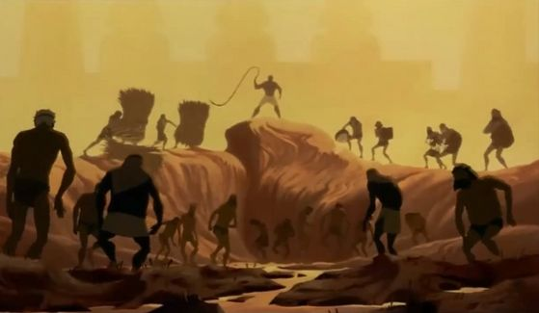

Slide 5
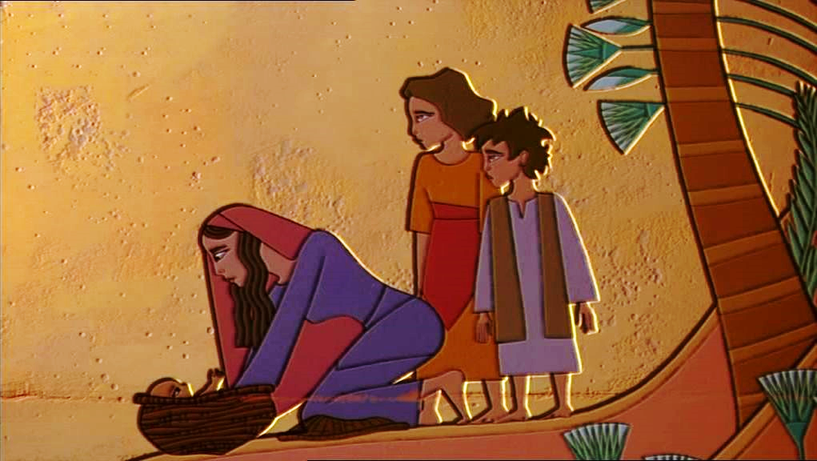

Slide 6
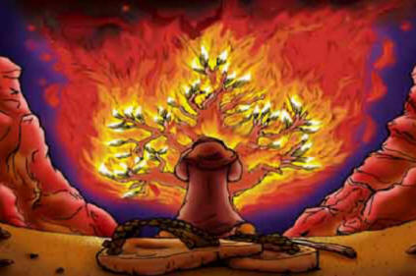

Slide 7
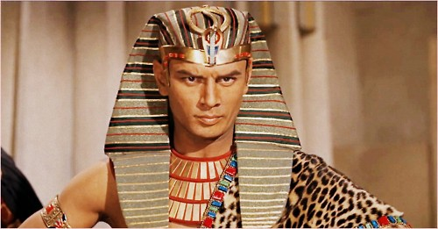

Slide 9
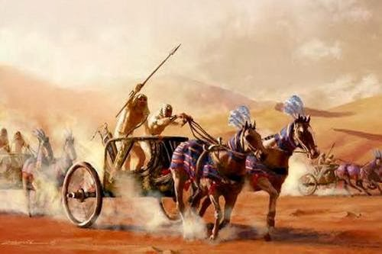

Slide 11
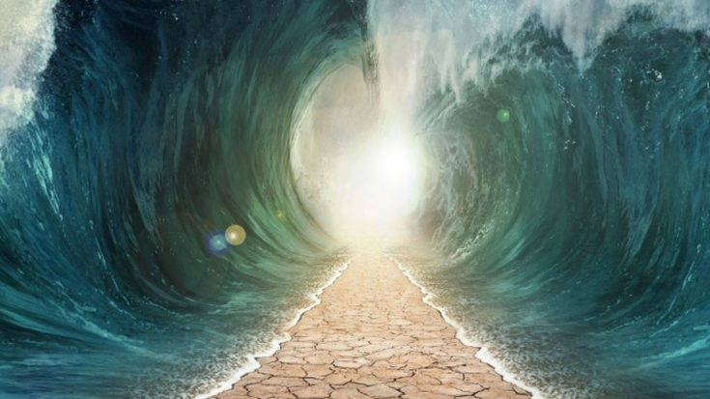

Slide 13
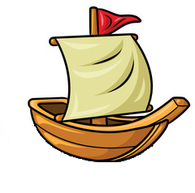
A sailor went to sea, sea, sea
To see what he could see, see, see
But all that he could see, see, see
Was the bottom of the deep blue sea, sea, sea

Slide 14
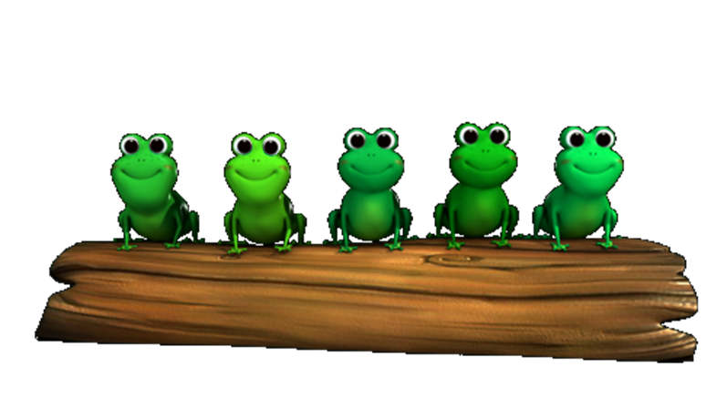
5 little speckled frogs sat on a speckled log
Eating the most delicious grubs; “yum-yum”
One jumped into the pool
Where it was nice and cool
Then there were 4 more speckled frogs ‘glub-glub’

Slide 15
1 2 3 4 5
Once I caught a fish alive
6 7 8 9 10
Then I threw it back again
Why did you let it go?
Because it bit my finger so
Which finger did it bite?
This little finger on my right.

Slide 16
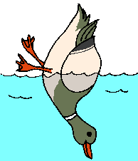
All the little ducks go upside down
Upside down, upside down,
All the little ducks go upside down
As they dabble at the bottom of the pond
All their little beaks go quack, quack, quack…
All their little feet go kick, kick, kick…
All their little tails go wiggle, wiggle, wiggle…

