Slide 1
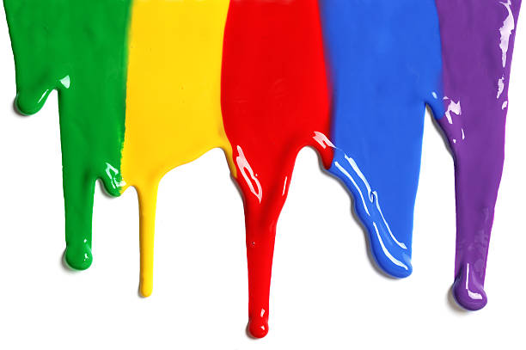
WELCOME
to the
Preschool Playgroup
Run by Holy Trinity Church
Find us on Facebook
playgroup@htcchicago.org

Slide 2
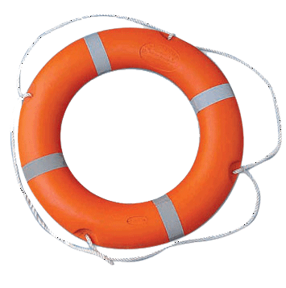
God Rescues

Slide 3
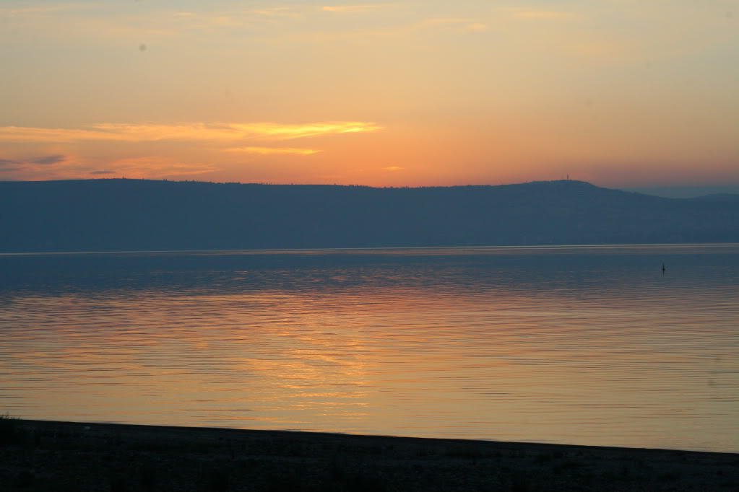
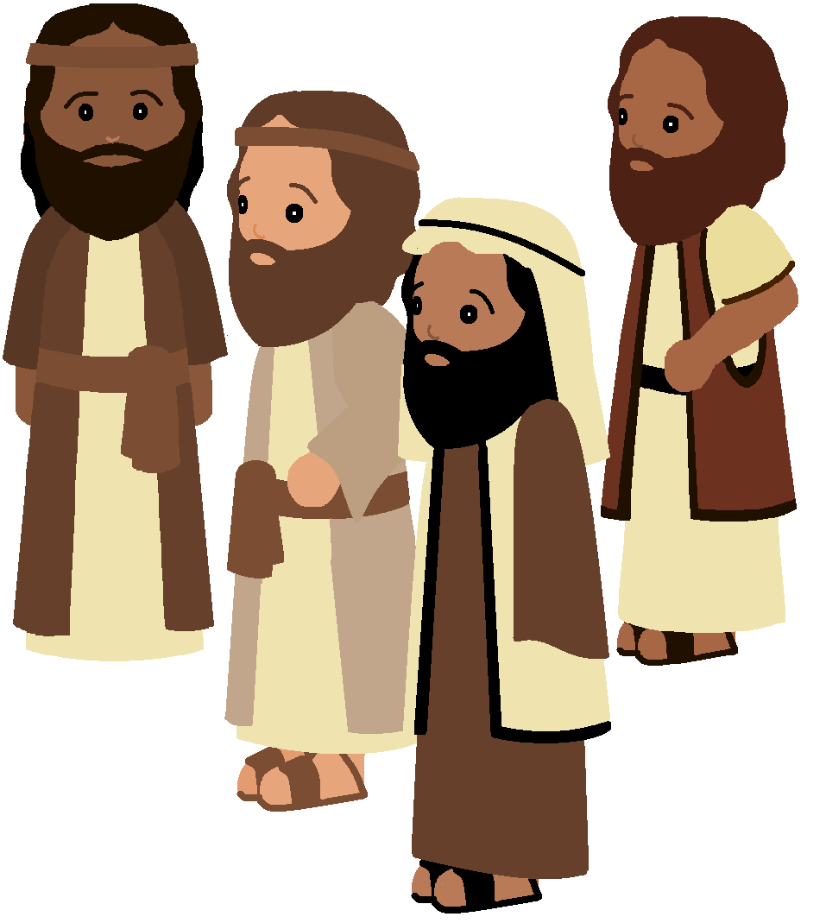

Slide 4
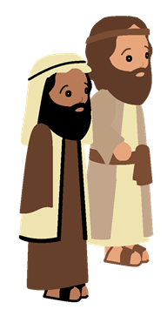

Slide 5
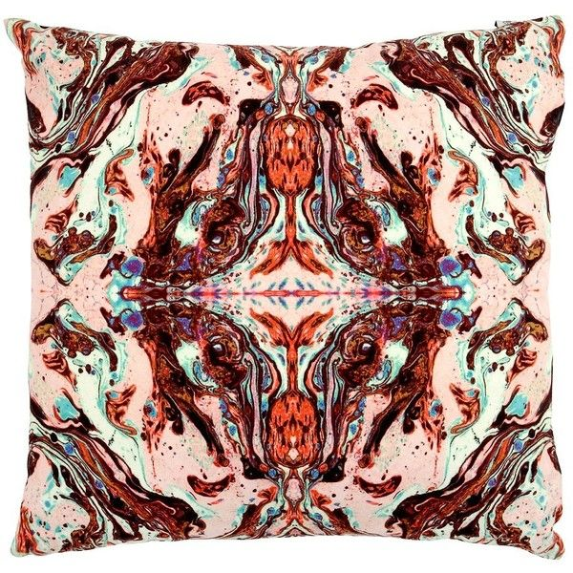
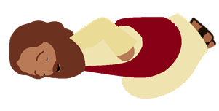

Slide 6
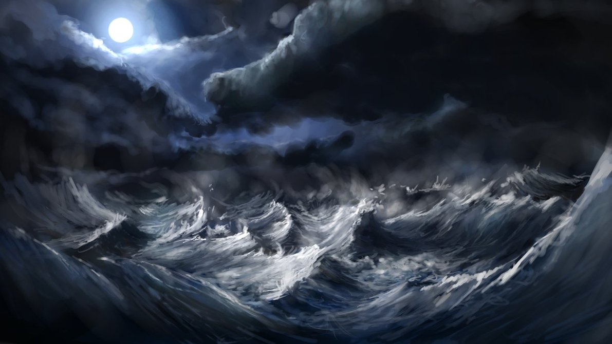

Slide 8
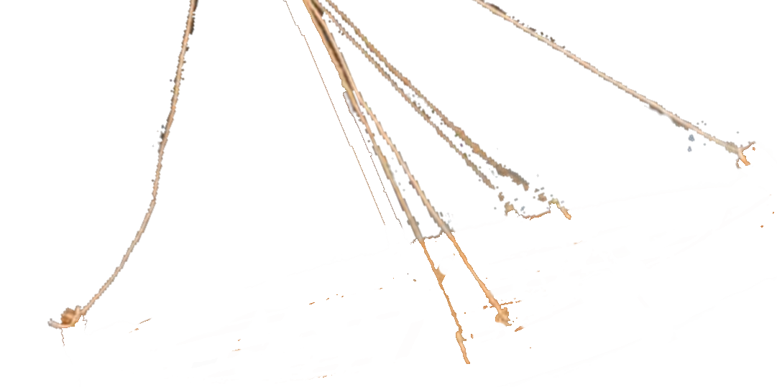

Slide 11
Be Quiet.
Be Still!

Slide 12
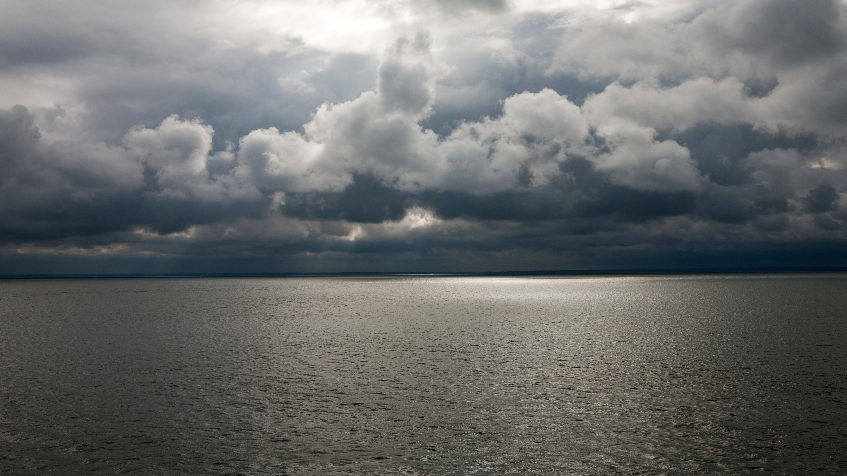

Slide 14
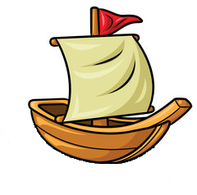
A sailor went to sea, sea, sea
To see what he could see, see, see
But all that he could see, see, see
Was the bottom of the deep blue sea, sea, sea

Slide 15
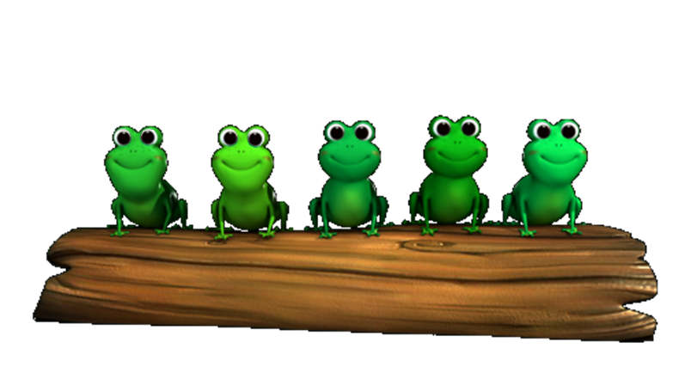
5 little speckled frogs sat on a speckled log
Eating the most delicious grubs; “yum-yum”
One jumped into the pool
Where it was nice and cool
Then there were 4 more speckled frogs ‘glub-glub’

Slide 16
1 2 3 4 5
Once I caught a fish alive
6 7 8 9 10
Then I threw it back again
Why did you let it go?
Because it bit my finger so
Which finger did it bite?
This little finger on my right.

Slide 17
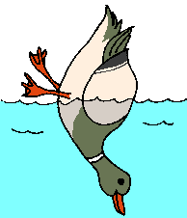
All the little ducks go upside down
Upside down, upside down,
All the little ducks go upside down
As they dabble at the bottom of the pond
All their little beaks go quack, quack, quack…
All their little feet go kick, kick, kick…
All their little tails go wiggle, wiggle, wiggle…

Slide 18
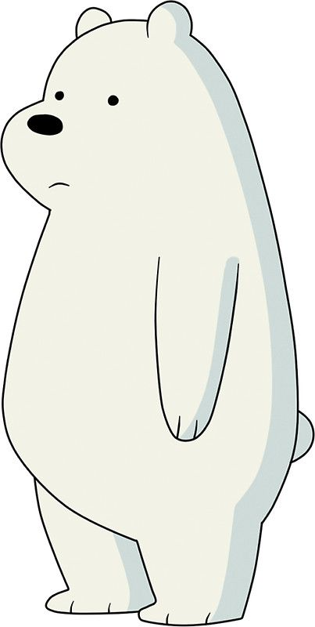
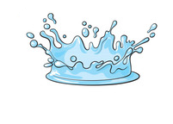
Row, row, row your boat gently down the stream
If you see a crocodile don’t forget to scream.
Row, row, row your boat gently to the shore
If you see a lion there don’t forget to roar.
Row, row, row your boat quickly down the river
If you see a polar bear don’t forget to shiver.
Rock, rock, rock your boat gently to and fro
Wibbly-wobbly, wibbly-wobbly
Into the water you go.

