Slide 1
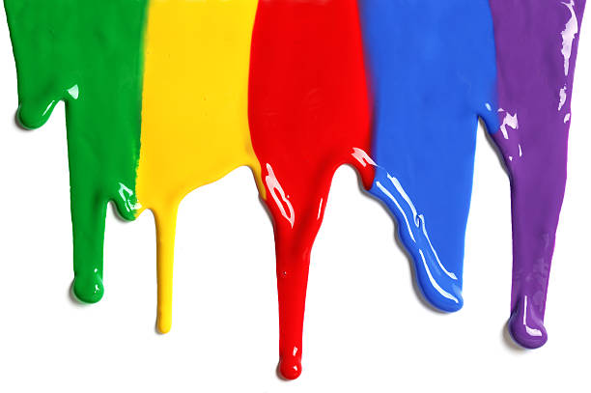
WELCOME
to the
Preschool Playgroup
Run by Holy Trinity Church
Find us on Facebook
playgroup@htcchicago.org

Slide 2
K
N
G
the
I
is here!

Slide 4
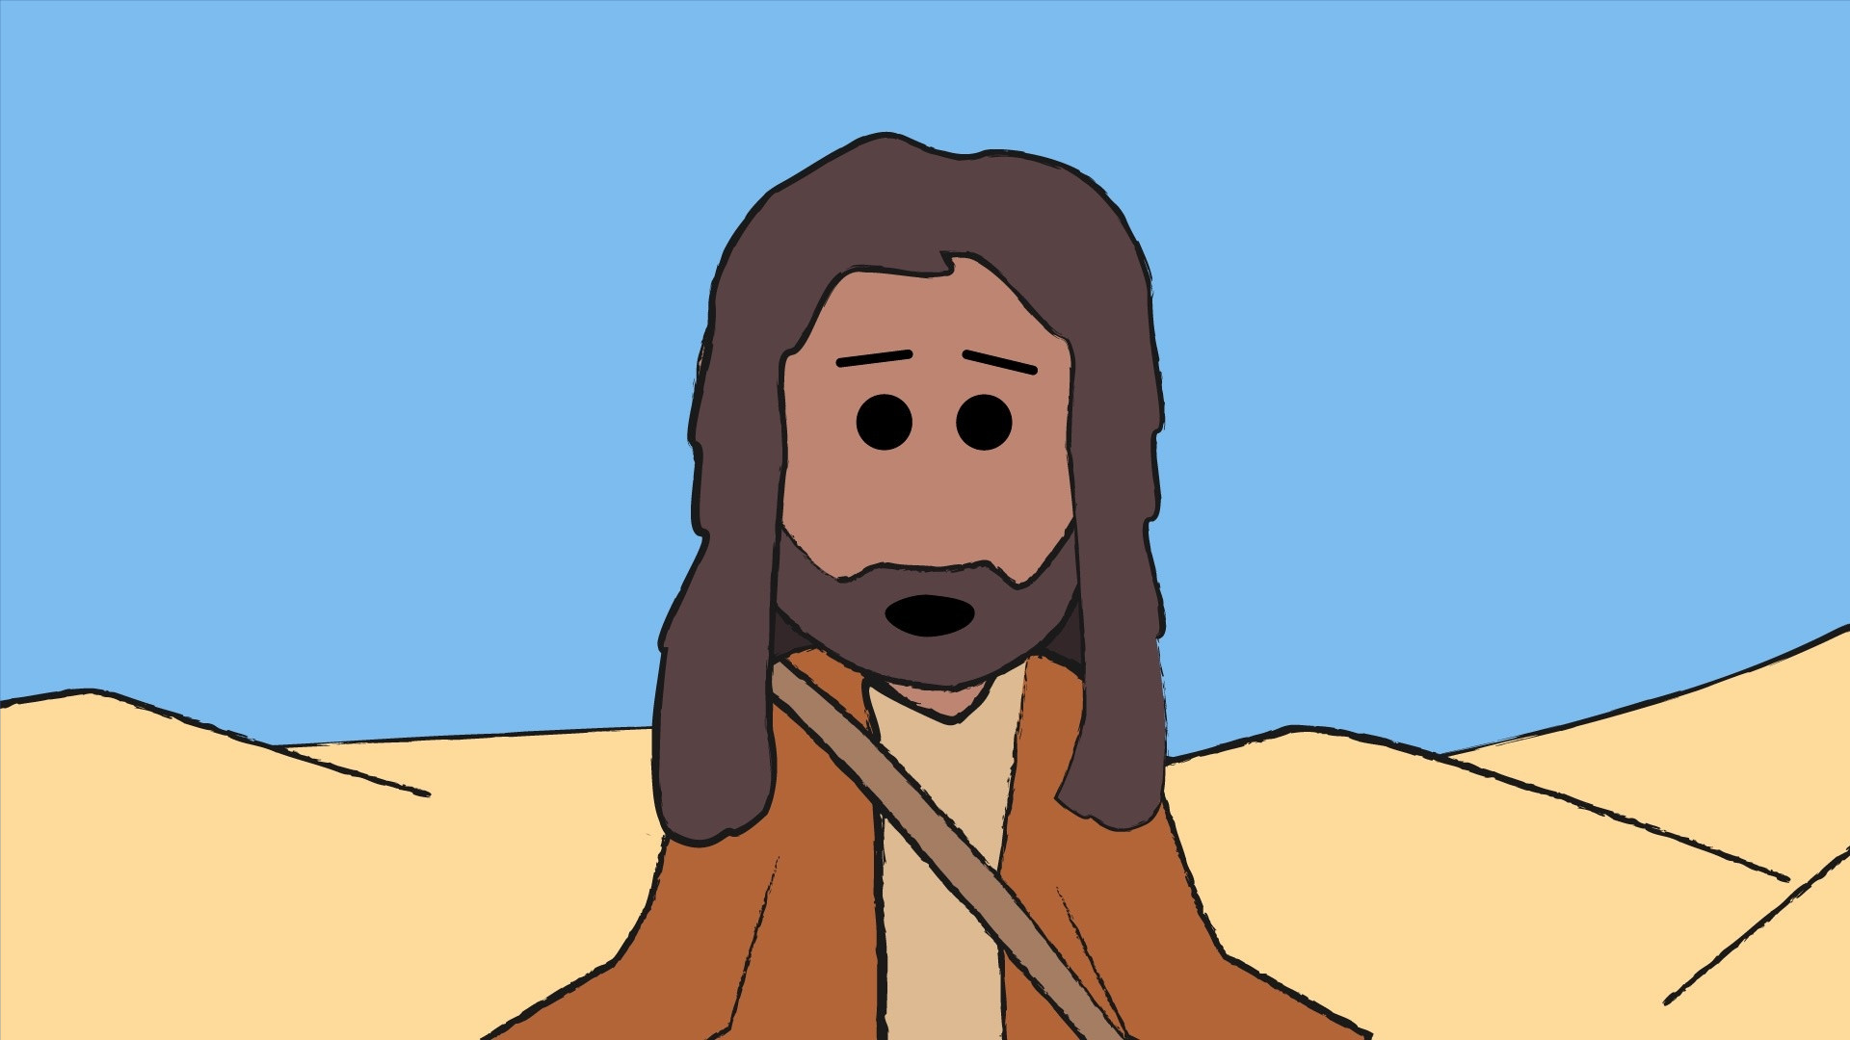

Slide 5
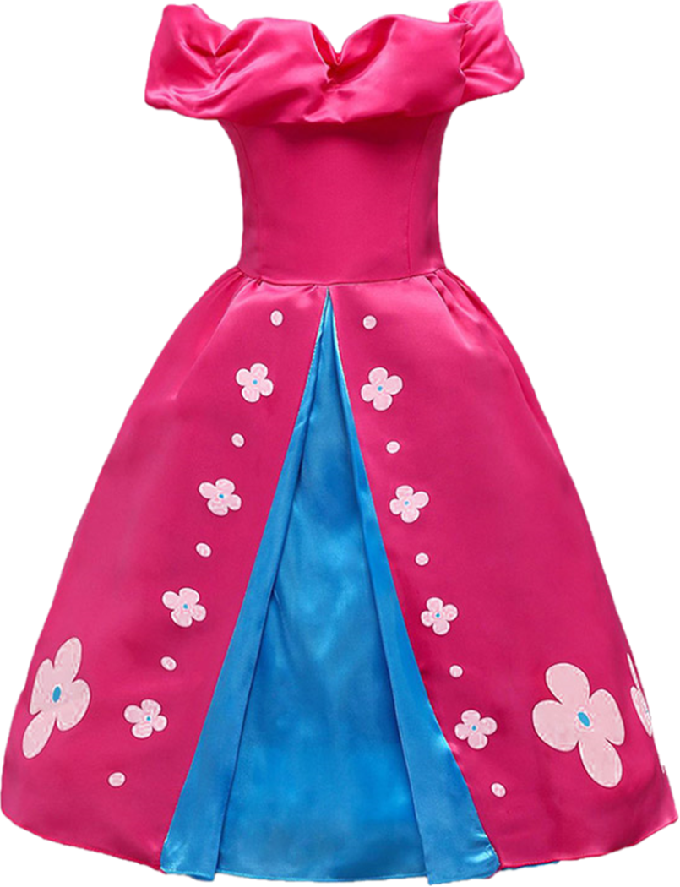
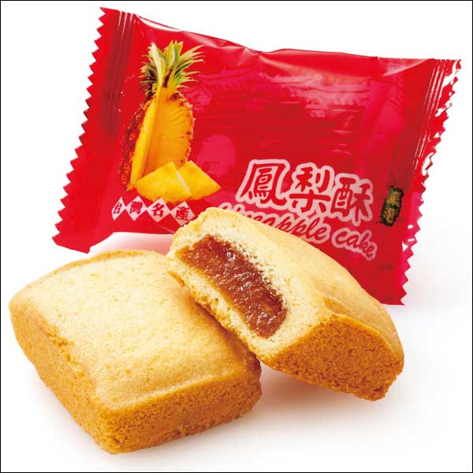
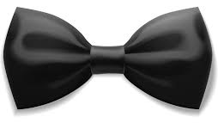

Slide 6
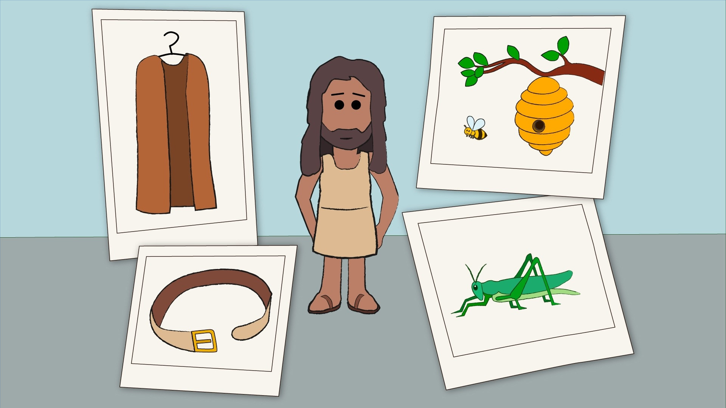

Slide 8
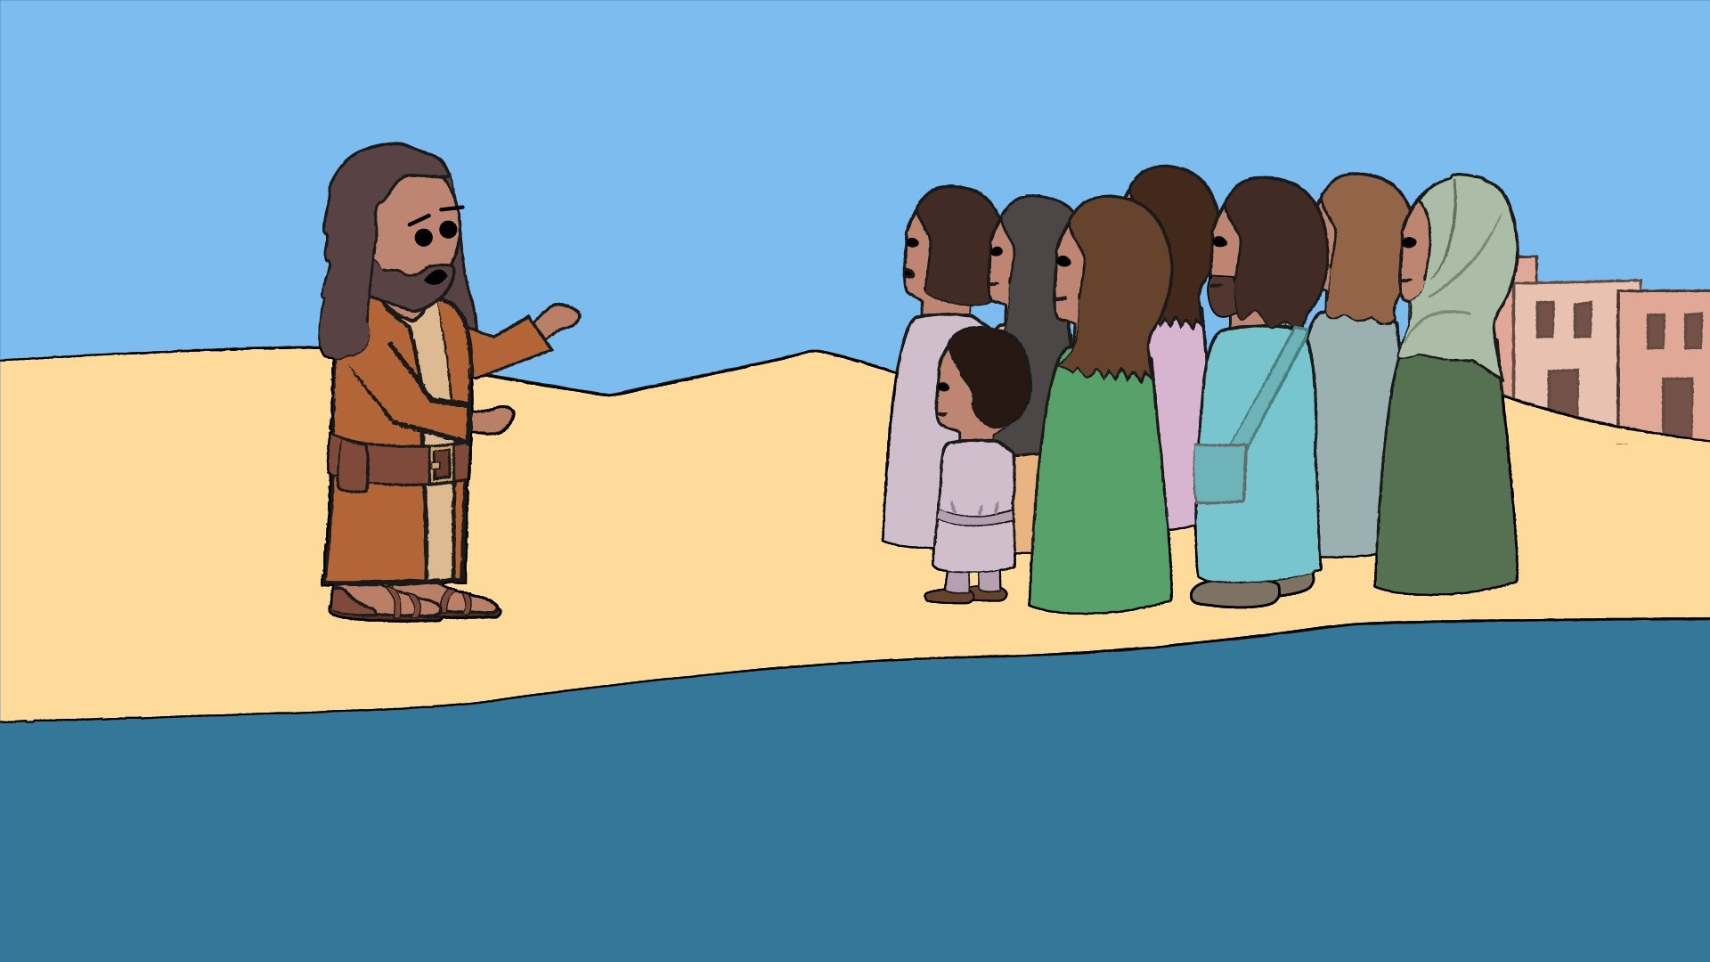

Slide 9
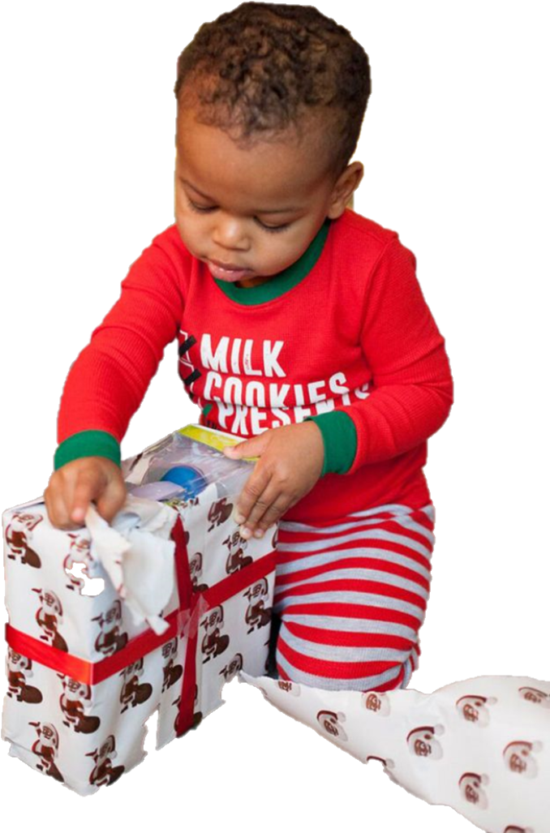
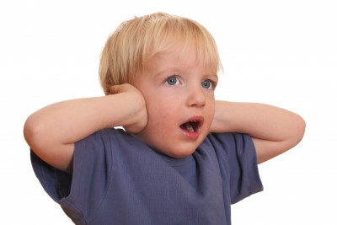
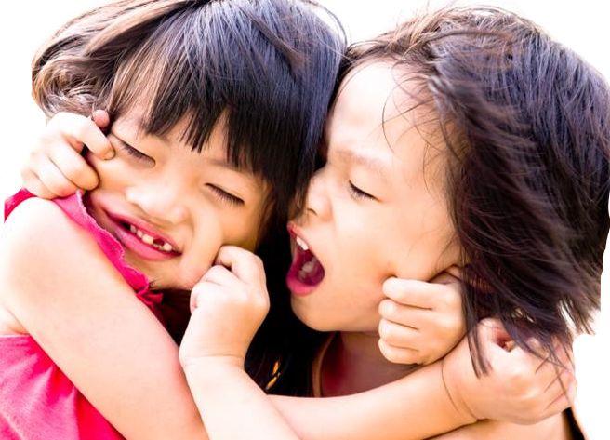

Slide 10
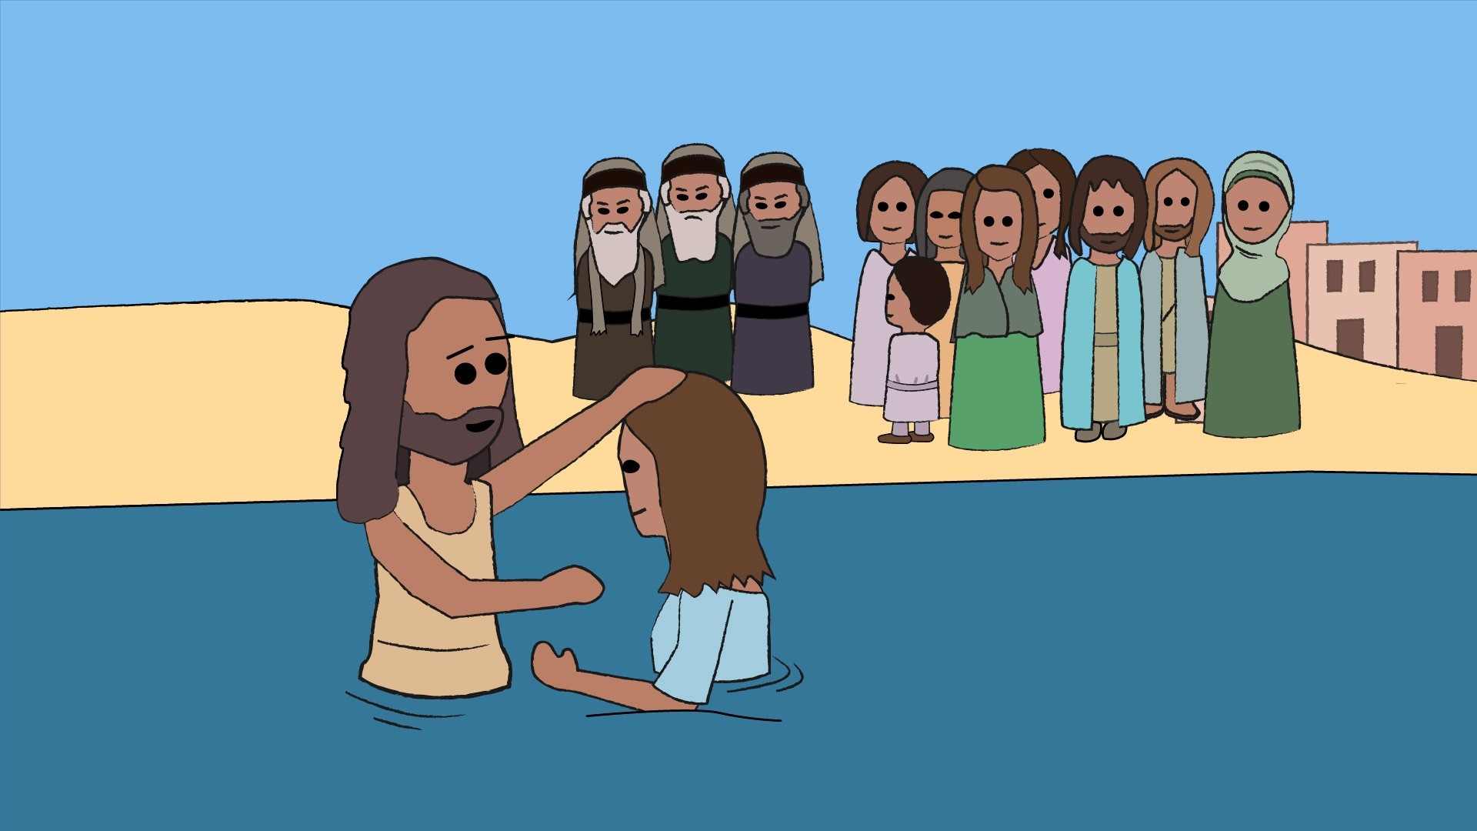

Slide 11
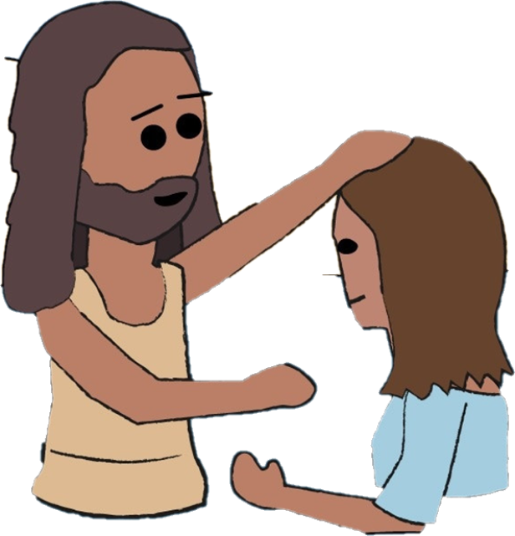

Slide 12
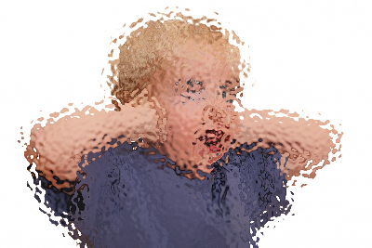
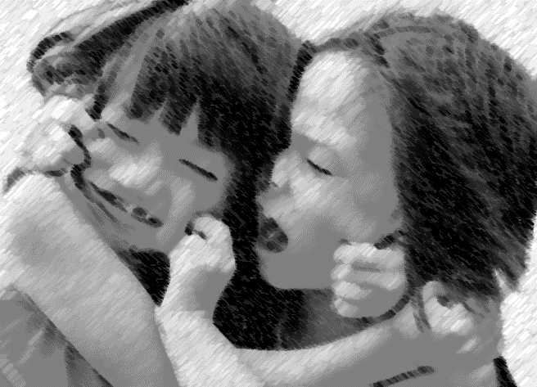

Slide 13
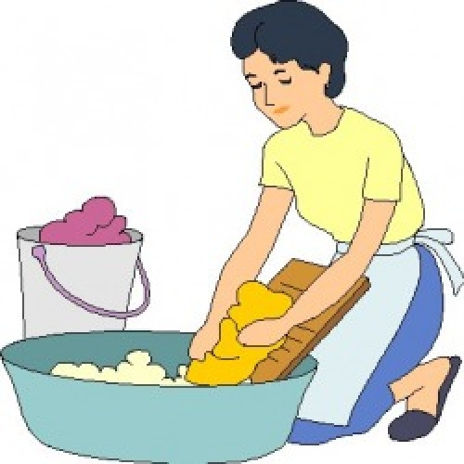
Way down in the valley where nobody goes
There’s a wishy washy washer woman
Washing her clothes
She goes washy washy up
She goes washy washy down
She goes washy washy up
She goes washy washy down
That’s how the washer woman washes her clothes
Washerman ... He goes scrub scrub up...

Slide 14
Head, shoulders, knees and toes,
Knees and toes,
Head, shoulders, knees and toes,
Knees and toes
And eyes and ears
and mouth and nose
Head, shoulders, knees and toes,
Knees and toes

Slide 15
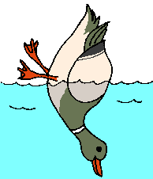
All the little ducks go upside down
Upside down, upside down,
All the little ducks go upside down
As they dabble at the bottom of the pond
All their little beaks go quack, quack, quack…
All their little feet go kick, kick, kick…
All their little tails go wiggle, wiggle, wiggle…

Slide 16
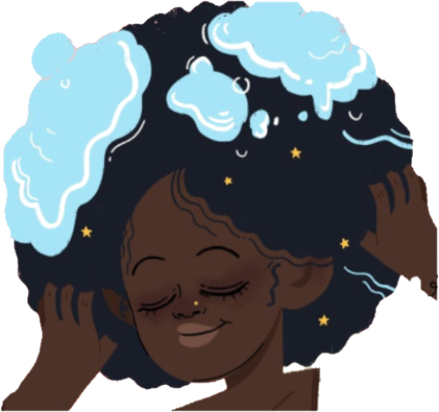
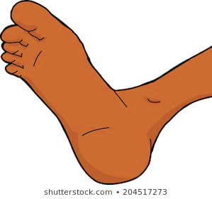
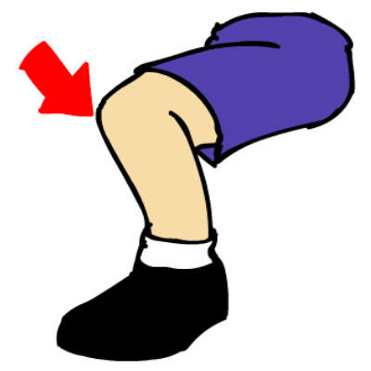
Can you wash your hair? I can wash my hair. Can you wash your feet? I can wash my feet. Can you wash your face? I can wash my face. Can you wash your knees? I can wash my knees.
I can wash my hair. I can wash my feet. I can wash my face. I can wash my knees. This is the way we take a bath.

Slide 17
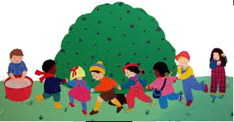
Here we go round the mulberry bush
The mulberry bush, the mulberry bush
Here we go round the mulberry bush
On a cold and frosty morning
This is the way we clean our face…
This is the way we brush our teeth…
This is the way we wash our hair…

