Slide 1
WELCOME
to the
Preschool Playgroup
Run by Holy Trinity Church
Find us on Facebook
playgroup@htcchicago.org

Slide 2
K
N
G
the
I
is coming!

Slide 6
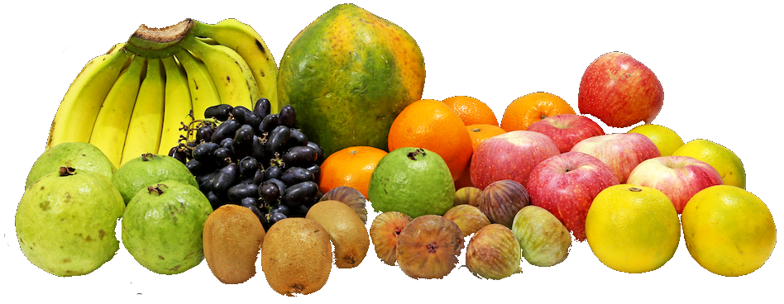

Slide 7
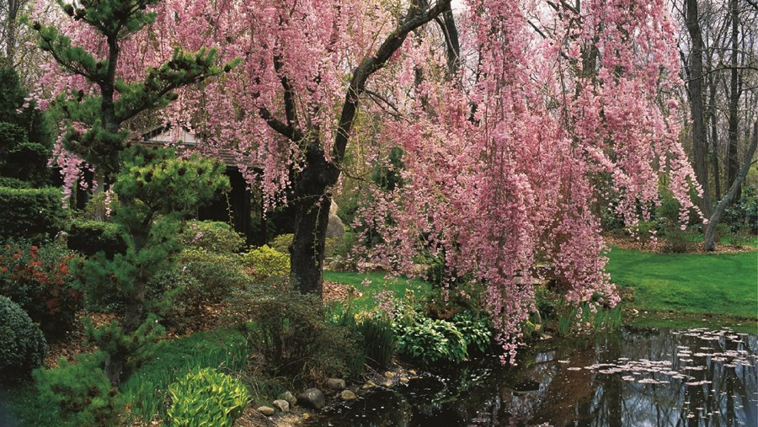

Slide 10
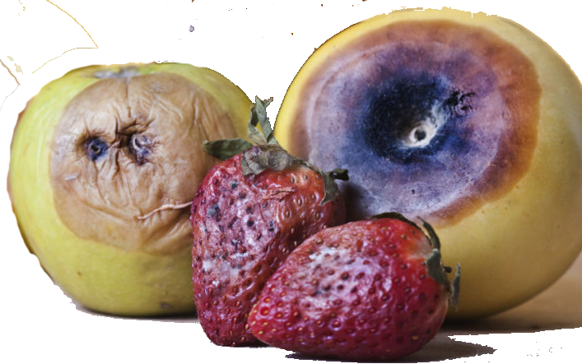

Slide 12
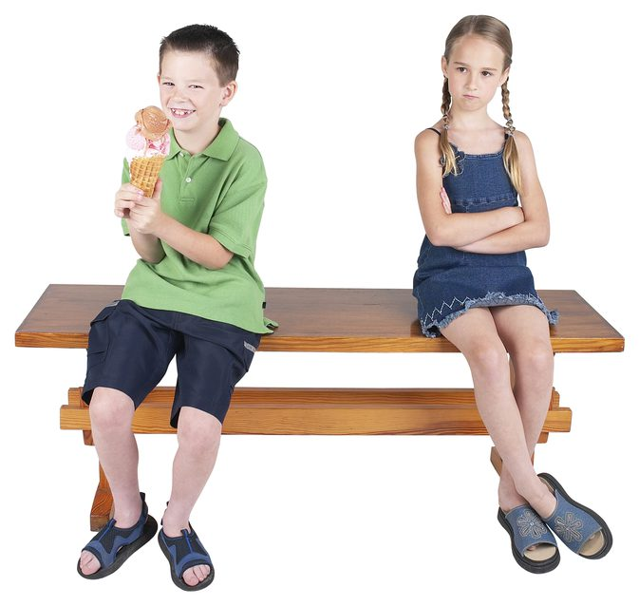
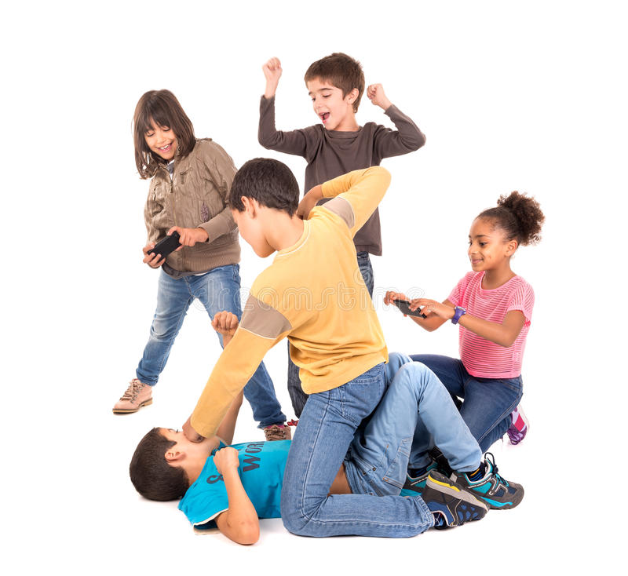
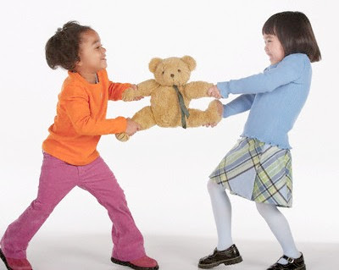

Slide 16
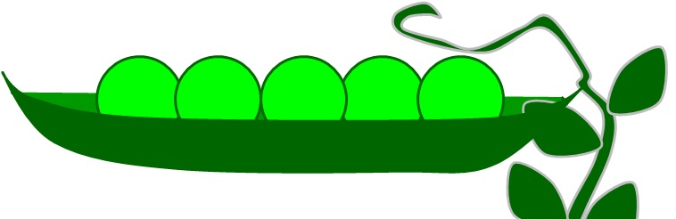
5 little peas
In a pea-pod pressed
1 grew, 2 grew
And so did all the rest
They grew and they grew
And they did not stop
Until one day the pod went
POP!
5 little peas
In a pea-pod pressed
1 grew, 2 grew
And so did all the rest
They grew and they grew
So fat and round
Then all the peas
Fell to the ground

Slide 17
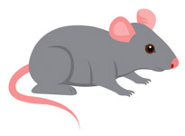
Round and round the garden
Like a teddy bear
One step, two steps
Tickle you under there
Round and round the haystack
Like a little mouse
One step, two steps
Right inside the house

Slide 18
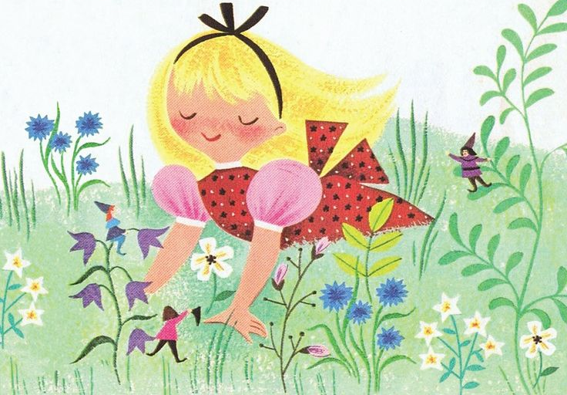
Mary, Mary, quite contrary
How does your garden grow?
With silver bells
And cockle shells
And pretty maids all in a row

Slide 19
Ring a ring of roses
A pocket full of poses
Atishoo, atishoo
We all fall down
Fishes in the water
Fishes in the sea
We all jump up with a 1 – 2 – 3

Slide 20
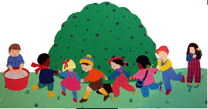
Here we go round the mulberry bush
The mulberry bush, the mulberry bush
Here we go round the mulberry bush
On a cold and frosty morning
This is the way we comb our hair…
This is the way we brush our teeth…
This is the way we put on clothes…

