Slide 1
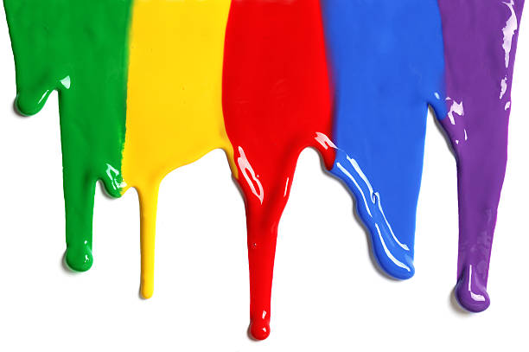
WELCOME
to the
Preschool Playgroup
Run by Holy Trinity Church
Find us on Facebook
playgroup@htcchicago.org

Slide 2
God Rescues

Slide 4
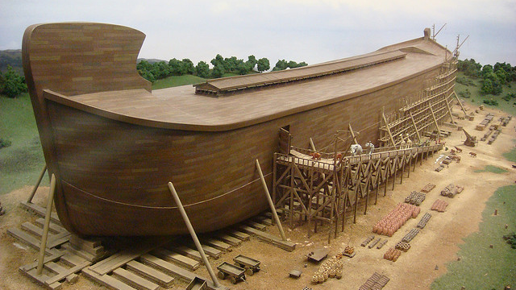

Slide 5
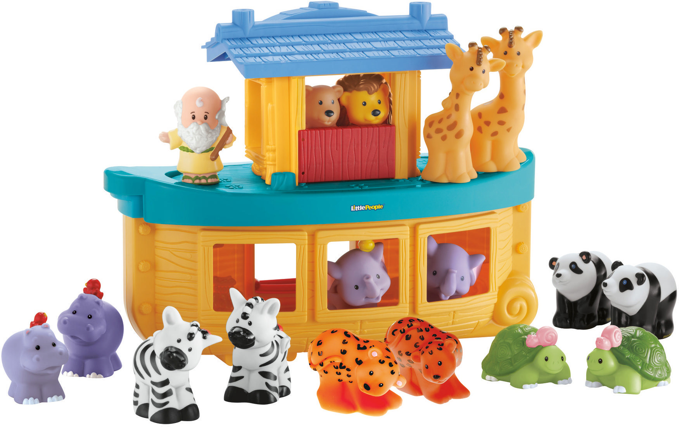
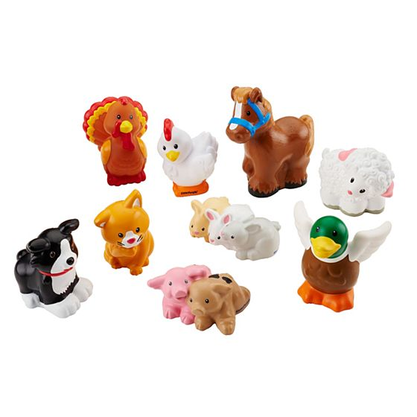

Slide 7
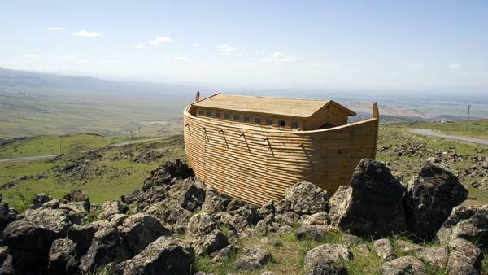

Slide 8
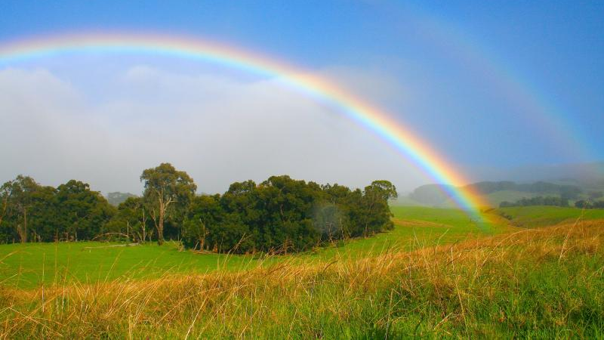

Slide 9
See the little bunnies sleeping ‘til noon
Shall we try and wake them with a merry tune?
They’re so still, are they ill?
Wake up soon!
Hop little bunnies, hop, hop, hop x3
Hop and Stop!

Slide 10
Hickory Dickory Dock
The mouse ran up the clock
The clock struck one
The mouse ran down
Hickory Dickory Dock
The clock struck two
The mouse said ‘Boo!’
The clock struck three
The mouse went ‘Wheee!’

Slide 11
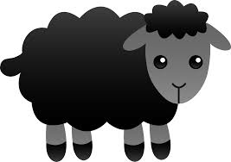
Baa baa black sheep have you any wool?
Yes sir, yes sir, three bags full
One for the master
One for the dame
And one for the little boy who lives down the lane.

Slide 12
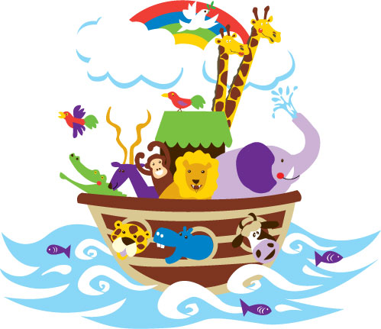
Old Man Noah had a boat
E-I-E-I-O
And on that boat he had a …
E-I-E-I-O
With a … here and a … there
Here a … there a … everywhere a …
Old Man Noah had a boat
E-I-E-I-O

Slide 13
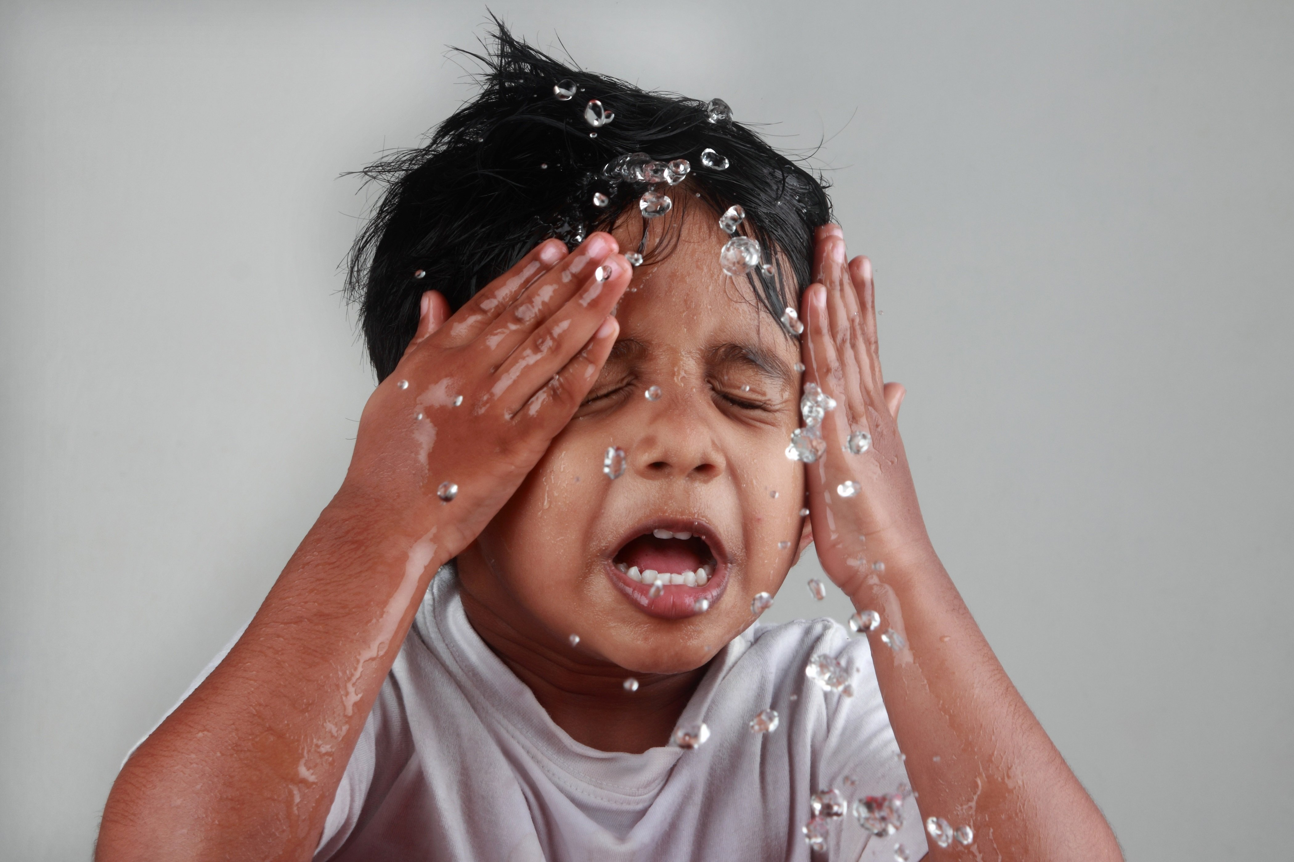
Next week:
Water play
Bring something splashproof
Or a change of clothes

