Slide 1
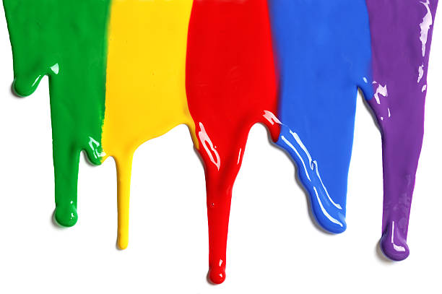
WELCOME
to the
Preschool Playgroup
Run by Holy Trinity Church
Find us on Facebook
playgroup@htcchicago.org

Slide 5
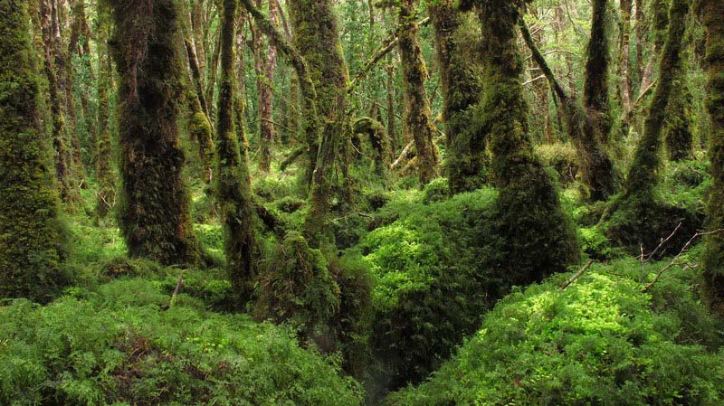

Slide 6
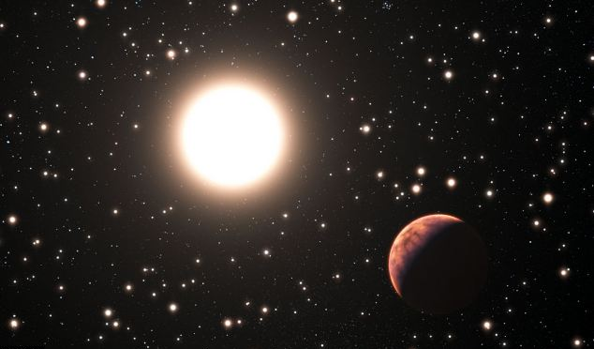

Slide 7
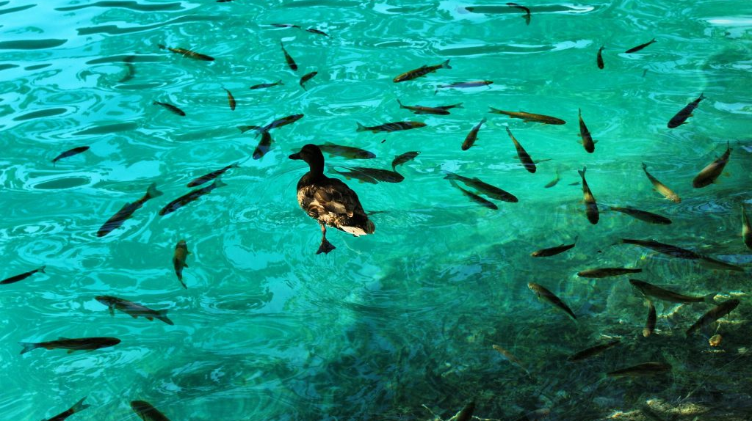

Slide 8
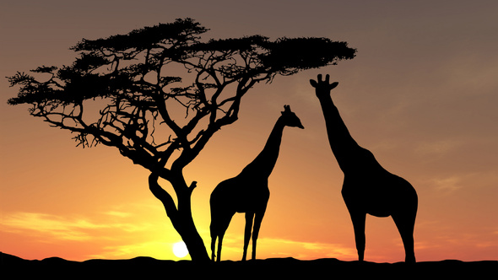

Slide 12
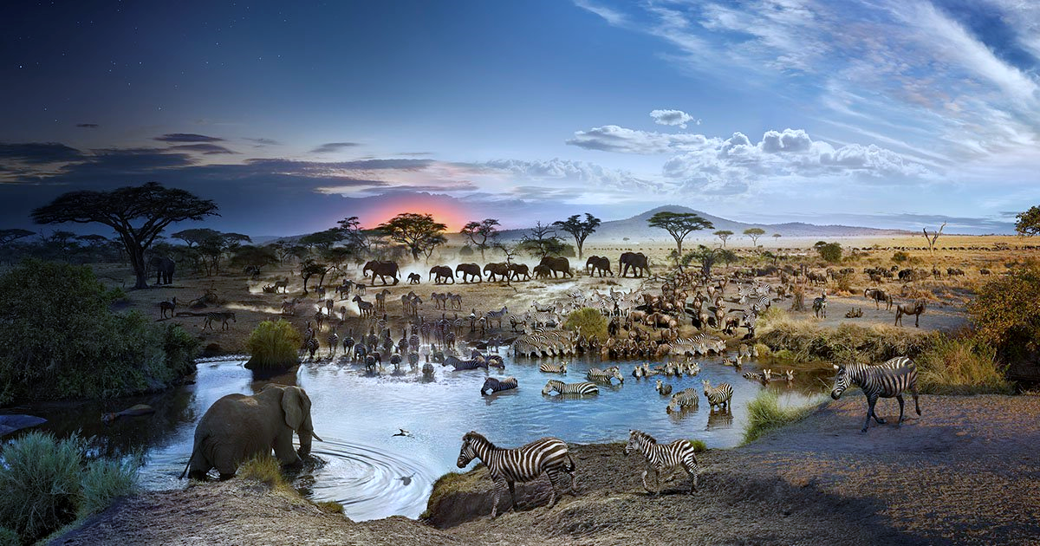

Slide 13
Twinkle twinkle little star
How I wonder what you are
Up above the world so high
Like a diamond in the sky
Twinkle twinkle little star
How I wonder what you are

Slide 14
The sun has got his hat on
Hip-hip-hip-hip-hooray
The sun has got his hat on
And he’s coming out to play

Slide 15
5 little peas
In a pea-pod pressed
1 grew, 2 grew
And so did all the rest
They grew and they grew
And they did not stop
Until one day the pod went
POP!
5 little peas
In a pea-pod pressed
1 grew, 2 grew
And so did all the rest
They grew and they grew
So fat and round
Then all the peas
Fell to the ground

Slide 16
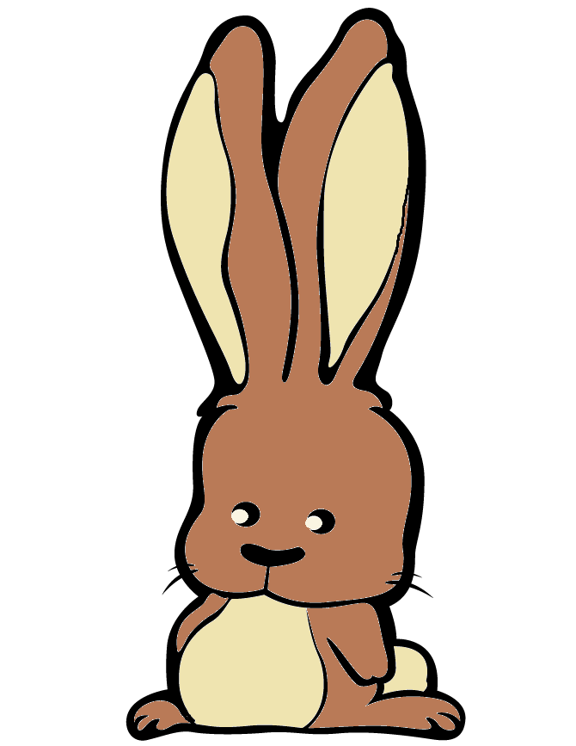
See the little bunnies sleeping ‘til noon
Shall we try and wake them with a merry tune?
They’re so still, are they ill?
Wake up soon!
Hop little bunnies, hop, hop, hop x3
Hop and Stop!

Slide 17
If you’re happy and you know it clap your hands
If you’re happy and you know it clap your hands
If you’re happy and you know it
And you really want to show it
If you’re happy and you know it clap your hands

